Slide 1
Sets
Membership and Properties

Slide 2


Definition
A set is a well defined collection of objects
e.g. {product1, product2, product3}
is an element of
is not an element of

Slide 3
Notation
Roster or enumeration notation
    e.g. {product1, product2, product3}
Set builder notation
    e.g. {x | x is the name of a product made by the company}

Slide 4
Example
A = {1, 2, 3, 4}
A = {n | n is a whole number less than 5 and greater than 0}
Notes:
Order is unimportant {3,1,2,4}
An element may not be written twice in a set.

Slide 5

Important sets
Empty set or Null set or = { }
Set of natural numbers
    N = {1, 2, 3, 4, ...}
Set of whole numbers
    W = {0, 1, 2, 3, ...}
Set of integers
    Z or I = {...,-2, -1, 0, 1, 2, ,...}
Set of real numbers
    R = {x | x is real}

Slide 6






Subsets
If A = {1, 2, 3}
    the subsets of A are
    {1} {2} {3} {1, 2} {1, 3} {2, 3} {1, 2, 3}
    eg {1} {1, 2, 3} {4} {1, 2, 3}
  Note means “is a subset of or is equal to”
    {1, 2, 3}
    since is a set, not an element.

Slide 7

Set Equality
A = B if B A and A B

Slide 8
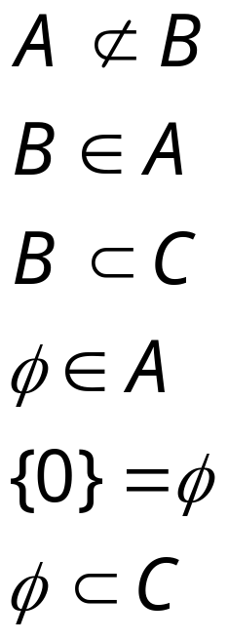
Examples
A= {1,3} B = {1} C = {1,2,3}
    Are these statements true or false?
True
False
True
False
False
True

Slide 9

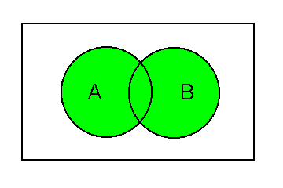
Operations on Sets
Union
    A B = {x | x A or x B}

Slide 10

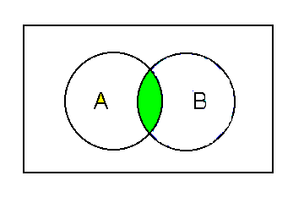
Operations on Sets
Intersection
    A B = {x | x A and x B}

Slide 11

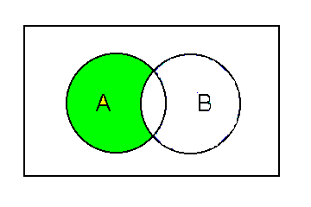
Operations on Sets
Difference
    A - B = {x| x A and x B}

Slide 12
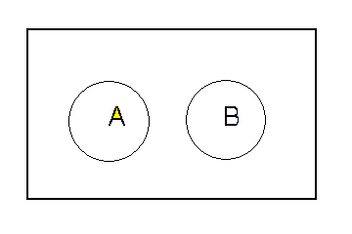
Disjoint Sets
A B =

Slide 13
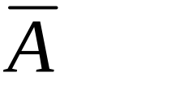
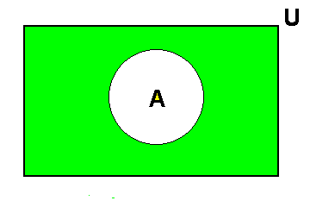
Complement of a Set
If A is a subset of the universal set U,
= U - A = {x| x U but x A}

Slide 14
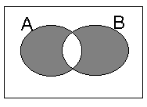
Symmetric Difference

Slide 15





Do these examples
Compare the Venn diagrams for the following to determine which are equal.
    A - B
    B - A
    (A B) - (A B)
    B
    A
    A B

Slide 16
    A - B
    B
A
B
A
B
    B - A
    A
A
B
A
B
    (A B) - (A B)
    A B
A
B
A
B

Slide 17
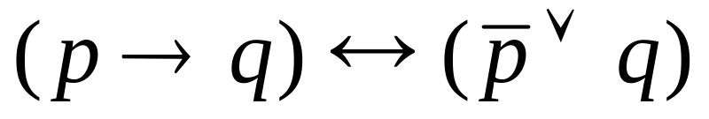





Worked Example
p
q
Draw a truth table and a Venn diagram for this statement.
T | T | T | F | T | T
T | F | F | F | F | T
F | T | T | T | T | T
F | F | T | T | T | T
Notes:
Do this one on the board.

Slide 18
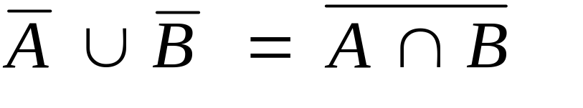
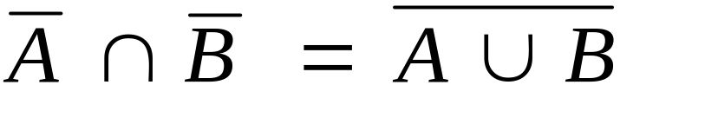
De Morgan’s Laws
There are two equations
Worked example, page 198, Ex 8-12

Slide 19
Laws of Sets
Idempotent laws
Commutative laws
Associative laws
Distributive laws
See Page 199 for details

Slide 20
Power Set
The set of all subsets
    If A = {1, 2}
    P (A) = { , {1}, {2}, {1, 2} }
If A has n elements,
then P (A) has 2^{n} elements
Compare this with the number of rows in a truth table,
e.g. for two statements
T | T
T | F
F | T
F | F

Slide 21
Cardinality
The number of elements in the set
If A = {a, b, c, d, e}, then |A| = 5

Slide 22

Product of Two Sets
The result is a set of ordered pairs.
If A = {1, 2} and B = {a, b, c}
  A B = {(1,a),(1,b),(1,c),(2,a),(2,b),(2,c)}

Slide 23
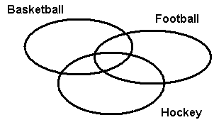
Venn Diagrams
12 play basketball and hockey
3 play basketball and hockey and football
17 play only hockey
5 play basketball and football but not hockey
23 play basketball
7 play football and hockey
20 play football
60 people surveyed

Slide 24

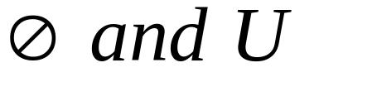

Duality Principle
From a valid set equality, a dual equality can be found by swapping
e.g.

Slide 25
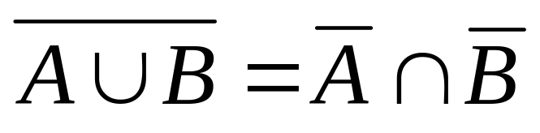
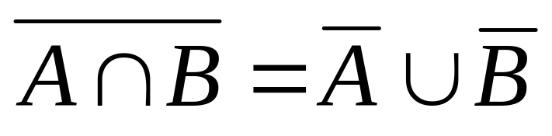
Worked Example
De Morgans Law
By the principle of duality

Slide 26
Computer Representation of Sets
Computers store sets as bit arrays
If U = {a, b, c, d, e, f}
A = {a, b, f} and B = {a, e}
  {1, 1, 0, 0, 0, 1} would be the bit array for A
  {1, 0, 0, 0, 1, 0} would be the bit array for B
  {1, 0, 0, 0, 0, 0} would be the bit array for the intersection of A and B

Slide 27

Example
U = {1, 2, 3, 4}, A = {1,3}, B = {3,4}
Form the bit arrays for
  A = {1, 0, 1, 0}
  B = {0, 0, 1, 1}
  = {1, 0, 1, 1}

Slide 28

Question
Does ? Yes
B
A
B
A

Slide 29
Tutorial Examples 1
Page 197 8-10 (a) to (g)
Page 198 8-11
Page 203, 8-19
Page 207
    8-1
    8-2 (b) (c) (g)
    8-3
    8-8 and 8-10(d)
Page 212
    8-23, 8-24 but omit (e), 8-27

Slide 30
Tutorial Examples 2
Page 209, 8-12 to 8-15, 8-17 to 8-21
Page 213, 8-26, 8-29 to 8-31,8-33,
8-34, 8-36, 8-37
Page 205, Example 8-23
Page 212, Problem 8-21
Venn diagram exercises on following pages

