Slide 1

Polygenic Scores: IGSS 2015 Tutorial
Ben Domingue

Slide 2
Gameplan
Overview
What are polygenic scores?
How are they used?
How are they created?
You create them.
Top hits
Homebrewed Genome-wide
PRSice
Caveats, etc.
Huge amount of expertise in this room. Let’s use all of it!

Slide 3
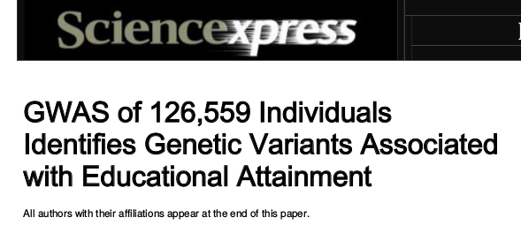
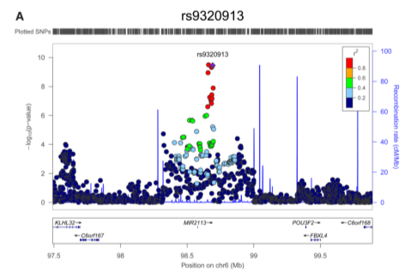

Slide 4
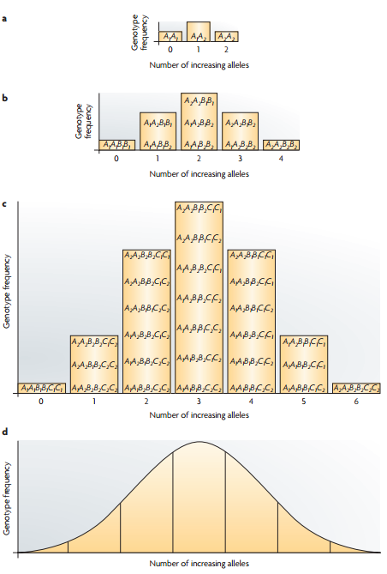
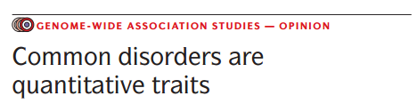
Polygenic Scores (PGS): think credit scores

Slide 5
What is a PGS
Mean (potentially weighted) # of risk alleles identified by GWAS
Let’s examine some findings for the PGS for educational attainment.

Slide 6
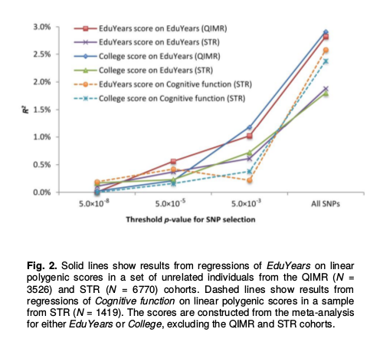
Predicts out of sample
Aside:
top-hits versus genome-wide.

Slide 7
PGS types
Top hits: only SNPs that reach some (stringent) level of statistical significance (1e-8)
Genome-wide: all SNPs or all below some nominal level of significance (0.5)

Slide 8
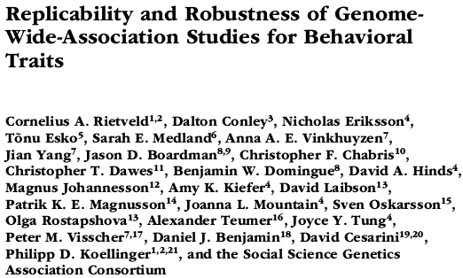
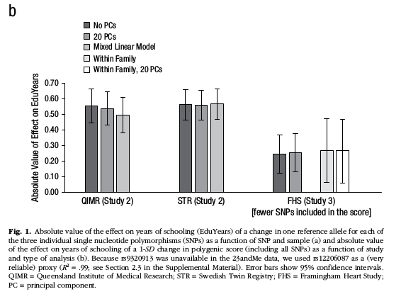
Predicts within families

Slide 9
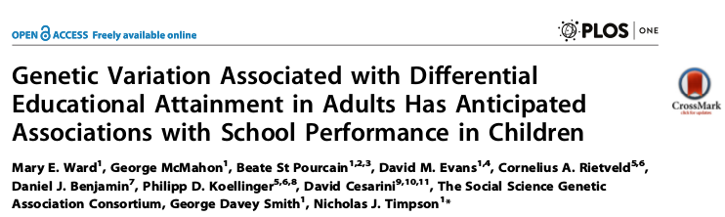
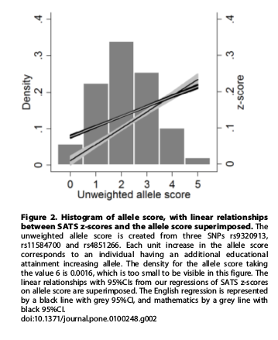
Predicts academic performance

Slide 10
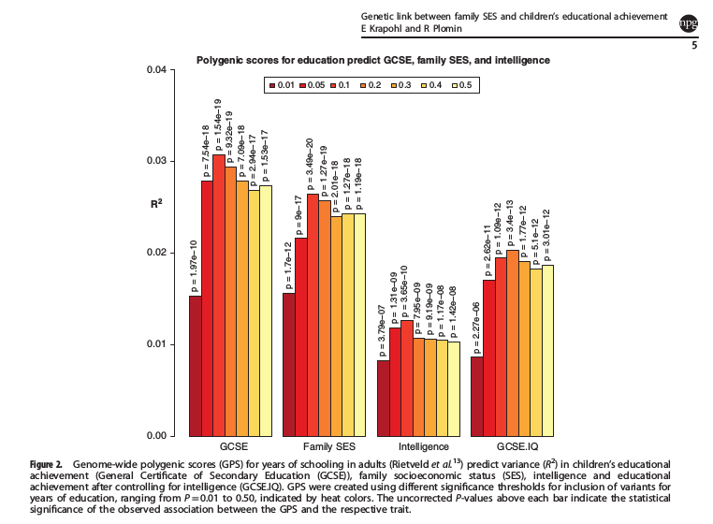
Mediated by intelligence …

Slide 11
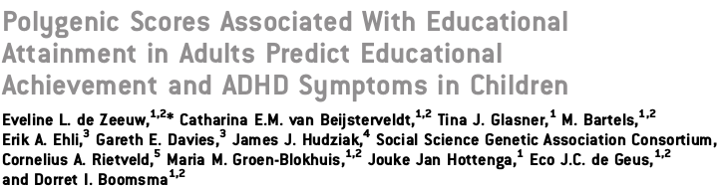
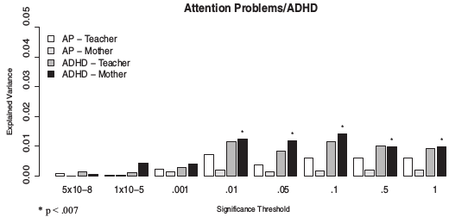
and ADHD!

Slide 12
Other characteristics of interest
BMI
Smoking

Slide 13
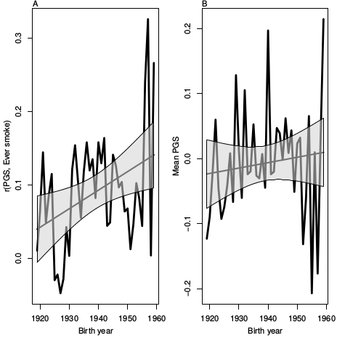
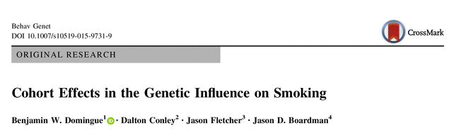
Smoking

Slide 14
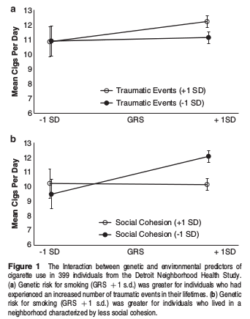
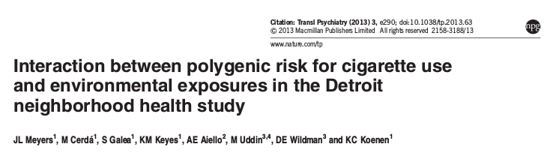

Slide 15
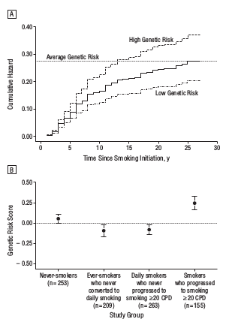
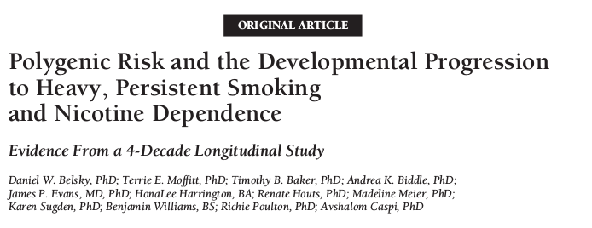

Slide 16
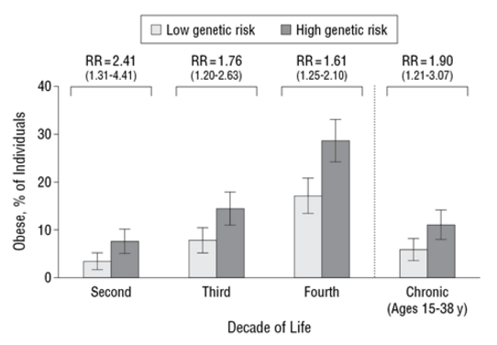
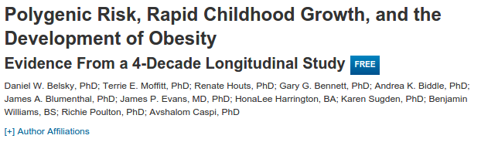
BMI

Slide 17
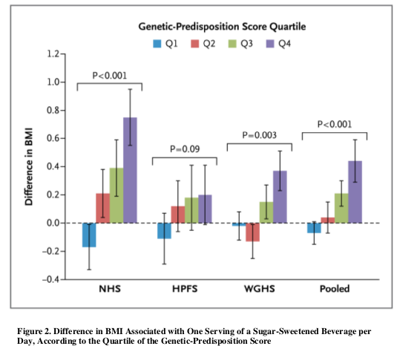
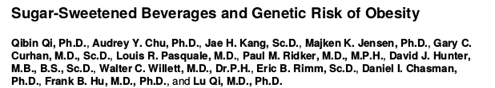

Slide 18
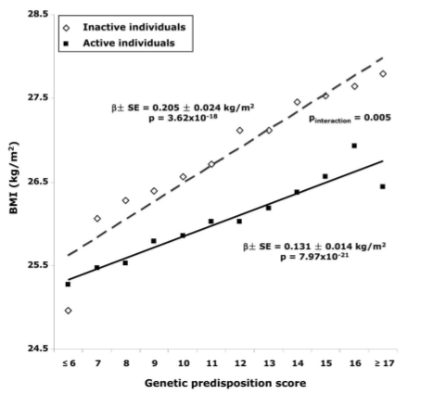
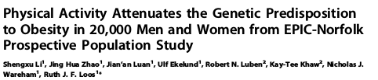

Slide 19
Now what?
Hopefully you have some interesting ideas for how to use a PGS (or at the very least have been inspired to think about how one might use them).
But where do they come from?

Slide 20
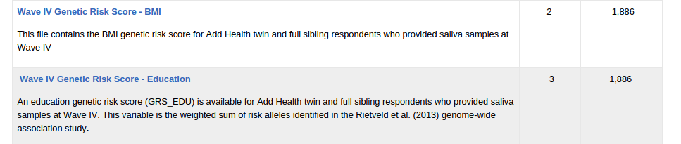
Constructed by “others”
But you are limited to what they have available (can’t use new or updated results).

Slide 21
What about making your own?
Hopefully you’ll leave today equipped to do so!

Slide 22
Some things to be mindful of before we get started.
Additivity
Strand Ambiguity
Weights
LD considerations

Slide 23
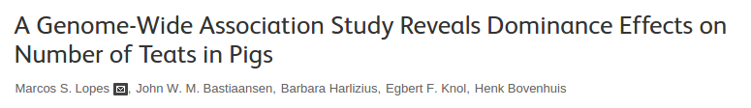
Additive Model of Genetic effects
In general, GWAS attempt to identify additive (as opposed to dominant or recessive) genetic effects.

Slide 24
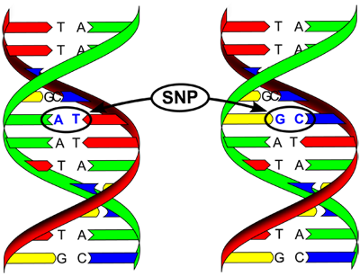
Ambiguous strands

Slide 25
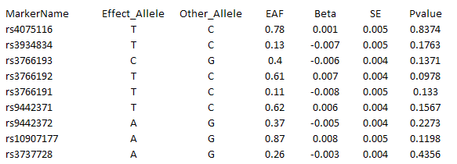
GWAS Results
Empirical Data
1 rs3934834 0 1005806 A G

Slide 26
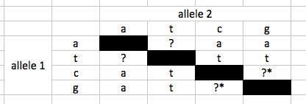
Strand issues
Paired bases: A-T, C-G
Fwd strand A/C implies reverse strand T/G
Suppose GWAS identifies A as risk allele. [note: they may not give you other allele.]
Your data:
What base in your data will be equated to the A in GWAS results?

Slide 27
Strand issues
In “top hits” scores, you can try to determine what is going on via comparison of allele frequencies to some kind of reference.
Authoritative info hard to come by (and needs to be population specific).
Not going to work if allele frequencies aren’t easily distinguished.
Very nasty issue
Questions? Comments?

Slide 28
Weights
Each SNP will be weighted by the magnitude of its effect.
For continuous traits, the estimated coefficient.
For dichotomous traits, log of the OR.
If you’re doing a top-hits score, then may not need to weight.

Slide 29
LD considerations
Too many variants in linkage with a certain causal variant could lead to overemphasis of that region in the PGS
Instead of LD pruning, LD clumping:
Select variants in LD blocks that are most highly associated with outcome.
I’m done with warnings, let’s construct some scores!

Slide 30
HapMap Data
The International HapMap Project is a multi-country effort to identify and catalog genetic similarities and differences in human beings. Using the information in the HapMap, researchers will be able to find genes that affect health, disease, and individual responses to medications and environmental factors. The Project is a collaboration among scientists and funding agencies from Japan, the United Kingdom, Canada, China, Nigeria, and the United States. [See Participating Groups and Initial Planning Groups.] All of the information generated by the Project will be released into the public domain.
The goal of the International HapMap Project is to compare the genetic sequences of different individuals to identify chromosomal regions where genetic variants are shared. [See What is the HapMap?] By making this information freely available, the Project will help biomedical researchers find genes involved in disease and responses to therapeutic drugs. [See How Will the HapMap Benefit Human Health?] In the initial phase of the Project, genetic data are being gathered from four populations with African, Asian, and European ancestry. Ongoing interactions with members of these populations are addressing potential ethical issues and providing valuable experience in conducting research with identified populations.
--http://hapmap.ncbi.nlm.nih.gov/thehapmap.html.en

Slide 31
The files
On my github page:
https://github.com/ben-domingue/igss2015
A – some QC stuff.
B – creating a phenotype
C[123] – creating polygenic scores
D – comparing output of B & C

Slide 32
EC2
Please log into your ec2 instance. Find address via the google docs spreadsheet.
https://docs.google.com/spreadsheets/d/1PsvJA9rXUfXN-w8PVjajmHTT_qKSxPSVCBlirVbfAwQ/edit#gid=0

Slide 33
A few notes about working on EC2
Not the place for permanent data.
You’ll be at the linux command line. Don’t panic! You mostly just need to cut/past text from the files I sent. A few useful commands:
R (to start R).
head [file name] to see start of file
ls to see contents of directory
In R: q() to kill an R session.

Slide 34
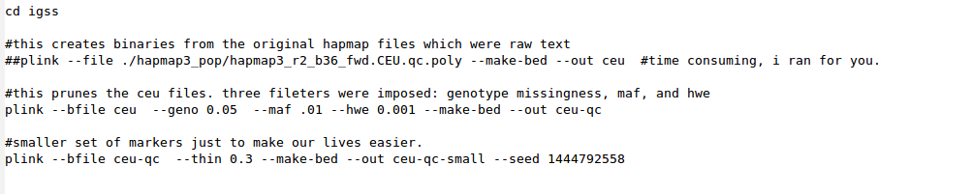
A_qc.txt
DO NOT RUN!
This converts raw plink files to binary plink files.
Imposition of basic QC filters for maf, hwe, and missingness.
We’re going to use a random subset of markers just to decrease computational time. Setting of seed means we all use common set.

Slide 35
Run commands from A_qc.txt in your ec2 instance.

Slide 36
Subsequent files mostly contain R source.
Look for comments indicating commands (primarily grep, awk, and plink commands) meant to be run at bash prompt.

Slide 37
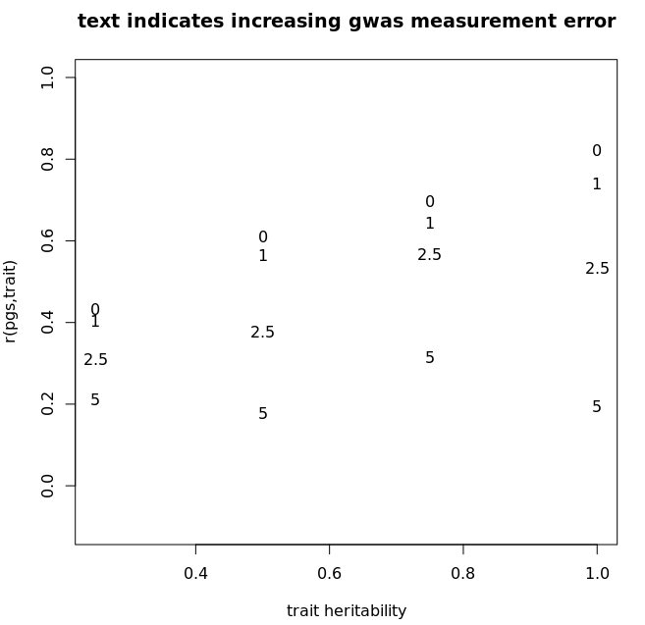
B_pheno_simulation.R
No HapMap phenotypes available.
Need to simulate reasonable phenotypes.
No need to run code, but you have it.
I want to convince you the simulated phenotype is reasonable.
We’ll observe slightly different correlations [these are based on just the causal variants which are known here].

Slide 38
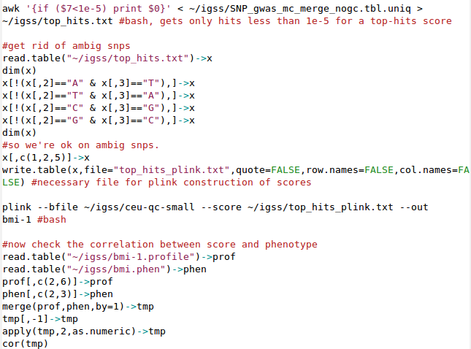
C1_pgs_top_hits.R
Pruning for top hits
Ditching ambig SNPs
Construct score with plink
Checking out results

Slide 39
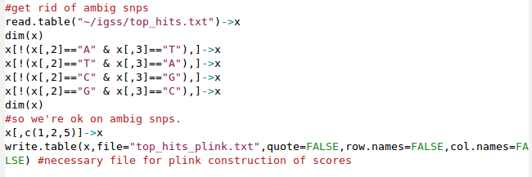
C1_pgs_top_hits.R
We went from 4444 to 3826.

Slide 40
Please run the C1_pgs_top_hits.R script.
Aim is to understand the mechanics of what is happening as well as the substantive implications.

Slide 41
C2_pgs_homebrew.R
Goal: Exert as much control as possible on what we ultimately give plink via the --score option.
This is done via make_pgs() function.

Slide 42
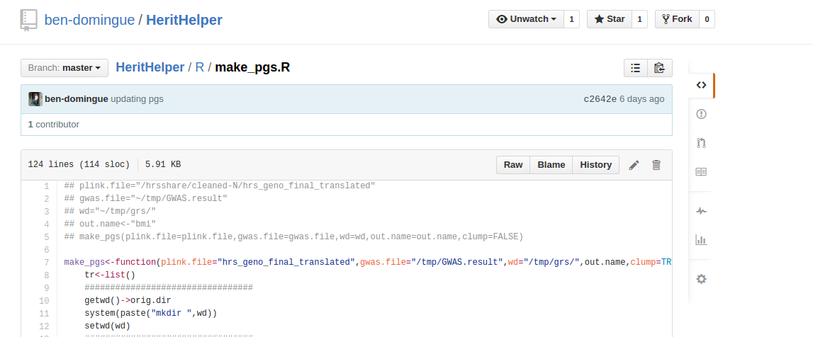
make_pgs()
Homebrewed function to create a pgs.
Available at https://github.com/ben-domingue/HeritHelper/blob/master/R/make_pgs.R

Slide 43
Explain make_pgs
How deep you go here is going to depend on how much fun you have wading through R code.
Specifically R code being used as a wrapper for calls to plink and other busy work.
If you want to walk through it, use debug(make_pgs) and then run the function.
We’ll walk through the main points as a group.

Slide 44
4 Step process
Remove ambig SNPs from the GWAS file.
Clumping
Remove ambig SNPs and those removed in step 2 from plink files.
Generate polygenic score
Step 3 is really messy.

Slide 45
Step 3. Cleaning plink files
Remember that the goal is to exert maximum possible control over what is happening.
Get rid of clumped SNPs
Eliminate ambig SNPs
“Force” everything to A/C
Flip effect if necessary
Revert to original SNP coding (undo #3)

Slide 46
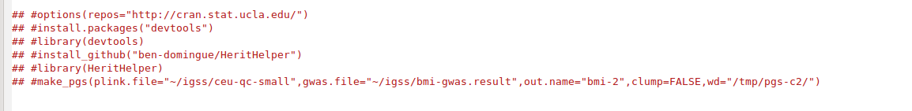
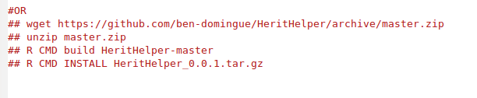
Quick use of make_pgs()
-Won’t work on EC2 easily, but you should be able to install on your machine or server.
-You can also download the package directly from github and install without the devtools package.
-If you are really interested in this option but these things sound complicated, please talk to me.

Slide 47
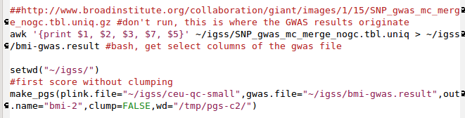
Using make_pgs
Get gwas results
Create genome-wide score without clumping

Slide 48
Let’s check in on ambig SNPs
# in GWAS results: 2 554 638
# in plink file: 406 123
# common: 375 285
# used to create risk score: 327 797

Slide 49
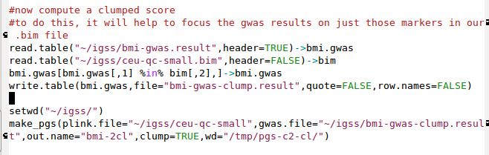
Clumped score
Restrict gwas results to only those snps in our .bim file.
Make clumped score!

Slide 50
Please run the C2 code.

Slide 51
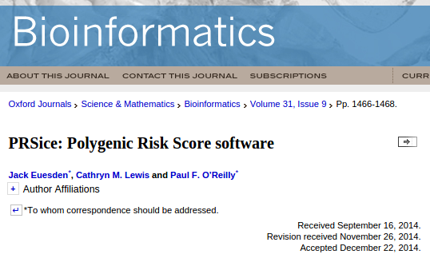
C3_pgs_PRSice.R
Now we’re going to construct polygenic scores via “official” software.

Slide 52
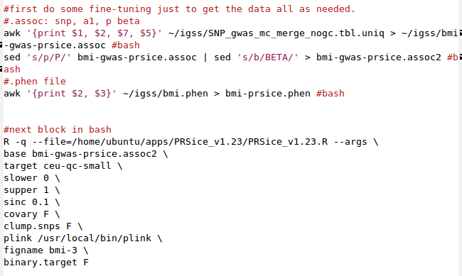
C3_pgs_PRSice.R
Some housekeeping, prepping files for PRSice
This is how you run PRSice. One caveat: requires being able to install several auxiliary R packages. Potentially a problem if you are using a server that doesn’t allow for that type of thing.

Slide 53
Please run the code in C3.

Slide 54
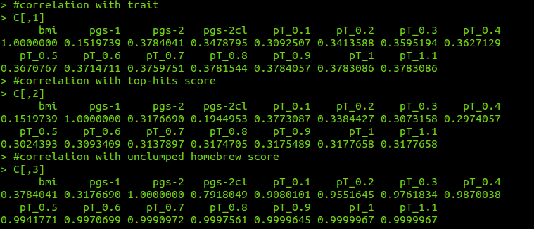
D_all.R
This contains source to put all results together.

Slide 55
Caveats
Polygenic Scores only capture GWAS variants
Common variants
Relatively constant prediction across environments
Conservative method for testing GxE

Slide 56
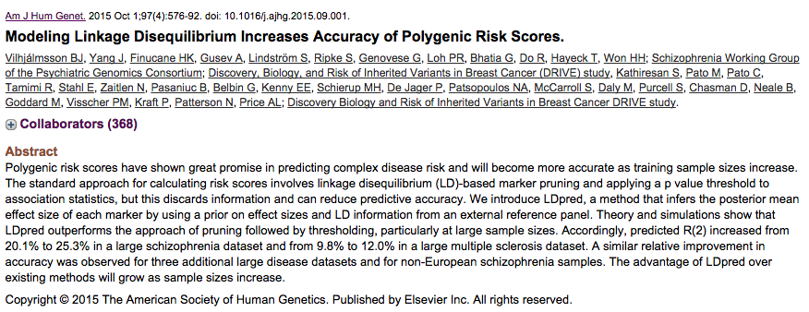
New LD considerations

Slide 57
Imputed versus genotyped
I’m not an expert on working with imputed data, but this will require some modifications to the workflow we’ve used here.

Slide 58
Getting stuff off EC2 instance
Zip everything up:
See end of D_all.R
Secure copy (scp)
Linux: scp igss.pem ec2-user@[your instance]:~/igss.zip .
Windows: Use pscp (part of putty suite)
NOTE: I will kill all images as of tomorrow unless instructed otherwise.
You should also be able to recreate things from publicly available hapmap data.

Slide 59
Additional Examples
Smoking
Domingue BW, Conley D, Fletcher J, Boardman JD. (2015). Cohort Effects in the Genetic Influence on Smoking. Behavior genetics,
BMI
Domingue BW, Belsky DW, Harris KM, Smolen A, McQueen MB, Boardman JD. (2014). Polygenic risk predicts obesity in both white and black young adults. PLOS One
Education
Domingue BW, Belsky DW, Conley D, Harris KM, Boardman JD. (2015). Polygenic Influence on Educational Attainment. AERA Open

