Slide 1
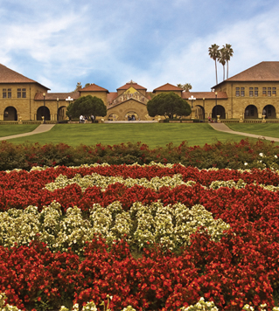
Moving forward 2016 Summer Workshop CEDUA El Colegio de Mexico, A. C.
Ben Domingue

Slide 2
Introduction

Slide 3
Schedule
LECTURE | HANDS-ON
Genome-wide data | Linux tools Starting with plink
Population stratification | More plink! Hapmap
Heritability | GCTA Other measures of relatedness
Polygenic Scores | Constructing polygenic scores PRSice
Looking forward | Creating a research agenda

Slide 4
Goals for workshop
Be able to read papers that utilize genetic data.
Start developing research questions that might utilize genetic data.
Begin to figure out how to work with genetic data.

Slide 5
Cover what we learned

Slide 6
Some other things you may want to know about
Great deal of caution associated with all of the coming topics!

Slide 7
Mendelian Randomization
Basic idea: genes as instrumental variables
Quick review of IV theory

Slide 8
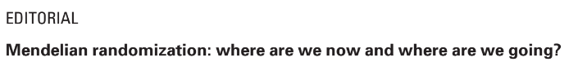
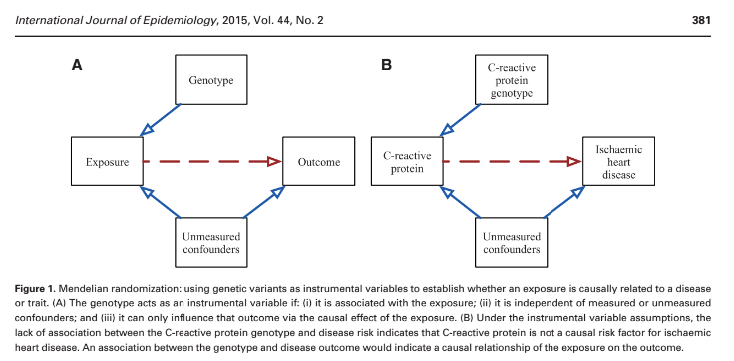
Beware pleiotropy!

Slide 9
MR examples

Slide 10
Other types of genetic variation
Exome? Rare variants? Cnvs

Slide 11
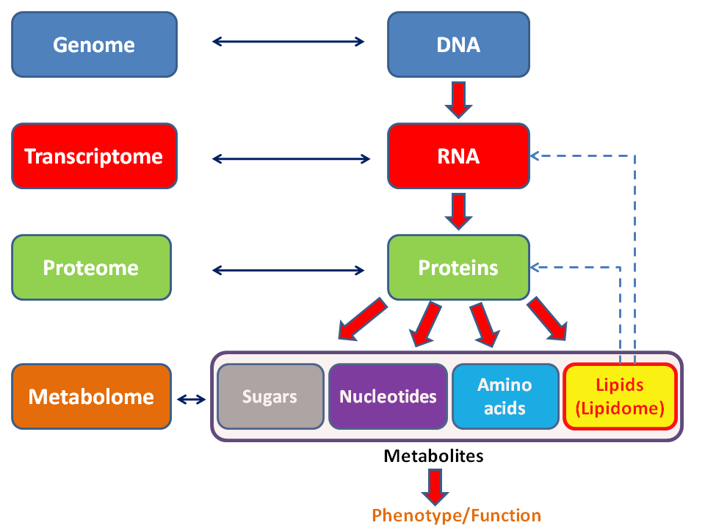
Higher-order processes
Obviously, lots of things occur between the fixed DNA and our dynamic selves.
Nascent interest in social science/demography in certain of these processes.
I’m going to talk about those that are fairly close to the genetics.

Slide 12

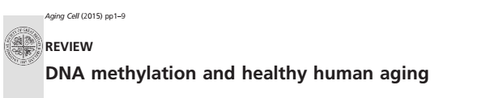
Epigenetics: what is it?

Slide 13
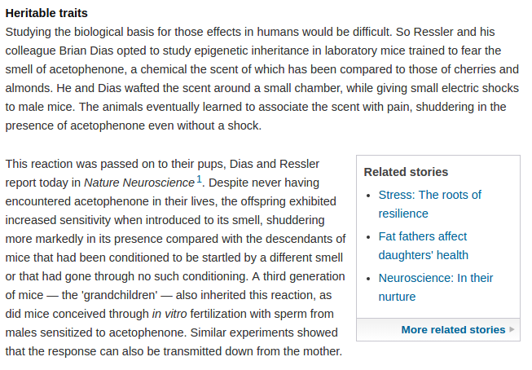
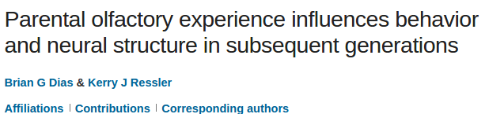
Why do we care?

Slide 14
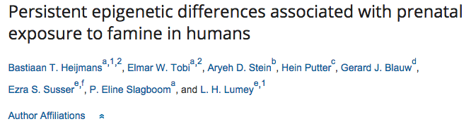
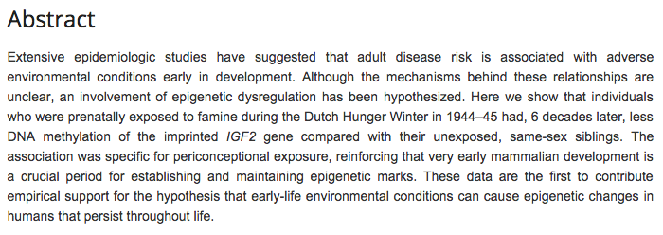
Dutch Hunger Winter

Slide 15
Biology
Society
Epigenetics!

Slide 16
Two examples
Telomeres
Methylation

Slide 17
telomeres

Slide 18
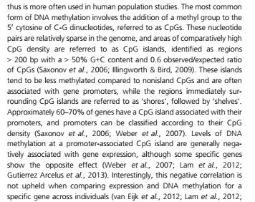
Methylation

Slide 19
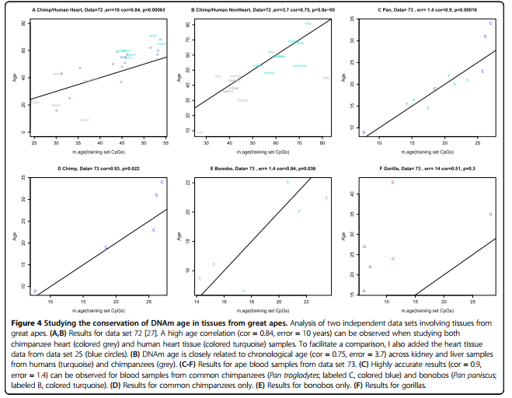
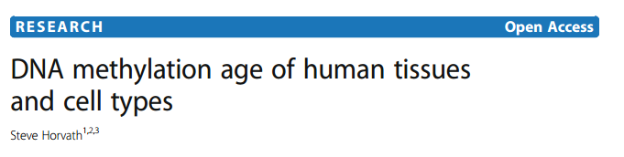

Slide 20
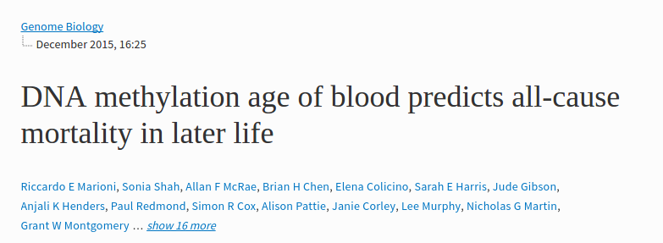

Slide 21
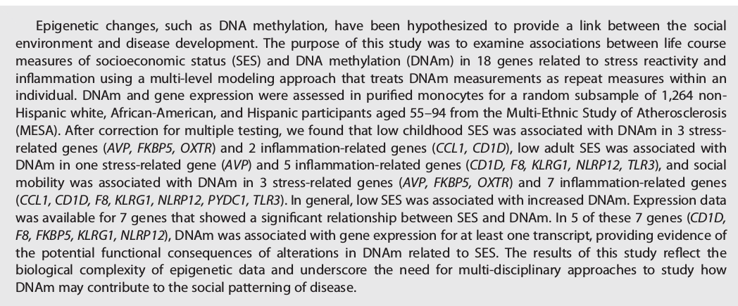
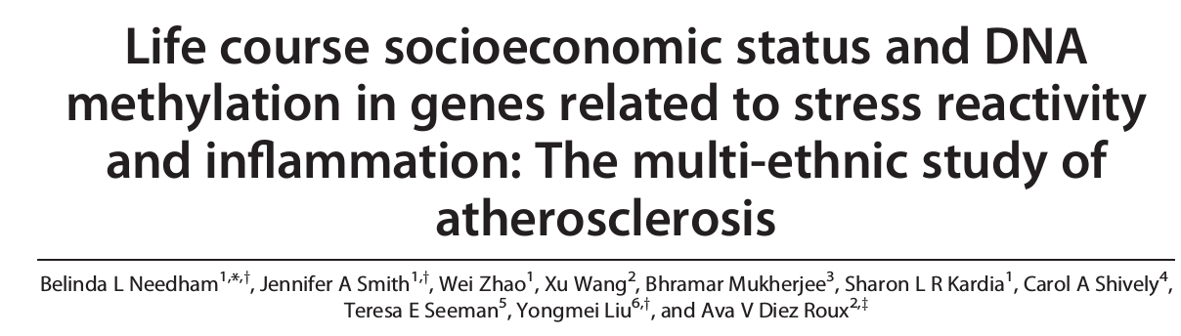

Slide 22
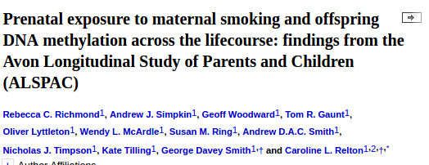
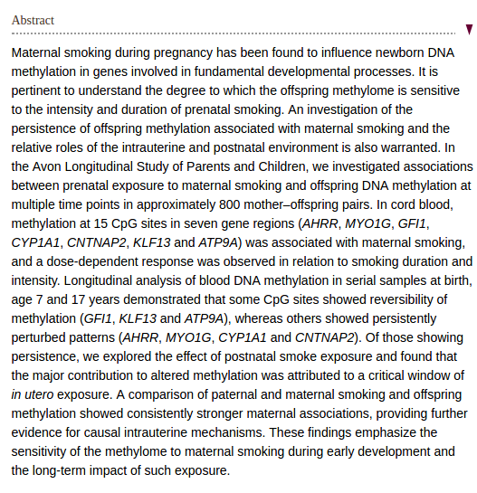

Slide 24
Where do we go from here?

Slide 25
Lots of time to flesh out research question

