Slide 1
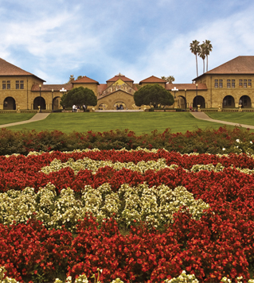
Moving forward 2016 Summer Workshop CEDUA El Colegio de Mexico, A. C.
Ben Domingue

Slide 2
Goals

Slide 3
Review

Slide 4
Some other things you may want to know about
Great deal of caution associated with all of the coming topics!

Slide 5
Mendelian Randomization
Basic idea: genes as instrumental variables
Quick review of IV theory

Slide 6
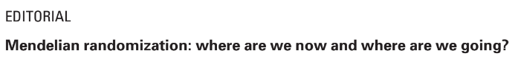
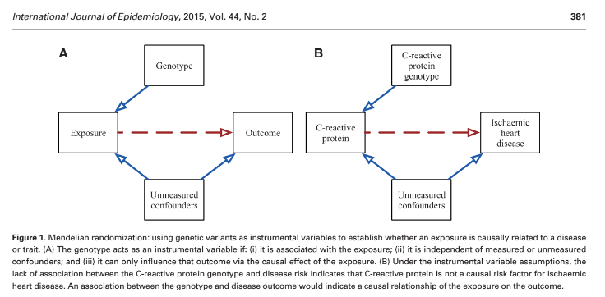
Beware pleiotropy!

Slide 7
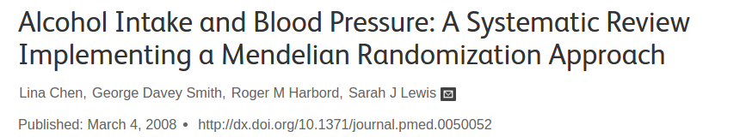
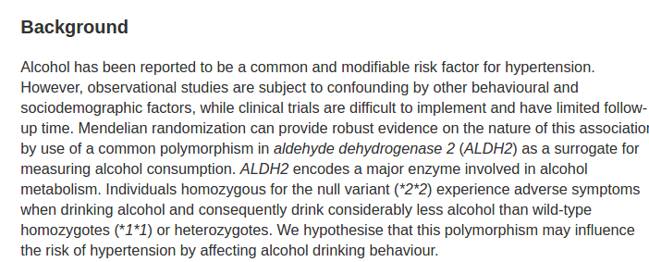

Slide 8
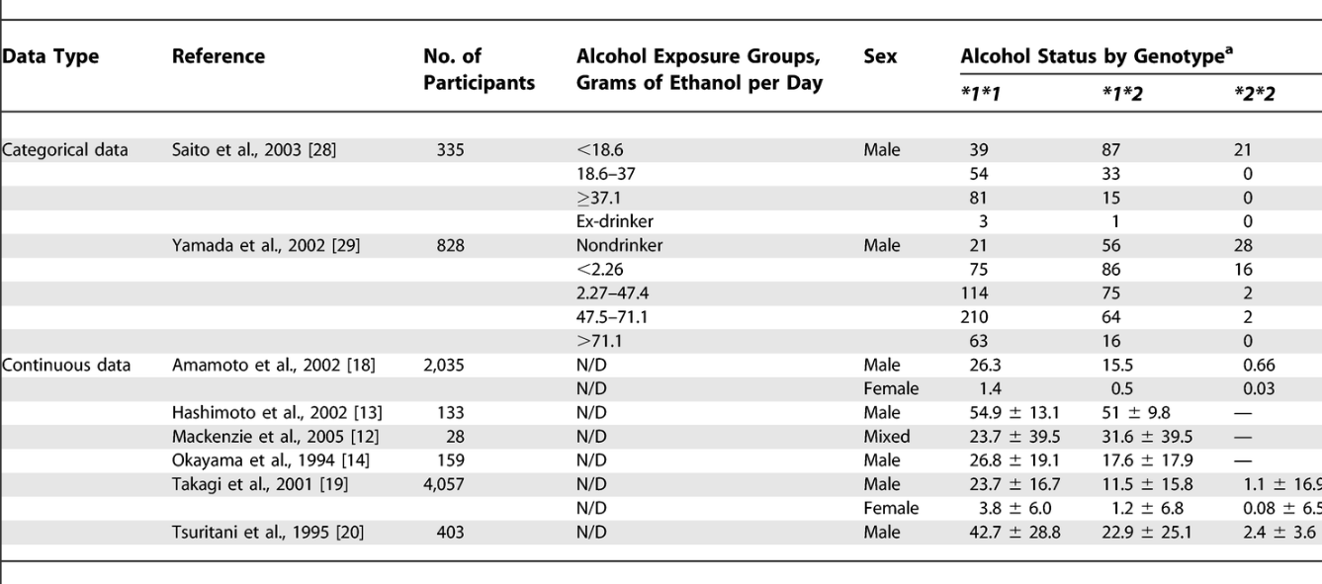

Slide 9
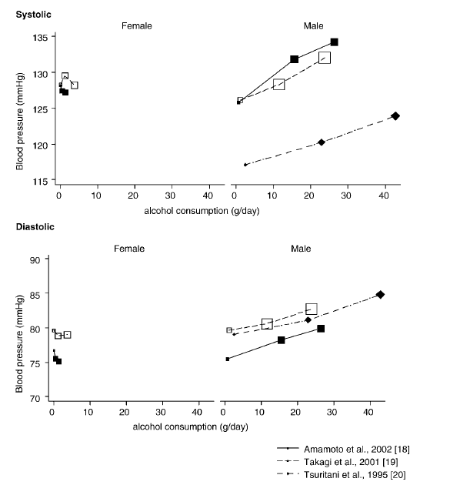

Slide 10
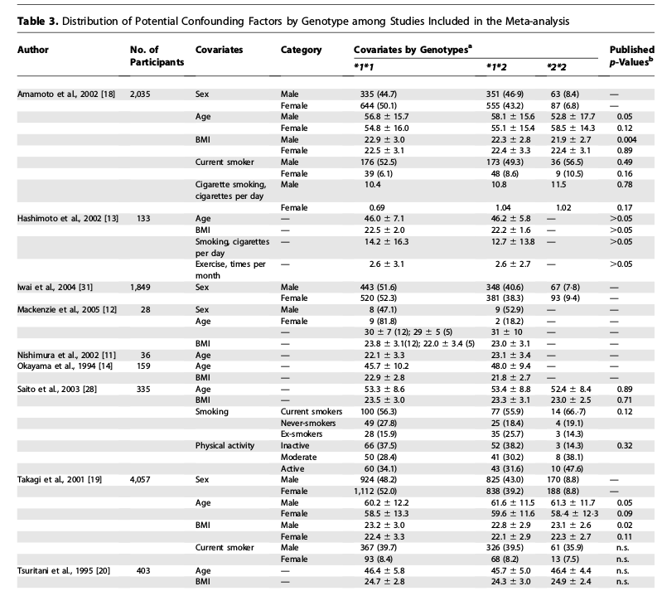

Slide 11
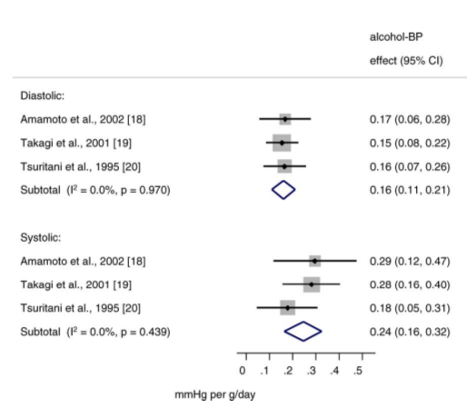
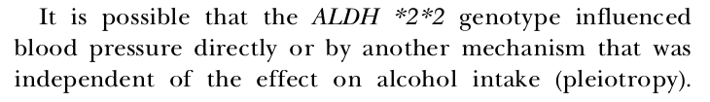
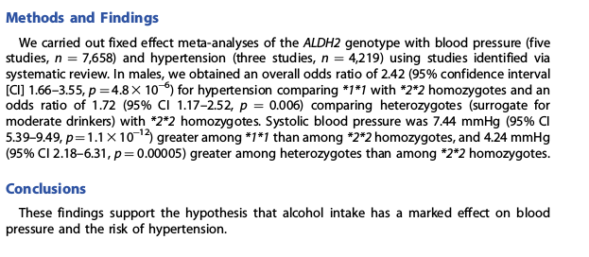

Slide 12
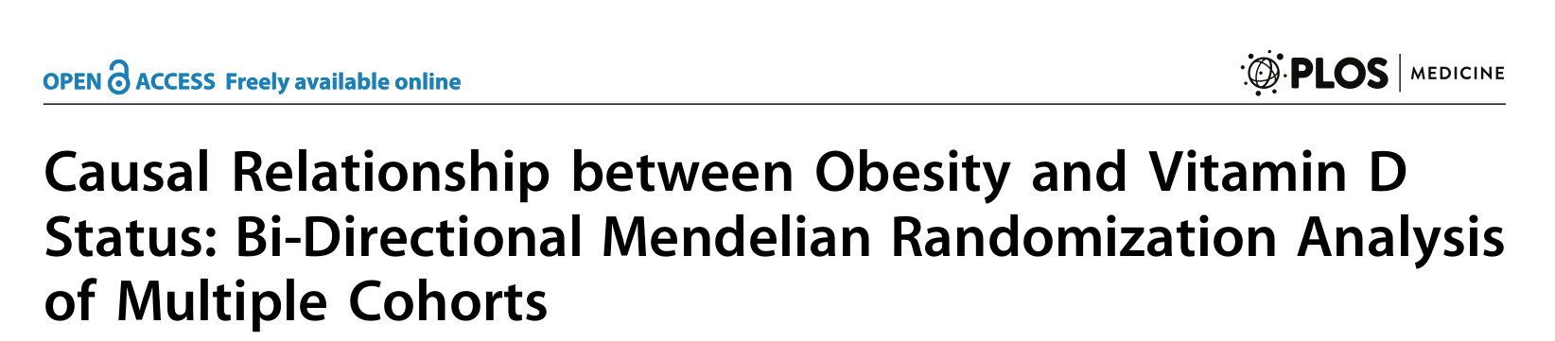
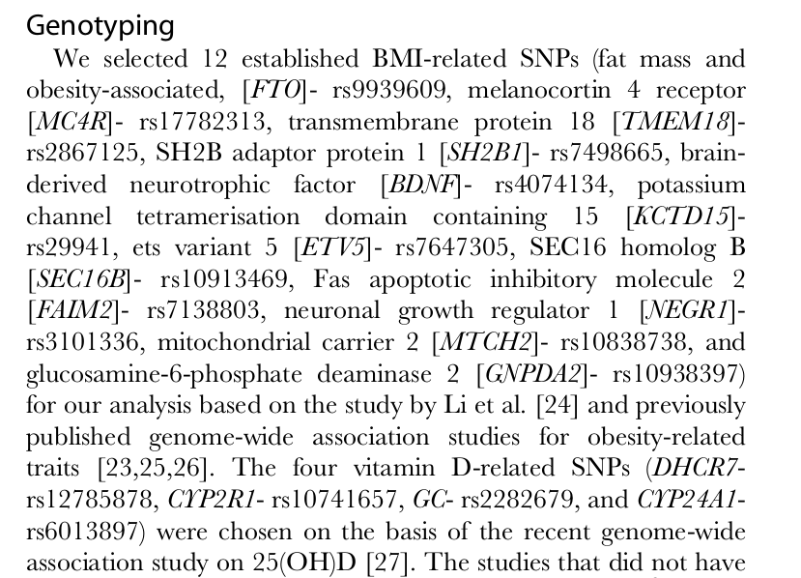
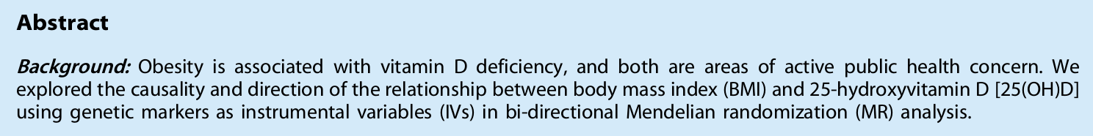

Slide 13
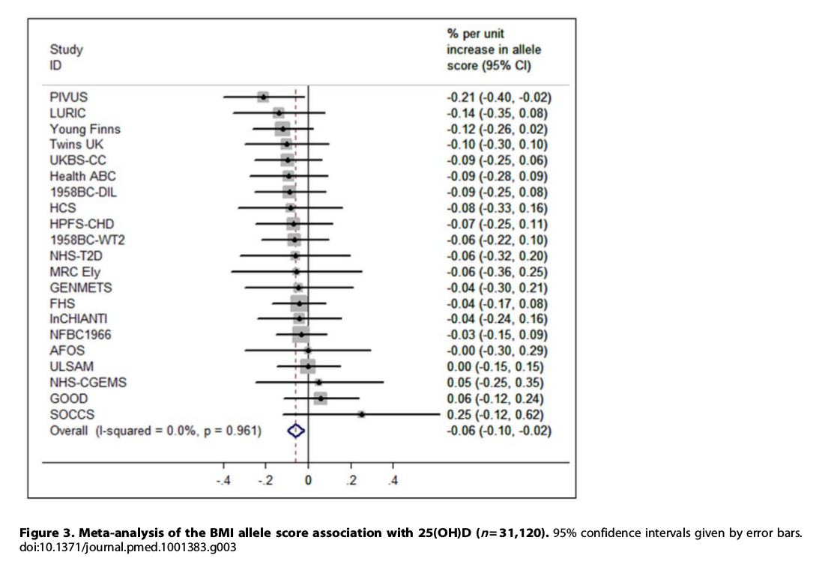

Slide 14
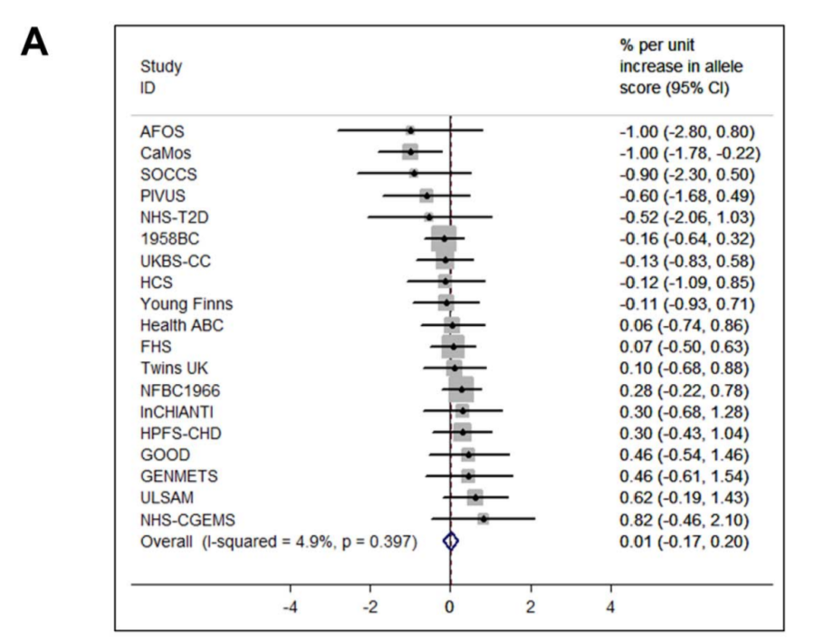

Slide 15
Other types of genetic variation
Exome? Rare variants? Cnvs

Slide 16
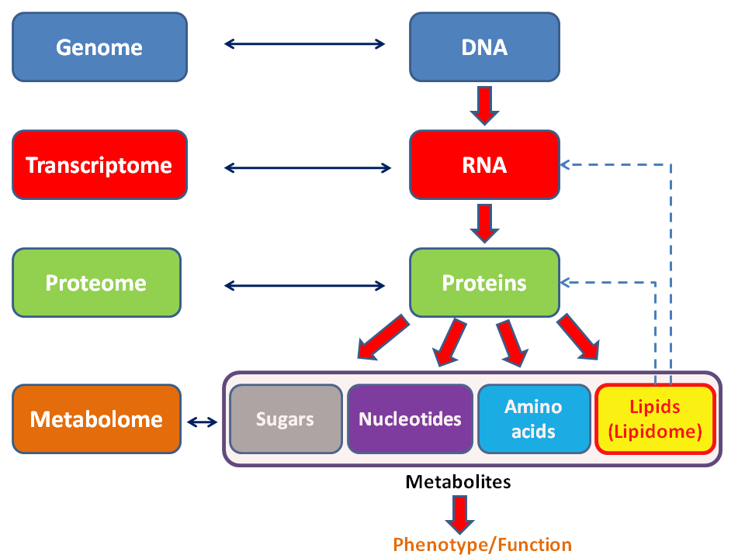
Higher-order processes
Obviously, lots of things occur between the fixed DNA and our dynamic selves.
Nascent interest in social science/demography in certain of these processes.
I’m going to talk about those that are fairly close to the genetics.

Slide 17

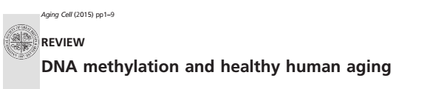
Epigenetics: what is it?

Slide 18
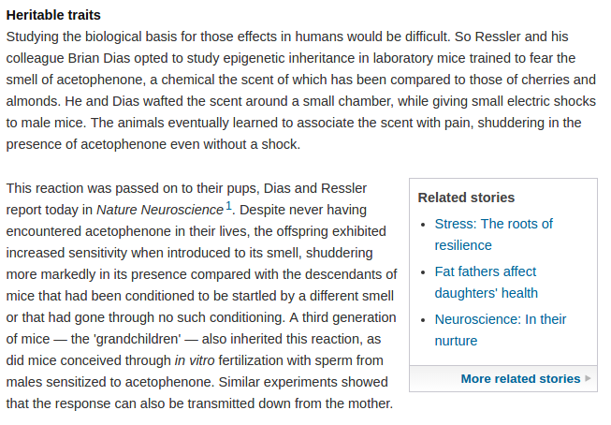
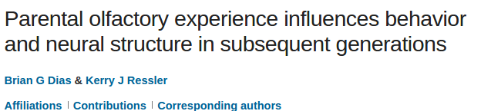
Why do we care?

Slide 19
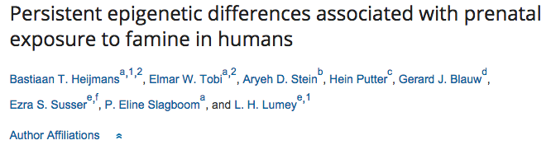
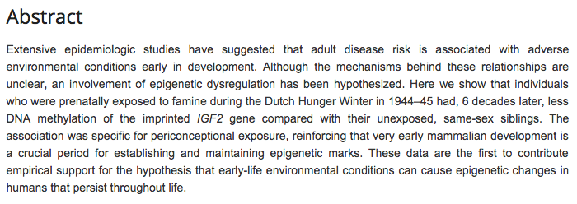
Dutch Hunger Winter

Slide 20
Biology
Society
Epigenetics!

Slide 21
Two examples
Telomeres
Methylation

Slide 22
telomeres

Slide 23
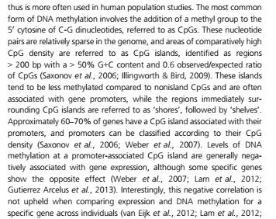
Methylation

Slide 24
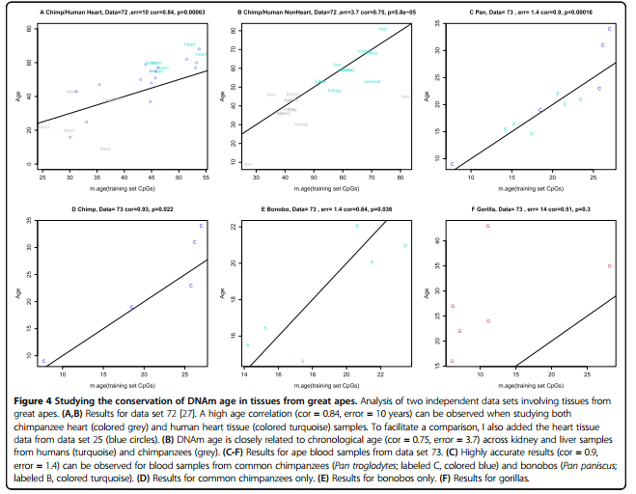
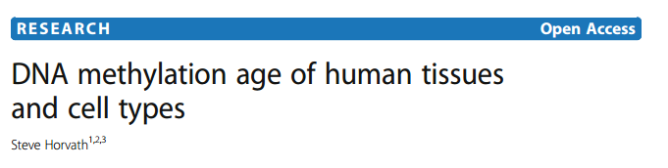

Slide 25
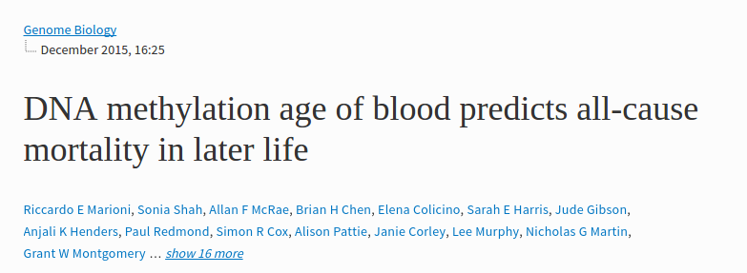

Slide 26
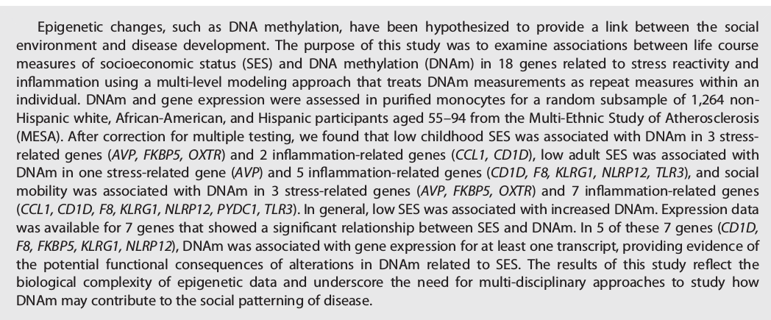
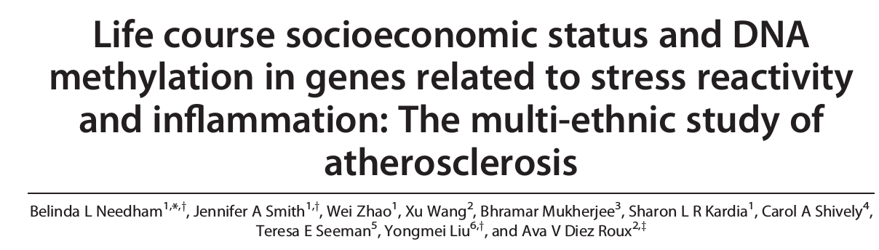

Slide 27
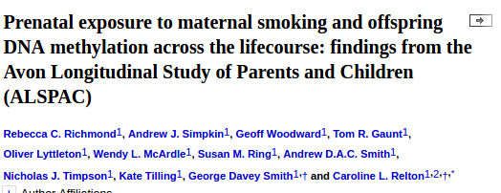
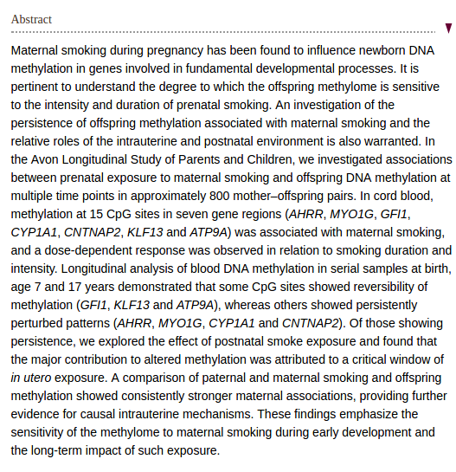

Slide 29
Where do we go from here?

