Slide 1
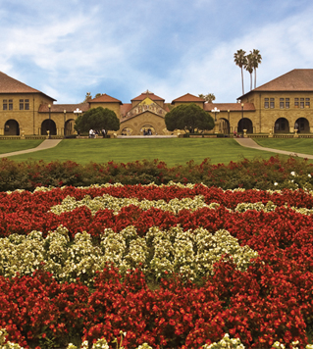
Working with population-based genetic data 2016 Summer Workshop CEDUA El Colegio de Mexico, A. C.
Ben Domingue

Slide 2
About me
Interests
Personal goals for this week
Feel free to interrupt, tell me to slow down, etc etc. We have LOTS of time.
About you all.

Slide 3
Resources available here:
https://github.com/ben-domingue/mex-gw-workshop

Slide 4
Schedule
LECTURE | HANDS-ON
Genome-wide data | Linux tools Starting with plink
Population stratification | More plink! Hapmap
GWAS & Polygenic Scores | Constructing polygenic scores
Relatedness and heritability | GCTA Other measures of relatedness
Looking forward

Slide 5
Goals for workshop
Be able to read papers that utilize genetic data.
Start developing research questions that might utilize genetic data.
Begin to figure out how to work with genetic data.

Slide 6
Goals for today
Start to understand relevant genetics and structure of genetic data.

Slide 7

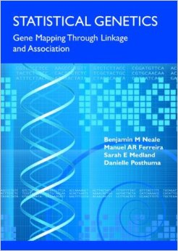
Basic quantitative Genetics

Slide 8
Vocabulary Worksheet
Phenotype, outcome, trait
Variant, locus, marker: a location in the genome where we observe variation.
Allele: instance of genetic variation (e.g., a SNP will have two alleles)
Heterozygote/homozygote
Admixture, admixed
Population (stratification, structure)

Slide 9
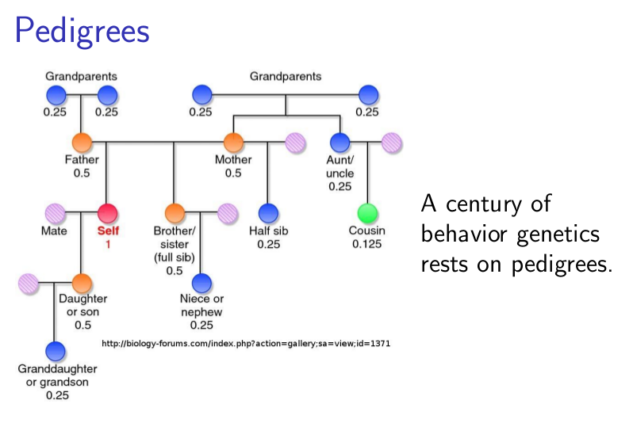

Slide 10
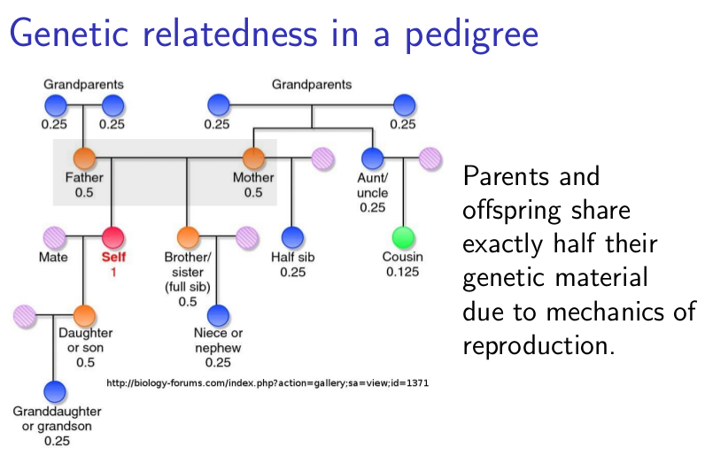

Slide 11
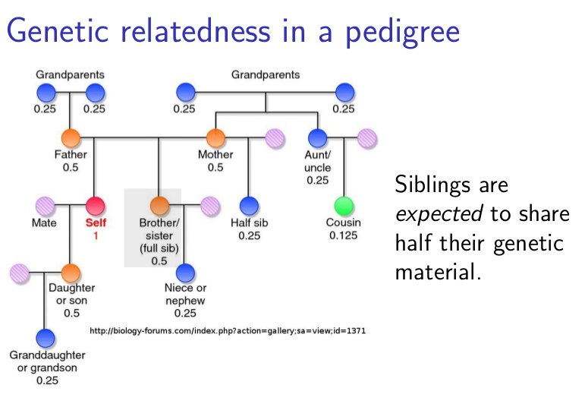

Slide 12
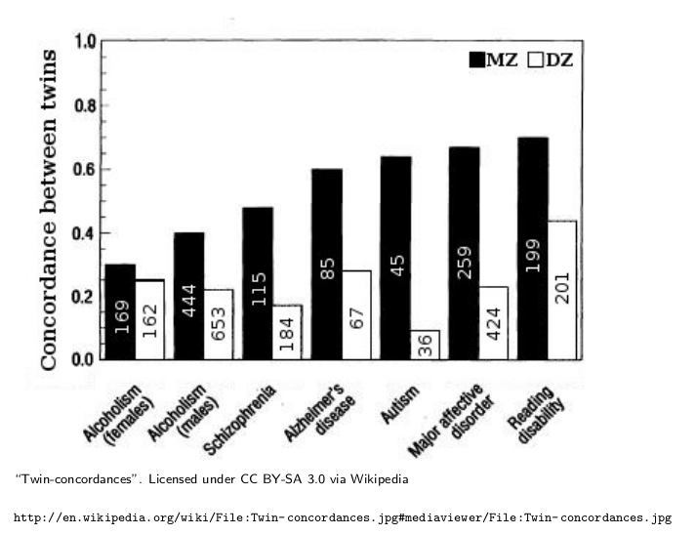
Increased genetic similarity → Increased Phenotypic Similarity

Slide 13
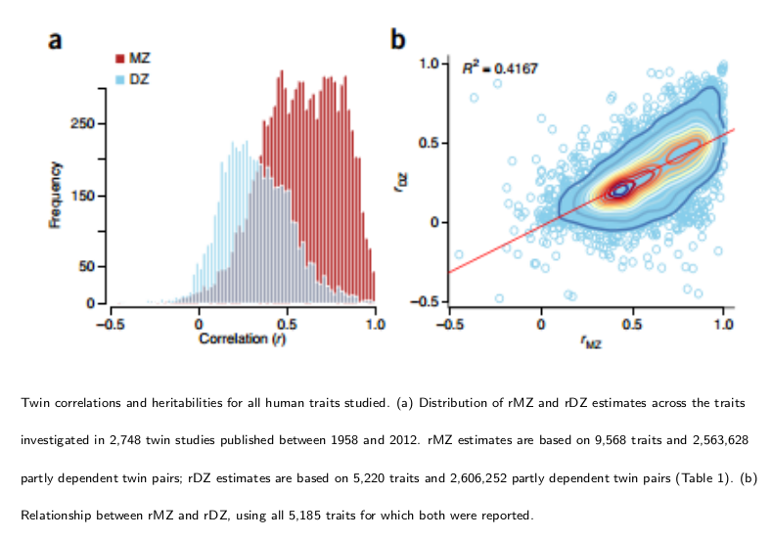

Slide 14
Turkheimer’s Law of BG
First Law: All human behavioural traits are heritable.
Second Law: The effect of being raised in the same family is smaller than the effect of the genes.
Third Law: A substantial portion of the variation in complex human behavioural traits is not accounted for by the effects of genes or families.

Slide 15
Moving past pedigree studies
Human Genome Project completed in 2003. Three big aims:
determining the order, or ”sequence,” of all the bases in our genome’s DNA
making maps that show the locations of genes for major sections of all our chromosomes
producing what are called linkage maps

Slide 16
Why the central role for DNA?
Central Dogma of Molecular Biology
“DNA makes RNA and RNA makes protein”
For social science:
Fixed at conception

Slide 17
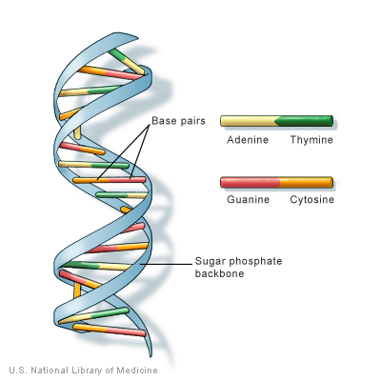
DNA
3 billion base pairs in total.
We are all identical at vast majority of them.

Slide 18
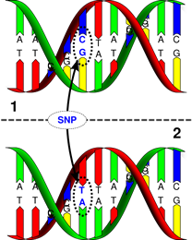
Single Nucleotide Polymorphisms (SNPs)
SNPs occur ~1/300 base pairs
In >1% of the population.

Slide 19
Single Nucleotide Polymorphisms (SNPs)
Two flavors of a SNP are “alleles”.
Major and minor alleles. Reference Allelle.
We inherit two pieces of genetic information, one from mom and one from dad.
Focus is on number (0,1,2) of reference alleles at a SNP.

Slide 20
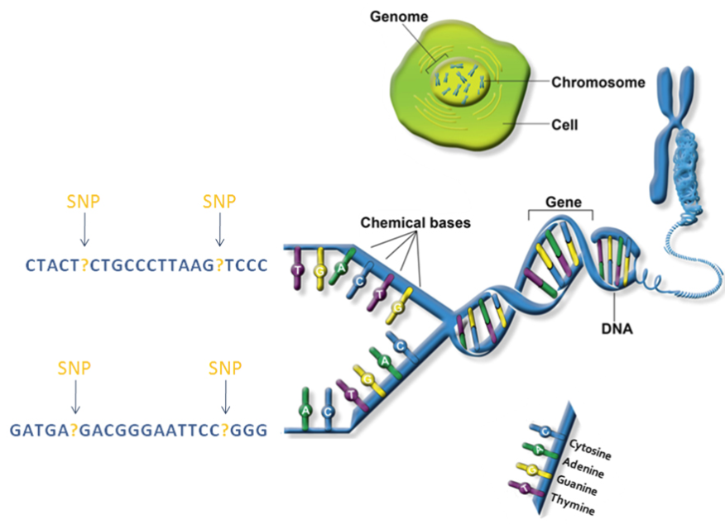
Chromosomes: Packages of DNA

Slide 21
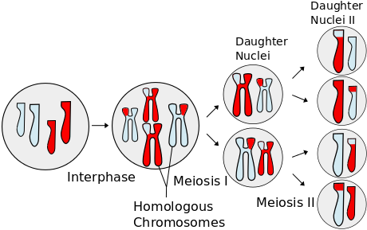
What’s this about genetics from mom and dad?

Slide 22
Some warnings
First and foremost: I am self-taught!

Slide 23
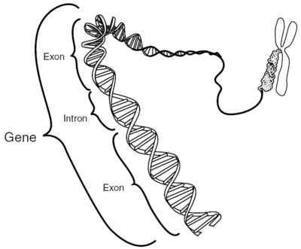
SNPs are not genes
We have ~25,000 genes.
SNPs may be embedded within genes. Or not.

Slide 24
Most traits are not Mendelian
Mendelian traits are due to difference at single genetic locus.
Most traits of interest to social scientists are influenced by LOTS of genes.
Mendelian: Cystic Fibrosis, sickle cell anemia
“Quasi-Mendelian”: breast cancer, Alzheimer’s
Complex: height, BMI, educational attainment, etc.
We will talk about trait “architectures”.

Slide 25
Genome-wide data is not sequence data
Genome-wide data will look at just SNPs (and even just a sample of those).
Sequence data contains information about EVERY base pair.
Of interest for study of rare variants and de novo mutations.

Slide 26
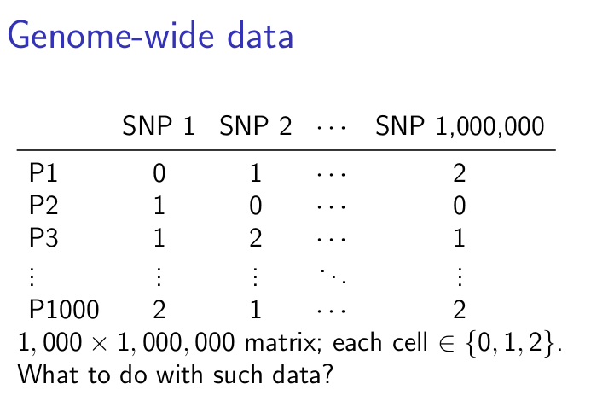

Slide 27
Genotyping in pop-based samples
Originally most DNA samples were based on blood draws.
In recent years, some form of saliva collection has become the dominant mode [especially for population-based studies].

Slide 28
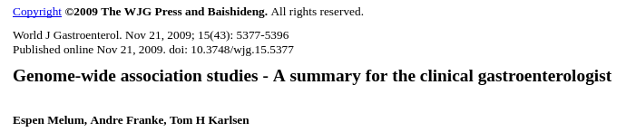
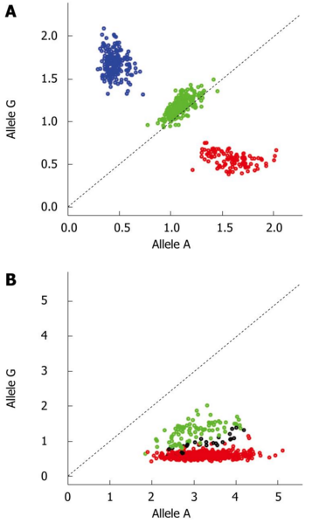
Call Algorithms
After samples are collected, lots of molecular biology takes place.
…
We’ll pick the story back up at “intensity plots”.
When calling algorithms work properly, we now have 0/1/2s for our SNPs.

Slide 29
The QC process
Before working with genetic data, need to filter out genetic variants and individuals that seem to be problematic.
Missingness
Allele Frequency
Hardy-Weinberg

Slide 30
Missingness
When we see high missingness, it is likely due to a failure of the calling algorithm.
We will exclude such SNPs.
E.g., those missing more than 5% of calls.

Slide 31
Allele Frequencies
SNPs are, by definition, common variants
Rare variants are hard to study in the general population.
We will exclude SNPs whose minor allele doesn’t occur at least 1% or 5% of the time.

Slide 32
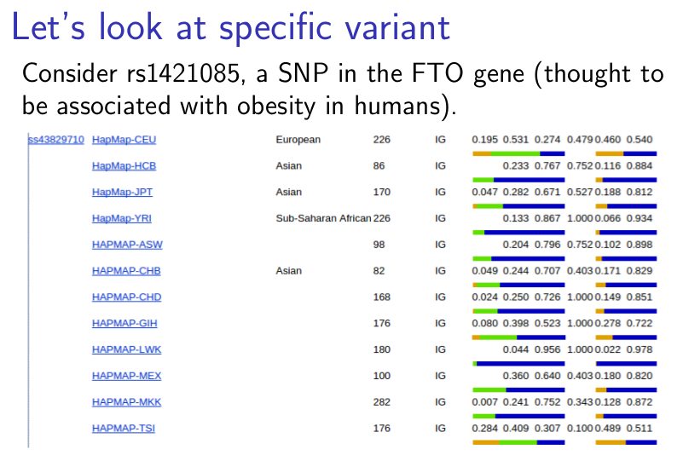
NOTE: Allele frequencies are not constant across human populations (“population stratification”)

Slide 33
Hardy-Weinberg Equilibrium (HWE)
Recall that we have 2 alleles at each SNP. We get one from mom and one from dad.
Suppose allele A has probability p and allele B has probability q (q+p=1).
What distribution of genotypes (AA, AB, BB) do you expect to see?
Pr(AA)=p^2
Pr(AB)=pq
Pr(BB)=q^2
Deviations can be a sign of genotyping error.
Key assumptions: random mating (maternal and paternal genotypes are independent); p & q are constant across sample (you don’t have admixed sample).

Slide 34
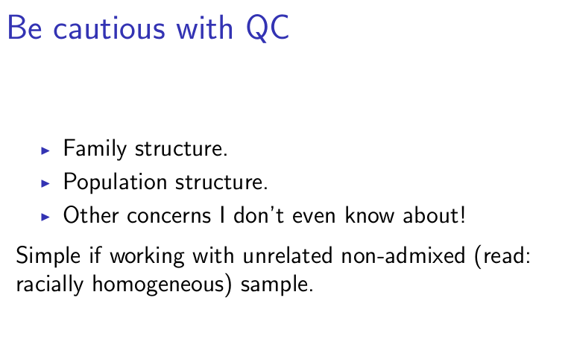

Slide 35
Warning: Working across mutiple populations is HARD.
I want to reiterate this.
It will be the basis for tomorrow’s talk.

Slide 36
Linkage: A Key concept
Linkage refers to the fact that “chunks” of chromosomes get inherited together.
Consequence: SNPs are correlated with those nearby.

Slide 37
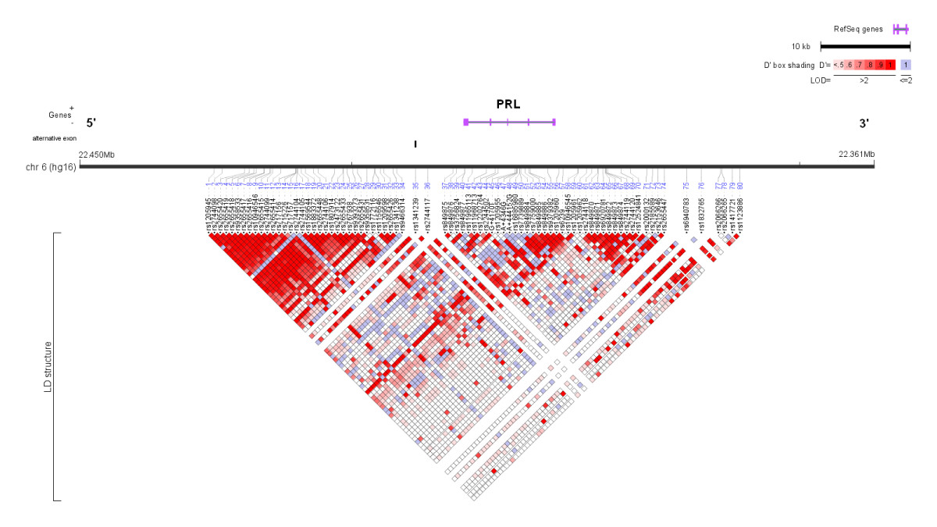
Linkage map
Tag SNPs
Linkage patterns vary across population.
Tag SNP in one group may not tag same gene in different population.

Slide 38
plink
plink is the standard tool for processing genome-wide (and now sequence) data.
Very good documentation: http://pngu.mgh.harvard.edu/~purcell/plink/
We are going to use it a lot this week. Most of the instruction will come in the lab portion, but let me first walk through the plink file formats.

Slide 39
Plain text
PED file (describes individuals):
First 6 columns:
Family ID
Individual ID
Paternal ID
Maternal ID
Sex (1=male; 2=female; other=unknown)
Phenotype
Columns 7 onward:
Genotypes
MAP file (describes genetic markers):
chromosome (1-22, X, Y or 0 if unplaced)
rs# or snp identifier
Genetic distance (morgans)
Base-pair position (bp units)

Slide 40

MAP example

Slide 41
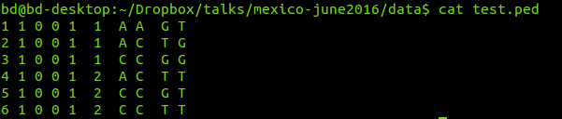
PED example

Slide 42
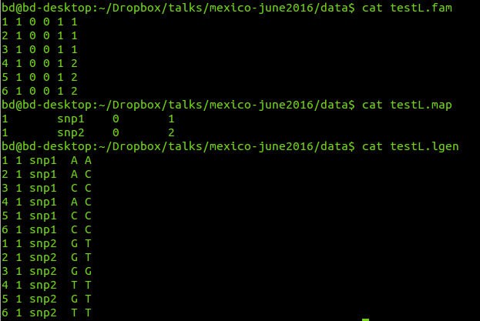
Long format (--recode-lgen)

Slide 43
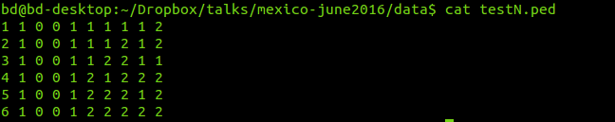
Numeric (--recode12)

Slide 44
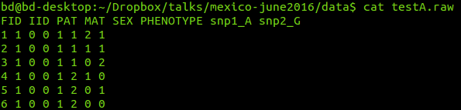
Additive (--recodeA)

Slide 45
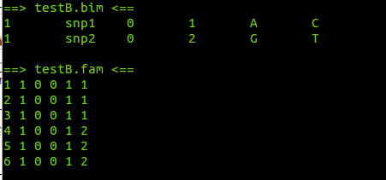
Binary (--make-bed)
There is also a .bed file. These are the genotypes (in binary).

Slide 46
Crucial Issues for this week
How do we tie genetic variation to phenotypic variation in a reliable way?
How does the population structure that exists in genetic data complicate this task?

Slide 47
Give overview of what is coming on each day
Tuesday: Population structure
How do ancestral differences affect study of genetics?
Wednesday: GWAS & Polygenic scores
How do we associate phenotypic variation to genetic variation?
Thursday: Relatedness & Heritability
How do we quantify genetic similarity between different humans (e.g., siblings versus first-cousins)?
How can we use this?
[Note: this is out of order with Wednesday for practical reasons.]

Slide 48
What data do we have?
Hapmap: https://hapmap.ncbi.nlm.nih.gov/downloads/index.html.en
Mexico:
http://www.pnas.org/content/106/21/8611.short

Slide 49
Research Brainstorm Session #1
Let’s set aside the next XX minutes to look for previously published papers of interest [potential replication projects?].
Biodemography & social biology, behavior genetics
Ssgac papers [and subsequent cites]
Cites of Science Paper: https://scholar.google.com/scholar?cites=12238045381303286987&as_sdt=2005&sciodt=0,5&hl=en
Sociogenomics topics
Polygenic score, mendelian randomization, gwas, gcta, gene-environment interaction (GxE)
Scholars
jason boardman, dalton conley, jason fletcher, guang guo, dan belsky, eileen crimmins, morgan levine, david rehkopf, jeremy freese,
IGSS: http://www.colorado.edu/ibs/cupc/conferences/IGSS_2016/

Slide 50
Research Brainstorm Session #1
Let’s set aside the next XX minutes to look for potentially interesting data sources.
I know some:
HRS, WHI,
Add Health
UK Biobank
But these are US/Europe specific. What about Mexico/Latin America?
Also, consider:
http://www.ncbi.nlm.nih.gov/gap
http://www.nhlbi.nih.gov/research/resources/genetics-genomics/share
http://ldsc.broadinstitute.org/gwashare/

