Slide 1
Height, body mass index, and socioeconomic status: mendelian randomisation study in UK Biobank http://www.bmj.com/content/352/bmj.i582
Objective To determine whether height and body mass index (BMI) have a causal role in five measures of socioeconomic status.
Design Mendelian randomisation study to test for causal effects of differences in stature and BMI on five measures of socioeconomic status. Mendelian randomisation exploits the fact that genotypes are randomly assigned at conception and thus not confounded by non-genetic factors.
Setting UK Biobank.
Participants 119 669 men and women of British ancestry, aged between 37 and 73 years.
Main outcome measures Age completed full time education, degree level education, job class, annual household income, and Townsend deprivation index.
Results In the UK Biobank study, shorter stature and higher BMI were observationally associated with several measures of lower socioeconomic status. The associations between shorter stature and lower socioeconomic status tended to be stronger in men, and the associations between higher BMI and lower socioeconomic status tended to be stronger in women. For example, a 1 standard deviation (SD) higher BMI was associated with a £210 (€276; $300; 95% confidence interval £84 to £420; P=6×10⁻³) lower annual household income in men and a £1890 (£1680 to £2100; P=6×10⁻¹⁵) lower annual household income in women. Genetic analysis provided evidence that these associations were partly causal. A genetically determined 1 SD (6.3 cm) taller stature caused a 0.06 (0.02 to 0.09) year older age of completing full time education (P=0.01), a 1.12 (1.07 to 1.18) times higher odds of working in a skilled profession (P=6×10⁻⁷), and a £1130 (£680 to £1580) higher annual household income (P=4×10⁻⁸). Associations were stronger in men. A genetically determined 1 SD higher BMI (4.6 kg/m²) caused a £2940 (£1680 to £4200; P=1×10⁻⁵) lower annual household income and a 0.10 (0.04 to 0.16) SD (P=0.001) higher level of deprivation in women only.
Conclusions These data support evidence that height and BMI play an important partial role in determining several aspects of a person’s socioeconomic status, especially women’s BMI for income and deprivation and men’s height for education, income, and job class. These findings have important social and health implications, supporting evidence that overweight people, especially women, are at a disadvantage and that taller people, especially men, are at an advantage.

Slide 2
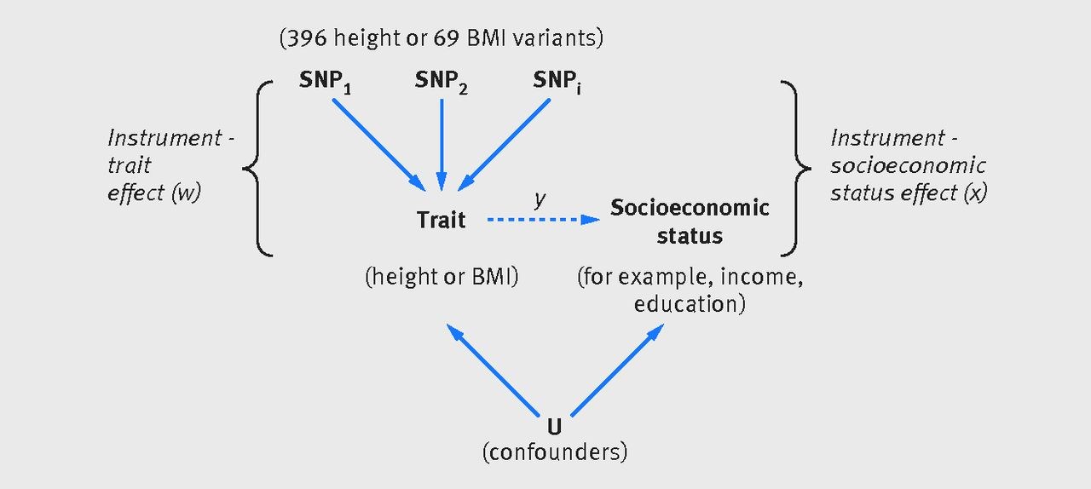
Height, body mass index, and socioeconomic status: mendelian randomisation study in UK Biobank http://www.bmj.com/content/352/bmj.i582
Fig 1 Principle of mendelian randomisation: if height or body mass index (BMI) causally influences socioeconomic status, genetic variants associated with that trait will also be associated with socioeconomic status. As genotype is assigned at conception, it should not be associated with factors that normally confound the association between BMI and height and socioeconomic status (eg, environmental and behavioural factors). We can use our estimates of the genetic-height/BMI association (w) and the genetic-socioeconomic status association (x) to infer the causal effect of height or BMI on socioeconomic status (y=x/w), which is expected to be free from confounding. If the estimated causal effect (y) is different from the observational association between the height or BMI and socioeconomic status, this would suggest that the observational association is confounded (assuming that the assumptions of the mendelian randomisation analyses are valid). SNP=single nucleotide polymorphism

Slide 3
Height, body mass index, and socioeconomic status: mendelian randomisation study in UK Biobank http://www.bmj.com/content/352/bmj.i582
What is already known on this topic
Socioeconomic status influences morbidity and mortality, with a recent review highlighting the 18 year gap in life expectancy between men living in the poorest and richest boroughs of London
Taller stature and lower body mass index (BMI) are associated with higher socioeconomic status, but the causal directions of these associations are poorly understood
Understanding the causal directions of these associations is important for public health and wellbeing policies
What this study adds
This study provides a high level of evidence (using 119 000 participants from the UK Biobank) for a causal effect from shorter stature and higher BMI to lower measures of socioeconomic status
Shorter height, as estimated by genetics, leads to lower levels of education, lower job status, and less income in men in particular, and higher BMI leads to lower income and greater deprivation in women
Genetic evidence has the advantage of being largely free from the problems that afflict observational studies; analyses using inherited DNA variation are much more robust to confounding, bias, and reverse causality

