Slide 1





Slide 2
H
L

Slide 3



H

Slide 4





Slide 7


Slide 10
L

Slide 11
H

Slide 13

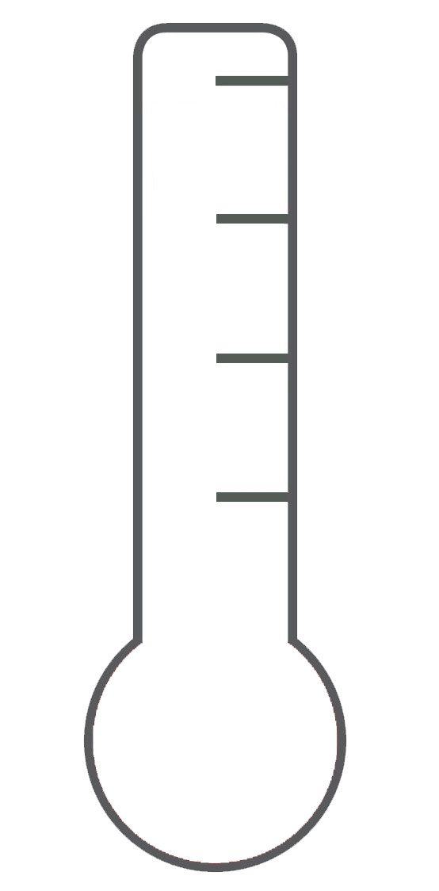



Slide 16
+ $3
+ $5
+ $2
+ $4
+ $1

Slide 17
50% chance
50% chance
- $6
- $7
50% chance
50% chance
- $4
- $5
50% chance
- $3

Slide 18
- $6
- $7
- $4
- $5
- $3

Slide 19
50% chance
50% chance
+ $6
+ $7
50% chance
50% chance
+ $4
+ $5
50% chance
+ $3

Slide 20
+ $6
+ $7
+ $4
+ $5
+ $3

Slide 21
50% chance
High pain
50% chance
Low pain
50% chance
Pain

Slide 22
High pain
Low pain
Pain

Slide 23
50% chance
50% chance
OR

Slide 24
Which one do you prefer?
Q
P
OR

Slide 25
210°
210°
210°
210°
210°

