Slide 1
How HOT do you expect the NEXT stimulus to be?
Skin temperature
Extremely hot

Slide 2
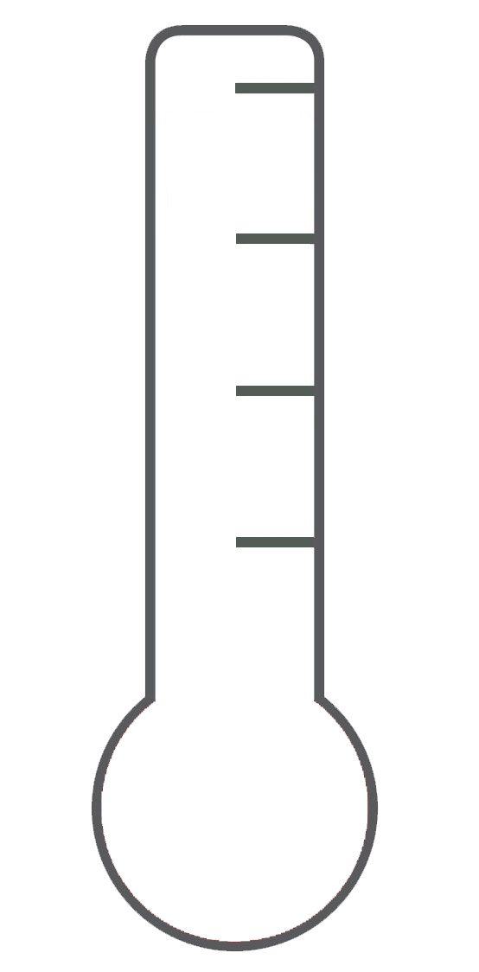
How HOT do you expect the NEXT stimulus to be?
Skin temperature
Extremely hot
Notes:
For symbolic learning expectations

Slide 3
How PAINFUL do you expect the NEXT stimulus to be?
Extremely painful
No pain
Notes:
For expectations (beside symbolic learning)

Slide 4
How PAINFUL was the last stimulus?
Extremely painful
No pain
Notes:
For all pain ratings (unless we choose to go with intensity + unpleasantness for the counterfactual task)

Slide 5
How CONFIDENT are you in your last rating?
Not at all
Extremely confident

Slide 6
How do you FEEL about this OUTCOME?
Neutral
Extremely negative
Extremely positive
Notes:
Affective rating for the counterfactual task

Slide 7

How PAINFUL do you expect the stimulus delivered FOLLOWING THIS PICTURE to be?
Extremely painful
No pain
Notes:
For cue recognition task

Slide 8

How PAINFUL do you expect the stimulus delivered FOLLOWING THIS PICTURE to be?
Extremely painful
No pain
Notes:
For cue recognition task

Slide 9

How PAINFUL do you expect the stimulus delivered FOLLOWING THIS PICTURE to be?
Extremely painful
No pain
Notes:
For cue recognition task

Slide 10

How PAINFUL do you expect the stimulus delivered FOLLOWING THIS PICTURE to be?
Extremely painful
No pain
Notes:
For cue recognition task

Slide 11

How PAINFUL do you expect the stimulus delivered FOLLOWING THIS PICTURE to be?
Extremely painful
No pain
Notes:
For cue recognition task

Slide 12

How PAINFUL do you expect the stimulus delivered FOLLOWING THIS PICTURE to be?
Extremely painful
No pain
Notes:
For cue recognition task

Slide 13

How PAINFUL do you expect the stimulus delivered FOLLOWING THIS PICTURE to be?
Extremely painful
No pain
Notes:
For cue recognition task

Slide 14
In relation to the previous clip, how do you feel?
Personal relevance
Not at all
Extremely
Notes:
Videos task- personal relevance

Slide 15
In relation to the previous clip, how do you feel?
Happy
Not at all
Extremely
Notes:
Videos task- happy

Slide 16
In relation to the previous clip, how do you feel?
Sad
Not at all
Extremely
Notes:
Videos task- sad

Slide 17
In relation to the previous clip, how do you feel?
Afraid
Not at all
Extremely
Notes:
Videos task- afraid

Slide 18
In relation to the previous clip, how do you feel?
Disgusted
Not at all
Extremely
Notes:
Videos task- Disgusted

Slide 19
In relation to the previous clip, how do you feel?
Warm and Tender
Not at all
Extremely
Notes:
Videos task- warm and tender

Slide 20
In relation to the previous clip, how do you feel?
Engaged
Not at all
Extremely
Notes:
Videos task- engaged

