Slide 1
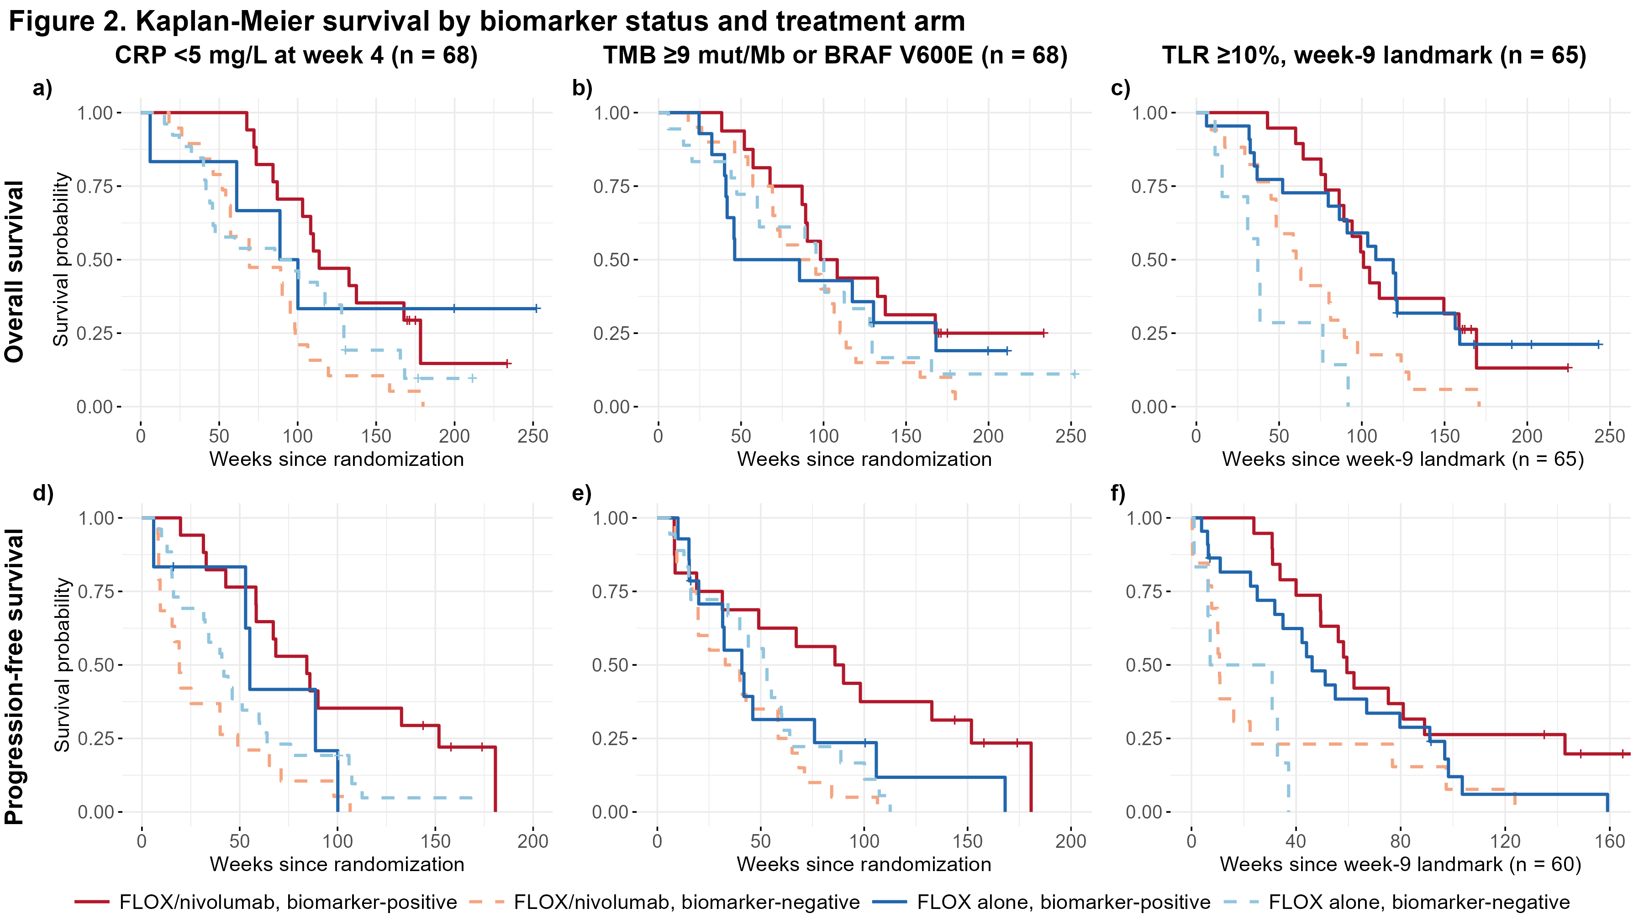
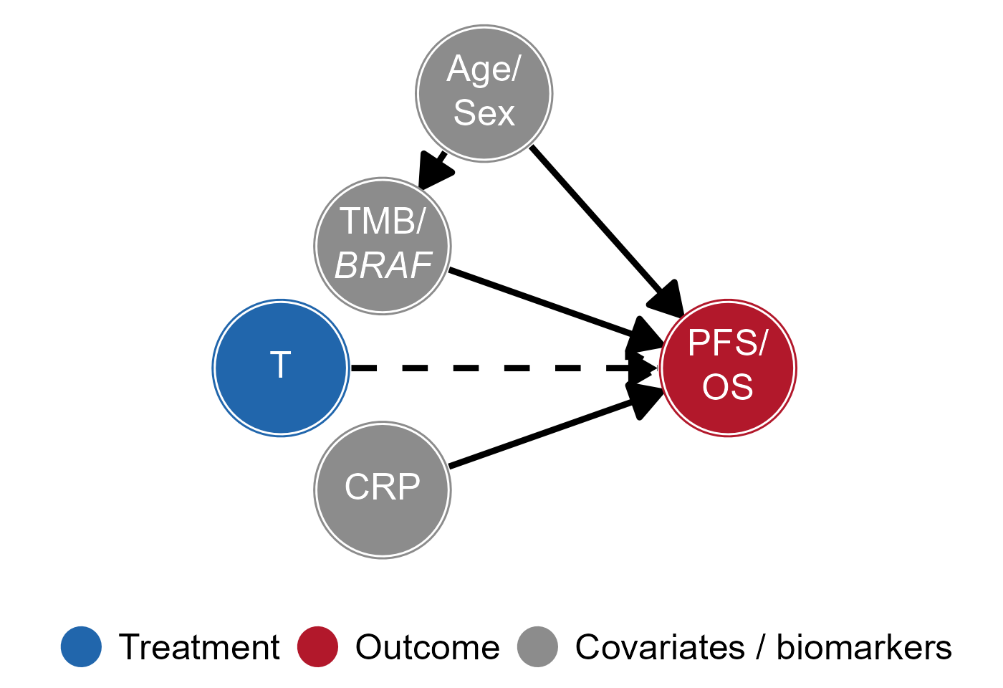
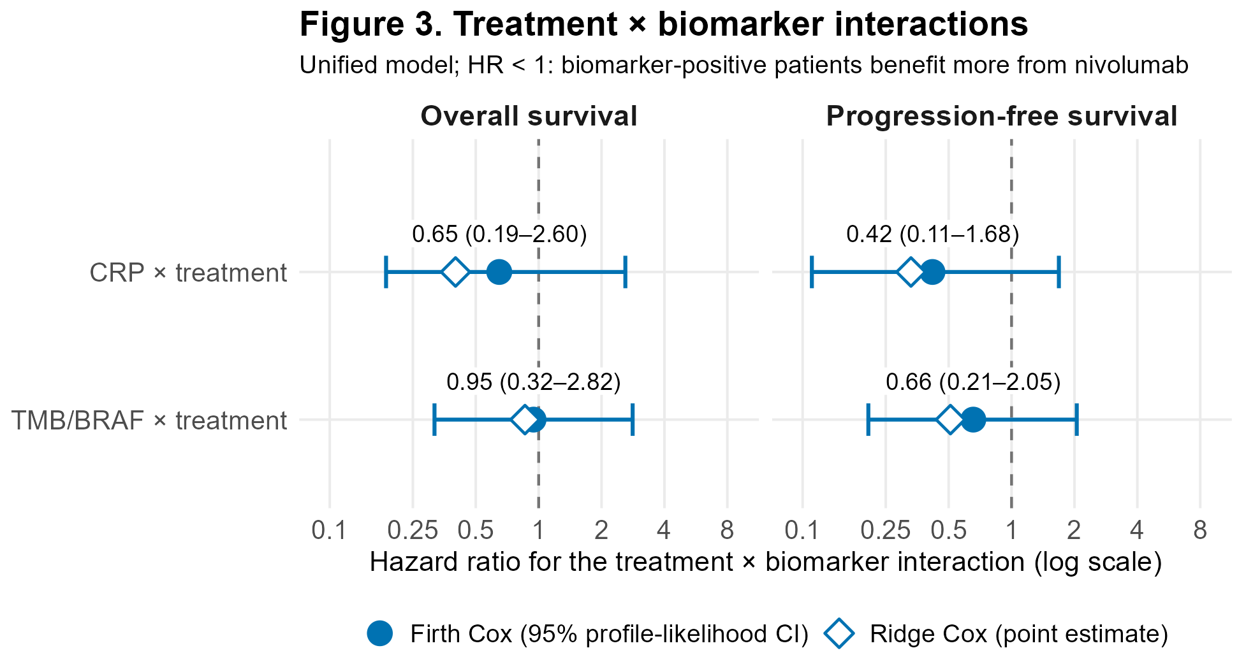


Biomarker signals in MSS/pMMR metastatic colorectal cancer (mCRC) are predominantly
prognostic, not predictive – lessons from the randomized phase-2 METIMMOX trial
Benjamin P. Geisler^{1,2@}, Megan Othus³, Sebastian Meltzer², Paula A. Bousquet², Emily A. Burger^{1,4}, Eline Aas^{1,5}, Anne H. Ree^{2,6}
¹Department of Health Management and Health Economics, University of Oslo, Oslo, Norway; ²Department of Oncology, Akershus University Hospital, Lørenskog, Norway; ³Fred Hutchinson Cancer Center, Seattle WA, United States; ⁴Center for Health Decision Science, Harvard T. H. Chan School of Public Health, Boston MA, United States; ⁵Division for Health Services, Norwegian Institute of Public Health, Oslo, Norway; ⁶Institute of Clinical Medicine, University of Oslo, Oslo, Norway.
4355P
Background
Results
Immune checkpoint blockade is ineffective in unselected MSS/pMMR mCRC.
METIMMOX (randomized phase 2; NCT03388190): alternating oxaliplatin-based chemotherapy (FLOX) + nivolumab vs FLOX alone; identical PFS.
Post hoc subgroup signals (TMB/BRAF, CRP, TLR) conflated prognostic and predictive effects; we separated them in one pre-specified interaction model per endpoint.
No marginal treatment effect: OS HR 0.96 (95% CI 0.58–1.61); PFS HR 0.80 (0.49–1.33).
Prognostic: CRP <5 mg/L and TMB/BRAF positivity were associated with longer PFS (HR 0.41 and 0.49) and, for CRP, longer OS (HR 0.49), regardless of treatment (Table 1, Figure 2).
Not predictive: no treatment × biomarker interaction reached significance (Figure 3). Most consistent signal: CRP × treatment for PFS, HR 0.42 (0.11–1.68), p = 0.21, ridge HR 0.33; attenuated for OS (HR 0.65).
TLR: strongly prognostic for both endpoints (landmark HR 0.35), but more frequent with FLOX alone (76% vs 53%) and with an interaction HR >1:
a marker of chemotherapy-responsive disease, not of nivolumab benefit.
Methods
68 complete cases (59 deaths; 63 PFS events).
Biomarkers before nivolumab: TMB ≥9 mut/Mb or BRAF V600E; CRP <5 mg/L after 2 FLOX cycles common to both arms (by chance 47% vs 19% positive).
TLR ≥10% at the first on-treatment CT: analyzed as intermediate endpoint with a week-9 landmark.
Per endpoint (PFS, OS): one Firth-corrected Cox model with age, sex, treatment, biomarker main effects and treatment × biomarker interactions (Figure 1); profile-likelihood 95% CIs, PLRT.
Ridge-penalized Cox as co-primary stability estimator.
Table 1. Hazard ratios (95% profile-likelihood CI) from Firth-corrected Cox regression
Term | Model | Overall survival |  |  | Progression-free survival
 |  | HR (95% CI) | p | Ridge HR | HR (95% CI) | p | Ridge HR
Treatment (FLOX/nivolumab vs FLOX) | Univariable | 0.96 (0.58–1.61) | 0.87 | – | 0.80 (0.49–1.33) | 0.39 | –
CRP <5 mg/L at week 4 | Univariable (prognostic) | 0.49 (0.27–0.84) | 0.009 | – | 0.41 (0.23–0.71) | 0.001 | –
TMB ≥9 mut/Mb or BRAF V600E | Univariable (prognostic) | 0.68 (0.40–1.13) | 0.14 | – | 0.49 (0.28–0.84) | 0.009 | –
TLR ≥10% (week-9 landmark)† | Univariable (prognostic) | 0.35 (0.21–0.61) | <0.001 | – | 0.35 (0.20–0.63) | <0.001 | –
CRP × treatment | Unified interaction model | 0.65 (0.19–2.60) | 0.52 | 0.40 | 0.42 (0.11–1.68) | 0.21 | 0.33
TMB/BRAF × treatment | Unified interaction model | 0.95 (0.32–2.82) | 0.92 | 0.86 | 0.66 (0.21–2.05) | 0.47 | 0.51
TLR × treatment | Landmark responder model† | 2.47 (0.75–7.75) | 0.14 | – | 1.88 (0.52–6.38) | 0.33 | –
Figure 1. Assumed relationships (DAG) behind the model. Dashed arrow: treatment effect possibly modified by CRP and TMB/BRAF.
n = 68; p = PLRT. Unified model: age + sex + treatment + CRP + TMB/BRAF + both treatment × biomarker interactions. Ridge: L2-penalized Cox, point estimates.
†Week-9 landmark, TLR-classified patients (n = 65 OS, 60 PFS); the responder model adjusts for age, sex, CRP and TMB/BRAF; TLR is measured on treatment, so this is not a treatment-selection estimate.
Abbreviations
Conclusion
CRP: C-reactive protein – OS: overall survival – PFS: progression-free survival – PLRT: penalized likelihood-ratio tests – TLR: target lesion reduction – TMB: tumor mutational burden
In this exploratory analysis, biomarker signals in MSS/pMMR mCRC were predominantly prognostic rather than predictive.
The CRP × treatment interaction for PFS is hypothesis-generating, and evaluation in adequately powered prospective studies could be considered.
Disclosure: B.P. Geisler has no potential conflicts of interest to declare. Funding: Study sponsored by Horizon Europe (101094938; ASCERTAIN project, www.access2meds.eu), Research Council of Norway (296114), Norwegian Cancer Society (215613 and 245151), South-Eastern Regional Health Authority (2018054), and Bristol-Myers Squibb and Sigma2 AS (in-kind donations). Views and opinions expressed are, however, those of the authors only and do not necessarily reflect those of the European Union or the European Health and Digital Executive Agency (HaDEA).
@ b.p.geisler@medisin.uio.no

