Slide 1
CEIS110 Module 3
Downloading weather data

Slide 2
Rubric
Activity | Requirement(s) | Points
Code | Screenshot of code in Spyder with your name, date, and zip code | 10
Execution | Screenshot of Python console showing program ran successfully | 20
Database file | Screenshot from Windows Explorer showing database file was created | 20

Slide 3
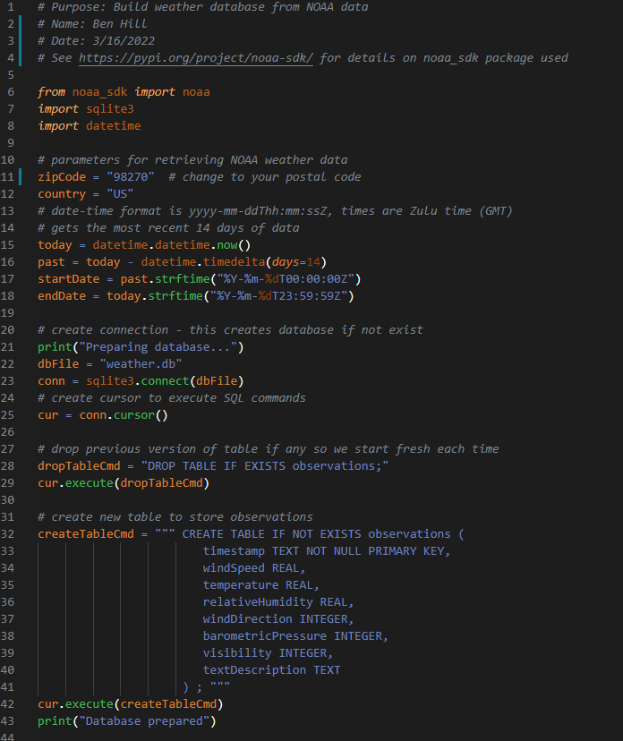
BuildWeatherDb.py Code (Screenshot)
Screenshot of code in Visual Studio Code
Must have your name and date in comments
Must have your zip code

Slide 4
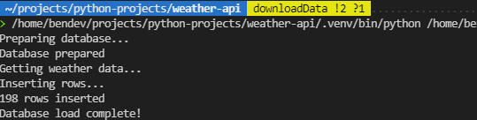
Python Console (Screenshot)
Screenshot of program output in Python console showing program executed successfully

Slide 5
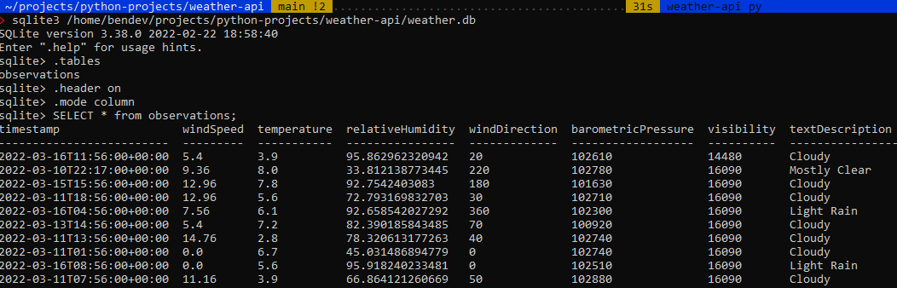
Weather.db File (Screenshot)
Screenshot of Windows Explorer showing database file Weather.db was created

