Slide 1


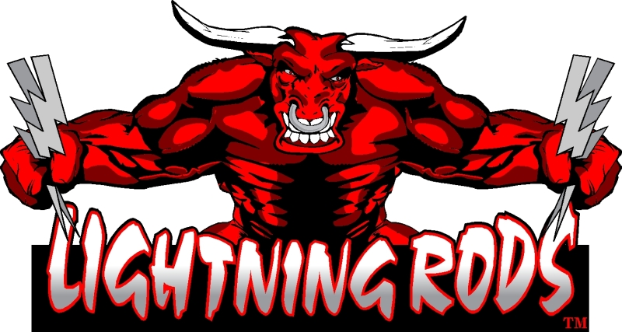
Marketeers of !nnovative Foods
Introducing The World’s First Energy Beef Stick!

Slide 2
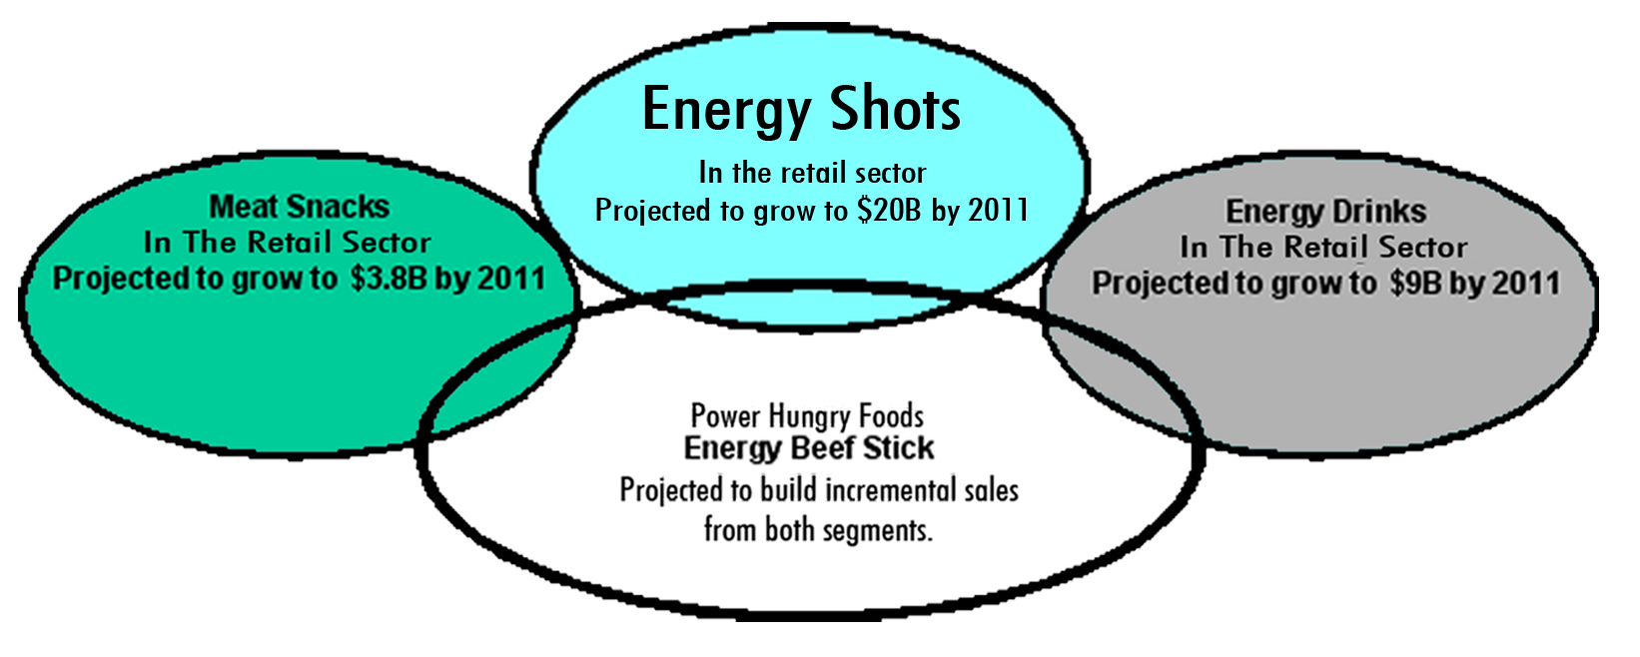
Bridging 3 Great and Growing categories together; Energy Drinks, Energy Shots, and Meat Sticks !
FROM ALL SEGMENTS!
A Recipe For Great Margins And Profits !

Slide 3
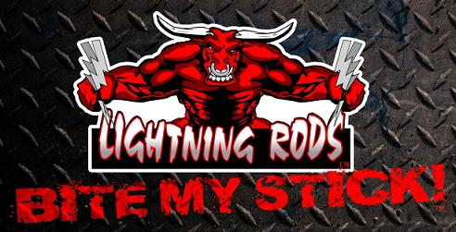
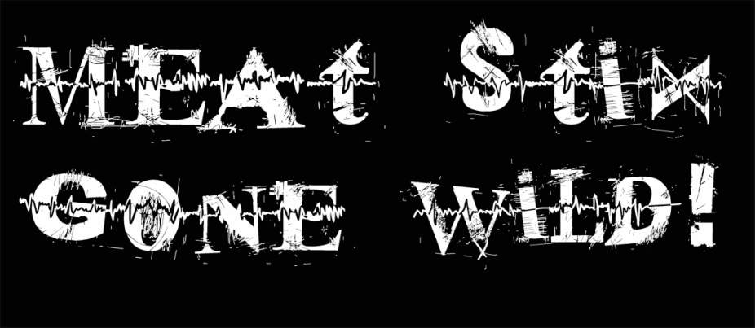
Our Synergy™ beef sticks which combine Protein, Guarana, and Ginseng is the most natural and effective way for the body to gain Energy and Mental clarity for a sustained 5 + Hours !
Superb trademarks and branding.
Great tasting product that is a great snack to satisfy hunger.
The best packaging in the industry with 3 versatile caddie display options.
Lightning Rods™ deliver on the promise of sustained energy for sports performance with no crash.
Customized marketing promotions.
Ultimate portability – shelf stable - and doesn’t take up much space in your pocket or backpack – 1 year shelf life.
Contains 100% USDA Beef, zero (0) trans fat, no fillers or MSG, and is low in carbs and sugar.
Educational and fun interactive website; www.NRGSTIX.com
Lightning Rods ™ were developed by Power Hungry Foods, LLC with the help of Dr. Rody Hawkins / RDI Foods; the inventor of Lunchables™ and the extensive redefining of the original Slim Jim™.
Growing list of Supportive Endorsees , Sponsored Athletes and Artists!

Slide 4
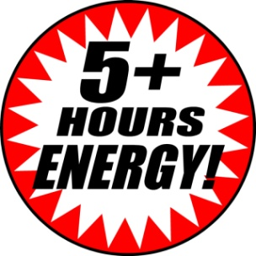
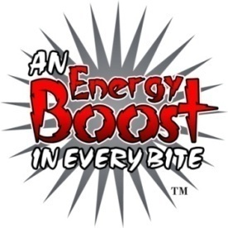
Lightning Rods Synergy ™
• are a great source of Natural Protein ‐ 6 grams per stick.
• contains the Guarana Fruit ‐ a natural caffeine source that is delivered through the
beef into the body for the benefit of long lasting energy.
• contain 90 mg of Natural Ginseng ‐ widely accepted as great for assisting the body in
restoring itself to health and for its valuable beneficial effects on sports performance.
• Synergy™ Beef Sticks which combine: Protein/Guarana/Ginseng is the most natural
and effective way for the body to gain Energy and Mental Clarity for a Sustained 5+
Hours!
• contains 100% USDA Beef, zero (0) trans fat and is low in carbs and sugar.
• have a balanced and complete source of Complex B – Vitamins including B ‐ 12 ‐ ‐ ‐
naturally. Other energy products boast about B – Vitamins ‐ ‐ But, they are (1) lab created
compounds that are very complicated, lack stability within the body, and are usually
unreliable for energy (energy shots) because of the poor absorption rate by the human
body.
• contain All of the Amino Acids (20) and the (10) essential amino acids in ideal amounts
for energy production in the body. While other energy products boast about containing
certain amino acids, (2) studies show no benefit to the body of consuming just a few amino
acids.
1 RDI Foods, Verified
2 RDI Foods, Researched

Slide 5

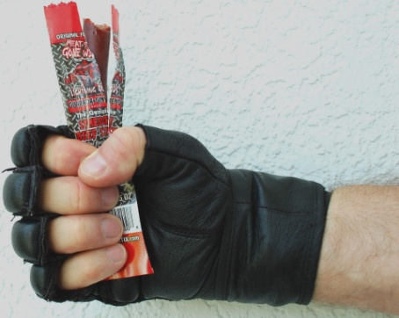
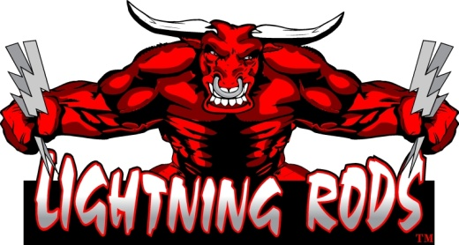
THE ENERGY EVOLUTION!
…Or should we say, “SYNERGY Revolution!”
Trends change, and improve. Active people, athletes, and anyone wanting a charge of energy in their day, gravitated toward the drink section. This poses confusion to the body. Energy enhancements work quite well, but are known to cause dehydration. The juice or water should be the supplement to an enjoyable energy boost snack, not the source. Drinks provide the rehydration, post energy boost! Core foods, such as meats and proteins supply natural energy and enhancing those type items provides a wholesome and healthy approach to boost your energy levels forming a SYNERGY for today’s high voltage lifestyles!
This is why our LIGHTNING RODS TM are the perfect blend of energy enhancement in a delicious beef snack stick. In your pocket, sports bag or maybe knapsack, it is a readily handy boost! They are “Meat Stix Gone Wild” TM and you’ll love the taste while enjoying the results! There is “An Energy Boost in Every Bite!”TM. Grab some LIGHTNING RODS TM and join the revolution! A SYNERGY in ENERGY ENHANCERS.

Slide 6
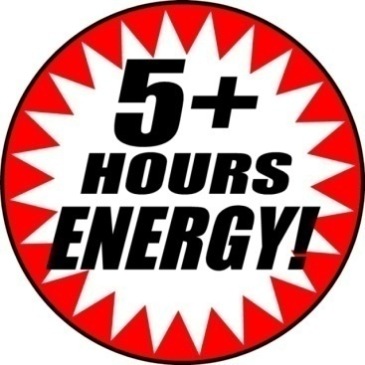
Join the Evolution Revolution!
Our proprietary blend of ingredients delivers an amazing 60 mg of caffeine per stick and at about 1oz - it represents 3/4th of what it takes the full consumption of an 8oz can of the leading energy drink to provide!
In addition, the delivery via a delicious and nutritious beef stick naturally containing protein/amino acids/B
vitamins will reduce the spike and subsequent drop off of our caffeine promise, thus enhancing the
experience in a more sustained effect.
The inclusion of Ginseng at 90mg exceeds most energy drink claims. At these specific levels, Lightning Rods provide a true Synergy of Energy Enhancers!

Slide 7
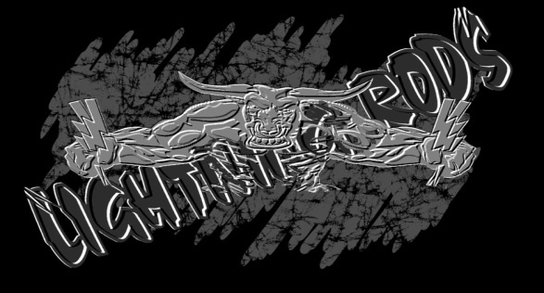
Events ‘n Media
-2009 Event Schedule-
NAGA World Cup- 1/24-25/09 Boca Raton, Fl.
Arnold Fitness Expo- 3/06-8/09 Greater Columbus Convention Center, OH.
Gladiator Elite MMA Tourney- 3/28/09 Warsaw, IN
Cocoa Beach/ Ron Jon 45th Surf Contest- 4/11-12/2009
NPC Lehigh Valley Body Building and Figure Championships- 5/16/09 Allentown, PA.
2009 NPC PA State Body Building and Figure Championships- 6/20/09 Allentown, PA.
Naga US Open/Disney- 7/4-5/09 Orlando, Fl.
UFC Fan EXPO 7/10-11 Las Vegas NV

Slide 8





Events ‘n Media
PHF: “Bite My Stick”: Scheduled plans on G4 8/2-29/09 One month intro cycle, nationwide –30 spots
Print Ads for our Key Demographics to be placed the 2nd and 3rd quarters of 2009

Slide 9


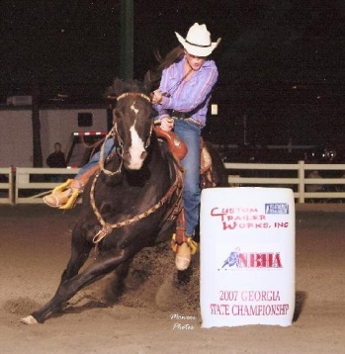

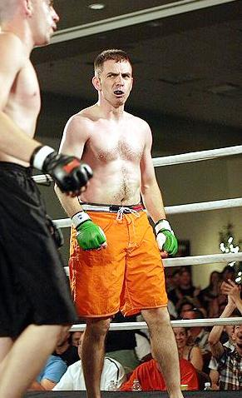


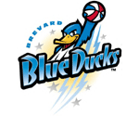

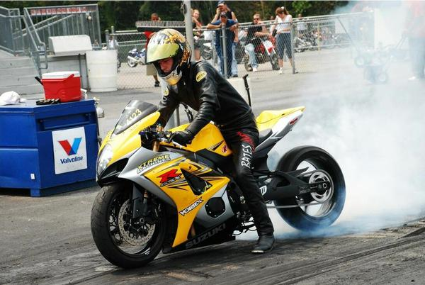








Events ‘n Media
Endorsees – Sponsors and Sponsorships

Slide 10

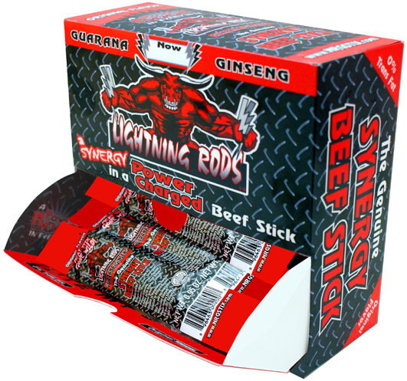
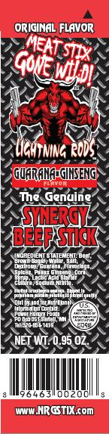
Pack And Pricing
Pack: One case has two display caddies. Each caddie has 42 individually wrapped sticks / 84 sticks per case. Each stick is .95 oz
Case Cost: $79.80
Stick Cost: 95 cents each, first receiver
Suggested Retail: $1.99

Slide 11
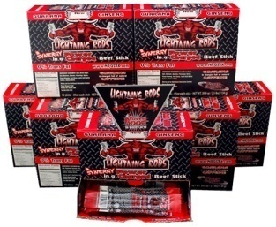

Energizing Facts!
Energy Shots, Energy Drinks and Energy Bars talk about their ability to provide energy for an extended period of time. How do they provide energy? What is the source? Energy comes from the breakdown of carbohydrates, proteins and fats. If these are not provided, you will not have energy. Some energy drinks provide simple carbohydrates (sugars) that are easily broken down into energy. This quick source of energy will provide a boost to your day, followed by a crash. The key is not to provide a spike of energy, but a long steady supply of energy. Some shots taunt this long duration of energy, but provide no source of energy. The Synergy Stick provides energy from carbohydrates, proteins and fats! Why the three sources? Because this is the way the body provides energy for the long haul. As mentioned, carbohydrates are used first as they provide a spike of energy from the start. This energy source requires the least amount of enzymes and goes quickly to the glycolysis pathway to provide energy. High sugar drinks deliver all this energy in a short amount of time, thus leading to the crash. The Synergy Stick has lower level of carbohydrates than the high sugar energy drinks. Proteins take more time to process but provide the same amount of energy as carbohydrates. The amine group on the protein and their varied structure requires more a complex preparation process to create the calories. This time thus delays the availability of calories from protein to later in the energy release process. Finally, fat is broken down by the process of beta-oxidation and their energy is released later in the day. Natural caffeine in Guarana helps promote this process. The energy release from the Synergy Stick is 15% from carbohydrates, 30% from protein, and 55% from fats, instead of all its energy from carbohydrates or none at all. This synergy of energy release will provide the energy you need for the long duration without a spike or a crash; energy lasting typically well over 5 hours!
Energy Shot in particular promote Vitamins and Amino Acids as their energy source. Because of the complexity of Vitamin B-12, it is not very stable outside of its protein structure found in animal products. Therefore, the formation of a stable, non-animal supplement is very complicated and usually unreliable. B-Vitamins found in the Synergy Stick are natural and in the right proportion to provide you with energy and nutrition that will satisfy for a long time. . B-Vitamins are not energy; they release energy from carbohydrates, proteins and fats. Because of the immense importance of B-Vitamins to the well-being of humans, they are chemically added to bread, cereal, prepared meals, energy shots and energy drinks. Meat contains all the amino acids and the 10 essential amino acids in sufficient amounts for energy production. These amino acids are the building blocks for sarcoplasmic proteins, myofibular proteins, and connective tissue proteins. In fact, all these proteins are present in meat and they work with the amino acids to release the energy, Thus The SyngeryTM Beef Stick surpassed all in effectiveness.

