Slide 1

TDWG 2026 · OSLO · WORKSHOP WKS10
Building a Repeatable AI Pipeline
Hands-on AI data processing for geological collections
Geological Collections with Darwin Core: Compound Specimen Model and Mineralogy Extension, Accelerated with AI. Four real collection datasets, one repository, and an AI assistant that works directly on your files.
Ben Norton (Yale University) | September 2026
Notes:
Welcome. This is a hands-on workshop: about 25 minutes of presentation, then you will process four real collection datasets with Claude Code. The goal is not to show you what AI can do. It is to teach you techniques you can repeat on your own data next week.

Slide 2




Today’s 90 minutes
A short presentation, then four datasets processed hands-on with the same method.
Presentation
Setup
Part A
Part B
Part C
Part D
Review
25 min
5 min
15 min
12 min
13 min
10 min
10 min
PART A
PART B
PART C
PART D
German mineral names
French mineral names
German localities
Mineral samples
Translate and validate against the mineral authority
Translate, validate, and check Strunz numbers
Split, rank and translate place hierarchies
Convert to the compound specimen model
WKS10 · Building a Repeatable AI Pipeline
2
Notes:
The agenda. The presentation sets up the method; the four parts apply it. Every part uses the same Standard Process, so by Part D you will be moving quickly. If you fall behind, skip to Part D, the shortest. Everything stays in the repository for you to finish later.

Slide 3



INTRODUCTION
Six months of building with AI
Multiple ETL pipelines across separate projects, with Claude involved at every step.
Repeatable and transparent
WHAT THAT HAS INCLUDED
Anyone can re-run the process and get the same result.
Data transforms and ETL pipelines (Python, SQL)
Testing and validation
Front-end user interfaces and back ends
Custom database abstraction layers
Documentation (Python, JS) and DevOps (Rust, PHP)
Reusable
Scripts and plans carry over to the next dataset.
Provenance
Every step leaves a file and a report behind.
The question behind all of it: how do we use Claude Code effectively in a collections data workflow?
“AI is an entry-level programmer. I can’t hire one, so nothing is being lost.”
WKS10 · Building a Repeatable AI Pipeline
3
Notes:
For about six months I have been building ETL pipelines for several separate projects using Claude every step of the way: data transforms, testing, front-end UI, even custom database abstraction layers. The question I kept coming back to is how to use it effectively in a collections workflow, so the result is repeatable, reusable, and has provenance. AI is an entry-level programmer. I can’t hire one, so nothing is being lost.

Slide 4



BEFORE WE START
We’re usually shown what AI can do.
Let’s flip that.
Most AI talks follow the same format: “look at this cool stuff.” I could do that too. But for six months I have worked almost exclusively on how to use AI, across many types of project, many programming languages and many contexts. I would rather use that to answer your questions.
What areas are you interested in?
What should be explored further?
What isn’t getting enough time or focus?
Which parts of your collections work would you most like to see AI applied to?
Where have you seen promise, but not enough real testing or evidence?
Which questions keep being skipped in AI talks: accuracy, cost, provenance, skills, trust?
WKS10 · Building a Repeatable AI Pipeline
4
Notes:
We are often told about AI: told it can do cool things, shown a demo. I want to flip that. I have spent roughly six months working almost exclusively on how to use AI, in many types of projects, many languages and many contexts. I can show some cool stuff, but that is what these sessions always are. So instead: what areas are you interested in? What do you think should be explored further? What do you feel is not given enough time or focus?
Facilitation: take 3–4 minutes. Capture answers on a flip chart or shared doc. Keep them visible and come back to them in the wrap-up. Where an answer connects to one of the four datasets, say so, and point to it during the hands-on part.

Slide 5



THE PROBLEM
The role of AI in museums
Every TDWG conference I have attended makes the same point.
Not enough time
Not enough money
Not enough people
That is unlikely to change. AI addresses the problem if it is used efficiently and strategically.
What problem does it solve?
What role does it play?
How accurate is it?
Backlogs of transcription, cleaning, translation and mapping work that no one has time for.
An assistant that plans, writes and runs code, supervised by the people who know the data.
Accurate enough only when it is verified. We come back to this at the end.
WKS10 · Building a Repeatable AI Pipeline
5
Notes:
A common theme at every TDWG I have attended: not enough time, not enough money, not enough people. It is highly unlikely that this will change. AI addresses the problem if it is used in an efficient and strategic manner. Three questions frame the rest of the talk: what problem does it solve, what role does it play, and how accurate is it?

Slide 6


THE MODEL LANDSCAPE
Many models, different strengths
Some models perform specific tasks far better than others.
A REAL EXAMPLE: SCREENSHOT → FIGMA MOCKUP
Match the model to the task, and be prepared to switch.
A plugin designed for exactly this task offered several models. The same task was run with each of them:
Opus
Failed completely
Large models are not always better. A fast, inexpensive model can win on a narrow task. Opus-class and Flash-class models will both have roles in biodiversity informatics.
Sonnet
Failed completely
GPT
Failed completely
Flash Lite
Failed completely
Flash
Succeeded
WKS10 · Building a Repeatable AI Pipeline
6
Notes:
Anecdote: I needed to turn a screenshot into a Figma mockup. I installed a plugin built for that task, which offered several models. I tried Opus, Sonnet, GPT, Flash and Flash Lite. All failed completely except Flash. The lesson: match the model to the task, and be ready to switch.

Slide 7
Models change quickly
Judgments about reliability go out of date: “Gemini Flash 3 is reliable; Flash 1 is not.”
Gemini Flash releases (above)
Claude releases (below)
Flash 3.5
Flash 3.6
Flash 2.0
Flash 3.7
Flash 2.5
Flash 3.8
2023
2024
2025
2026
Claude 1
Claude 3
Opus 4.5
Opus 5
Sonnet 4.5
Sonnet 5
Claude 4
Six Gemini Flash releases and five Claude releases in under two years. Test again before you decide a model “can’t do it.”
WKS10 · Building a Repeatable AI Pipeline
7
Notes:
Release dates as recorded in the workshop notes: Claude 1 Mar 2023, Claude 3 family Mar 2024, Claude 4 family May 2025, Sonnet 4.5 Sep 2025, Opus 4.5 Nov 2025, Sonnet 5 Jun 2026, Opus 5 Jul 2026. Gemini Flash 2.0 Feb 2025, 2.5 Jun 2025, 3.5 May 2026, 3.6 Jul 2026, 3.7 Aug 2026, 3.8 Sep 2026. Verify these dates before presenting. The point is the pace: a judgment about what a model can do has a short shelf life.

Slide 8



Broader implications
No longer bound to general-purpose software
Building software keeps getting easier
Demand for custom solutions keeps rising
Excel and similar tools stop being the ceiling for what a small collections team can build.
Scripts, small apps and pipelines that once needed a developer are now within reach.
Every collection has its own quirks. Custom tools fit them better than generic ones.
The skill that matters is describing what you want precisely, then checking what you get.
WKS10 · Building a Repeatable AI Pipeline
8
Notes:
Organizations are no longer bound to general-purpose software such as Excel. Building software keeps getting easier, and demand for custom solutions keeps rising. For collections people, the valuable skill is being able to describe exactly what you want and then check the result.

Slide 9





AI AND PEOPLE
The hardest part of any project is people
AI changes how much work a task takes. It does not change how people work.
AI reduces labour
The same work takes less time and costs less.
Getting people to change how they work every day is the most difficult task in any software project.
Time saved is reinvested
Learn new skills and take on work that was out of reach.
It takes communication skills and a real investment of time. AI cannot do it.
People move to higher-level work
Demand for software is higher than ever. Design, decisions and review stay with people.
WKS10 · Building a Repeatable AI Pipeline
9
Notes:
The most difficult task in any software development project is not technical. It is convincing people to change the way they do things every day. That requires a specific set of communication skills and a real time investment, and AI cannot do it for us. What AI does do is reduce labour requirements, both financial and temporal. The time saved can be reallocated: people can build new skills and accomplish more. Demand for software and other technical assets is higher than ever, so AI gives people the chance to focus on higher-level tasks.

Slide 10



AI AND PEOPLE
What stays human
AI is not free of costs, and it is not a replacement for people.
Entry-level roles are at risk
We are social creatures
AI is pattern matching
The routine tasks that AI now absorbs are the tasks people have traditionally learned on. We need new ways to train people and bring them into the field.
People will always seek contact with other people. For now, some tasks must be done by humans, above all communication between people.
Pattern matching is at the heart of many AI models. That is why they excel at repetitive, well-defined work, and why their results must be checked.
AI takes on the repetitive work. People stay responsible for change, communication and judgement.
WKS10 · Building a Repeatable AI Pipeline
10
Notes:
There are problems. The biggest is for entry-level workers: the routine work AI takes over is the work people used to learn on, so we need to think about how new staff build experience. Bear in mind that we are social creatures and will always seek interpersonal interaction. At least for now, there will always be tasks that must be performed by humans, especially communication between people. Finally, pattern matching is at the heart of many AI models. That explains both their strength on repetitive transformations and why we validate everything they produce, which is the technique you will use in the exercise.

Slide 11
USING AI EFFECTIVELY
Most data is AI-ready with the right prompt
Success depends on three factors.
1
2
3
The prompt
The context
The model
Every task, note and guideline, stated explicitly. The wording itself matters.
Documentation, authorities, definitions, examples: everything a new colleague would need.
Chosen for the task, and retested as models change.
WKS10 · Building a Repeatable AI Pipeline
11
Notes:
Core premise: most data is AI-ready with the right prompt. Success depends on three factors: the prompt, the amount of context, and the model. In the exercise you will control all three: the prompts are written for you, the repository provides the context, and you can switch models.

Slide 12
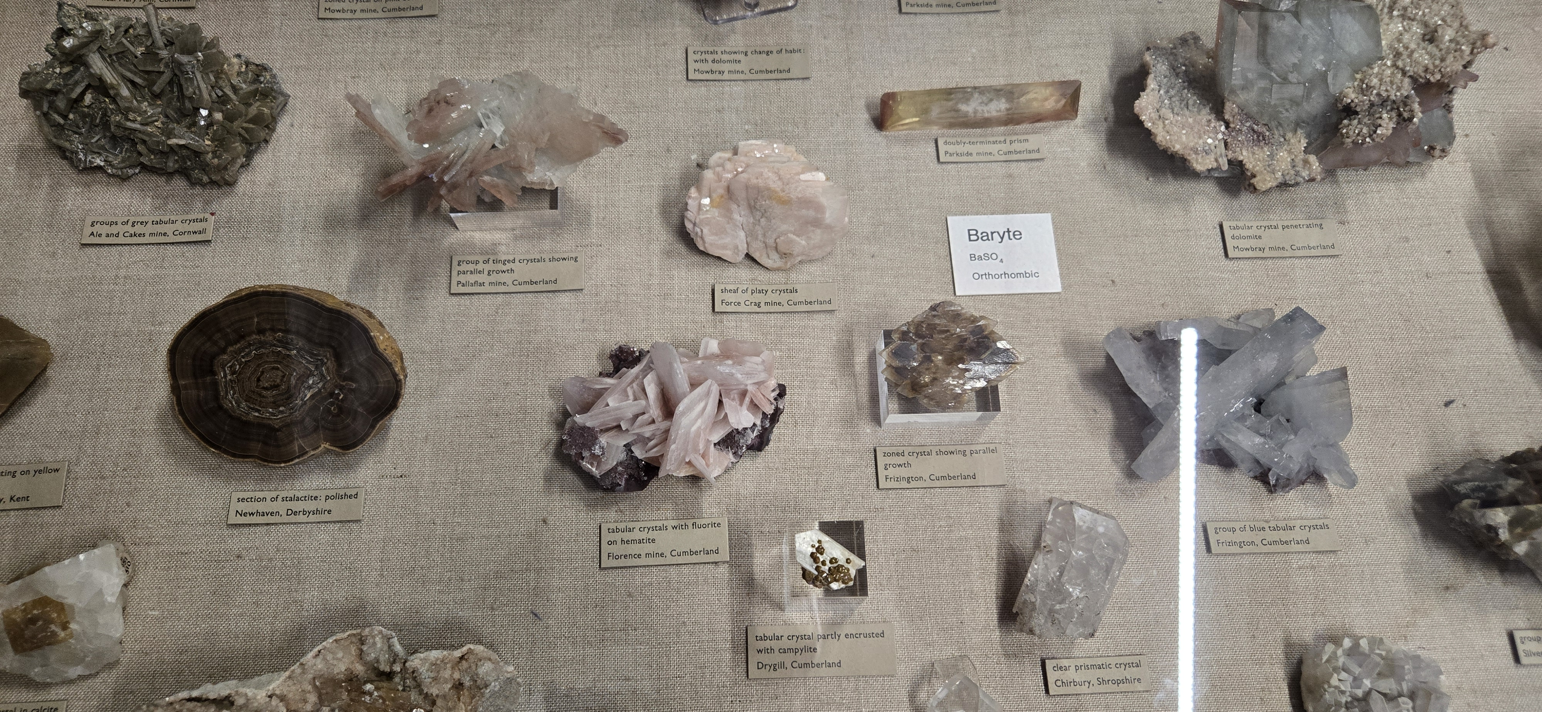
USE CASE · MODEL SELECTION
Cataloguing a mineral case from one photograph
Thirteen photographs of NHM UK display cases, 4000 × 1848 px, some holding more than twenty specimens and their cards.
THE GOAL
1
Find every specimen
A separate outline and crop for each rock.
2
Find every label
Specimen cards, strips and group cards.
3
Transcribe each label
Verbatim text, parsed into fields.
4
Link label to specimen
Which card describes which rock.
The baryte case: specimens on hessian, a printed card below each one, and a single species card for the whole group.
Two runs over the same photographs, with two very different kinds of model.
WKS10 · Building a Repeatable AI Pipeline
12
Notes:
A real example of choosing the model. The Natural History Museum in London displays its minerals in cases like this one: specimens laid on hessian, a small printed card under each, and one card naming the species for the whole group. I photographed thirteen of them.
The goal sounds simple. Find every specimen, find every label, read each label, and work out which label belongs to which rock. A person does this at a glance. The question was which kind of model could do it.
I tried it twice. The first run used a purpose-built vision model. The second used a general multimodal model. Same photographs, same goal.

Slide 13
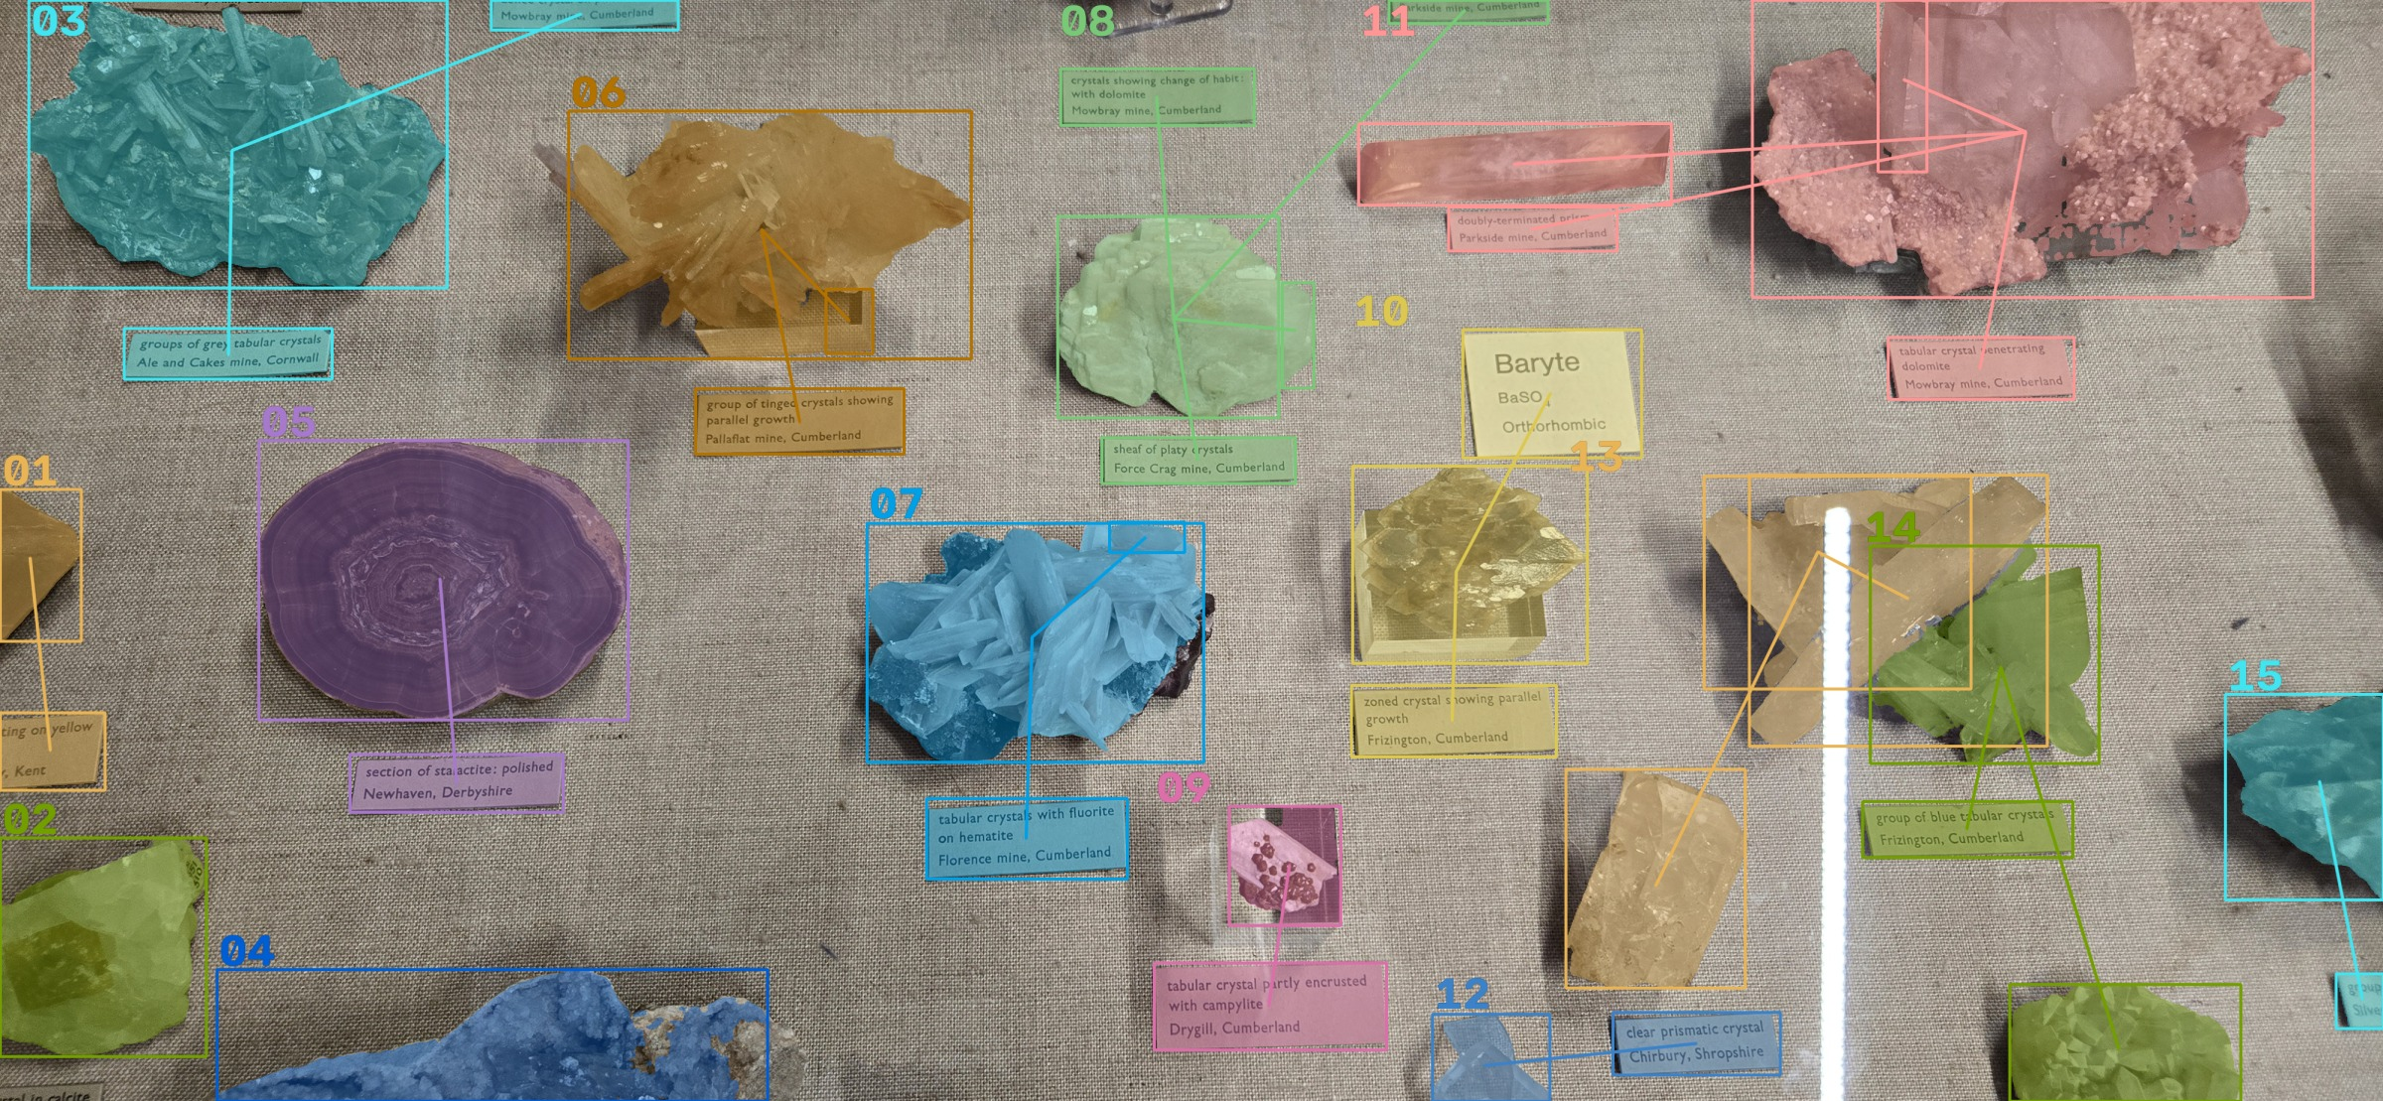
RUN 1 · SEGMENT ANYTHING (SAM 2.1)
Run 1: a purpose-built vision pipeline
SAM 2.1 finds shapes and PP-OCRv3 reads text. Everything in between is rules written by hand.
RULES WRITTEN TO MAKE IT WORK
Tile the panorama into overlapping squares
Model the cloth so it is not a “specimen”
Find cards by the texture of their print
Stitch crystal-facet masks into whole rocks
Pair each card with the rock above it
Straighten, enlarge and read each card three ways
Ten stages, zero-shot, free and CPU-only: 18–172 seconds per photograph.
SAM output on the baryte case: 15 segments, 13 with a transcription, 103 seconds on CPU.
WKS10 · Building a Repeatable AI Pipeline
13
Notes:
The first run used SAM 2.1, Meta's Segment Anything model, with PP-OCRv3 to read the cards. Nothing was trained; both models were used as they come.
The catch is that SAM only finds shapes. It has no idea what a specimen or a label is. So everything between the masks and the result had to be written as rules: tile the wide photograph into squares, model the hessian so it isn't taken for a rock, find the cards by the texture of their print, stitch the facet masks back into whole specimens, pair each card with the specimen above it, then straighten and read each card several ways and keep the best reading.
That is ten stages of hand-tuned logic. It runs free on a laptop, but every stage is a place to go wrong. On this case it looks convincing: 15 segments, 13 with text.

Slide 14
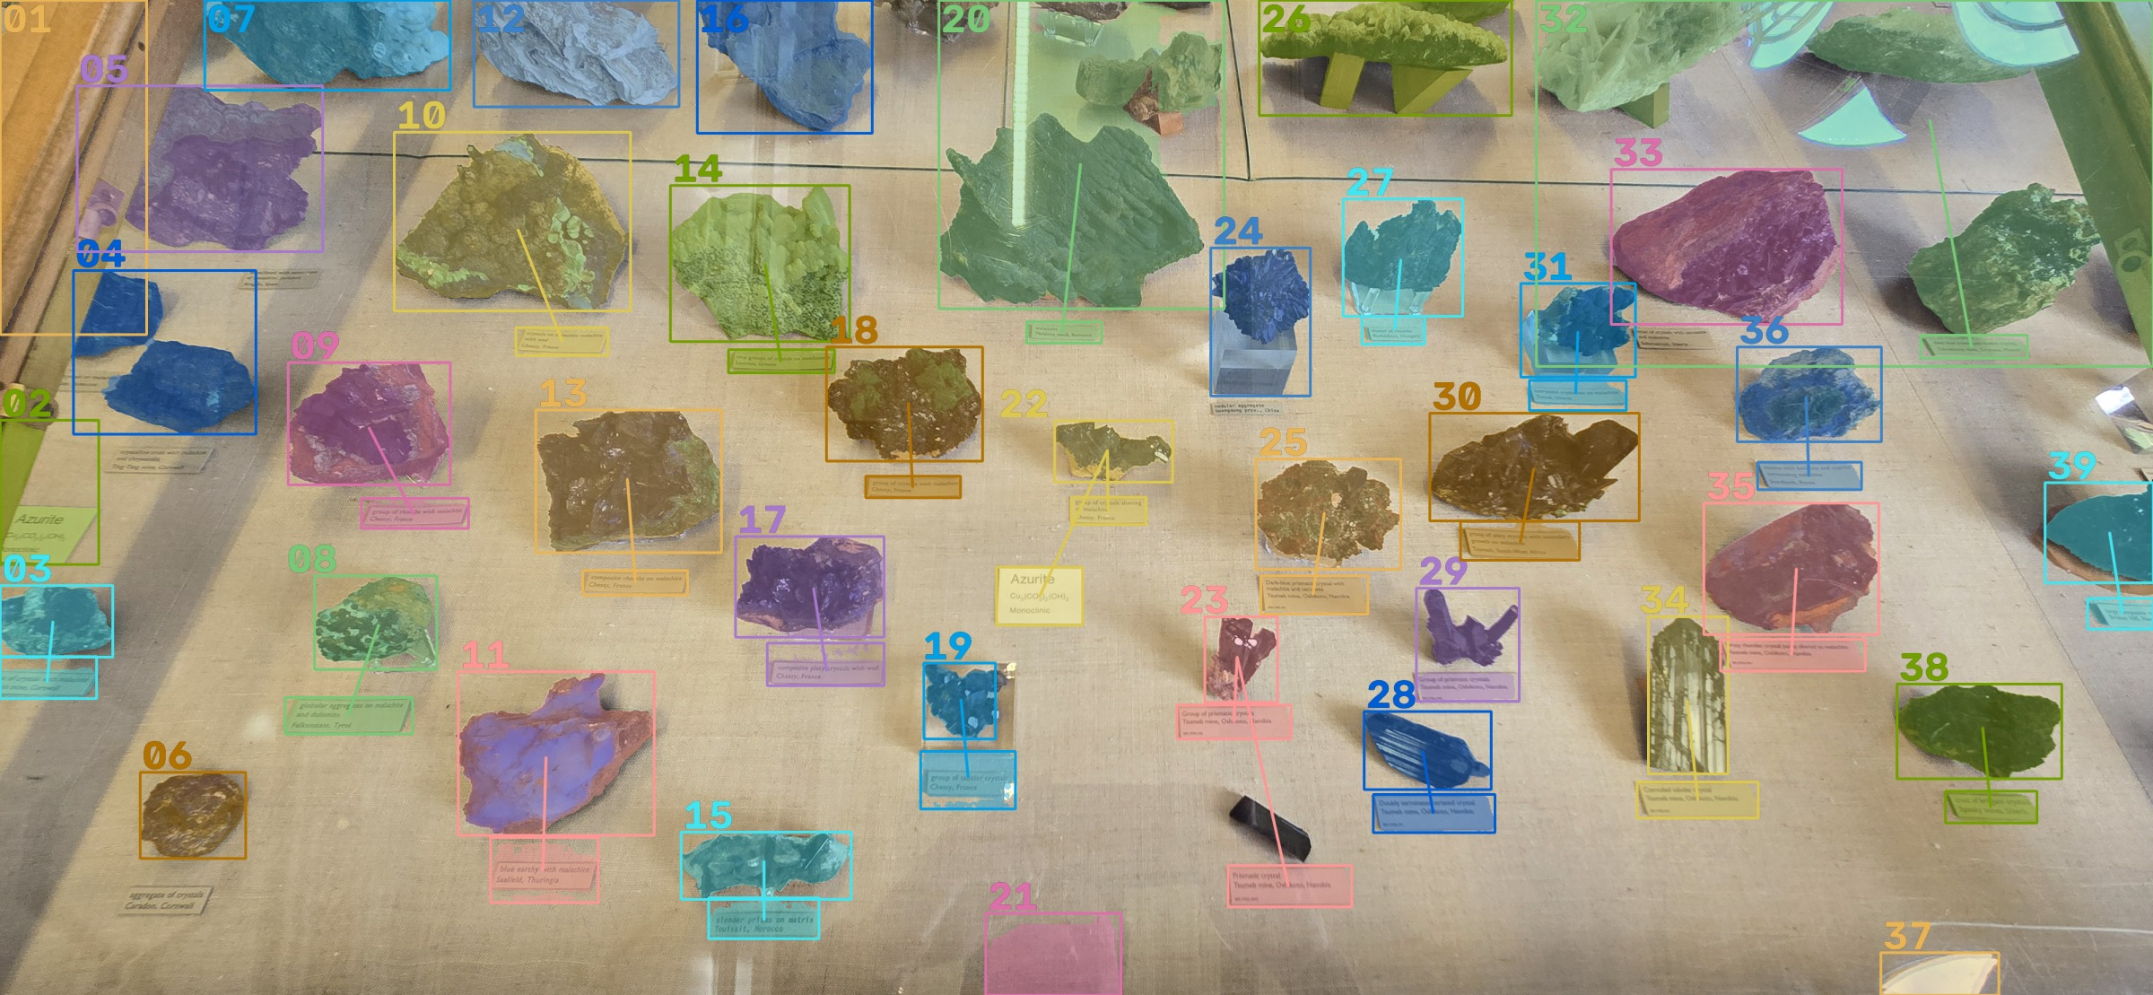
RUN 1 · RESULTS
Segmentation worked. Reading and pairing did not.
On the densest case SAM found 39 segments, but only 14 of them carry any text at all.
117
segments across all 13 photographs
59
carry a transcription: about half
77 of 114
SAM output on the azurite case: 39 segments, 14 with a transcription, 172 seconds on CPU.
verified cards paired to a specimen
WKS10 · Building a Repeatable AI Pipeline
14
Notes:
Here is the densest case, the azurite case. SAM is good at what it was built for: the outlines are clean, and it found 39 segments. But only 14 of those carry any text, and some of that text is not usable.
Across all thirteen photographs: 117 segments, 59 with a transcription, which is about half. The pipeline verified 114 cards but could pair only 77 of them with a specimen.
In other words, finding shapes was the easy part. Reading small, low-contrast italic cards, and knowing which card belongs to which rock, was not.

Slide 15
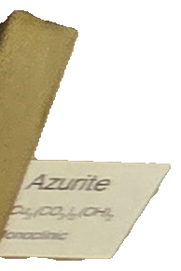
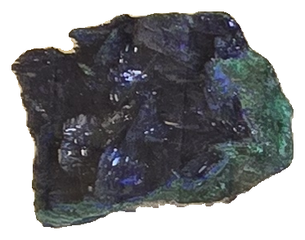
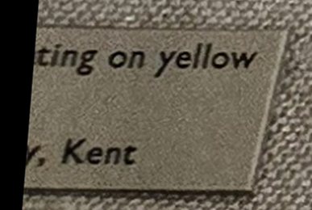
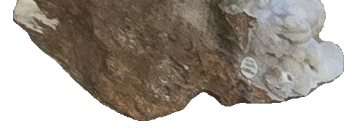
RUN 1 · FAILURE MODES
What the failures look like
Each is a judgement a person makes at a glance, and a rule someone would have to write.
One group card, one owner
Cut off by the frame
A clean mask
A clipped card
The Azurite card names every specimen in the case. Pairing by distance gave it to one.
A specimen running off the edge is segmented as if it were whole.
SAM outlines rocks well. Knowing what belongs to them is the hard part.
Read as “ting on yellow | Kent” and still paired with a specimen.
WHAT THE OCR READ ON THE AZURITE CASE
compasiterhombs onmalachite | Chessya Francn
michseite
Thunsain Okoa Ne Doudly terginu wriaedne
WKS10 · Building a Repeatable AI Pipeline
15
Notes:
Four crops from the SAM output show where it broke down.
First, the group card. One card reading Azurite, with the formula and crystal system, names every specimen in the case. The pipeline pairs cards by distance, so it gave that card to a single specimen.
Second, specimens cut off by the edge of the photograph are segmented as if they were whole. Third, to be fair, the masks themselves are often very good. Fourth, a card clipped by the frame was read as 'ting on yellow, Kent' and still attached to a specimen.
And the OCR on the small italic cards produced strings like these. Each of these problems could be patched with another rule, and each rule is another threshold to tune for the next collection. That is when I changed the model instead.

Slide 16
RUN 2 · GEMINI 3.7 FLASH
Run 2: one model call per photograph
Detection, reading and pairing share one look at the whole case, so the model sees which card sits with which rock.
SAM PIPELINE
GEMINI PIPELINE
Finds specimens
Masks, backdrop model, stitching
One prompt returns boxes
Finds labels
Print-texture detector
The same prompt
Transcribes
PP-OCRv3
Same prompt, plus a translation
Pairs card and rock
Distance × placement cost
Same prompt, with its reasoning
Names the mineral
Not attempted
Read off the label, linked to Wikidata
Fixing a mistake
Re-tune a threshold, re-run
Correct it in a review screen
Time and cost
18–172 s, CPU, free
15–65 s, under $0.05 a photo
WKS10 · Building a Repeatable AI Pipeline
16
Notes:
The second run replaced the ten stages with a single Gemini call per photograph. The prompt asks for four things at once: a box for every specimen, a box for every label, a verbatim transcription with an English translation, and which label belongs to which specimen, with a confidence and a one-line reason.
Why one prompt rather than four? Because pairing depends on seeing the whole case. A separate pairing step would be handed boxes without pixels. So detection, reading and pairing share one look.
Look at the table. Everything SAM needed a hand-written stage for, Gemini does in the same prompt, and it does things SAM never attempted: it names the mineral and links it to Wikidata. It is also faster, and it costs a few cents a photograph.
This is the model landscape slide again, in practice: the specialised model was not the right tool for this task. The general one was.

Slide 17
RUN 2 · RESULTS
The model reads. The code guarantees.
$0.047 · 65 s
22 of 23
$0.083
the densest case: 21 specimens, 21 labels, and 15 partial objects set aside
terms on one case matched in Wikidata; the miss was reported, not guessed
the whole 17-photograph Geneva collection
RULES STATED IN THE PROMPT, ENFORCED IN CODE
WHAT NEVER COMES FROM THE MODEL
Only objects wholly inside the frame are catalogued
A lone specimen owns every label in the photograph
A group card links to every specimen and lends its name
Each rule has its own test
Wikidata links: only candidates Wikidata returned
Darwin Core terms: one fixed mapping table
Record structure: every answer is normalized
Corrections: saved as new versions, never overwritten
Match the model to the task, then build the checks around it.
WKS10 · Building a Repeatable AI Pipeline
17
Notes:
The second run worked, and the numbers are small. The densest case, 21 specimens and 21 labels, took about 65 seconds and under five cents, and 15 objects cut off by the frame were set aside rather than catalogued. On one case, 22 of 23 terms matched in Wikidata; the one miss, the archaic spelling 'pyrrhotine', was reported as unmatched rather than guessed. A whole 17-photograph collection from Geneva cost eight cents.
But the reason I trust it is not the model. It is what surrounds it. The cataloguing rules are written in plain language in the prompt and then enforced in code after the model answers, each with its own test. The model never supplies a Wikidata identifier: it only chooses among candidates that Wikidata itself returned. The Darwin Core mapping is a fixed table, not a model decision. And every correction a reviewer makes is saved as a new version, so what the model said stays next to what a person decided.
It is not perfect. Handwritten notes read worse than printed cards, and the mineral name comes from the label, not the rock. That is why the review screen exists.
The lesson: match the model to the task, then build the checks around it.

Slide 18






USING AI EFFECTIVELY
Rules of thumb
What six months of daily use has taught me.
Hold their hand
Have the model review the plan
Wording matters
AI models are dumb and computers are dumb. Give the model every task, note and guideline.
Models are good at finding gaps and ambiguity in instructions before anything runs.
I have had mediocre results become good ones when someone else phrased the same instructions differently.
Process the data ahead of time
Compare levels of context
Provide examples
Profile and clean the data before asking for transformations.
Ask: “What if you didn’t provide all the context?” Then test it.
A worked example says more than a paragraph of rules.
WKS10 · Building a Repeatable AI Pipeline
18
Notes:
Hold their hand: the best results come from giving the model every task, note and guideline. Have the model review the instructions: it finds gaps and ambiguity. Wording matters: several times I have had mediocre results, and someone else phrased the same instructions differently and the task succeeded. Process the data ahead of time. Compare results using different levels of information. Provide examples.

Slide 19




FUNDAMENTALS
Pipelines and ETL
A pipeline is a sequence of small, defined steps from a source to a target.
Extract
Transform
Load
Pull data from its source (a CMS export, a CSV, a database) in its verbatim form.
Clean, split, categorize, translate, reconcile and restructure to match the target model.
Write the transformed data to the target format or system.
ORGANIZING A PIPELINE
Discrete stages
with defined inputs and outputs
Config files
instead of hard-coded logic
Small scripts
that can be re-run at any time
A report
that defines what each output contains
WKS10 · Building a Repeatable AI Pipeline
19
Notes:
ETL vocabulary: Extract pulls data from its source in its verbatim form. Transform cleans, splits, categorizes, translates, reconciles and restructures it. Load writes it to the target. Organize a pipeline as discrete stages with defined inputs and outputs, driven by config rather than hard-coded logic, with small repeatable scripts. Always generate a report that defines what the output contains.

Slide 20
FUNDAMENTALS
Anatomy of a staged pipeline
Processes change the data. Each one writes a numbered stage file, so every step can be opened, checked and re-run.
Original verbatim dataset
Make copy
Stage init
Drop empty and single-value columns
Translate
Stage 00
[code]_init
[code]_stage_00
Stage 03
Iterative single transforms
Stage 02
Transform sequence
Stage 01
Rename and drop columns
Generate column lists
[code]_stage_03
[code]_stage_02
[code]_stage_01
Sample and unique valuesets
Transform process
Extract process
Optional process
Stage file
Source, never edited
WKS10 · Building a Repeatable AI Pipeline
20
Notes:
This is what a staged pipeline looks like in practice, and it is the pattern every dataset follows today.
Start from the original, verbatim dataset. It is never edited. The first process makes a copy, which becomes the initial stage in data/input. The next process drops columns that are empty or hold a single value, and writes Stage 00. If the source is not in English, an optional translation step sits in between.
From Stage 00 we extract, rather than transform: generate the column lists, and optionally samples and unique value sets. These are what you and the model read to understand the data before planning any changes.
Then the transforms. Rename and drop columns to get Stage 01. Apply the planned sequence of transforms to get Stage 02. Then iterate on single transforms, one at a time, until Stage 03 is ready to load.
The point is that every process writes a new numbered file. Nothing is overwritten, so you can open any stage, compare it with the one before, and re-run a single step without starting again.

Slide 21
Key points for pipeline work
DO
PROVENANCE: HOW DO WE TRACK AI USE?
Avoid runaway codebases
Make it repeatable: config files and scripts
Define metrics
Provide examples for context
Make a plan, then have Claude review it
Use a stepwise architecture
Generate a report at every stage
Preserve the source in its verbatim form
Store everything in a standardized GitHub repository
Minimize reliance on AI for specific transformations: script the task so it runs without the model
Save AI decisions as mapping files that can be reviewed and re-applied
Generate reports
Computers are still dumb. Plan for that.
WKS10 · Building a Repeatable AI Pipeline
21
Notes:
Key points: avoid runaway codebases; make things repeatable with config files and scripts; define metrics; give examples; make a plan and have Claude review it; use a stepwise architecture; report at every stage; keep the source verbatim. Provenance: store the work in a standardized repository, minimize reliance on AI to perform specific transformations by scripting the task, and generate reports. In today’s exercise, model translations are saved to mapping files for exactly this reason.

Slide 22


METHOD
Human-readable transformations
Plain-language instructions an AI can follow to turn a source dataset into a target result.
THE CHALLENGE
Opens the black box
Lowers the barrier
Writing for AI is a skill of its own.
Anyone on the team can read, question and contribute to the logic.
Domain experts can take part without needing to code.
Adults read between the lines of how someone speaks. AI, like a child, takes the words as written and fills every gap with a guess.
AI-reviewed documentation
Built-in verification
IN THE SEGMENTATION USE CASE
Models flag gaps and ambiguities, so the docs come out tighter and more complete.
The instructions become the spec the script is checked against.
The cataloguing rules are written in plain English, stated in the prompt, enforced in code, and each has its own test.
WKS10 · Building a Repeatable AI Pipeline
22
Notes:
The idea is simple. Instead of writing a data transformation as code first, we write it in plain language, as numbered steps or at least a bulleted list. An AI model can read those instructions and apply them to a source dataset to produce the target result. For example, you might write out how to map a legacy collection spreadsheet to Darwin Core.
Why bother? First, transformations are usually programmatic and hard to read unless you have specific technical skills. That creates a black box: often only one or two people really understand how the data gets from A to B. That limits who can engage, and when those people move on, the knowledge goes with them. Plain-language instructions take the black box away.
Second, this lowers the bar for a task that has always been very technical. The curator who knows the data best can now read the transformation and say, "that's not right."
Third, the AI reviews the instructions as well as carrying them out, and it's very good at spotting missing steps and ambiguous wording. I think of these models as a pattern-recognition savant with the whole internet at its fingertips, but with a child's grasp of your context. It notices every gap, and it will fill any gap you leave with a guess. So the review process pushes you toward documentation that is both more concise and more complete.
Finally, the instructions double as a verification tool. Once a script exists, you can check it against the written procedure to confirm it does only what the instructions say. That's how you catch drift between what you meant and what the code actually does.
The challenge is knowing how to write for AI. Adults are good at interpreting how someone speaks: we read tone, intent and what was left unsaid. Children and AI models struggle with that. They take the words as written. Writing instructions an AI will follow correctly is a distinct skill, and it takes practice. The segmentation example you just saw is a case in point: its cataloguing rules are written in plain English, stated in the prompt, then enforced in code with one test per rule.

Slide 23


THE TOOL
What is Claude Code?
An AI assistant that works inside your project folder, not in a chat window.
A CHAT ASSISTANT
CLAUDE CODE
You paste data in, and copy answers out
Forgets the project between conversations
Describes code, but you have to run it
Results live in the chat history
Reads and writes the files in your repository
Reads project rules from CLAUDE.md in every session
Writes scripts, runs them, and reads the output
Asks before it edits files or runs commands
Results are files: stages, scripts, reports
Install
Sign in
Open the repository
Desktop app, VS Code extension or terminal
Paid Claude plan or API account
Claude reads CLAUDE.md and the docs
WKS10 · Building a Repeatable AI Pipeline
23
Notes:
Claude Code differs from a chat tool in one key way: it works on your files. It reads the documentation in the repository, writes scripts, runs them, and reads the results. A CLAUDE.md file gives it the project rules at the start of every session, which is the most efficient way to provide context. It asks permission before editing files or running commands. Setup: install, sign in, open the repository folder.

Slide 24



SOURCE AND TARGET
The workshop repository
The source is never changed. Every step writes a new numbered file and a report.
data/input/
data/output/<dataset>/
data/dist/<dataset>/
Verbatim source files
_00 → _01 → _02 → _03
plus a report for each step
Result, unresolved values,
summary report
data/authorities/
Mineral names, varieties, geopolitical divisions. Used as context or for validation
docs/
Workshop notes, dataset profiles, transformation specs and your plans
schemas/
Import template and data dictionary for the compound specimen model
src/transform/
One small script per step: <dataset>_<from>_to_<to>.py
WKS10 · Building a Repeatable AI Pipeline
24
Notes:
Repository layout. data/input holds the verbatim exports and is never edited. Each dataset has a folder in data/output starting at version 00; every step writes the next number plus a report. data/dist holds only reviewed, validated deliverables. Authorities, docs, schemas and scripts support the process. Participants: clone github.com/ben-norton/tdwg2026-wks10.

Slide 25
SOURCE AND TARGET
Four source datasets
Real exports, with the problems real exports have.
PART A
PART B
PART C
PART D
German mineral names
French mineral names
German localities
Peabody mineral samples
2,191
21,460
14,092
67
unique names; 1,748 end in -it
specimen rows; 3,663 distinct names
locality strings with 1–9 values each
specimens made of 245 mineral parts
e.g. Quarz, Schwefel, Rotgültigerz, unbestimmt
e.g. Allevardite = Rectorite, Adulaire/titanite, à identifier
e.g. zw. Paphos und Limasol, Czechoslovakia, bei, ?
e.g. Corundum var. ruby, Garnet, Mica
WKS10 · Building a Repeatable AI Pipeline
25
Notes:
Four datasets. A: 2,191 German mineral names from NM Bern; most end in -it, but some need knowledge (Quarz, Schwefel). B: 21,460 specimen rows from MHN Geneva with French names and Strunz numbers, including synonyms, uncertain identifications and notes. C: 14,092 locality strings from Basel, mixed English and German, with qualifiers and historical countries. D: 67 Yale Peabody specimens, each with 2–5 minerals, to be converted to the compound specimen model.

Slide 26
SOURCE AND TARGET
One table that points to itself
A compound specimen and each of its parts are all dwc:Material records. A part names its parent in isPartOfMaterialEntityID.
1
The compound specimen
dwc:Material
The physical object you catalogue: an almandine schist. It has no parent.
materialEntityID
Its parts
2
materialEntityType
Each identifiable mineral or rock becomes its own record: the garnet and the schist.
verbatimIdentification
is part of
geoName
3
The link
isPartOfMaterialEntityID
A part’s isPartOfMaterialEntityID holds the parent’s materialEntityID.
materialEntityID | materialEntityType | verbatimIdentification | geoName | isPartOfMaterialEntityID
1 | Compound Specimen | Almandine Schist
2 | Mineral | Garnet | Almandine | 1
3 | Rock | Schist | Garnet-mica Schist | 1
WKS10 · Building a Repeatable AI Pipeline
26
Notes:
Before the Part D procedure, here is the target in its simplest form.
In Darwin Core, a compound specimen and each of its parts are all the same kind of record: dwc:Material. There is no separate table for parts. Instead the table points to itself. Every record has a materialEntityID, and a part carries its parent's ID in isPartOfMaterialEntityID.
Read the example. Record 1 is the compound specimen, an almandine schist: the physical object in the drawer. It has no parent. Record 2 is the garnet, a mineral, identified as almandine. Record 3 is the schist itself, a rock, identified as a garnet-mica schist. Both parts point back to record 1.
That one self-reference is all the structure the compound specimen model needs. On the next slide you will see the steps to get there from a source row that lists several minerals in one field.

Slide 27
SOURCE AND TARGET
Target: the compound specimen model
One physical specimen, several identifiable parts, each linked to its parent.
SOURCE (ONE ROW)
MIN.058343: Beryl, Tourmaline, Muscovite, Quartz
USA. Connecticut. Middlesex County.
PROCEDURE
Find the fields holding part names
Define material category criteria
List the changes to transpose repeating columns
Create the join: is_part_of
Stack the dataset
MIN.058343
parent · cataloged_name: Beryl
Beryl
is_part_of: MIN.058343
Tourmaline
is_part_of: MIN.058343
Muscovite
is_part_of: MIN.058343
Quartz
is_part_of: MIN.058343
WKS10 · Building a Repeatable AI Pipeline
27
Notes:
The target data model for Part D is the compound specimen model, aligned with the Mineralogy Extension. A physical specimen is a material entity that can contain component parts. Each part becomes its own record, linked to the parent by is_part_of. Procedure: find the fields that hold part names, define the criteria for material categories, list the changes needed to transpose the repeating columns, create the join ID, and stack the dataset.

Slide 28
METHOD
The Standard Process
The core ETL procedure used for every dataset today. Each step becomes one prompt.
1
2
3
4
Profile
Define the target
List the changes
Provide resources
Columns, languages, delimiters, unique values, qualifiers, vocabularies
What should the end result look like?
Every transformation from source to target
Documentation, authorities (GADM), definitions
5
6
7
8
Write a plan
Generate the script
Run the process
Review the results
Stages and reports. Then have Claude review it
One small script per stage
Numbered outputs, never overwritten
Always generate a report
WKS10 · Building a Repeatable AI Pipeline
28
Notes:
The Standard Process: 1. analyze (profile) the dataset; 2. define the target; 3. list the changes; 4. provide helpful resources such as normative documentation, external authorities (GADM) and definitions; 5. write a stepwise plan including stages and reports, and have Claude review it; 6. generate the script; 7. run the process; 8. review the results, which must be described by a report. Step 5 is highlighted because it is where most problems are caught.

Slide 29
THE KEY TECHNIQUE
AI translates. Authorities validate.
Every name the model produces is checked against a trusted list before it is accepted.
Found → dictionary in data/dist
Rule
Model
Authority check
Hämatit → Hematite
Quarz → Quartz
mineral_names_en.tsv, varieties_en.csv
Not found → unresolved, for review
~2/3
12 → 1,756
16 of 367
of the German list validates with a simple -it → -ite rule. The model is only needed for the rest.
French names whose Strunz number agrees with the authority, before and after removing one leading zero.
Austrian locality terms match the geopolitical authority exactly. So there it is used as context, not as a pass/fail check.
WKS10 · Building a Repeatable AI Pipeline
29
Notes:
The central technique for Parts A and B: rules first, the model for what the rules cannot handle, and then a deterministic authority check on every result, whatever produced it. Matches go to the dictionary; everything else goes to an unresolved file for a person. Figures from profiling the workshop data: a suffix rule alone validates roughly two thirds of the German names. For the French data, only 12 name/Strunz pairs agree as written, but 1,756 agree once the leading zero is removed. That is “process the data ahead of time”. For localities, the authority names are English/ASCII, so it serves as context.

Slide 30
EXERCISE
Hands-on: your turn
Open the Exercise Guide. Every prompt is written out for you to copy.
Setup
5 min
Clone the repository, open it in Claude Code, run Prompt 0 to create CLAUDE.md
Part A
15 min
German mineral names, together: profile, plan, review, build, validate, review unresolved
Part B
12 min
French mineral names: distinct values, synonyms, Strunz check
Part C
13 min
German localities: split, rank, translate (model pass on Austria)
Part D
10 min
Peabody samples: spec → script → compound specimen model
github.com/ben-norton/tdwg2026-wks10
WKS10 · Building a Repeatable AI Pipeline
30
Notes:
Switch to the Exercise Guide. Run Part A together on screen: participants type the same prompts at the same time. Then let pairs work through B, C and D. Walk the room. If people fall behind, send them to Part D, then use the reference outputs for the rest.

Slide 31


REVIEW
How do we know it’s accurate?
Compare with human error
Use the latest models
Manual digitization is not error-free either. What error rate would you accept from a new colleague?
Reliability improves quickly from one generation to the next.
Build in verification
Compare runs
Authority checks, row counts in every report, and a reviewed unresolved list.
Run the same task with different levels of context and instruction, and compare.
WKS10 · Building a Repeatable AI Pipeline
31
Notes:
How do we know it is accurate? Compare AI errors with human error; manual digitization is not error-free. Use the latest models. Build in verification: reports, metrics, and a review of unresolved values. Compare runs made with different levels of context. Ask tables to share their unresolved counts from Parts A and B.

Slide 32
WRAP-UP
Back to your questions
WHAT YOU TAKE HOME
YOUR QUESTIONS FROM THE START
A repeatable pipeline, not a one-off result
The Standard Process, as eight prompts you can reuse
Mapping files and reports that record every AI decision
Unresolved lists that show where people are still needed
Which did today’s exercise answer?
Which need a different kind of test?
Which should the community explore together?
The Mineralogy Extension is heading for ratification: your feedback on the compound specimen model is welcome.
WKS10 · Building a Repeatable AI Pipeline
32
Notes:
Return to the questions captured at the start. Which did the exercise answer, which need a different test, which should the community explore together? Take-home: a repeatable pipeline, the Standard Process as reusable prompts, mapping files and reports that record AI decisions, and unresolved lists that show where people are still needed. Invite feedback on the compound specimen model and the Mineralogy Extension.

Slide 33



Thank you
Workshop repository
github.com/ben-norton/tdwg2026-wks10
Exercise Guide
docs/WKS10_Exercise_Guide.docx
Contact
ben.norton@yale.edu
Ben Norton (Yale University) | TDWG 2026, Oslo | September 2026
Notes:
Thank participants. Point to the repository and the guide, and invite follow-up by email.

Slide 34




CREDITS
Thanks to Yale Peabody Museum, Naturhistorisches Museum Bern, Naturhistorisches Museum Basel, Muséum d'histoire naturelle de Genève, and Natural History Museum UK for providing source data for this presentation.
Attributions
Graphical assets, typefaces and tools used in this presentation.
TDWG 2026 Oslo logo
Icons: Lucide
Conference logo of TDWG 2026 (Biodiversity Information Standards), used on the title and closing slides.
Lucide icon set, lucide.dev. ISC License, © Lucide Contributors. Portions derived from Feather (MIT License, © Cole Bemis). Rendered through the react-icons package (v5.6.0, MIT License) and recoloured for this deck.
Icons used: arrow-down, arrow-right, arrow-up-right, book-open, boxes, check, clock, code, coins, compass, download, eye, file-check, filter, folder-input, folder-open, gem, git-branch, graduation-cap, hand, handshake, image, key-round, languages, layers, list-checks, mail, map-pin, message-circle-question, messages-square, palette, package-check, pencil, puzzle, recycle, repeat, scale, search, search-check, shield-check, shuffle, sparkles, sprout, table, timer, type, trending-up, upload, user-check, users, wrench, x.
Typefaces
Raleway (Google Fonts, SIL Open Font License) and Calibri (Microsoft). Courier New for file paths.
Design and diagrams
Colour palette and layout adapted from the SYM06 “Rocks, Minerals, and Metadata” deck. Diagrams and timelines are original to this presentation.
Tools
Icon and code licences permit reuse with attribution. Please keep this slide in any shared copy of the deck.
Built with PptxGenJS (MIT License). Figures come from profiling the tdwg2026-wks10 datasets.
WKS10 · Building a Repeatable AI Pipeline
34
Notes:
Attribution slide. Lucide icons are ISC-licensed (portions from Feather, MIT); rendered via react-icons (MIT). The TDWG 2026 logo belongs to the conference. Leave this slide at the end of any shared copy of the deck.

