Slide 1
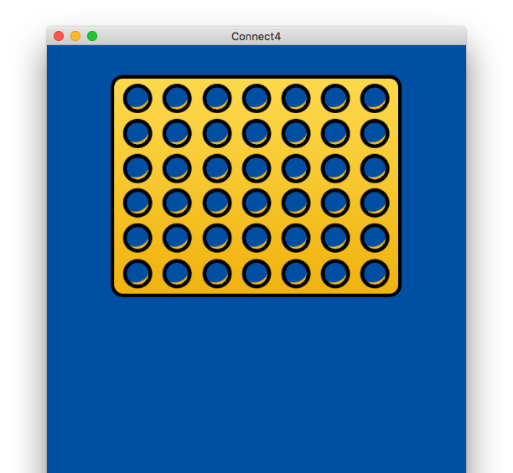
Connect4
Project by Ben Pearce

Slide 2
What is my project?
My project (“Connect4”) is a desktop app built with modern web technologies, which allows 1 or more users to play the connection game, Connect Four.
Connect4 will give the user an option to play against a computer AI.

Slide 3
Minimax Algorithm
The AI part of my project utilizes an algorithm known as “Minimax”.
Pseudocode (Wikipedia)
TypeScript (Connect4)
function minimax(node, depth, maximizingPlayer)
if depth = 0 or node is a terminal node
return the heuristic value of node
if maximizingPlayer
bestValue := −∞
for each child of node
v := minimax(child, depth − 1, FALSE)
bestValue := max(bestValue, v)
return bestValue
else
bestValue := +∞
for each child of node
v := minimax(child, depth − 1, TRUE)
bestValue := min(bestValue, v)
return bestValue

Slide 4







Technologies

Slide 5
Any questions?

