Slide 1
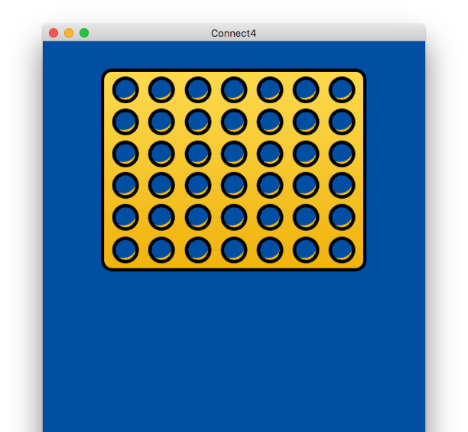
Connect4
Project by Ben Pearce

Slide 2
What is my project?
My project (“Connect4”) is a desktop app built with modern web technologies, which allows 1 or more users to play the connection game, Connect Four.
Connect4 will give the user an option to play against a human opponent or a computer AI.
Aims
Use web technologies to create a Connect Four game with a complex GUI, high quality 2D graphics and animation.
Create basic AI which the user will be able to choose to play against, and be able to adjust the difficulty of.
Game will also have a two player mode and options to adjust the size of the board.
Objectives
Develop a front-end for my application using modern web technologies, using Electron.
Style user interface with CSS3
Animate and create game front-end with Pixi.js
Create Connect Four game logic in JavaScript and a Minimax style algorithm to simulate the computer opponent.
Create intuitive menus & options for user to adjust settings and modes.

Slide 3
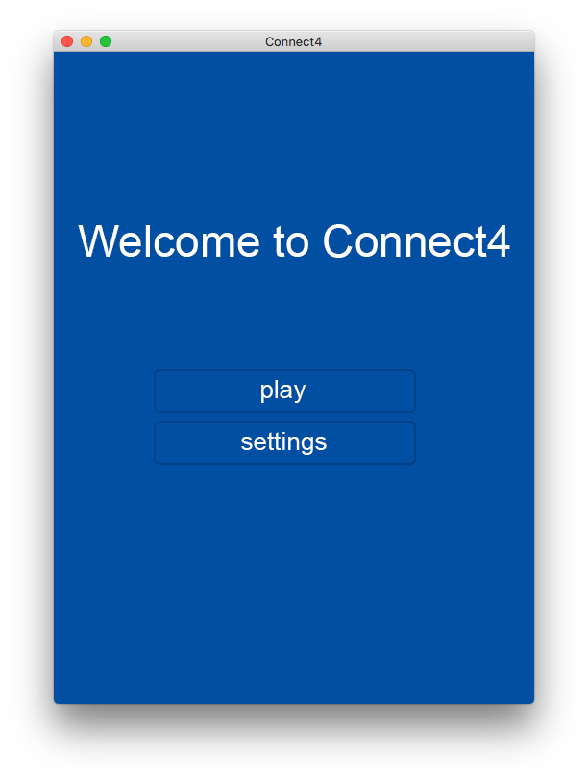
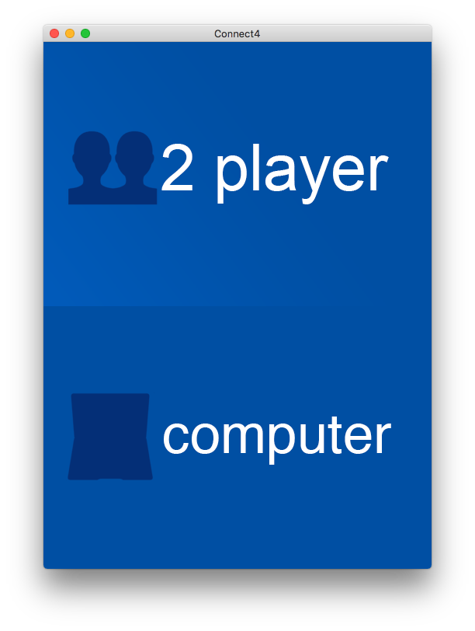
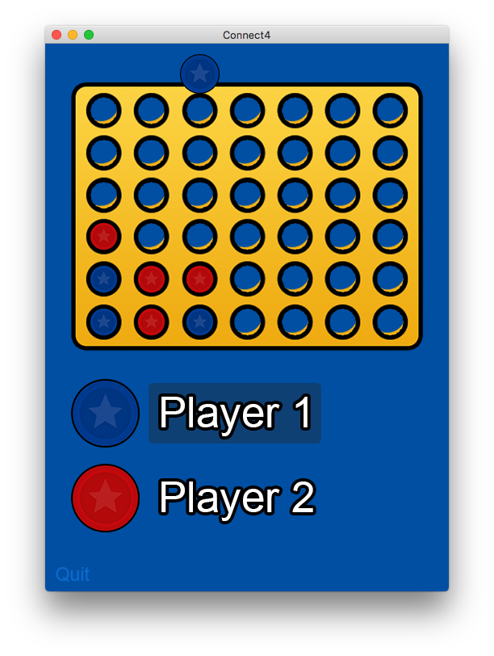
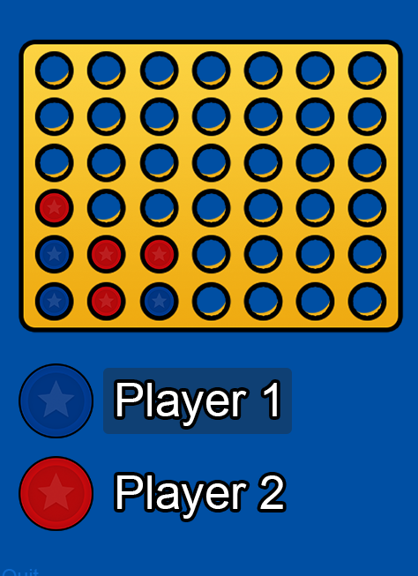

Screen designs

Slide 4







Technologies

Slide 5





Electron allows you to build cross platform desktop applications with modern web technologies (HTML5, JavaScript & CSS).
The flexibility and standardized use of web technology makes creating graphical desktop applications with Electron a walk in the park!
The use of Electron is growing rapidly.
Apps built on Electron:

Slide 6
Technologies

Slide 7
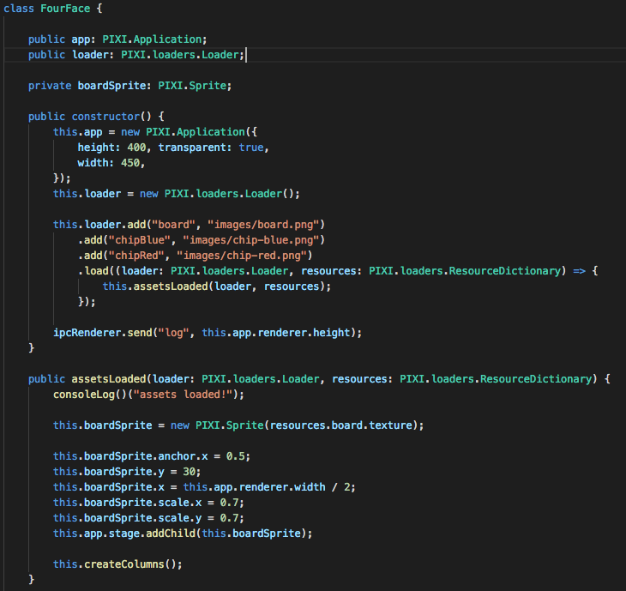
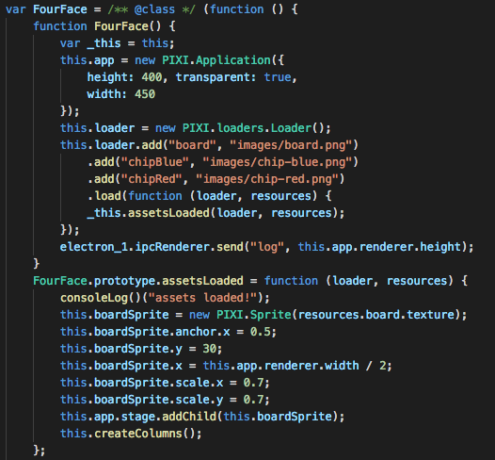
TypeScript is a strict syntactical superset of JavaScript.
TypeScript “transpiles” to plain JavaScript, and its compiler can compile to many different ECMAScript standards.
Transpiler

Slide 8
Minimax Algorithm
The AI part of my project utilizes an algorithm known as “Minimax”.
Pseudocode (Wikipedia)
TypeScript (Connect4)
function minimax(node, depth, maximizingPlayer)
if depth = 0 or node is a terminal node
return the heuristic value of node
if maximizingPlayer
bestValue := −∞
for each child of node
v := minimax(child, depth − 1, FALSE)
bestValue := max(bestValue, v)
return bestValue
else
bestValue := +∞
for each child of node
v := minimax(child, depth − 1, TRUE)
bestValue := min(bestValue, v)
return bestValue

Slide 9
Minimax Algorithm
O |  | X
X
X | O | O
Win! +10
O |  | X
X | X
X | O | O
O | X | X
X
X | O | O
O |  | X
X |  | X
X | O | O

Slide 10
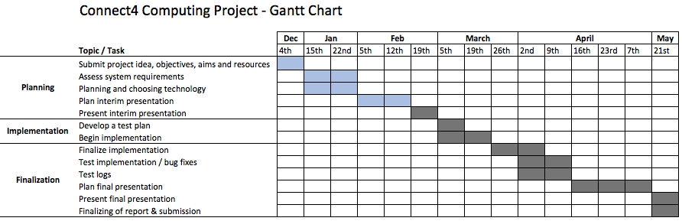
Gantt chart

Slide 11
Prototype demo

Slide 12
Any questions?

