Slide 1
Hack AI '23
Ben & Joel

Slide 2
Data Understanding – Airlines and country (Ben)
Airlines and Country datasets are basically lookup tables that should be used to map codes in the other dataset to understandable info
Some airline codes in the airlines dataset have multiple airline types
should make an embedding that encapsulates this with a vector representation
Notes:
Before doing anything to the data, we set out to understand the datasets and their corresponding features. Starting with the Airlines and Country dataset, we found that these are essentially just lookup tables that can be used to merge the datasets together. Upon investigating the airline dataset, we found that some airlines have multiple airline types. This makes any mappings made between the datasets non-unique. To fix this, we need to produce an embedding that factors in multiple airline types into the data. This makes each airline instance unique in the dataset. We can achieve this by creating an embedding that encapsulates the airline type within a vector representation. Joel will go over this later.

Slide 3

Data Understanding – COVID, gdp & Seats (Ben)
Represent COVID dataset with stringency index$∈[0, 100]$
9 response indicators, one of which being travel bans
GDP dataset has a varying sampling frequency
Could interpolate info using pd.interpolate(polynomial)
Need to standardize measure
Seats dataset
The dataset that links them all together
Operating_airline IATA – merge airline_type
Departure_country_iata – use with country dataset then merge stringency index
Large STD. in the Total_seats feature ~${10}^{6}$
Notes:
Moving onto the COVID, GDP, and seats datasets, we found that all of the COVID related data could be encoded by the stringency index. The stringency index ranges from 0 to 100 and is based upon 9 response indicators, one of which being travel bans. The GDP dataset consists of data with varying sampling frequency and a non-standardized GDP measure. As such, the data needs to be standardized to work over the same period as well as being interpolated such that the sampling frequency is the same as that of the other features used to train the models. The seats dataset is the primary dataset that links the other datasets together.
The operating_airline IATA code can be used with the airline dataset to get the airline_type for the flights. The departure_country_iata can be used with the country dataset to get the iso code, and then used with the COVID dataset (and GDP if we use the GDP data). The arrival_country_iata can be used with the country dataset to get the iso code, and then used with the COVID dataset. seats_year and seats_month used to identify when the flight was.

Slide 4
Data Understanding – LF & Validation (Ben)
Load factor dataset contains our target feature
There are random periods with 0s → `cargo’
Validation dataset
Requires all features to be interpolated/merged over the time-frame and 𝐿 months before the time frame
The preceding 𝐿 months of data is used to predict timestep 𝑡+1
The features must be sorted temporally and by organization
Notes:
The load factor dataset contains our target feature. We noticed that there are random periods with 0 load factors. When checking this against the airline type dataset, we find that the 0s correspond to airlines that have cargo airline types. Therefore, these 0s are correct load factor values. Finally, the validation dataset is what we use to validate our model and optimize it to minimize the generalization loss. This dataset requires all of the features to be interpolated or merged over the time-frame and L months before the time frame. The preceding L months of data is used to predict timestep t+1. i.e. to predict load factor at timestep 𝑡+1, we need the data for each timestep over the range 𝑡−𝐿:𝑡. The features must also be sorted temporally and by organization.

Slide 5
Data preprocessing (JoeL)
Ensured consistency between datasets
Column names
Datetime format
Sampling Frequency
Made sure all the data was monthly
Notes:
We began our preprocessing stage by ensuring consistency between the data sets we had chosen from the data understanding phase, namely we changed column names to be consistent and made sure the date time format was the same across all data sets.
After that we ensured the sampling frequency was monthly. Annual and quarterly data points were far out numbered by the number of monthly data points so we felt we could afford to drop them.

Slide 6
Data preprocessing (Joel)
Some of the datasets we had chosen had NaNs that needed to be dealt with. We investigated a range of methods of dealing with these:
Fill with 0
Fill with Mean value + a small amount of noise (1std dev)
Linear interpolation
Train models to fill missing data points
Stationarity
Tested using QQ plots to see if our data was stationary
Merging columns in seats dataset
Notes:
Then we began looking at ways to deal with Nans in our datasets. We investigated a range of different methods of dealing with these; filling the missing data points with 0, filling the missing data points with the mean + a small amount of noise, linear interpolation or even training a new model to predict the missing data points. We opted to fill with the mean value and a small amount of noise. This is because some of the data points required extrapolation as well as the fact we deemed interpolation to be too time consuming because we weren’t aware of the pandas interpolate method.
In hindsight it may have been better using a mix of interpolation for central data points and mean + noise for the points on the edge of the datasets.
We were also going to remove zeroes in the load factor data but after our data understanding phase we realised these were essential for cargo flights.
We also tested for stationarity in the data set and found via QQ plots that our data wasn’t stationary (we got a non-linear plot).
Stationarity is essential because many of the assumptions models (such as arima) are built upon are only true if the data is stationary. For example Law of large numbers, central limit theorem.
The seats data set had departure/arrival country that we had decided not to include in our model. We ignored these features and added the datapoints together to get a total number of global seats for each airline.

Slide 7


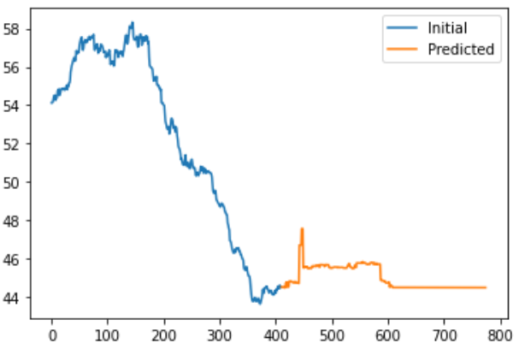
Feature Engineering (Joel)
Encoding cyclical features*
Creating feature embeddings
Handling multi-airline types
Make notes on other things we made embeddings for
Time-series prediction of stringency index for the test-set using XGBoost
* https://developer.nvidia.com/blog/three-approaches-to-encoding-time-information-as-features-for-ml-models/
Notes:
We also decided it was important to encode our months in a cyclical fashion. This ensures that models that don’t have a perception of time baked in would be able to perceive the cyclical nature of months and hopefully exaggerate seasonalities in the data. We got this idea from an nvidia blog post referenced at the bottom of the slide.
As part of data understanding we had noted that different organisations could be described by one or more “types”. These different types are essential features of the passenger load factor, for example cargo planes RARELY have any passengers. We decided to embed this feature in a binary fashion, like in the top diagram shown on this slide. An airline that could be described as low cost, regional and leisure would be encoded by 110100.
We wanted to include the stringency index but the data set did not cover the required months for the validation or test data set. To include this we created a model to predict the average global stringency index using XGBoost. This meant using the month and year data from the test data we could add a new feature using our predictive model. The bottom diagram shows our predicted global average stringency index for the year 2022 in orange, and for the previous 410 before 2022 used as training data. The model wasn’t great, and we are aware of some improvements we could’ve made, but we decided to use it anyway.
Refs:
https://developer.nvidia.com/blog/three-approaches-to-encoding-time-information-as-features-for-ml-models/

Slide 8
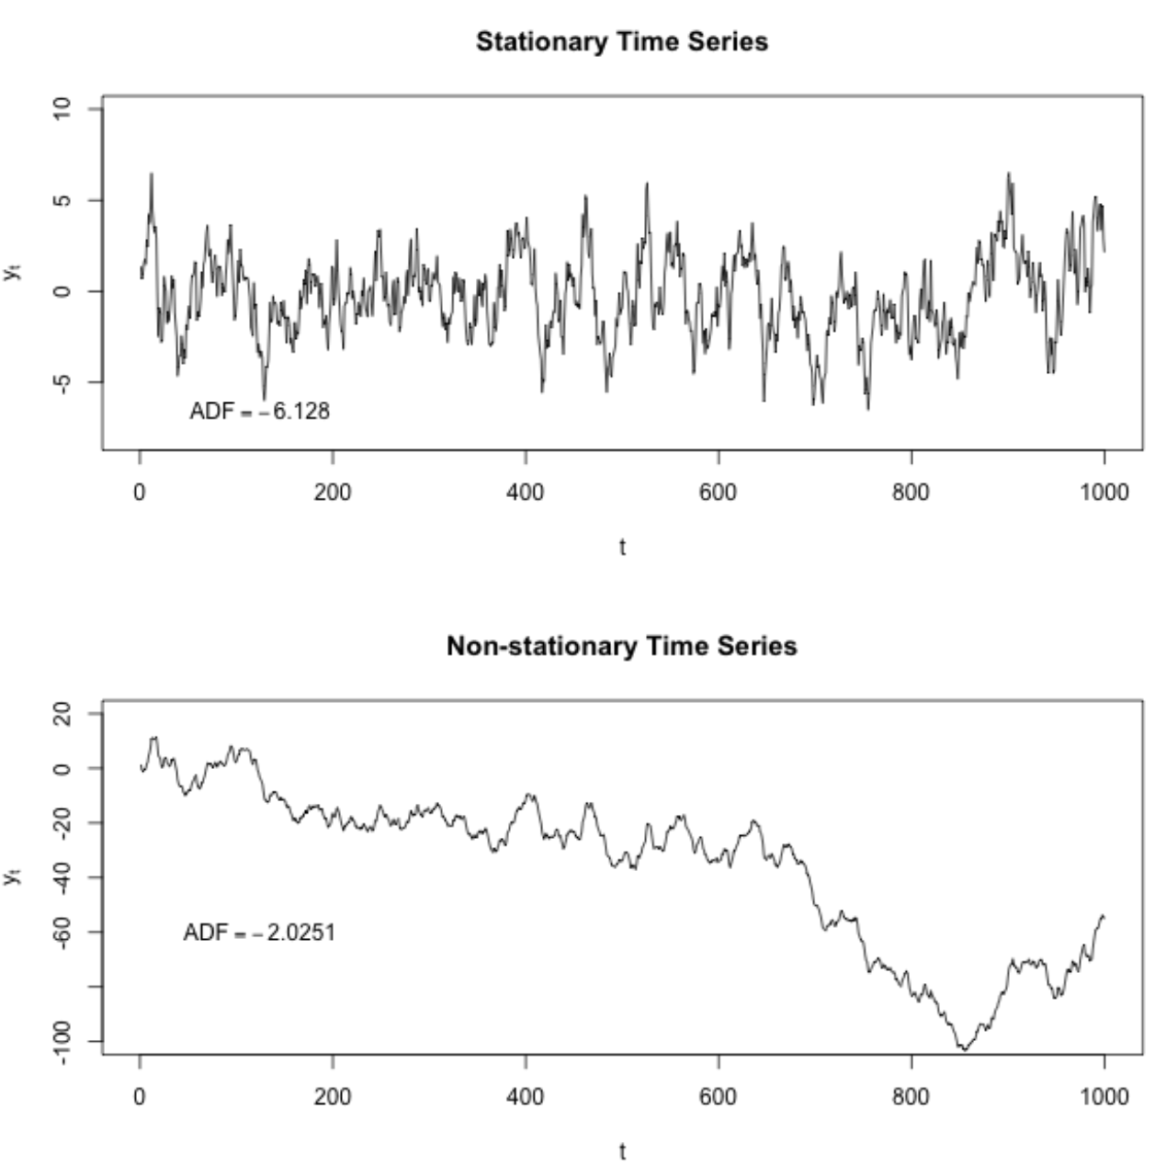
Time-Series Modelling
Thought of potentially using the following models
ARIMA
Decision trees
Prophet
Decided to use LSTMs to save time
able to learn the non-linear and non-stationary nature of a time series
reduces error in forecasting
Notes:
We thought of using the following time-series models:
-ARIMA
-Decision trees
-Prophet
Instead, because we did not have time to ensure our data is stationary, we decided to use LSTMs. LSTMs are able to learn the non-linear and non-stationary nature of a time series, thus reducing the error in forecasting.

Slide 9
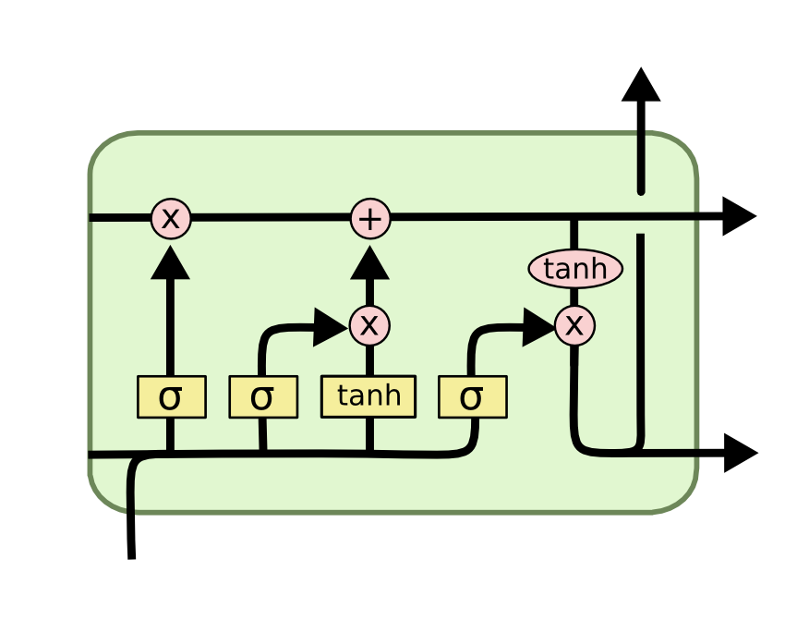
Time-Series modelling - LSTMs
RNNs are a family of ANNs for processing sequential data
Continually add state information
A major property is their distributed hidden state
If we train RNNs on data that has long temporal dependencies – gradient vanishes/explode
LSTMs solve this problem
LSTMs use gates that saturate at 0 and 1
Warning: Prone to overfitting
Notes:
Before we talk about LSTMs, we first need to talk about RNNs. RNNs are a family of NNs that are used for processing sequential data. They continually add state information due to their directed cycles in their computational graphs (they’re essentially just recursive functions). A major property of RNNs is their distributed hidden state which allows for the efficient storage of information about the past (compared to NNs). If we train RNNs on data that has long temporal dependencies, their gradient vanishes/explodes. LSTMs solve this problem. LSTMs use gates that saturate at 0 and 1, reducing the effects of vanishing gradients. A big issue of LSTMs, however, are overfitting.

Slide 10
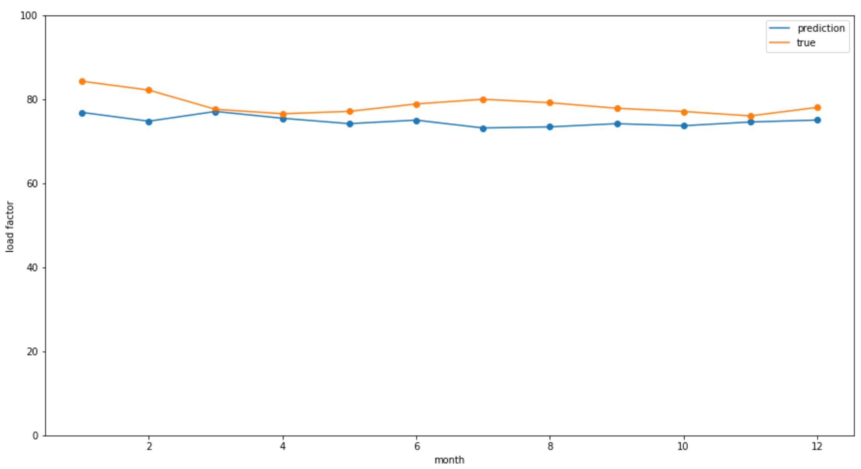
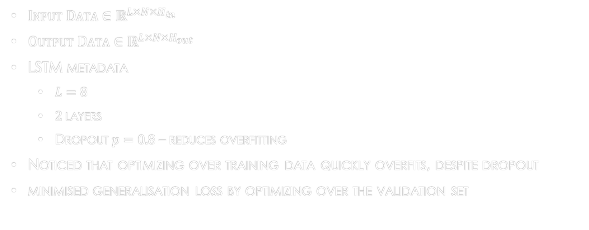
Model Training and validation
$Input Data∈ℝ^{L×N×H_{in}}$
$Output Data∈ℝ^{L×N×H_{out}}$
LSTM metadata
$L=8$
$2$layers
Dropout $p=0.8$ – reduces overfitting
Noticed that optimizing over training data quickly overfits, despite dropout
minimised generalisation loss by optimizing over the validation set
Notes:
The dimension of the input data should be (𝐿×𝑁×𝐻𝑖𝑛), with L being the sequence length, N being the batch size, and Hin being the number of input features. An LSTM operates on this input and returns data of shape (𝐿×𝑁×𝐻𝑜𝑢𝑡), with Hout being the number of output features. To train our model, we used an LSTM with 2 layers that requires a sequence length of 8 months to train. Additionally, we used a high dropout to reduce overfitting.

Slide 11
Improvements (Ben)
Include GDP data
requires interpolation and standardizing the measure
Use other time-series models and compare performance
Think generalisation performance would be better with other models
link organisation code iata to the stringency index of countries the airline operates in rather than a average global index
Improve the xgboost model used to predict the stringency index
Increase sampling frequency
Notes:
Although we believe our approach was good, if we had the time, we would have went about a few of our decisions differently. Firstly, we would have included GDP data by standardizing the GDP measure across the dataset and then interpolating data to get a monthly sampling frequency. We would have also trained the models that we previously mentioned, and compare their performance with the LSTM model. We think the generalisation performance of the other models would have outperformed that of the LSTM. We would have also taken into account the stringency index on a per nation basis instead of using an average global index. Additionally, we would have made our data stationary and tested it using the augmented dickey fuller test, improving the XGBoost model we used to predict the stringency index, as well as allowing us to effectively train other time series models. One additional thing we could have done (although its not necessarily an improvement) is researching models trained over different sampling frequencies and seeing what the effects are.

Slide 12
Conclusions (Joel)
What factors did we find that affected the load factor the most?
What are the difficulties with univariate time-series models?
Some seasonalities are more important than others
A key feature at one point in time is often a salient feature at another point in time
E.g. the stringency index is more important during COVID-19 times and its importance diminishes after mid-2021
Notes:
We think one of the most important features of our model was the binary embedding of the airline type. This has a very strong impact on the passenger load factor and we think that is one of the reasons our model performed better than other people.
We also noted that one of the difficulties with training time-series models with datasets like the ones provided is that there are often multiple overlapping seasonailties that can make it hard for a model to accurately predict the passenger load factor. For example the actual season is different for different hemispheres and as a result the passenger load factor for each country would have its own seasonality. This also applies for things such as global holidays like Christmas, or national holidays.
Another difficult problem to deal with is that key features at one point in time can become less important at other points in time. For example the stringency index is more important during covid-19, afterwhich it’s importance diminishes.

Slide 13
Thank you for listening ☺

