Slide 1
LS-DYNA features: Staged Construction *CONTROL_STAGED_CONSTRUCTION etc
This presentation is a basic introduction to Staged Construction in LS-DYNA. See also the Remarks for *CONTROL_STAGED_CONSTRUCTION in the Keyword Manual.

Slide 2
Staged construction: what is it?
Break the analysis into periods of time that can be referenced in loading definitions and rerun separately
Introduce parts sequentially during the analysis, including self-weight, e.g. new construction
Remove parts at particular times during the analysis, e.g. excavating soil, removing temporary props
With the explicit analysis method, we use time scaling to reduce timescale to the order of 10-100 seconds, i.e. there is a scaling factor between real-life time and analysis time.
With the short analysis time comes a risk of introducing unrealistic dynamic effects. These are reduced by:
Applying and removing loads gradually (ramp, not step)
Applying damping (e.g. *DAMPING_GLOBAL)

Slide 3
Staged construction analysis: why?
Set up correct initial condition for main analysis
E.g. prepare model for a seismic analysis
In-situ stresses/deformation may be dependent on construction sequence
Set up correct stresses in load-bearing versus non-loadbearing walls
Soil heave/settlement in response to excavation and new construction
Retro-fit materials should not be stressed by the weight of the structure
Analyse conditions during construction
Examine risk of failures when structure is incomplete

Slide 4
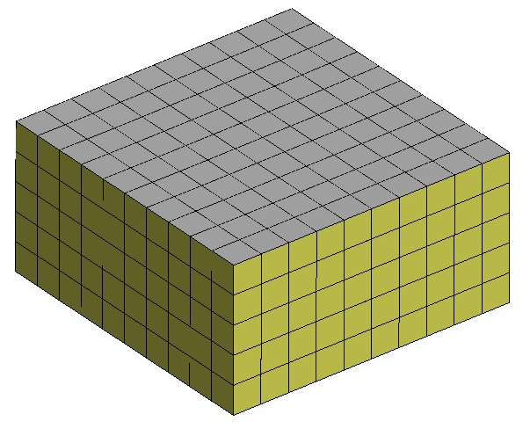

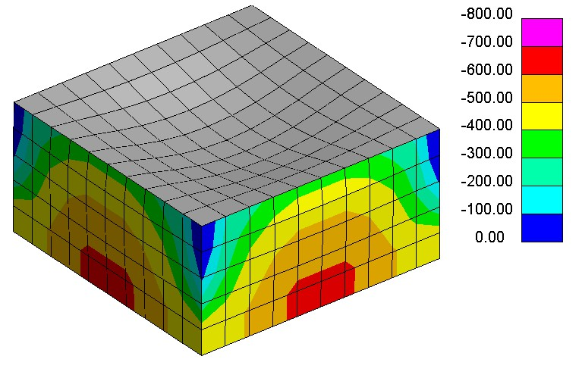
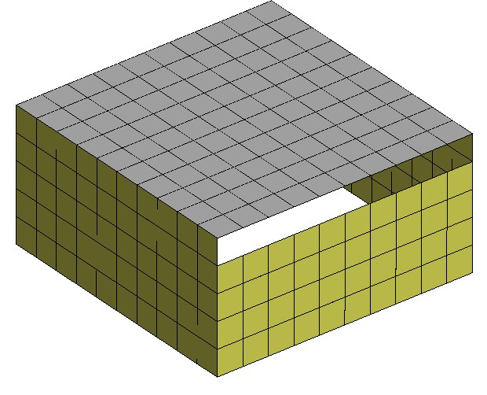
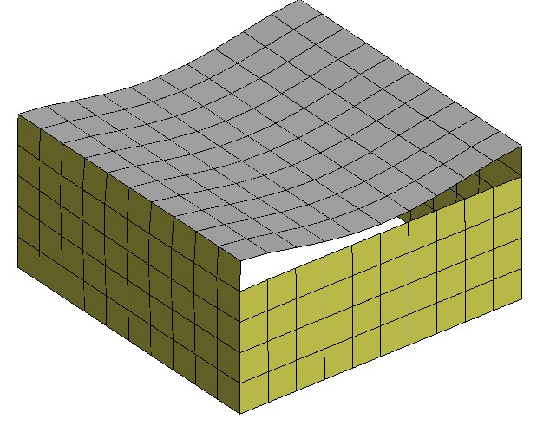
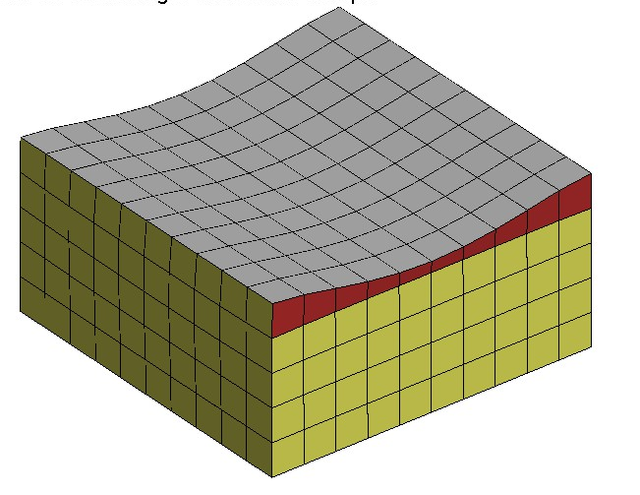
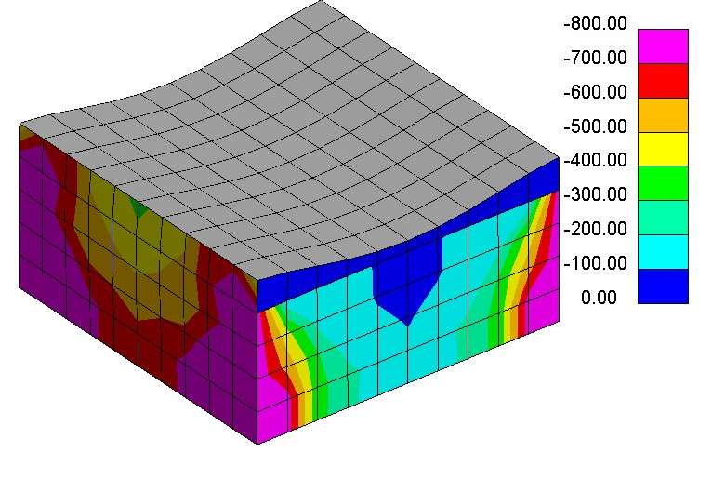
Example: non-loadbearing walls
Complete structure present at time=0
Add gravity
2-way spanning slab; all walls equally loaded
Incomplete structure present at time=0
1-way spanning slab; walls differentially loaded
Add gravity
Fill gap

Slide 5
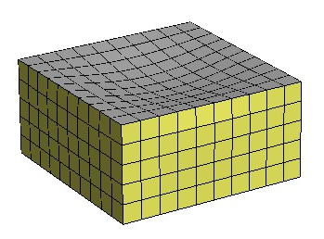
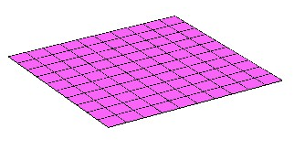
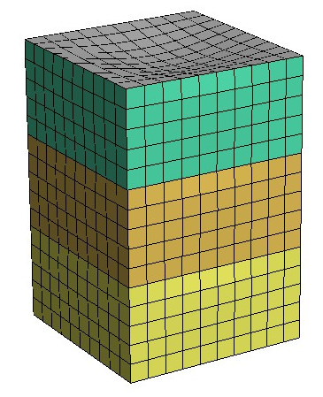
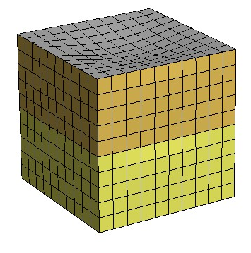
Example
Parts added sequentially
As each part is added, its self-weight is automatically ramped up from zero to its full value
Start of analysis
End of Stage 1
Gravity load
3rd storey
Time
2nd storey
Time
1st storey
End of Stage 2
End of Stage 3
STAGE 1
STAGE 2
STAGE 3
Time

Slide 6
Staged Construction Keywords
Main keywords:
*CONTROL_STAGED_CONSTRUCTION
Which stages should be run; gravity acceleration to be applied
*DEFINE_CONSTRUCTION_STAGES
Define the start and end times of each stage
*DEFINE_STAGED_CONSTRUCTION_PART (_SET)
Define the stages at which parts become active or are removed
Subsidary keywords (not usually defined in the keyword file, but LS-DYNA creates them automatically in response to the above):
*LOAD_STIFFEN_PART
*LOAD_REMOVE_PART
*LOAD_GRAVITY_PART

Slide 7

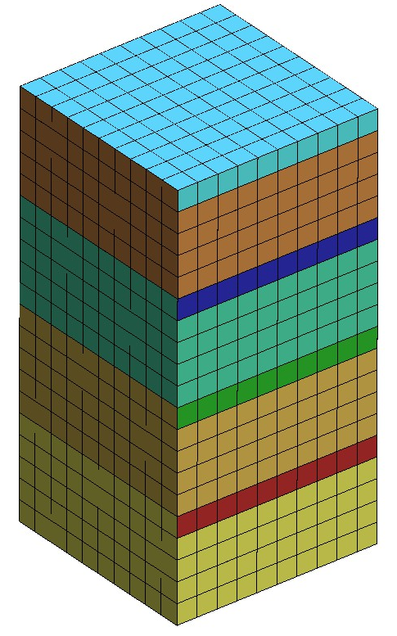
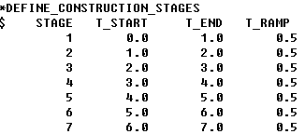
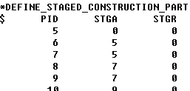
Example: keywords
Initial model contains all the elements, including parts that become active later in the analysis
Example: Part ID 6 becomes active at Stage 5, starting at analysis time 4.0, and the gravity load will be ramped up over the next 0.5 seconds.
Adding/deleting elements, and application of gravity loading, is managed automatically by LS-DYNA

Slide 8
Notes
Acceleration due to gravity is defined here. Gravity will be applied to all parts defined under *DEFINE_STAGED_CONSTRUCTION_PART. Do NOT use *LOAD_BODY in addition to staged construction.
The analysis does not have to begin at Stage 1. In this case, the analysis begins at Stage 5 so the analysis time will begin at 4.0 (not at 0.0).
The first stage MUST begin at Time = 0.
This is how to define a part that is present throughout the analysis, and receives gravity load from *CONTROL_STAGED_CONSTRUCTION.
Parts omitted from this list will be present throughout the analysis, but will not receive gravity loading from *CONTROL_STAGED_CONSTRUCTION.

Slide 9
Active, Dormant, and Removed Parts
“Active” is the normal condition for elements in an LS-DYNA analysis.
“Dormant” is a state specific to Staged Construction and occurs before the analysis reaches the stage where the part becomes active (STGA on *DEFINE_STAGED_CONSTRUCTION_PART).
The elements are present in the analysis and are processed by LS-DYNA in the normal way, but any stresses or forces generated are scaled by the factor given on *CONTROL_STAGED_CONSTRUCTION – 1.0e-6 by default.
In the d3plot file, dormant elements are flagged as “deleted” so that post-processors automatically blank them out.
When they become active, the stress and history variables are re-initialized.
Parts are removed when the analysis reaches the stage STGR on *DEFINE_STAGED_CONSTRUCTION_PART. These elements are deleted from the analysis and are no longer processed by LS-DYNA.
To reduce any dynamic response, gravity load is ramped down to zero before the elements are deleted

Slide 10
Timestep control (explicit analysis method)
Active elements have the usual influence on timestep and/or mass-scaling.
Dormant elements are treated as having their usual mass, but reduced stiffness; hence the timestep calculated for these elements is much larger than if the same elements were active.
If no elements are active (e.g. at the start of the analysis) then LS-DYNA may set a very large timestep. Avoid this possibility using LCTM on *CONTROL_TIMESTEP to define a maximum timestep size for the analysis.

Slide 11
Running or rerunning a subset of stages
At the end of each stage (as defined on *DEFINE_CONSTRUCTION_STAGES), LS-DYNA writes a file named end_stageN_dynain where N would be 001 for the end of stage 1, etc.
These dynain files contain the information needed to start a new analysis from the same state: deformed node coordinates, stress and history variables for every element, etc.
Stage 1
Stage 2
Stage 3
Analysis 1
end_stage001_dynain
end_stage002_dynain
end_stage003_dynain
Analysis 2
Instructions for preparing this keyword file are given on the next slide…
end_stage002_dynain
0.0
1.0
2.0
3.0
Time

Slide 12
Running or rerunning a subset of stages
Copy
Initial keyword file (Analysis 1):
*CONTROL_STAGED_CONSTRUCTION
0,1,3
*CONTROL_...
*DATABASE_...
*MAT_...
*SECTION_...
*PART_...
*NODE
*ELEMENT_...
*DEFINE_...
*INITIAL_...
*BOUNDARY_SPC
*LOAD_...
Keyword file for Analysis 2:
*CONTROL_STAGED_CONSTRUCTION
0,2,2
*CONTROL_...
*DATABASE_...
*MAT_...
*SECTION_...
*PART_...
*NODE
*ELEMENT_...
*DEFINE_...
*INITIAL_...
*BOUNDARY_SPC
*LOAD_...
*INCLUDE
(path)/end_stage001_dynain
(run from stage 1 to stage 3)
(run from stage 2 to stage 2)
Remove keywords that are present in the dynain file and any *INITIAL cards; add *INCLUDE reference to the dynain file
end_stage001_dynain contains:
*BOUNDARY_SPC
*NODE
*ELEMENT_...
*INITIAL_...

Slide 13
LS-DYNA features: Staged Construction *CONTROL_STAGED_CONSTRUCTION etc
This presentation is a basic introduction to Staged Construction in LS-DYNA. See also the Remarks for *CONTROL_STAGED_CONSTRUCTION in the Keyword Manual.

