Slide 1
Introduction to
Transactional Replication
SQL Saturday #58 (on a Friday)
Mystic Lake Casino
2010-10-29

Slide 2
Contact Information
E-mail: thulben@gmail.com
Blog: blog.semperoccult.us
Twitter: @thulben

Slide 3
What is replication?
SQL Books Online says:
SQL Server replication is a set of technologies for copying and distributing data and database objects from one database to another and then synchronizing between databases to maintain consistency.

Slide 4
Types of replication
Transactional
  With updating subscriber
Merge
Snapshot

Slide 5
Types of replication
(in this presentation)
Transactional
  With updating subscriber
Merge
Snapshot

Slide 6

Simplified Topology
Subscriber 1
Magic!
Magic!
Magic!
Publisher
Subscriber n

Slide 7
What really happens
Distribution Agent
Subscriber 1
Distributor
Log Reader
Publisher
Distribution Agent
Subscriber n

Slide 8
Requirements
Each table defined as an article in a publication must have a primary key
  This is so that replication knows exactly which rows are affected by any DML at the publisher and can distribute the changes accordingly

Slide 9
What you don't need
Identical schema at the publisher and subscriber databases
  Different indexes
  Can drop non-published tables at the subscriber

Slide 10
How it works: Log Reader
DML happens in a published table
Record of that change is recorded in the publisher's transaction log
Some time later, the Log Reader agent comes along and reads the publisher's transaction log and notes which rows were changed at which LSN
The Log Reader Agent places these changes in the distribution database and marks the rows as distributed in the publisher's transaction log

Slide 11
How it works: Log Reader (cont)
Replication makes it so that transactions will clear out of the publisher's transaction log only if they've been marked as distributed (all other considerations aside).
This means that if, for whatever reason, the Log Reader isn't able to run for a while that your publisher's transaction log might grow despite taking log backups!

Slide 12
How it works: Distribution
The subscriber database keeps track of what the last LSN successfully delivered to it from the publication was
Every now and then, the Distribution agent will query the distribution database for commands that have happened since that LSN

Slide 13
How it works: Distribution
If it finds some, it will run special stored procedures that were created by the replication setup to apply the commands
  There is one stored procedure at the subscriber for each article for each of insert, update, and delete
  The appropriate stored procedure will be executed at the subscriber for each row that changed
Once the commands are applied at the subscriber, the Distribution agent updates the LSN at the subscriber so it knows where to pick up next time.

Slide 14
How it works: Snapshot
A snapshot is used to synchronize publisher and subscriber when new articles are added.
The Snapshot agent generates relevant schema files and data files for the article(s) in question
  Data files are generated in native-mode bulk copy format
When the Snapshot agent is done generating the snapshot, it places record of the snapshot into the distribution database so that the Distribution agent can apply the snapshot at the right time.

Slide 15
How it works: initialization
When you add a new article to a publication (or new subscribers to an existing publication), you need a way to synchronize the subscriber at the right place in the stream of commands so it starts delivering at the right place
Options
  Use a snapshot
  Initialize from backup
  Specify an LSN (new in 2008)
  Punt (“replication support only”)

Slide 16
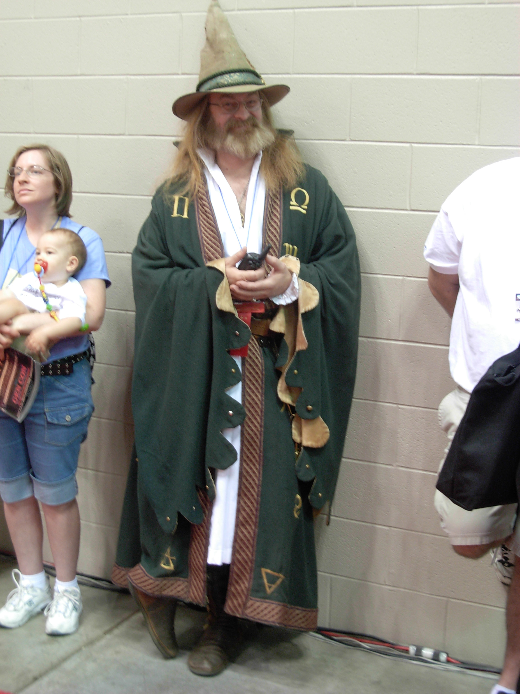

Slide 17
JUST SAY NO!

