Slide 1
Phonebook Phun
Learning indexing concepts with an analog phone book

Slide 2
About Me (Ben Thul)
Database Engineer @SurveyMonkey
Martial Artist
Board gamer
E: ben.thul@spartansql.com
W: www.spartansql.com
T: @spartansql

Slide 3
Clustered Indexes
A clustered index is the set of columns by which the data itself is physically* organized.
In our phone book, the clustered index is (FamilyName, GivenName)
Other (non-indexed) columns are StreetAddress, PhoneNumber
Clustered indexes don’t have to be unique
There are many “Smith, Mary” entries
If not unique, you need some other criteria to make them unique
In a phone book, this may not be true
In SQL Server, the storage engine adds a unique-ifier
Once the index key is resolved, all of the data is there
*The data is actually stored in this order logically, not physically.

Slide 4
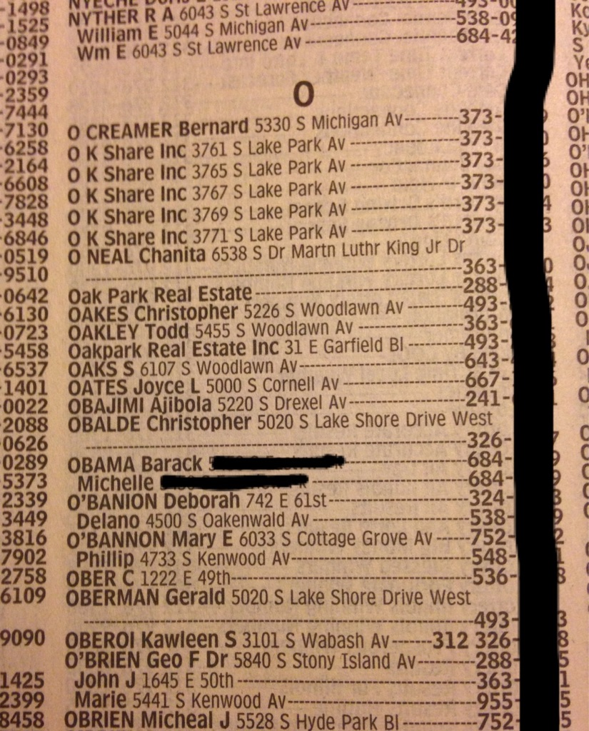
https://imgur.com/Fph97PW

Slide 5
Clustered Indexes - 2
What sorts of questions are easy to answer?
“What is John Anderson’s phone number?”
“Where does Mary Smith live?”
“How many people with the family name Jones are there?”
Any question where at least FamilyName is involved.
What sorts of questions are possible to answer?
“How many people live on the 1200 block of Elm Street?”
“How many phone numbers are there that contain ‘5’?”
“Who does the phone number 777-867-5309 belong to?”
Literally any question involving any combination of (FamilyName, GivenName, PhoneNumber, StreetAddress) (any or all of them could be unspecified)

Slide 6
*Logical vs Physical Order
Imagine that the phone book was changeable
As new people move in, entries are added
As people move away, entries are deleted
As people move within the area, their address and possibly phone number are updated
If someone moves in, we need to add an entry to the phone book
But where?
We know where in the ordering they need to go because we know their family name and given name
But there’s no room to put them on the page physically!
So, we take half of the records on the page and write them to a new page
Now the old page has room on it for the new entry
This is called a page split in SQL Server

Slide 7
*Logical vs Physical (2)
When someone moves out of the area, we can just remove their entry from the page
Perhaps leaving room for someone else’s entry later!
When someone moves within the area, we update their ancillary information (i.e. phone number and address) and write the record back into the same location
If someone changes their name, we have to do a delete and insert (perhaps doing a page split on the insert)
If the phone book ships with some empty space on each page, we might not have to move records around when someone moves in
In SQL Server, this called a fill factor (i.e. how full do we want each page)

Slide 8
Non-clustered indexes
Imagine now that we have the same set of people, but we want to easily answer questions about people’s given name
We’re going to create a second phone book that is sorted by GivenName
Once we resolve to a specific record, it points us back to our main phone book with a (FamilyName, GivenName) pair
For example, let’s say you met someone at the pub and you know his name is Aaron, but you didn’t get his phone number.
The entry in this secondary phone book for Aaron would be located near the beginning and if you wanted his phone number, it would say “See Zocher, Aaron in the main phone book”.

Slide 9
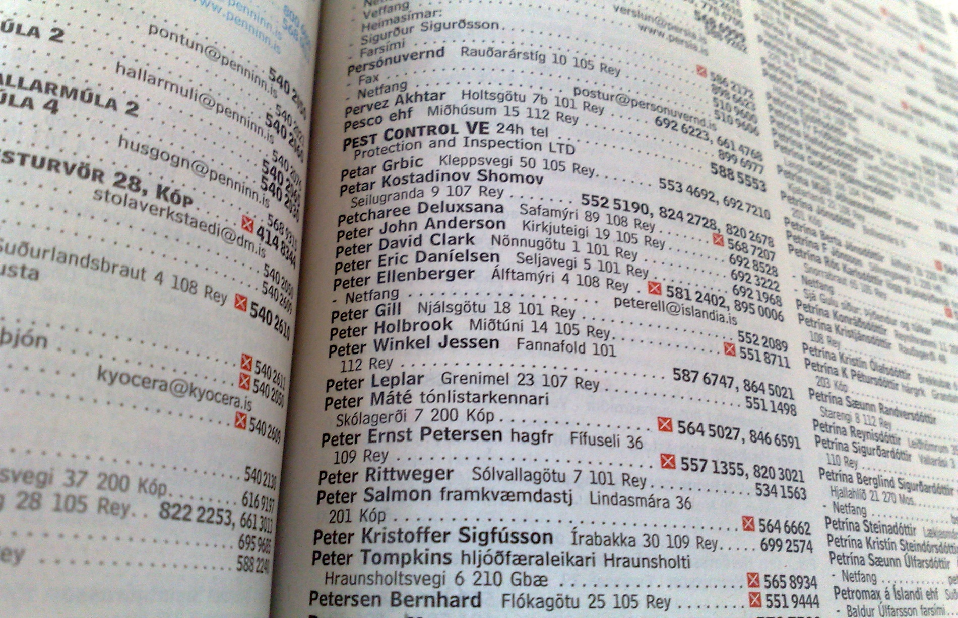
Non-clustered indexes
https://www.flickr.com/photos/reinvented/2978671397

Slide 10
Non-clustered indexes – 2
What sorts of questions are easy to answer?
“How many people named John Anderson are there?”
“What are the 10 most popular given names?”
Any question where given name is a component and at most family name is the only other piece of information required
What sorts of questions are possible to answer using only this index?
“What is the distribution of (FamilyName, GivenName)?”
Any question involving only (GivenName, FamilyName)
What sorts of questions are impossible to answer given only this index?
“What is Steve Thompson’s phone number?”
This can be answered by following the “Thompson, Steve” reference back to the main phone book. This is called a “Key Lookup” in SQL Server.

Slide 11
Include columns
Let’s augment the previous compressed phone book
The typical use case now is that you’re still looking up by given name, but almost every time you do, you want to know that person’s phone number
Now, when you look up your mate Aaron, instead of getting a pointer back into the main phone book, you see that his family name is Zocher and his phone number is 777-555-1234.
If your typical usage pattern is “whenever I ask for certain records (e.g. (GivenName, FamilyName)), I want certain other information (e.g. PhoneNumber))
This can be more efficient than the clustered index even if the clustered index supports your query!

Slide 12
Include columns - 2
What sorts of questions are easy to answer?
“How many people named John Anderson are there?”
“What are the 10 most popular given names?”
Any question where given name is a component and at most family name and/or phone number is the only other piece of information required
What sorts of questions are possible to answer using only this index?
“What is the distribution of (FamilyName, GivenName)?”
“What is Steve Thompson’s phone number?”
Any question involving only GivenName, FamilyName, PhoneNumber
What sorts of questions are impossible to answer given only this index?
“What is Steve Thompson’s address?”

Slide 13
Filtered Indexes
I’ve been misleading you this entire time
Every phone book you’ve ever used has a “where clause” attached to it
Imagine that the master phone book has every person in the world in it
The phone company probably has such a thing (if virtually)
If you’re asking questions like “In the Greater Phoenix Metropolitan Area, how many people named ‘Gary Erikson’ are there?”, you wouldn’t use the master phone book
The phone company creates location-specific versions of the master phone book
The where clause for these phone books is “where Address in («list of cities in the Phoenix Metro»)”
In real phone books, the filtered index is “(FamilyName, GivenName) include (PhoneNumber, Address) where Address in («some specific geography»)”

Slide 14
Filtered indexes - 2
What sorts of questions are easy to answer?
Go back to the non-clustered index slide, but just add an assumption that you’re only going to get back info for Phoenix residents
What sorts of questions are possible to answer?
Ditto
What sorts of questions are impossible to answer?
Anything involving anyone from another area
Explicitly: “where Address = “«some address in Seattle»”
Implicitly: (no predicate that narrows the Address to Phoenix)

Slide 15
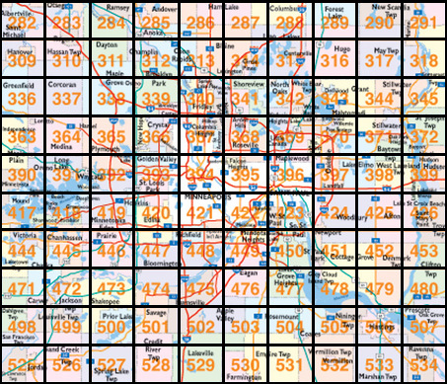
Bonus – spatial indexes

Slide 16
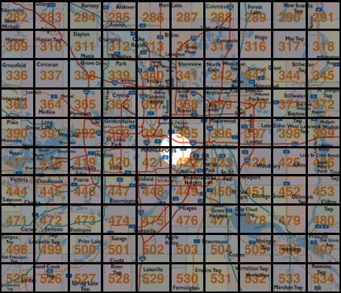
Bonus – spatial indexes

