Slide 1
Designing an alternative to Replication
A Real World™ Example

Slide 2
About me (Ben Thul)
Database professional since 2006
Database Engineer at SurveyMonkey
e: ben.thul@gmail.com

Slide 3
Replication
Everyone’s Least Favorite Workhorse

Slide 4
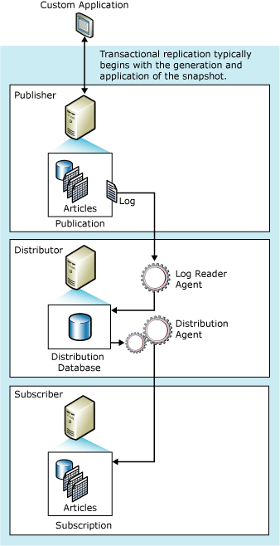
REPLICATION
Publisher
Has one or more Articles
DML/DDL against any of the Articles is marked in the transaction log
Distributor
Runs Log Reader Agent to consume marked records from Publisher, inserts them into Distribution database
Subscribers
Receives results of actions run at Publisher, replays them at each Subscriber (either via Push or Pull)
Notes:
Picture from: https://technet.microsoft.com/en-us/library/ms151706(v=sql.105).aspx

Slide 5
Replication
Pros
Has been around for a long time
When it works, it works
In most cases, fairly simple to set up/configure
Has a lot of options for configuration if you need them
A robust system for initializing subscribers
Cons
Has a reputation for being ‘fragile’
Implications for backup/restore strategy
DML statement affects 1000 rows at publisher → 1000 individual commands to be run at subscriber
Default configuration stops distribution on any error (including trying to delete a non-existent row!)
Built-in monitoring isn’t great

Slide 6
Service Broker
A new way to solve old problems

Slide 7
Service Broker
Service Broker sends messages from one location to one or more other locations
Has support for conversations
Service A sends a message to service B and it responds
Conversations can go back and forth as many times as is necessary

Slide 8
Service Broker
In order to build a replication system on top of this, we need
A way to generate messages when events happen to Articles at the Publisher
A way for subscribers to receive and replay those events
How hard could it be?

Slide 9
Configuration

Slide 10
Configuration
Before we can talk about pushing messages from one place to another, there’s some plumbing we need to do
Tell each side about where the other side is (i.e. routes)
Tell each side what types of messages it can expect (i.e. message types, contracts)
If the Publisher and Subscriber are on different servers, configure authentication between them

Slide 11
Configuration (Routing)
Service Broker routing can wildcard on any of:
Service name
Broker instance (sys.databases.service_broker_guid)
In our implementation, both Service name and Broker instance are specified
Routing is used to determine what server the destination service is on when the conversation is initiated and what database to deliver the message to once it gets there.

Slide 12
Configuration (Message Types)
Each side of the conversation has to know what types of messages are to be sent
Message types are merely a name and what type of validation is done on the message (either NONE, WELL_FORMED_XML, or VALID_XML (validated against an XML schema)
Message Type is specified when a SEND statement is issued
Message types are bundled into Contracts
Each Message Type in a Contract is specified as being able to be sent by either the initiator of the conversation, the target, or either.
Contract name is specified when a BEGIN DIALOG statement is issued

Slide 13
Configuration (Endpoints)
If the two Services are in databases that are on separate servers, a Service Broker endpoint will need to be set up on both the Publisher and Subscriber
Authentication can be any of
Windows (NTLM)
Window (Kerberos)
Certificate (both servers share a common server-level cert)

Slide 14
Publication

Slide 15
Publication
Each table considered for replication via Service Broker has a trigger on it. The trigger
Examines the DML operation performed (Insert, Update, Delete)
Creates an XML message to represent the change using the UPDATE() and COLUMNS_UPDATED() functions
Sends the message

Slide 16
Publication
“Sending the message“ warrants further discussion
In a Microsoft whitepaper*, they suggest re-using conversation handles and also to use ≈ 1 in 150 of them
In order to abstract this from the application, procedures were made to create handles and send messages using these stored conversation handles
* https://technet.microsoft.com/en-us/library/dd576261(v=sql.100).aspx

Slide 17
Publication
The first implementation of this used a naïve round-robin method
We encountered blocking on the conversation handle if anything did a DML and didn’t commit right away
We moved to a READPAST strategy where the select from the handles table just gets a handle that has the right contract type and isn’t locked right now
We try this five times and if we still haven’t gotten a handle, then resign ourselves to the round-robin strategy

Slide 18
Publication
DEMO

Slide 19
Subscription

Slide 20
Subscription
In the subscriber database, messages are processed via Service Broker Activation
A background process determines when to start a stored procedure to process messages
Multiple “activated procedures” can be running at once (up to a user-configured maximum)

Slide 21
Subscription
The Activation procedure
Grabs a bunch of messages off of the queue
Classifies each message by what table the message affects
Passes the message to a procedure that only processes messages for that table

Slide 22
Subscription
Each table-specific procedure
Parses the message back out into its constituent columns
Parses the update mask (generated by COLUMNS_UPDATED() in the trigger
In the case of an insert or delete does the simple operation (i.e. insert all the columns or delete by primary key)
In the case of an update, interprets the update mask to determine which columns need to be updated

Slide 23
Subscription
DEMO

Slide 24
caveats
Or “Lessons Learned”

Slide 25
Caveats (Text Columns)
Any columns that admit arbitrary text can produce a message that will not be replayed correctly at the subscriber
e.g. “I <3 SQL” will become “I &lt;3 SQL”
As a workaround, (var)(n)char columns are cast to an equivalent length (var)binary type which is then base-64 encoded with the BINARY BASE64 clause to FOR XML
The subscriber also needs to take steps to base-64 decode this information and then produce the original value from the publisher

Slide 26
CAVEATS (Update Mask)
The first version of the function that decodes the update mask used sys.columns at the subscriber to turn the bit mask into column names
If the columns were enumerated differently at the publisher and the subscriber, the message would be applied incorrectly
How does this happen? In development:
Add two columns at the publisher
Remove the first of the two
Add the second at the subscriber

Slide 27
CAVEATS (Update Mask)
As a way around this, a copy of the publisher enumeration of the columns for replicated tables is sent to the subscriber so that it can be referenced when the bitmask is decoded
This is also accomplished via sending a message periodically via Service Broker

Slide 28
Caveats (Message Replay Order)
Our implementation uses Broker Prioritization to say that some messages should be consumed before others
For the purposes of this discussion, prioritization is done at a Contract level (i.e. each Contract can be given a higher or lower priority)
Initially, prioritization was done at the table level
This had a side effect of updates occasionally being consumed before their corresponding insert
Which leads to “non-convergence”

Slide 29
Caveats (Message Replay Order)
To get around this, we reorganized the contracts into logical operations (i.e. a contract for each of insert, update, and delete)
Inserts are prioritized highest
Deletes are next highest priority
Deletes are rare in our environment
Updates are the lowest priority

Slide 30
Resources
Code can be downloaded from GitHub
https://github.com/ben-thul/BrokerReplication

