Slide 1
Trees Everywhere!
Querying Hierarchical Data

Slide 2
About me (Ben Thul)
Database Engineer for SurveyMonkey
MCITP – Administrator/Developer
Contact Info
e: ben.thul@spartansql.com
t: @spartansql
w: http://www.spartansql.com

Slide 3
Why do I care?
As it turns out, trees are good for modeling certain real-world phenomena
Matri- or Patrilineal family trees
Taxonomies (e.g. “Domain, Kingdom, Phylum, etc…”)
Organizational Charts
Hierarchical Categories

Slide 4
Why do I care? – cont.
Once the hierarchy is modeled, it should be easy to answer questions like:
What member(s) are related (either as ancestor, descendent, or sibling)?
How far down the tree am I (i.e. some notion of “level”)?

Slide 5
What is a tree?
For the purposes of this discussion, a tree is a defined set of parent/child relationships amongst a group of members in which the following are true
No member is parent to itself
One member is said to be superior to all other members. That is, all members can trace their lineage back to a single member
Every member has at most one parent

Slide 6
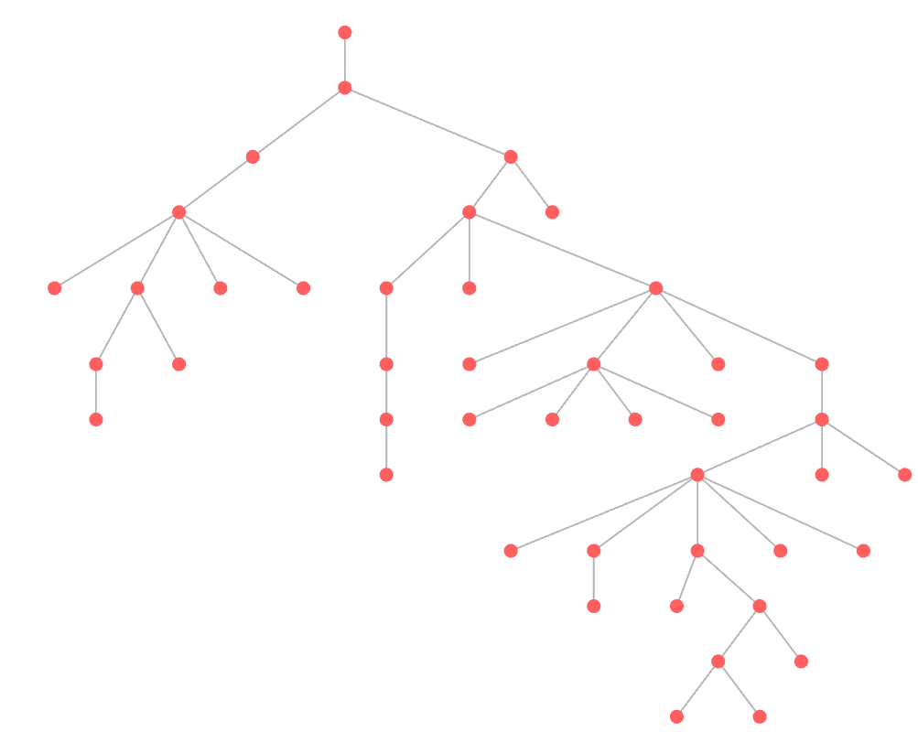
A Tree - Visualized

Slide 7
For the math nerds mathematicians
These are directed, acyclical, non-weighted graphs where each node has at most one edge going into it.

Slide 8
How do I model this?
A common method is to use what is referred to as adjacency
i.e. Add a column to each record that says which record is the immediate predecessor of this record
There are various techniques of traversing the records all the way up and all the way down to find all ancestors and descendants

Slide 9
How do I model this? – An Example
ID | ParentID
1 | NULL
2 | 1
12 | 2
112 | 12
1112 | 112
61299 | 1112

Slide 10

The Bad/Old Days

Slide 11
Hope you like JOINs!
Prior to SQL 2005, you could query this using UNION’d joins
It was actually pretty efficient (for finding the lineage of a given ID)! ☺
Not so great for getting “related” rows
But writing it was tedious. ☹
And error prone. ☹
The general pattern is as follows
Find the root element, select it
For each successive level, union the above with
Find the previous level’s members
Join with their immediate descendants
Rinse/lather/repeat for as many levels as you have

Slide 12
Demo Time
Pre-2005 Style

Slide 13
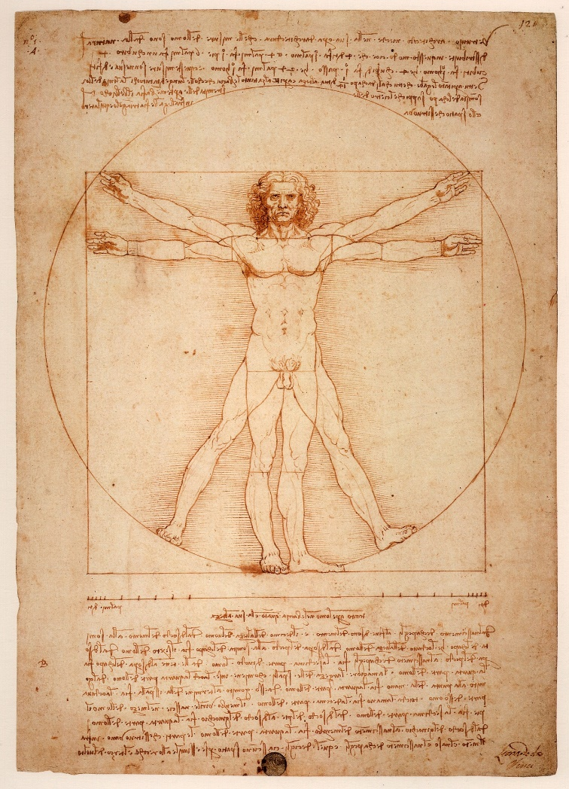
A Renaissance

Slide 14
Recursive Queries
With SQL 2005, recursive queries were introduced
Similar in spirit to the last style, except that we can teach a robot how to do those joins

Slide 15
Recursive Queries - Example
WITH cte as (
-- get the “root” ID
select ID, ParentID
from dbo.yourTable
where ParentID is null
union all
-- get the children of the parents we’ve found so far
select child.ID, child.ParentID
from dbo.yourTable as child
join cte as parent
on child.ParentID = parent.ID
)
select *
from cte;

Slide 16
Recursive Queries – Continued
As compared with the last style, we need only express the logic once, so much less error prone
Works well if the data is indeed acyclical (i.e. no a → b → … → a)
Automatically adjusts depth based on new data
As compared with the JOIN style

Slide 17
Demo Time
Recursive Queries

Slide 18

Your Future is Bright

Slide 19
Introducing the hierarchyid
hierarchyid is a CLR datatype that was introduced in SQL 2008
Encodes a position within a hierarchy
Provides methods for common operation
IsDescendant – tests whether one node is a descendant of another
GetAncestor(n) – walks the tree going up, getting the nth ancestor
GetReparentedValue – moves a node from one parent to another
Indexable!

Slide 20
What does it look like?
Just looking at the value (i.e. select h from table) will yield a varbinary-looking value (e.g. 0x5D5E00E7B21FF800001F123F000006ECCC)
You can look at a more readable version by calling the ToString() method on it (e.g. /1/10/92/919/9184/12345/)
You can also specify your values in the human-readable version above for the purposes of equality testing, inserts, updates, etc.
Implicit conversion will take care of things for you

Slide 21
Demo Time
hierarchyid queries

Slide 22
Citations
http://sqlblog.com/blogs/adam_machanic/archive/2015/04/07/re-inventing-the-recursive-cte.aspx – Script for sample data
https://technet.microsoft.com/en-us/library/bb677212(v=sql.105).aspx – Working with hierarchical data
https://msdn.microsoft.com/en-us/library/bb677193.aspx - hierarchyid method reference
https://commons.wikimedia.org/wiki/File:Frogner_Park_Trees.JPG
https://pixabay.com/en/caveman-primeval-primitive-man-159359/
https://pixabay.com/en/leonardo-da-vinci-vitruvian-man-1125056/
https://www.flickr.com/photos/buckaroobay/3721809183
https://github.com/ben-thul/HierarchyCLR - CLR source code

