Slide 1
ML Final Project
Laptop Recommendation System
陳子睿 石偉辛 江睿哲 葉佳翰 郭政維

Slide 2
Outline
Introduction
Data Collection
Data Preprocessing
Data Visualization
Model Construction
Results
Problems
Demo and Conclusion

Slide 3

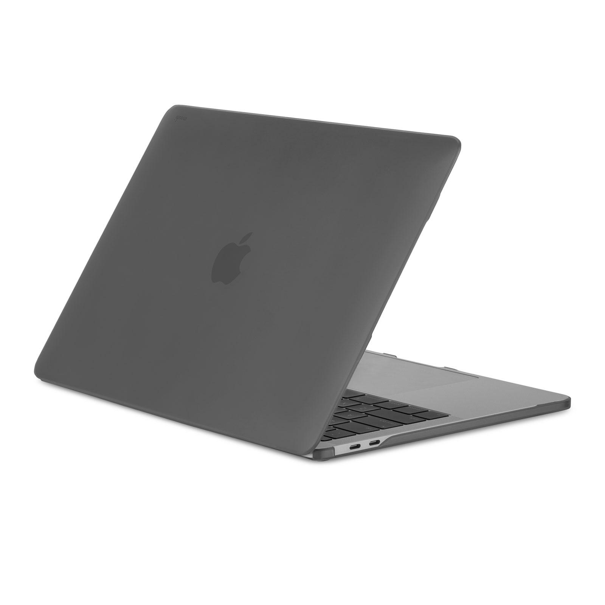
Introduction
Predict which system’s laptop is better for those who want to buy a new one
How to predict?
based on public usage habits and satisfaction survey

Slide 4

Introduction
Motivation

Slide 5

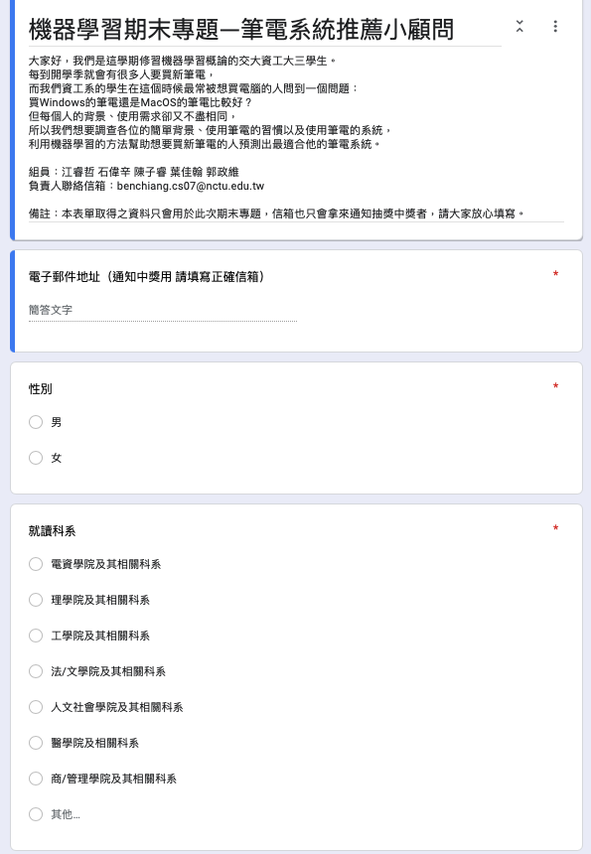
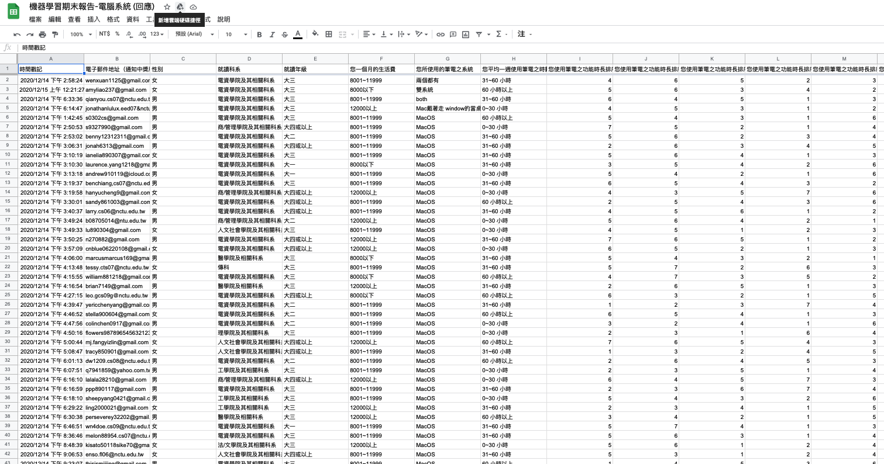
Data Collection
https://forms.gle/DLzdcLwNu3XCJzCo7
Questionnaire post on social media
9 questions and 15 features

Slide 6
Data Collection: Features
Basic information
gender
department
grade
money (living expense)

Slide 7
Data Collection: Features
Usage-relative information
system
time
apple (using other Apple device?)
satisfy (satisfaction degree)
usage (usage habit)

Slide 8
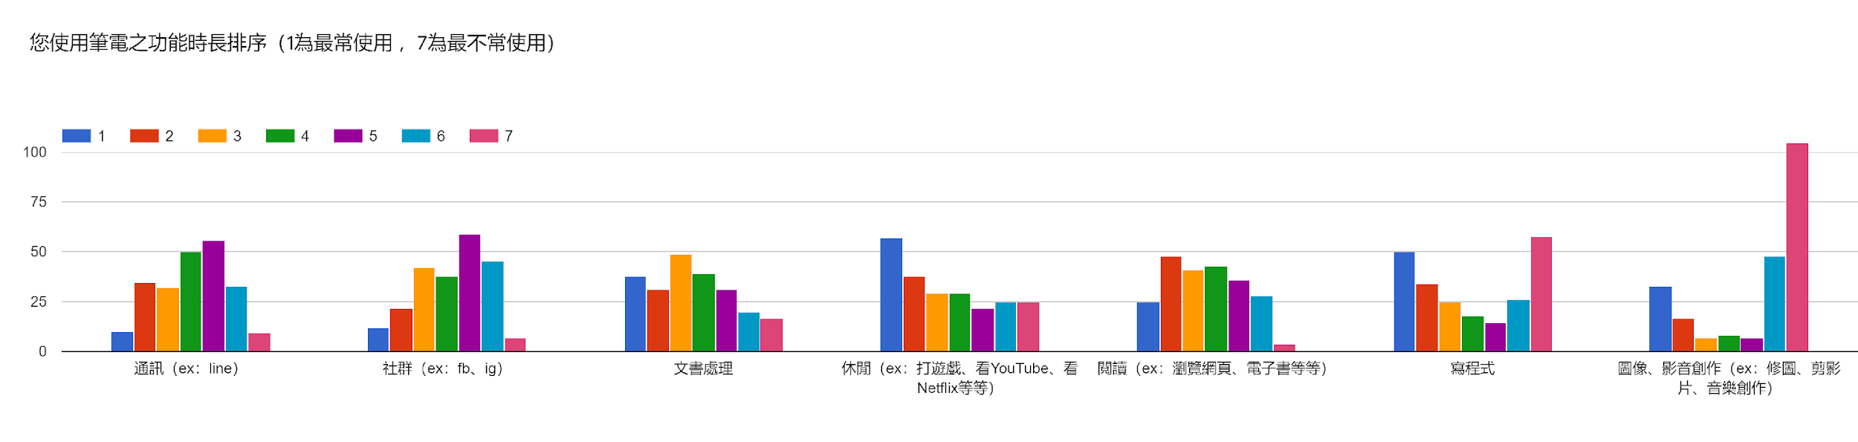
Data Collection: Features
Usage (usage habit): sort the following 7 laptop function
communication
social
word_processing
entertainment
reading
coding
creation
15 features = 4 basic + 5 usage-relative + 7 usage - 1

Slide 9
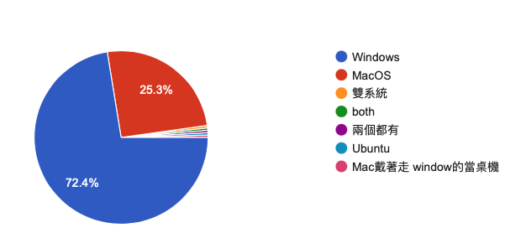
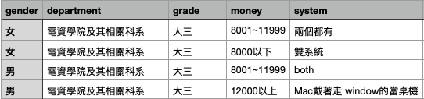
Data Preprocessing
Drop noised data
System != Windows or MacOS

Slide 10
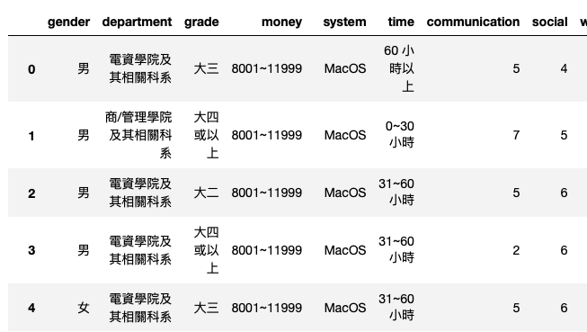
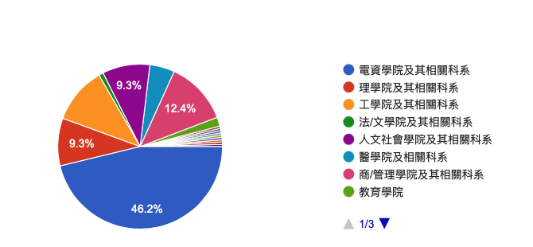
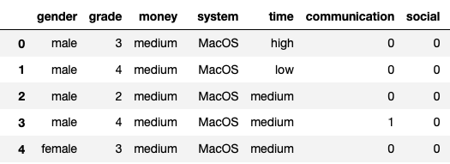
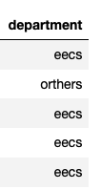
Data Preprocessing
Transform data format
chinese -> english or number
department -> eecs or s&t or others (balance)

Slide 11
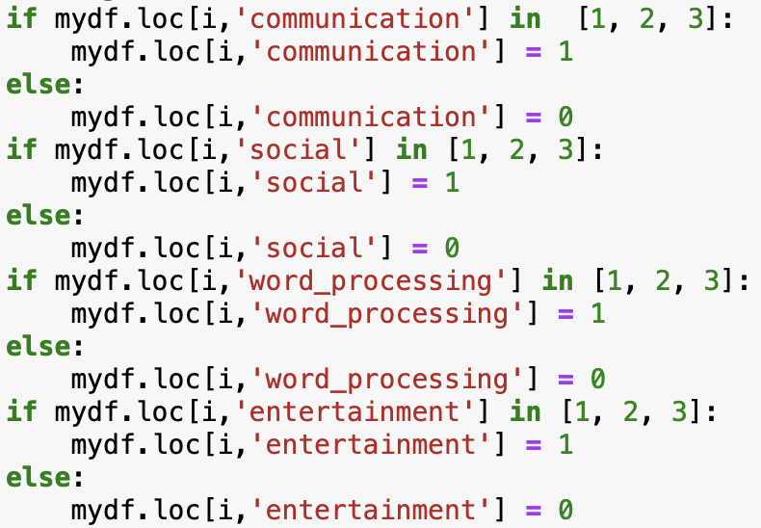
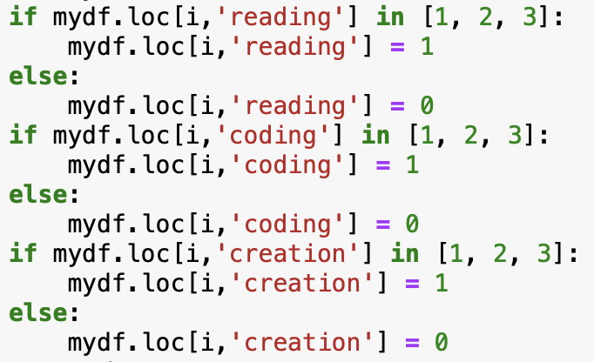
Data Preprocessing
Transform data format
top 3 -> 1 ,else -> 0

Slide 12
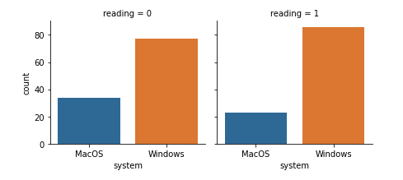
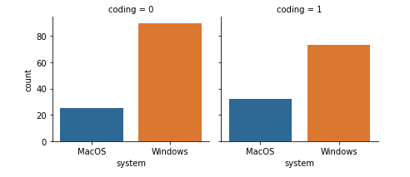
Data Preprocessing
Data visualization for choosing useful features
Some interesting observations...

Slide 13
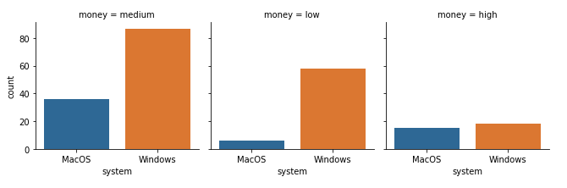
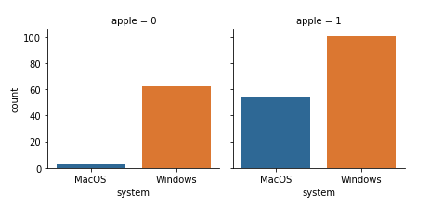
Data Preprocessing
And more observations

Slide 14
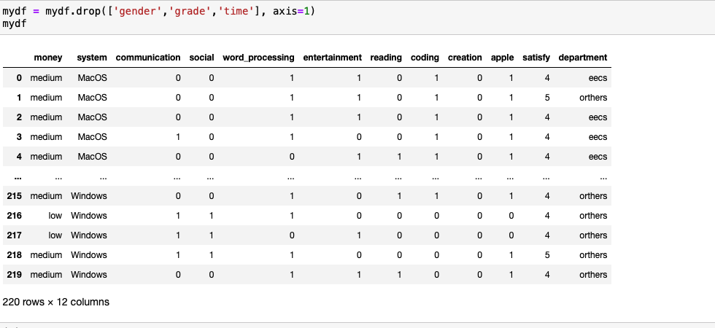
Data Preprocessing
Drop useless features (gender, grade, time)

Slide 15

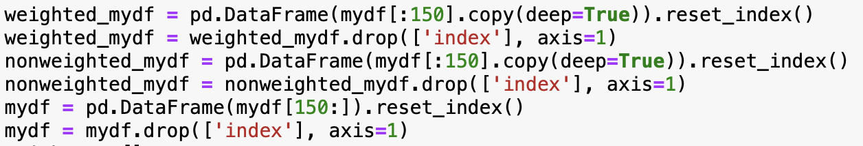
Data Preprocessing
Shuffle the data
Train test split

Slide 16
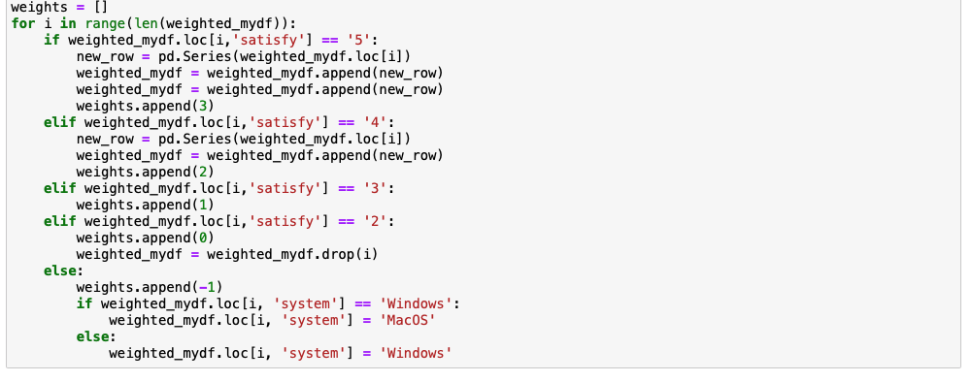
Data Preprocessing
Add weights to training data based on satisfy (satisfaction degree feature)
if satisfy = 5 (非常滿意) weight = 3
if satisfy = 4 (滿意) weight = 2
if satisfy = 3 (普通) weight = 1
if satisfy = 2 (不滿意) weight = 0
if satisfy = 5 (非常不滿意) weight = -1

Slide 17
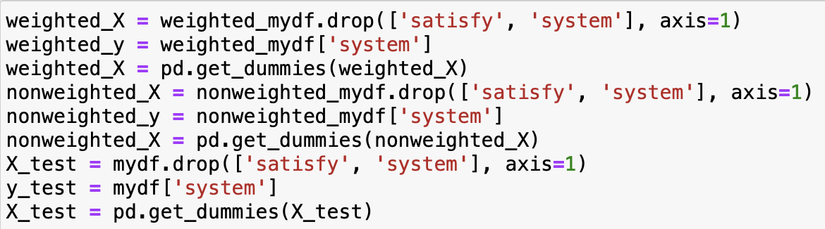
Data Preprocessing
Generating features(X) and target(y)
One-hot encoding (get_dummies)

Slide 18
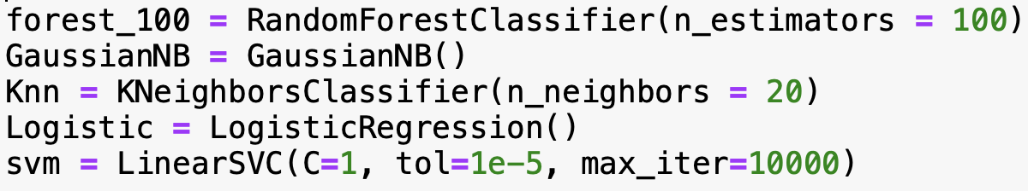
Model Construction
Using sklearn models
Random Forest
Multinomial Naive Bayes
KNN
Logistic Regression
Linear SVM

Slide 19
Model Construction
Random Forest
Multinomial Naive Bayes

Slide 20

Model Construction
KNN (KNN does not support sample_weight)
Logistic Regression

Slide 21
Model Construction
Linear SVM

Slide 22
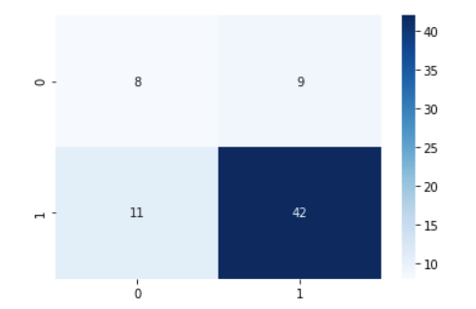
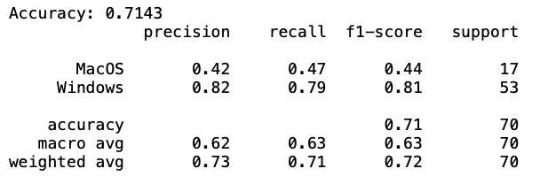
Results
Random Forest

Slide 23
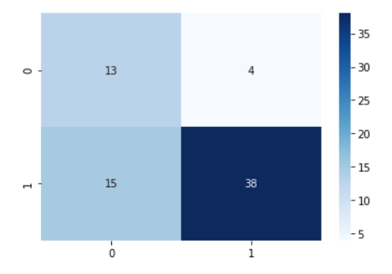
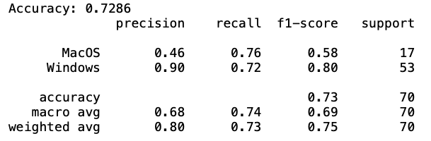
Results
Multinomial Naive Bayes

Slide 24
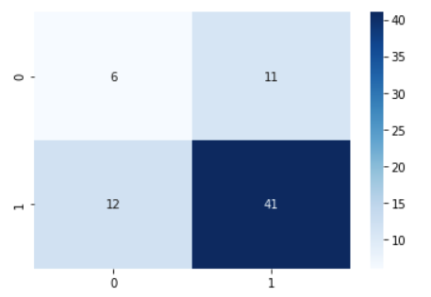
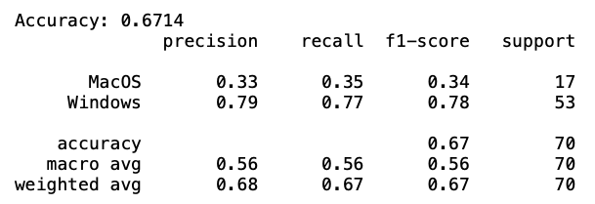
Results
KNN

Slide 25
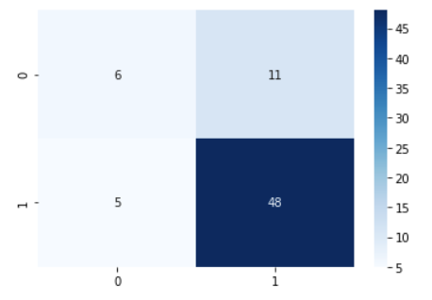
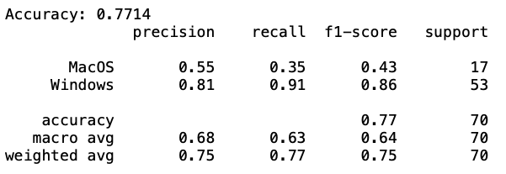
Results
Linear SVM

Slide 26
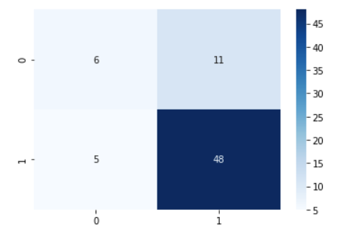
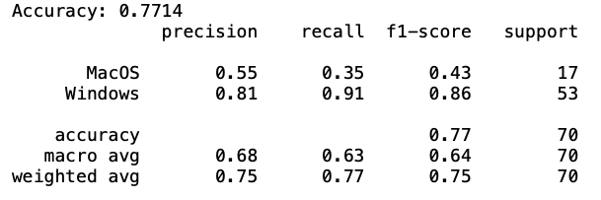
Results
Logistic Regression

Slide 27
Problems
Unfavourable performance on macOS prediction
may cause by unbalanced data
or cause by the design of our questionnaire (feature design)
Usage feature does not contribute a lot to the model
may cause by the design of our questionnaire (feature design)

Slide 28
Demo
A laptop recommendation system based on the Naive Bayes model

Slide 29
Conclusion
From collecting public usage habits and satisfaction on their laptop with the use of machine learning techniques, we surely can make a laptop recommendation system.
Naive Bayes model has the best performance in our task.

Slide 30
Q&A

Slide 31
Thanks For Listening

