Slide 1
CHUNG SIU KEUNG 230328167
Notes:
---

Slide 2
Forecast Hong Kong's daily minimum grass temperature
Use Recurrent Neural Networks (RNN) and Long Short-Term Memory (LSTM) for the data.
Data: Historical from Hong Kong Observatory (1980-2024 for training, 2025 Jan-Oct for testing).
Notes:
Problem Statement, Proposed Solution

Slide 3
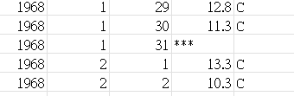
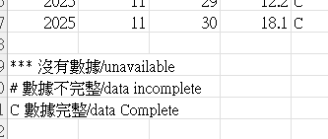
Data and Preprocessing
Title: Data and Preprocessing
Source: HKO dataset from data.gov.
Preprocessing: Skip metadata(Header), handle '***' missing, drop invalid rows.
Sequences: Window size = 30 days to predict next day.
Training Data: 1980-2024 (~16,436 entries); Test: 2025 Jan-Oct (~304 entries).

Slide 4
Models
RNN: 2 layers (50 unit, batch size=32 , epochs=100).
LSTM: 2 layers (50 unit, batch size=32, epochs=100).
RNN: MAE=0.96°C, RMSE=1.31°C
LSTM: MAE=1.10°C, RMSE=1.38°C
Notes:
Title Slide, Executive Summary

Slide 5
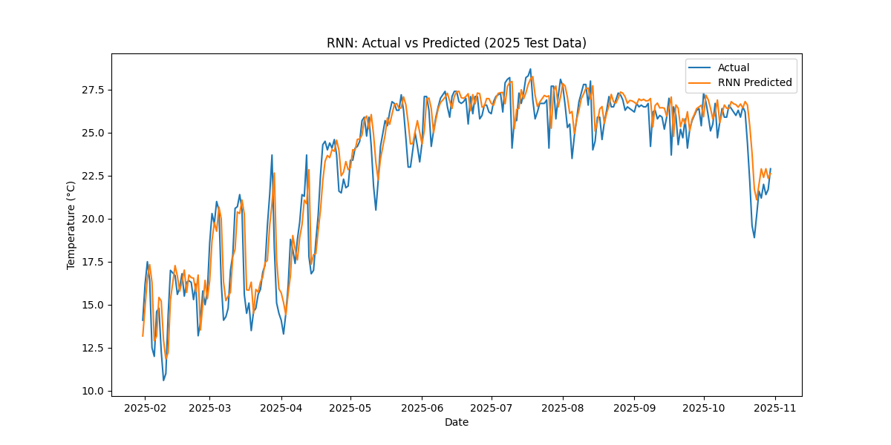
Notes:
The title slide serves as the first impression of your business proposal. It should include the name of your company, the proposal title, and optionally a tagline that summarizes the essence of your proposal. This slide sets the tone for the entire presentation, so ensure it is visually appealing and professional. Consider adding your company logo and a clean background design that aligns with your brand identity. The purpose of this slide is to immediately communicate what the proposal is about and who is presenting it, creating clarity and professionalism from the start.

Slide 6
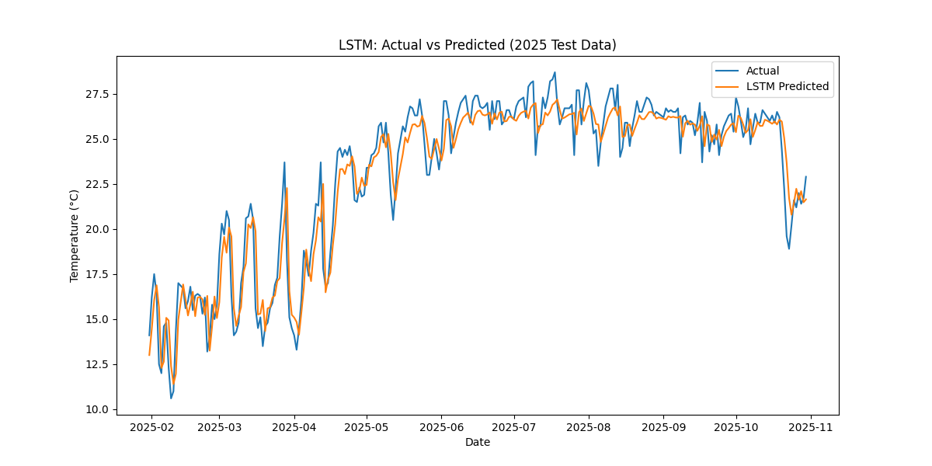
Notes:
The executive summary provides a concise overview of the entire proposal. It should highlight the key points such as the problem being addressed, the proposed solution, and the expected outcomes. This section is critical because many decision-makers may only read this part before deciding whether to proceed. Include the value proposition, anticipated benefits, and a brief mention of financial implications. Keep it clear and compelling, focusing on why your proposal matters and what makes it unique compared to alternatives.

Slide 7
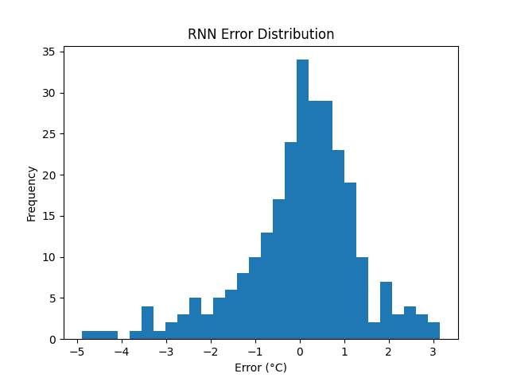
Notes:
The problem statement defines the issue your proposal aims to solve. Clearly articulate the pain points, inefficiencies, or gaps in the market that justify the need for your solution. Use data and evidence to support your claims, such as industry reports, customer feedback, or performance metrics. This slide should make the audience understand the urgency and importance of addressing the problem, setting the stage for your proposed solution.

Slide 8
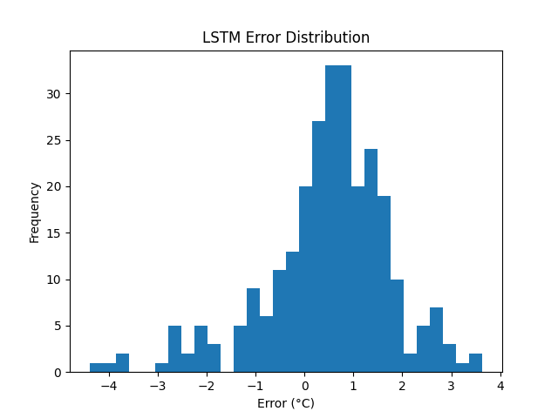
Notes:
This slide outlines your solution to the identified problem. Describe the product, service, or strategy you are proposing, and explain how it effectively addresses the problem. Highlight the unique features or advantages that differentiate your solution from competitors. Include any supporting visuals or diagrams to make the concept clear. Emphasize the benefits and expected impact on the target audience or market.

Slide 9
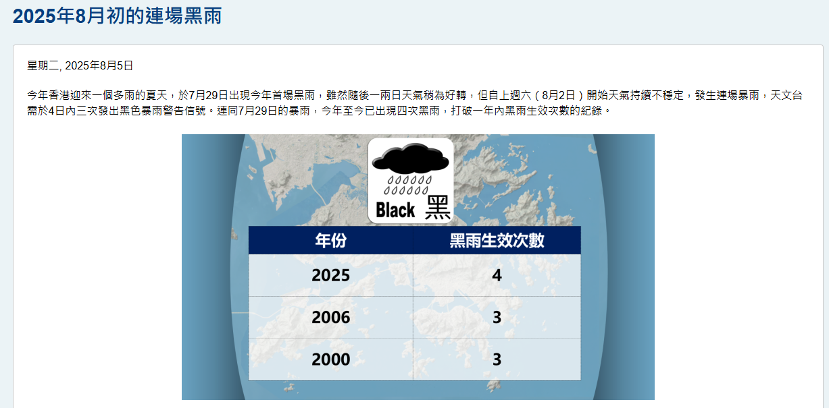
extreme events
Notes:
Financial projections provide an estimate of future revenues, expenses, and profitability. Include key metrics such as break-even analysis, return on investment (ROI), and cash flow forecasts. Present data in tables or charts for clarity. This slide should demonstrate that your proposal is not only feasible but also profitable in the long term. Ensure assumptions are realistic and supported by market research.

