Slide 1
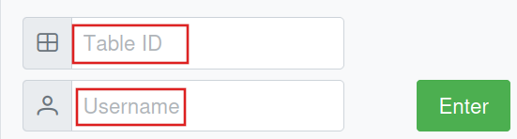
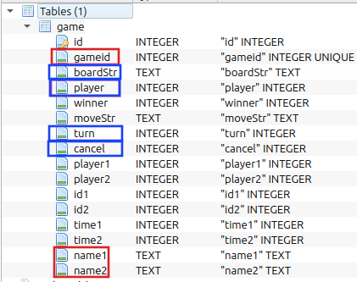
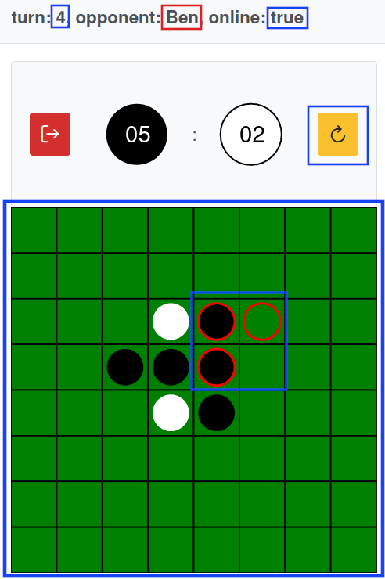
Frontend
Datenbank

Slide 2
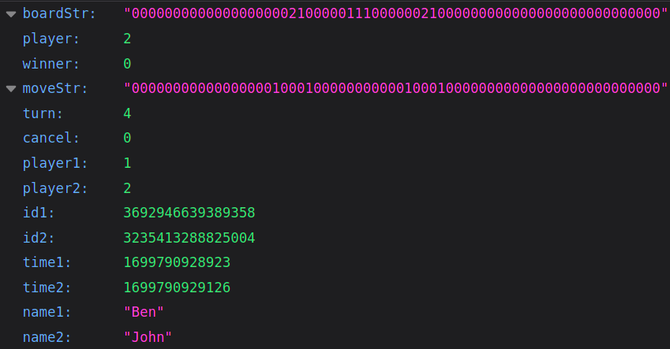

Slide 3
/enter (get)
{
"tableId": int,
"username": str
}
/gameinfo (get)
{
"tableId": int,
"userId": int
}
{
turn,
player,
boardStr,
cancel,
online,
opponent,
color
}
/makeMove (post)
{
"move": 0-63
"player": 0|1
"tableId": int
}
/cancel (post)
{
"player": 1|2,
"tableId": int
}
/resetDB
/debugDB
/example

