Slide 1

Python Flask web framework

Slide 2

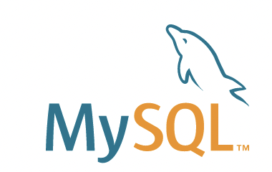
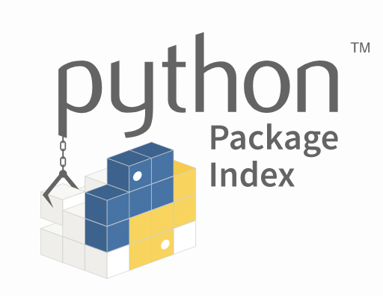
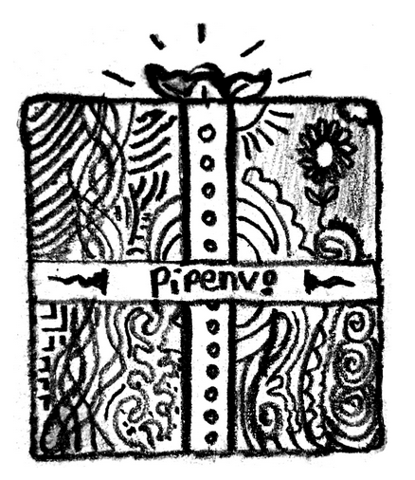
Python World
Object-relational mapper (ORM)
MySQL Connector for Python
Ibm.com
Pinterest
Patreon
Brilliant
Netflix
AirBnb
Reddit
Mozilla
Uber
pip3 packet manager
pip3 list/install
globale installation of packages
pipenv as virtual packet manager
pip3 install pipenv
pipenv shell

Slide 3
What are “frameworks” for?
No framework
With framework
Library 1
Library 2
Library 1
Library 2
Framework
Your code
Your code

Slide 4
Created 2010 under BSD License
Micro web framework
- lightwight
- only include what you need
Routes
Debugging
Templates
HTTP Methods (GET, POST)
Safe Escaping to avoid injection
Cookies
Sessions
Logging
JSON Responding
Extensions are easy to integrate

Slide 5
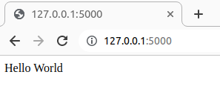
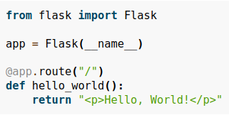
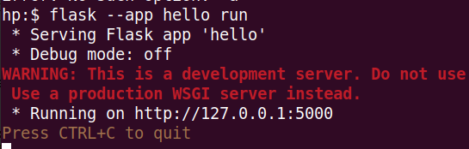
Installation:
pip3 install flask
apt-get install python-flask
Create a minimal Python program:
saved as "hello.py"
Running a development webserver:
flask --app hello run

Slide 6
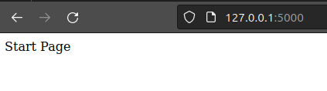
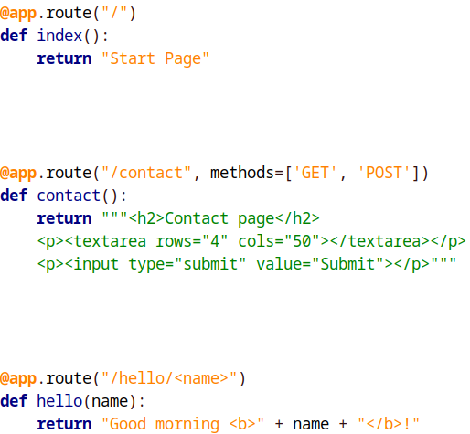
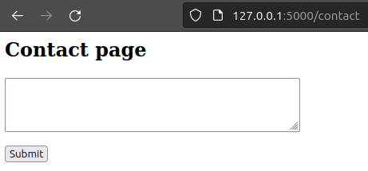


Slide 7
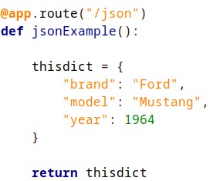
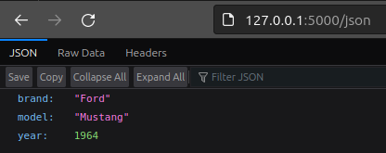
JSON Response (for REST APIs)

Slide 8
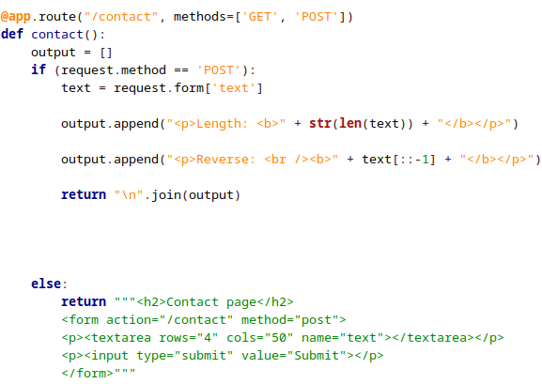
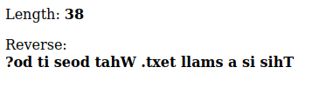
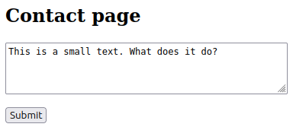
HTTP Methods

Slide 9
Last words
Whats missing:
Templates
Cookies + Sessions
Escaping
Sources:
Flask Documentation
Files on GitHub

