Slide 1
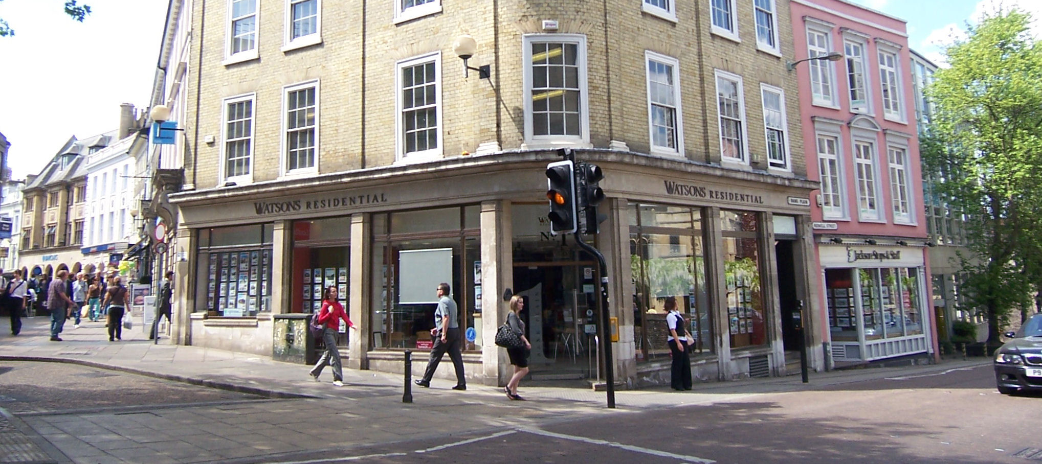
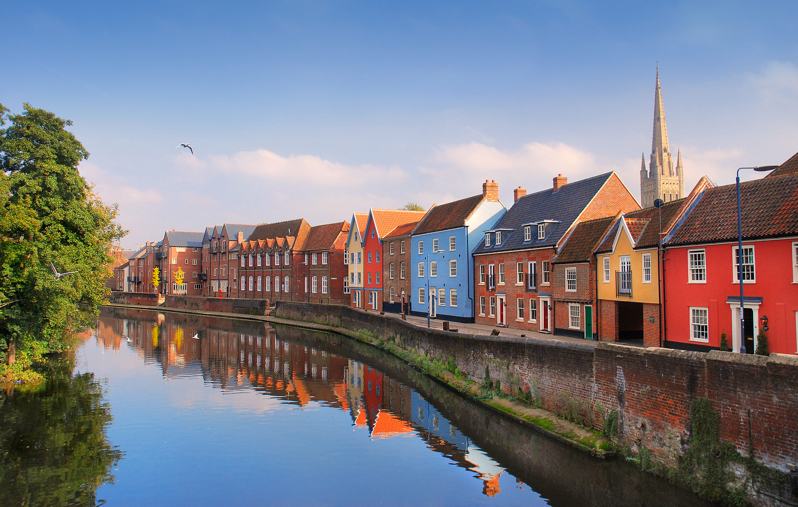


Slide 2



BISHEE
BARNABEE

Slide 4





