Slide 1

Analyzing crime in Chicago through machine learning
By Ben

Slide 2
INtroduction
The city of Chicago publishes an up-to-date list of all reported crimes.
The records span from 2002 to the modern date, allowing a few days of delay to catalog the crimes and publish them.
According to official FBI data, Chicago is one of the leading cities in homicides, having more than quadruple the amount of crimes in New York City, and more than double the amount of crimes in Los Angeles.
Being able to parse the data presented by these huge data sets is a problem central to understanding the crimes in the city of Chicago.
By analyzing the data in a mathematically rigorous way, researchers may be able to glean insight into the underlying causes of crimes, and also may be able to figure out indicators of future crimes to occur.
All of this categorization and analysis falls under the umbrella of Data Science, a field which analyzes large sets of data using probability and statistics, and makes useful conclusions from the analysis. In this paper, we will attempt to parse the city of Chicago’s up-to-date dataset, and try to perform some crime "prediction." We will do this by utilizing techniques from machine learning: specifically, K-means clustering.

Slide 3
K-means clustering
K-means clustering is an unsupervised learning method used to partition n number of clusters into groups with individuals exhibiting similar characteristics. Data is divided into non-overlapping subsets, minimizing intra-cluster distances and maximizing inter-cluster distances. Venue data scraped from Foursquare is added to a k-means clustering algorithm to create 5 clusters segmenting the different communities of Chicago.

Slide 4
Dataset
The data set is publicly available through the city of Chicago’s website.
The information presented in this data set is quite comprehensive, including information about the date and time of the crime, location of the crime, type of crime, etc.
The type of crime is given a standardized set of codes called the Illinois Uniform Crime Reporting (IUCR) codes. Thus, each IUCR corresponds to a specific type of crime. The list of crime codes and corresponding crimes can also be found through the city of Chicago’s website.
The Crimes dataset recording incidents from 2001-present (minus the most recent seven days) downloaded from the Chicago Data Portal is visualized to show which clusters have the most criminal incidents.

Slide 5
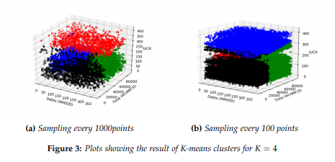
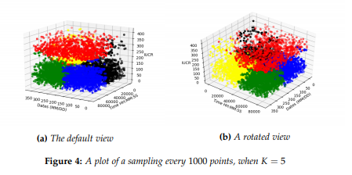
results
The data set is publicly available through the city of Chicago’s website. The information presented in this data set is quite comprehensive, including information about the date and time of the crime, location of the crime, type of crime, etc.
Also gather that gambling is far less frequent than other crimes by the same method. It’s worth noting that the database includes all reported crimes, but unreported crimes are not listed in the database (of course, that’s because no one has reported them!), so it may not be entirely accurate of what actually happens in the city of Chicago.

Slide 6
Discussion
This project has largely been a proof of concept to show that clustering data sets about crime is entirely possible, and allows us to gain insight into the underlying trends of crime.
Future Work Clustering data and analyzing it is an important step to many other machinelearning algorithms. In particular, prediction of crime points can be achieved by multiple methods:
Minimizing the distance between a crime occurrence and the centroid of a cluster
Performing regression analysis on the identified clusters and fitting crimes to the best fit line In the current implementation, we can take a partially filled out crime report and match it to the most likely cluster based on the minimization of the dimensions provided. This leads to the possibility of studying crimes on specific dates, times of the day, or specific types of crime. For example, perhaps law enforcement would be interested in knowing the most statistically likely type of crime happening on January 1 at midnight.
There are multiple opportunities to extend this experiment. Other variables could be analyzed including venue customer demographics. Venue ratings could also be analyzed to see if there is any correlation with number of crimes.

Slide 7
COnclusion
This project has largely been a proof of concept to show that clustering data sets about crime is entirely possible, and allows us to gain insight into the underlying trends of crime.
In the current implementation, we can take a partially filled out crime report and match it to the most likely cluster based on the minimization of the dimensions provided.
We can also form a regression line for serialized points we have that match coordinates via least squares or similar methods. We could also implement the K-nearest neighbors algorithm (which finds the most similar points given a specific points), with the condition that they be in the same cluster as we predict our data point will be in. This would provide a list of k possible crime types that are most likely to occur in Chicago on January 1 at midnight.

