Slide 1
Exo Robotics
Tian
Ben
Intishar
30th July 2023

Slide 2
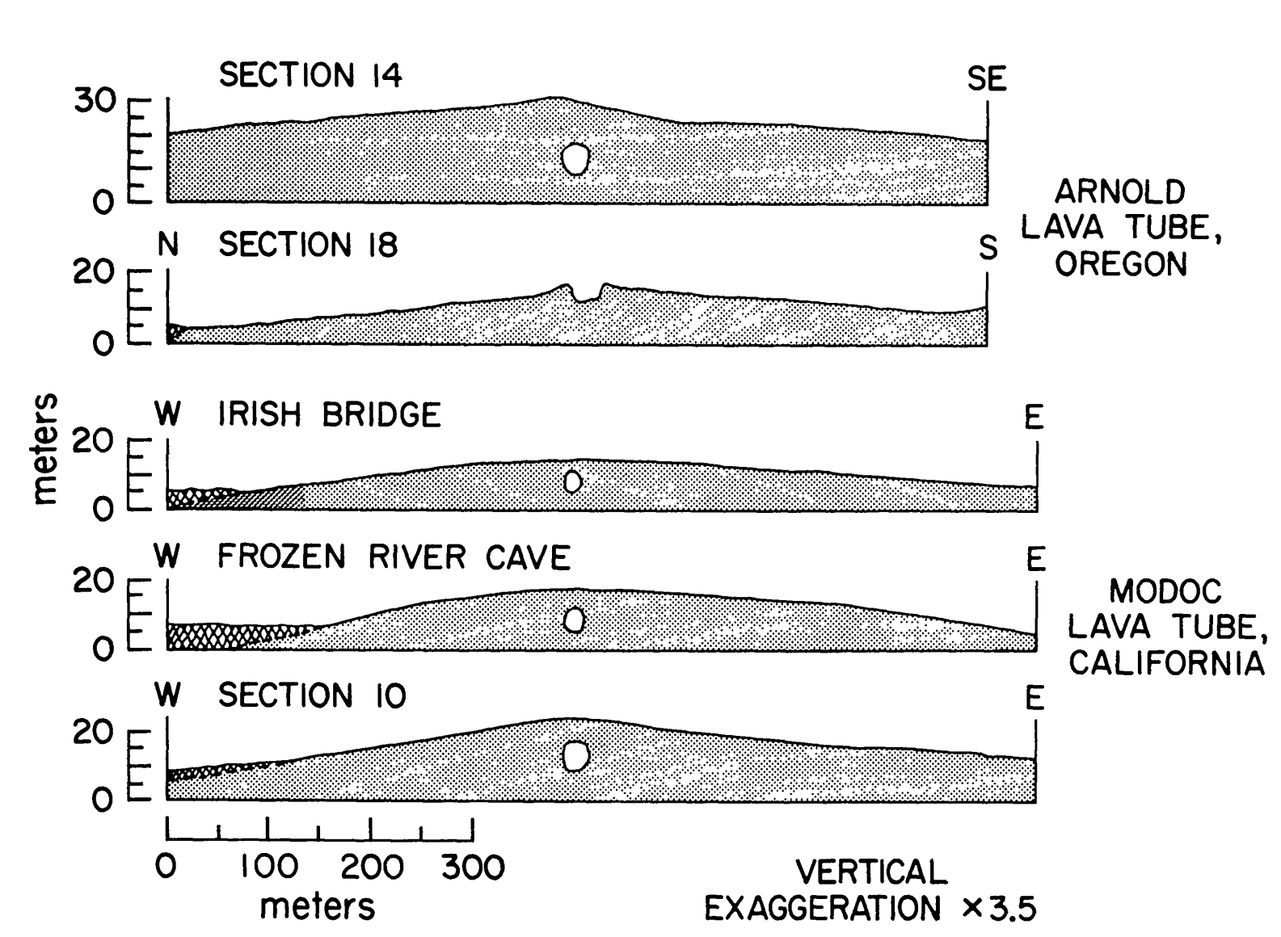
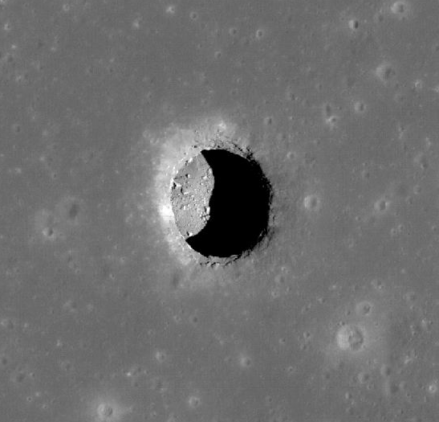
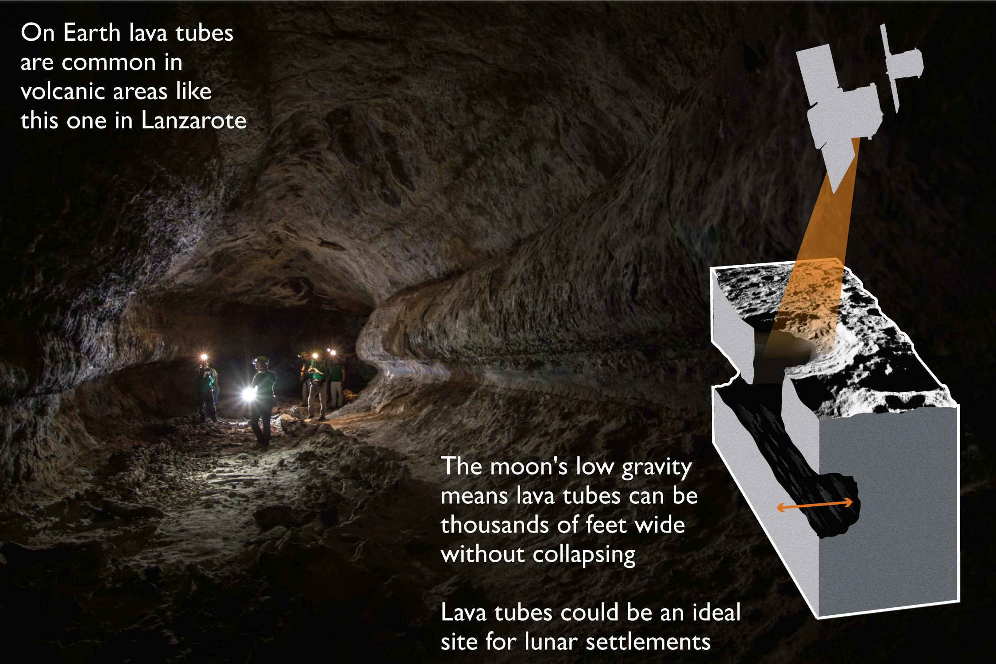
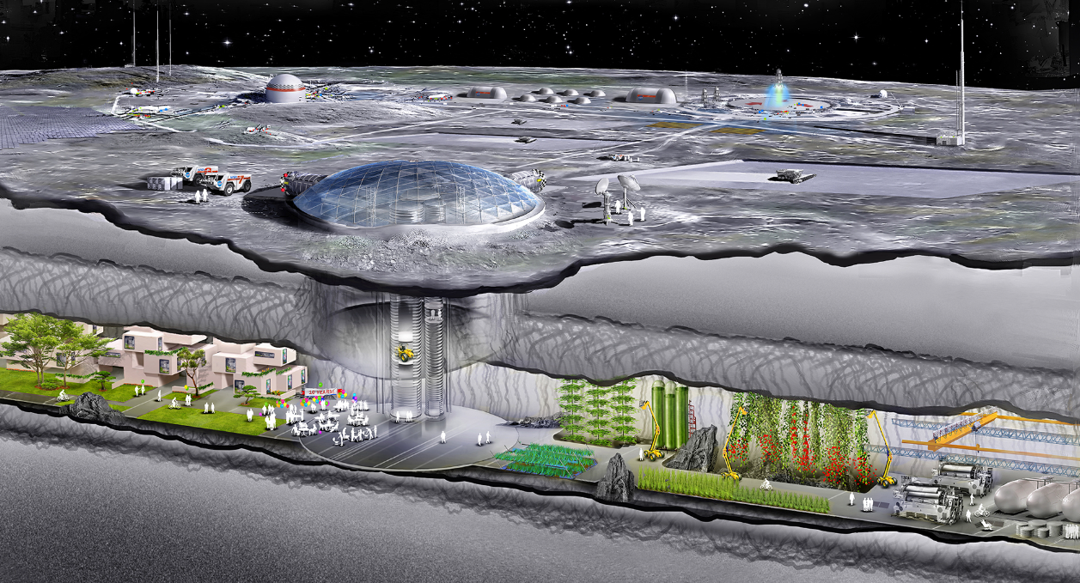
Use Case
Lunar Surface:
Radiation
Micro meteorites
Hot (127ºC) and cold (-173ºC)
Lava Tube Interior:
1-10m of shielding
Relatively constant 17ºC

Slide 3
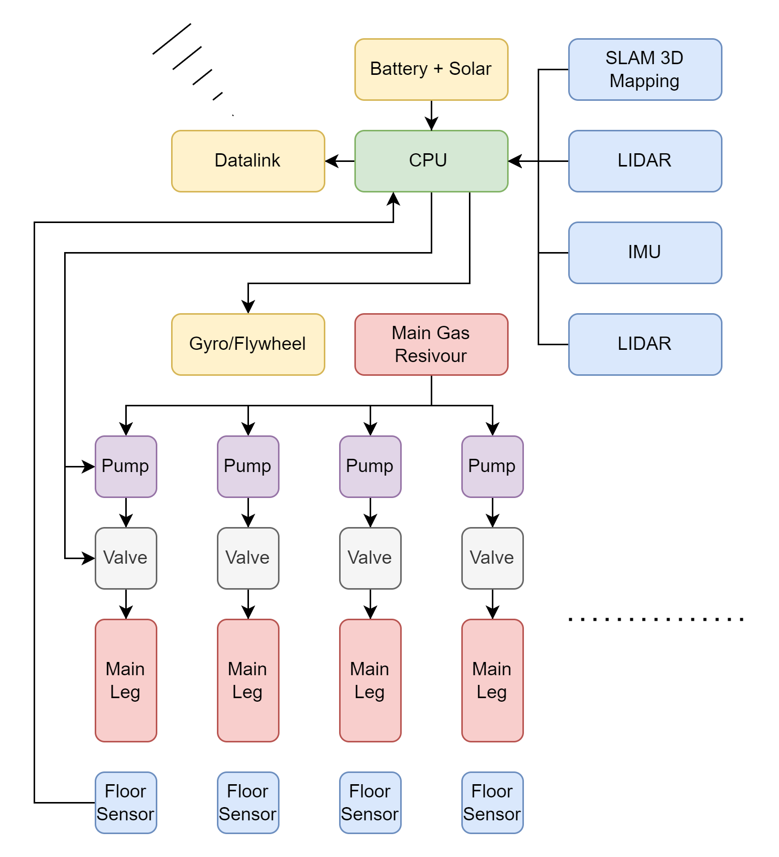
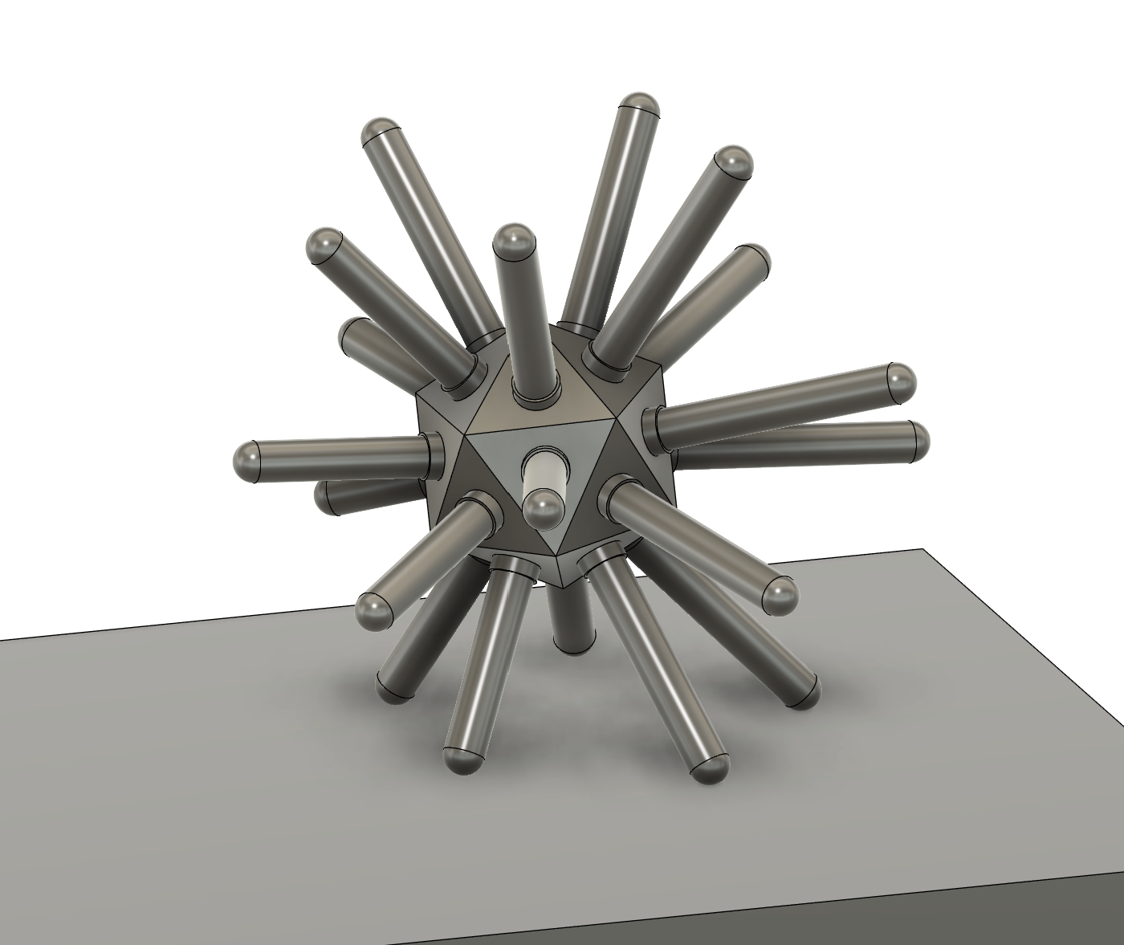
Novel Movement System
Can roll over obstacles
Redundant appendages in event of damage
No consumables
Can jump upwards using a gyro/flywheel

Slide 4
Soft Robotics
Rubberised skin
Flexible and extendable appendages
Built-in impact resistance
Deflectable so can be
Can inflate to very large size without large weight penalty

