Slide 1

eHarbinger
Meghan Clark: Front End Developer
Brian Marks: Database Developer
Priyam Nidhi: UX Developer
Benson Tsai: Back End Developer
Notes:
Meghan: 11, 12, 13, 18, 22
Priyam: 2, 3, 5, 10, 14 19
Brian: 6, 7, 15, 16, 20, 23
Benson: 4, 8, 9, 17, 21

Slide 2
Overview
Background
Requirements
Analogy
Analysis
Market Research
Design
Advantages
Upcoming Improvements
Post Implementation Review
eHarbinger Demonstration

Slide 3
Background
Expanding market in games
Games as a service
F2P games introduce variety
Blurred lines between games & social media
Consoles allowing sharing
Lifetime of games increasing
Notes:
58% of Americans play video games
Average age of players: 30
77% of gamers play at least one hour a week
Point 1 reference http://www.bigfishgames.com/blog/2014-global-gaming-stats-whos-playing-what-and-why/
Point 2 http://www.internap.com/2014/12/01/top-five-online-gaming-industry-trends-2015/
F2P: Free to Play
http://metro.co.uk/2011/12/02/the-problem-with-online-gaming-readers-feature-242285/
Talks about host quit messages, check compatibility level

Slide 4
Background
Compatibility levels
Toxicity
Not all games are familiar
Host can quit session midway
Design can exclude communication
Ways to stay in touch
Trusted meter to judge opponent’s capability
Lack of a trusted gaming community
Notes:
http://www.theguardian.com/technology/2015/jul/23/16-trends-that-will-change-the-games-industry

Slide 5
Requirements
Frustration
Incompatible team
Trolls in gaming
Lack of visibility/service post game
As a multiplayer online gamer, I can specify my skills and find the right match for the desired gaming community.

Slide 6
Requirements
Web based application
Match based on attributes
Assemble a team
Find opponents
Parse through created profiles
Discussion board
Agile lifecycle
Notes:
Target segment is mainly gamers aged 18-35 years with disposable income. Should be ideally playing online games for an hour/day and willing to try/learn about new games.
The product function is to match users with other users based on their compatibility in various video games. The primary software components discussed in this document are: the product will contain a user profile with publicly available information about the users, for users that have been matched together, a chat will be available for the users to communicate, and there will be a section private to each user where he/she may answer questions. The responses to these questions will determine how the users are matched together.
The users answer a questionnaire upon joining and information obtained from the questionnaire is used to match them with others. The algorithm used to match users is laid out to retrieve the correct values from the database.

Slide 7
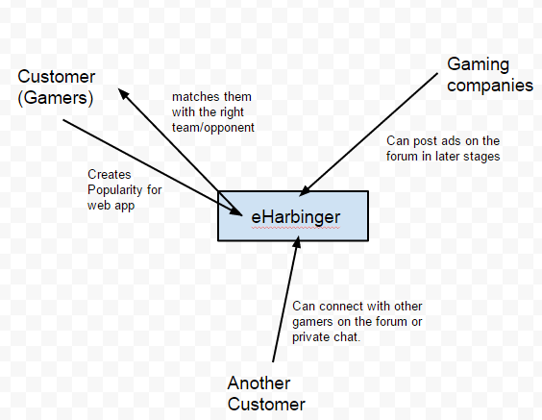
Requirements
Notes:
The eHarbinger system connects gamers with other gamers as well as gaming companies

Slide 8
Analogy
Profile must include games played and levels
Requirements broken down through:
Web page
Database
Server
Dictionary with the breakdown
Notes:
Familiar example: Our team had decided on this idea for a project after seeing multiple other students in the School of Engineering come across this issue. A lot of students within the school like to play a popular multiplayer online game such as League of Legends. However sometimes it isn’t possible to get enough people on the same level to progress within the game.
This issue isn’t just within NYU School of Engineering. Many forums for gaming websites will have others complaining about this issue from seeing who has a Steam account to play GTA V to finding a Call of Duty server that isn’t full of twelve year old boys shouting insults about other players’ moms online. Our team believes that we will be able to solve this issue through our own matchmaking website.

Slide 9
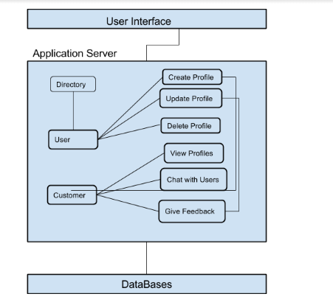
Analysis
Notes:
I will replace this is with a real chart created on Ppt as it looks more professional

Slide 10
Market Research
Build the gaming community
Provide rating capabilities
Stay updated with latest games
Post on the forum
Chat to learn more from your matches
Stay connected post games
Product that services!

Slide 11
Market Research
In survey conducted, 78% of respondents liked playing games with more than 2 gamers
96% of respondents have often played games with players they disliked due to skills
Popular features that target segment wants:
Game Tags
Team preferences
List of games updated weekly
Age (>13 years)
Notes:
Should there be a link to the survey?
https://www.surveymonkey.com/analyze/5dfqPmTtazNh1_2FmNnyxtAlxDheBbIeCJQV5jGwriheY_3D

Slide 12
Market Research

Slide 13
Market Research

Slide 14
Market Research
Hear from some of our customers
https://www.youtube.com/watch?v=vm8gyUz1XgE

Slide 15
Design
User signs up and creates profile
User answers game and personality questions
Matches suggested after running necessary algorithms based on weighted sum of:
Games played
Personality questions
User can message their matches to play together
Notes:
Sign up
Answer questions
Get matched
Contact and play

Slide 16
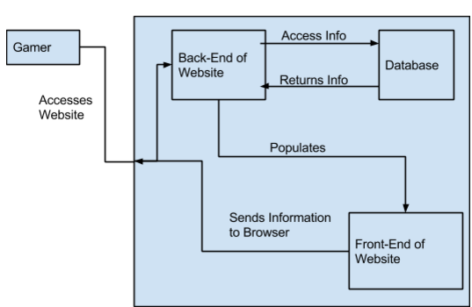
Design
Notes:
This is a diagram that gives a higher level version of the previous slide

Slide 17
Design
Identified interfaces and deployment architecture
UML diagrams for cohesiveness
Activity diagrams
System design testing
Notes:
Activity diagrams see how a usual activity will occur: start to bottom

Slide 18
Advantages: Why choose us?
Provide the matching capabilities at no charge
Enhance gaming experience
Connect the user with other games and gamers
Foster a strong gaming community
All levels of gamers find a match
Agile approach helps accommodate needs
Notes:
Partner with premium ad networks that perform well on gaming sites

Slide 19
Further improvements
After trying the website, some suggestions:
Skins, player descriptions, leaderboards
Notification when your matches are online
Monetization strategy
Ads from the multiplayer gaming websites
Launch Android and iOS version
Matching functionality extended to other domains like online tutoring
Notes:
Kixer: mobile recommendation engine
Developing an online brand strategy by tagging with other gamers
Charge for skins and avatars

Slide 20
Post Implementation Review
What we did right
Met external deadlines
Conducted bi-weekly walkthroughs
Modularized design of classes (high cohesion, low coupling)
Upheld a democratic environment
Utilized group collaboration products
Thorough market research
Current market for product
Future possibilities

Slide 21
Post Implementation Review
What we did wrong:
Certain group-set deadlines were missed
Strict timeline did not allow to replicate all the suggestions gathered from market research
Underestimated hours for fault correction
Notes:
Remove testing part

Slide 22
Post Implementation Review
What we would change:
Strict in-person reviews before submitting documents
Firm group deadlines/milestones monitored by the project manager
Close monitoring through integration test
Revisiting suggestions made by users and integrating them with front end

Slide 23

eHarbinger Demonstration
Any questions about eHarbinger?
http://pdc-amd01.poly.edu/~bt773/eHarbinger
Thank you Prof. Strauss for advising us!

