Slide 1
Linear Algerbra Basics
Date: 2026-01-05
Presenter: Jongbum Won

Slide 2
Vector and Matrix Notations
Scalar: magnitude only
Vector: magnitude + direction (boldface, lowercase)
Matrix: 2D array of numbers (uppercase)

Slide 3
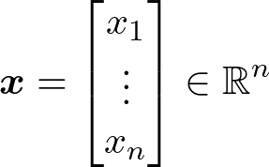
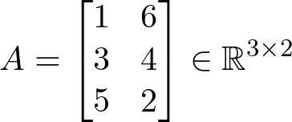
Vector and Matrix Notations
Scalar: magnitude only
Vector: magnitude + direction (boldface, lowercase)
Matrix: 2D array of numbers (uppercase)
scalar
vector
matrix

Slide 4
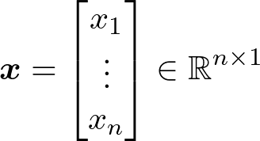
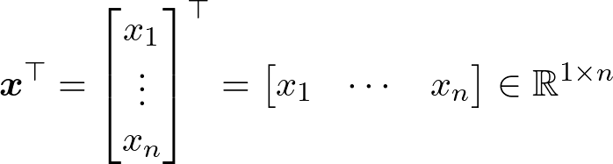
Vector and Matrix Notations
- An n-dimensional vector typically refers to a column vector (i.e., an n × 1 matrix)
(column) vector
row vector

Slide 5

Linear equation and system
- Linear equation: an equation that may be put in the form
are variables
are coefficients

Slide 6
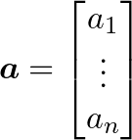
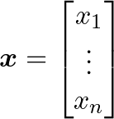
Linear equation and system
- Linear equation: an equation that may be put in the form
are variables
are coefficients

Slide 7
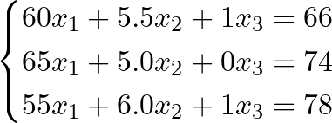
Linear equation and system
- Linear system: a set of linear equation involving the same variables
환자 ID | 몸무게 | 키 | 흡연여부 | 기대수명
1 | 60 kg | 5.5 ft | 1 | 66
2 | 65 kg | 5.0 ft | 0 | 74
3 | 55 kg | 6.0 ft | 1 | 78
We can predict the newcomer's lifespan if we can solve for x.

Slide 8
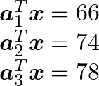
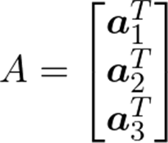
Linear equation and system
- Linear system: a set of linear equation involving the same variables
Notes:
내적의 관점으로 각 equation을 vector equation으로 볼 수 있다.

Slide 9
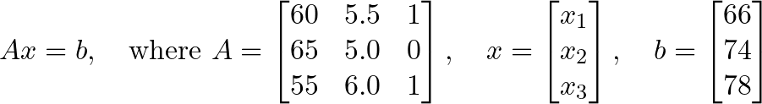
Linear equation and system
- A linear system can be represented in matrix-vector equation as Ax = b
Notes:
그걸 합치면 A가 되고, Ax=b꼴로 표현이 가능하다.

Slide 10
Linear equation and system
- A linear system can be represented in matrix-vector equation as Ax = b
Notes:
즉, linear system은 Ax=b라는 matrix equation의 형태로 표현이 가능하다.

