Slide 1
Intro to VCS, Git, & GitHub
general assembly

Slide 2

AGENDA
What is version control?
Github
Creating a repo
Cloning a repo
Bringing to local computer
Making changes
Staging
Pushing
data science

Slide 3
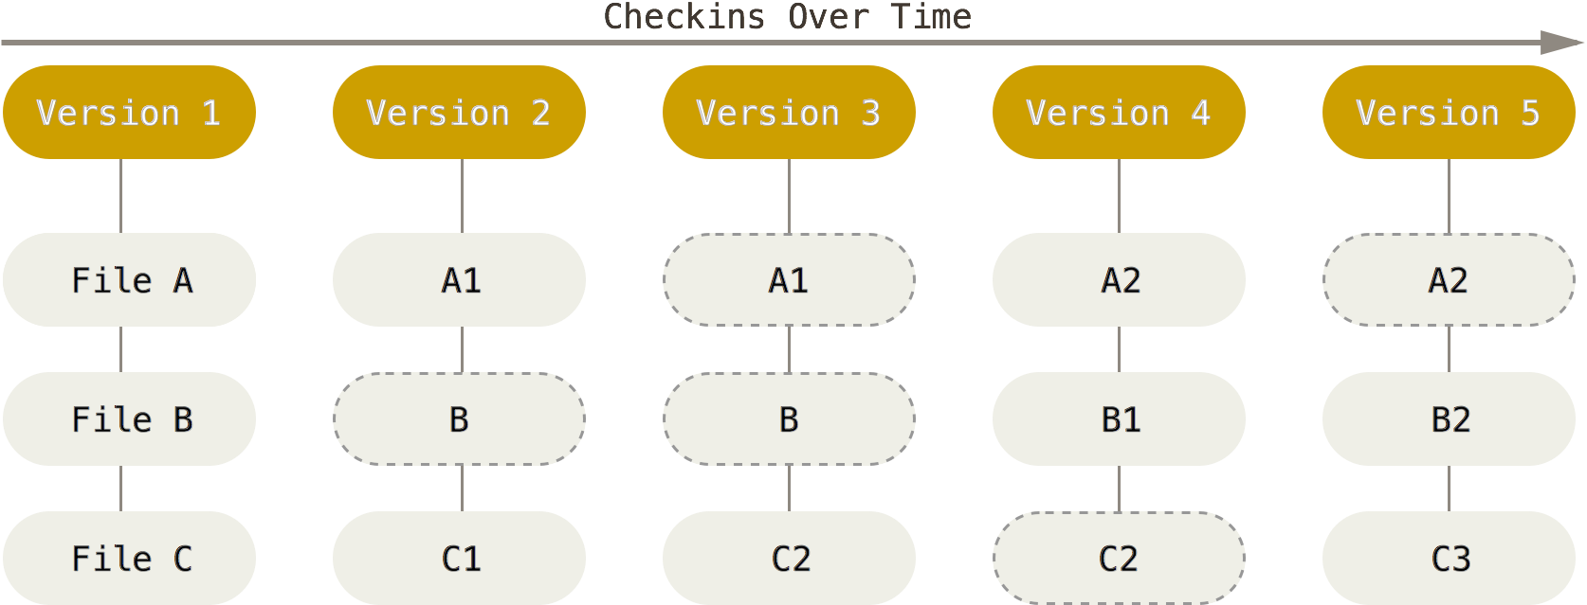
Version Control
A system that records changes to a file or a set of files over time so that you can recall specific versions later
Local Version Control
Centralized Version Control (Subversion, Perforce, CVS, etc)
Distributed Version Control: (Git, Mercurial, etc)
data science

Slide 4
Version Control
A system that records changes to a file or a set of files over time so that you can recall specific versions later
Local Version Control
Centralized Version Control (Subversion, Perforce, CVS, etc)
Distributed Version Control: (Git, Mercurial, etc)
data science

Slide 5
VCS Benefits
Formal system for tracking different versions of projects
Useful for Software
Easy Collaboration
Involvement in Open Source Projects
Skill for Employment
data science

Slide 6
GitHub
A website that allows you to put Git repos online
Not a VCS
Box for Git
Benefits:
Backup
Collaboration
Visual Interface
data science

Slide 7
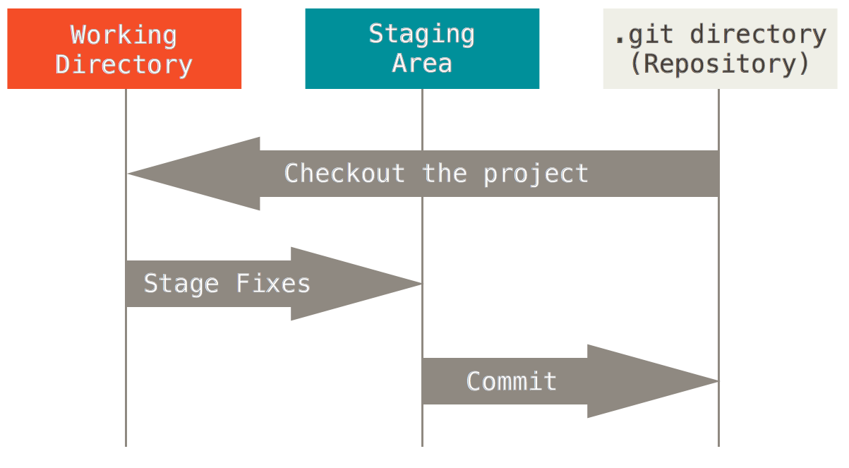
Three File States
Committed: Data stored in local database
Modified: Changed but not committed yet
Staged: Marked in its current version to go into next commit
3 Sections of a Git Project
Working Directory
Staging Area
Git Directory
data science

Slide 8
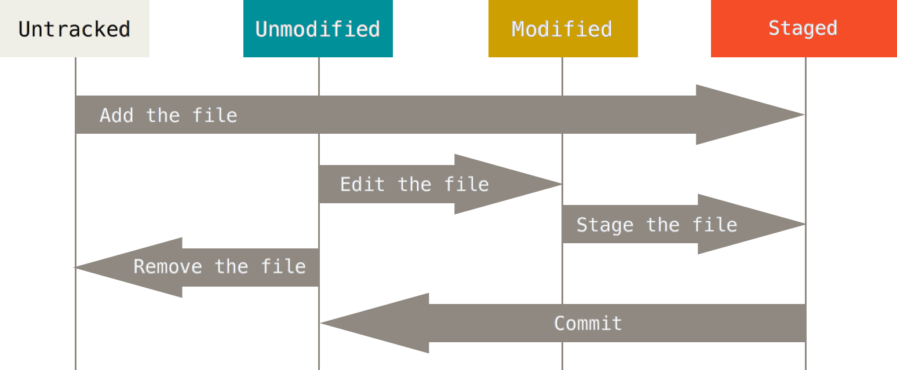
Basic Workflow
data science

Slide 9
Commands
Fork a repo: Make a copy of a repo in your account.
Log into GitHub
Go to repository
Click fork
Pull: Pull your changes into a repo
Create a new repository
Click on + then new repository
Choose name and description
Public
Initial readme
Click create
Copying repo to local computer:
Open git, terminal
Change working directory to where you want to save the repo
git clone [url of repo]
Hit enter
Type password
Repo is copied to a sub directory of working directory
data science

Slide 10
Commands
Status: Status of files (tracked, untracked, modified or not)
git status
Staging: Prepping files for committing.
git add filename
git add .
Commiting: Committing the changes to Git
git commit –m “Comment for the commit”
Log: Log of changes
git log
Push: Push the changes to the GitHub repo
git push origin master
Push master branch to the origin remote
Type password and you’re done
data science

Slide 11
To Do
Fork the course repo
Create a new repo for homework
Clone to local computer
Change README.md in homework
Commit changes
Push to GitHub
data science

