Slide 1
Lab03
Background subtraction
Threshold
Connected component

Slide 2
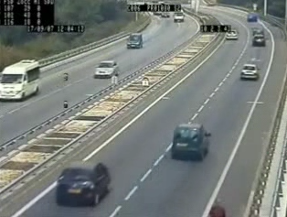
輸入一段影片

Slide 3
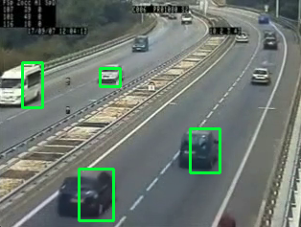
輸出成果
Background subtraction
Threshold
Connected component
框出前景

Slide 4
0. 讀取影片
影片(video)是由連續的影像(image)組成，組成影片的影像稱為影格(frame)，影片播放時會不斷呈現新的影格，影格間的時間稱作更新頻率(frame rate)。
cap = cv2.VideoCapture(filename)
cap.isOpened()
檢查影片是否被成功讀取
ret, frame = capture.read()
不斷讀取來源影格，把資訊寫進frame
cv2.imshow("frame", videoFrame)
顯示影片
cv2.waitKey(33)
等待幾毫秒再讀取下一禎

Slide 5
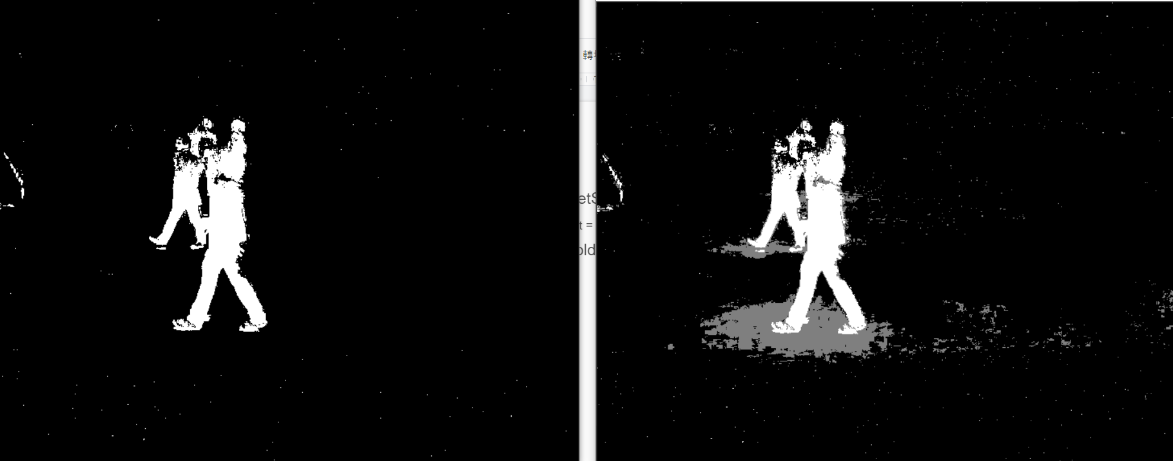
Background Subtraction
backSub = cv2.createBackgroundSubtractorMOG2()
創造一個BackgroundSubtractor
fgmask = backSub.apply(frame)
用在frame上面

Slide 6
2. Threshold
shadowval = backSub.getShadowValue()
找出shadow的值，default = 127，0: background，255: foreground
ret, nmask = cv2.threshold(fgmask, shadowval, 255, cv2.THRESH_BINARY)
輸出圖片 輸入圖片 threshold最小值 最大值 method

Slide 7
3. Connected Component
Two-Pass Algorithm:
Pass 1:
• Perform label assignment and label propagation.
• Construct the equivalence relations between labels when two different labels propagate to the same pixel.
• Apply resolve function to find the transitive closure of all equivalence relations.
Pass 2:
• Perform label translation

Slide 8
3. Connected Component
找connected component時，要同時計算相連區域面積
若相連區域面積 > T，找出相連區域最外圍的四個邊

Slide 9
4. 框出物體
opencv畫矩形
cv2.rectangle(影像, (頂點座標), (對向頂點座標), 顏色, 線條寬度)

