Slide 1

JustDice GMBH
Detailed Financial Analysis for the year 2022

Slide 2
Introduction
Whatever the size of the business, ensuring that it's successful or not is important to calculate the feasibility of its future, or just to give an insight into how effective it is and JustDice GmbH is no different.
For example, some of the processes may need to be changed to make the business more profitable. Success can be measured in a number of different ways, and it's important to remember that what success means for one business, might not be the same for any other business. Success is often measured based on a number of realistic targets.
A company's success is often associated with its sales revenues and profits. Essentially for a company like JustDice GmbH to be profitable , the revenue must be more than the Expenses.
In the slides below we will be looking at JustDice financial report and analysis for the year 2022 starting with Revenue.

Slide 3
Revenue Analysis

Slide 4
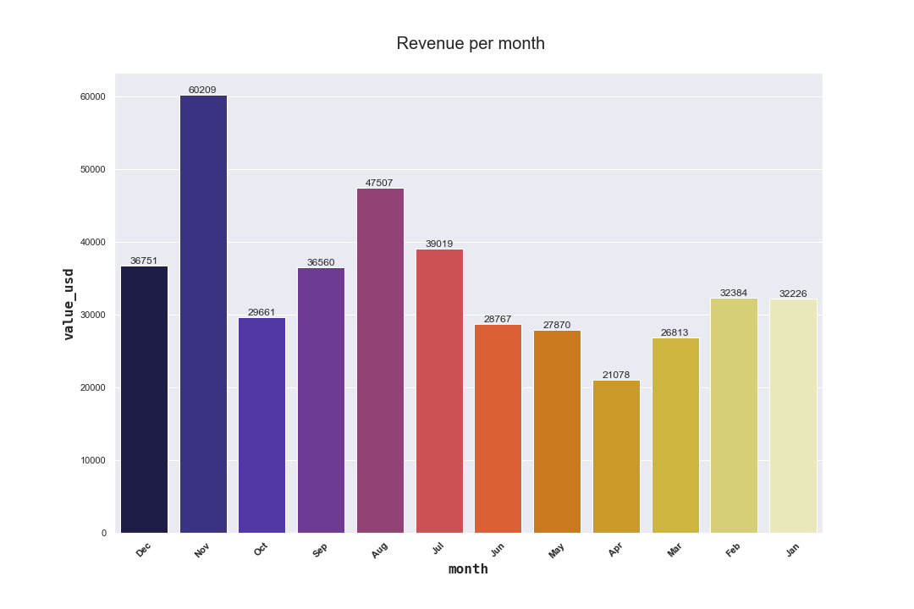
Total Revenue =$ 418 845
Graphical representation of the Revenue by Month.

Slide 5
Payout Analysis

Slide 6
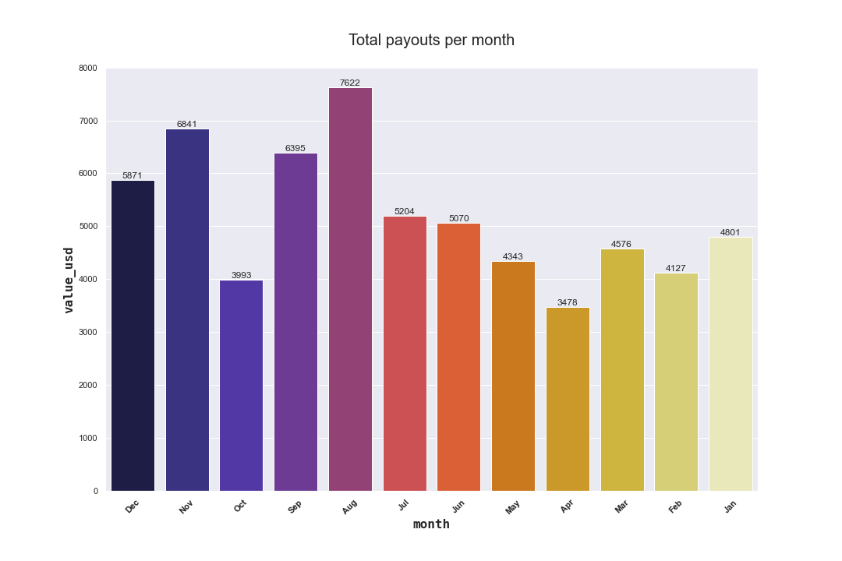
Total Payouts=$ 62321 Below is a graphical presentation of the Revenue by Month

Slide 7
Ad Spend Analysis

Slide 8
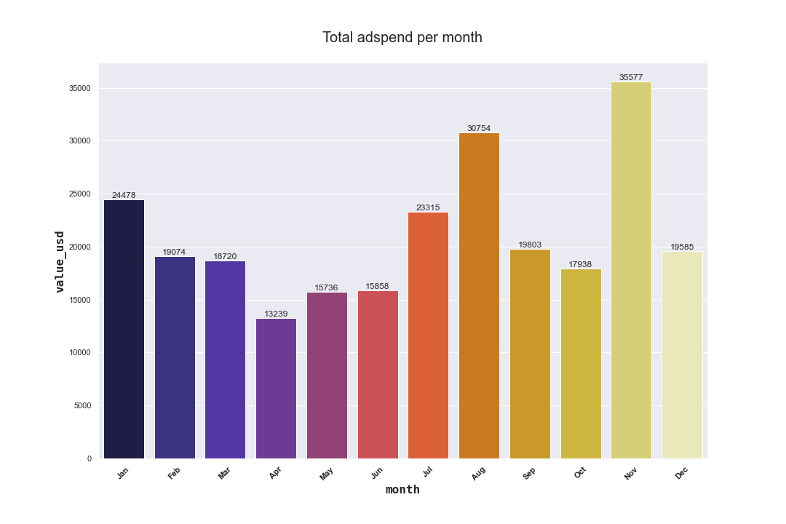
Total Ad Spend=$ 254 071 Below is a graphical presentation of the Ad spend by Month

Slide 9
Ad Spend per Network
Network ID | Value in $
60 | 214 834
10 | 39 237
TOTAL | 254 071

Slide 10
Top ten clients with the highest ad spend value in $
Client Id | Value in Dollars
174 | $ 104 607
94 | $ 71 367
121 | $ 42 158
71 | $ 11 021
189 | $ 4475
104 | $ 3188
256 | $ 2969
302 | $ 2632
275 | $ 1998
380 | $1764

Slide 11
Country id with the highest Ad Spend value in $
Country Id | Value in Dollars
1 | $ 243 186
109 | $ 10 053
213 | $ 501
17 | $ 334

Slide 12
Analysis on Installs.

Slide 13
Total installs = 216 888 The table below shows the top ten total installs per Operating System
Operating System | Number of Installs
11 | 79355
12 | 56679
10 | 45660
9 | 16285
8 | 5736
8.1.0 | 3894
13 | 2634
7.0 | 898
7.1.2 | 775
7.1.1 | 748

Slide 14
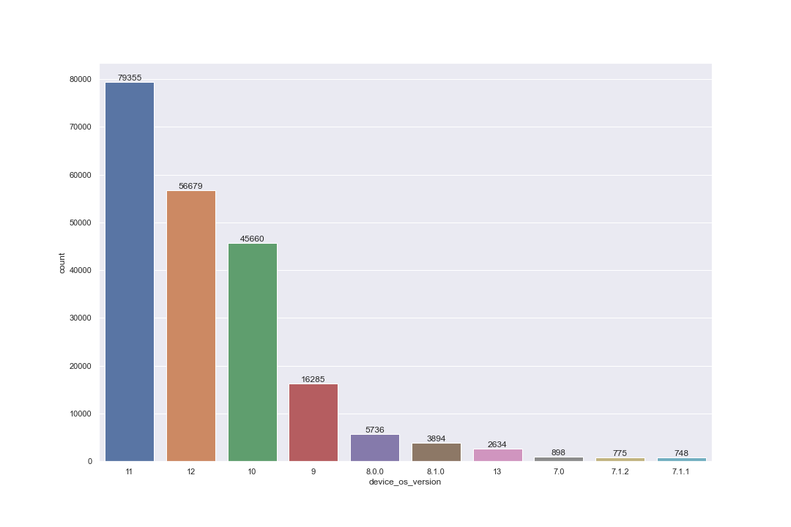
Graphical representation of the total number of installs per Operating System.

Slide 15
The table below summarizes the number of installs per month.
Month | Number of installs
August | 30428
November | 22732
January | 21224
September | 19945
December | 19332
July | 17884
October | 17387
June | 14906
February | 14816
March | 13518
May | 13424
April | 11342

Slide 16
A graphical Representation of the number of installs per month

Slide 17
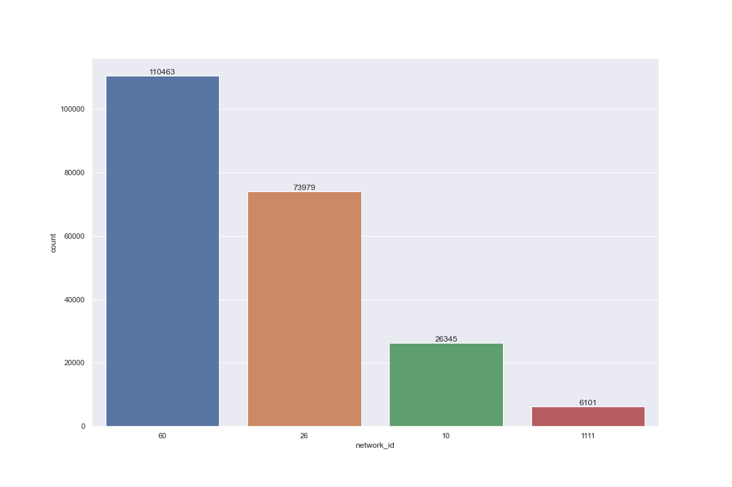
Number of installs per Network Id

Slide 18
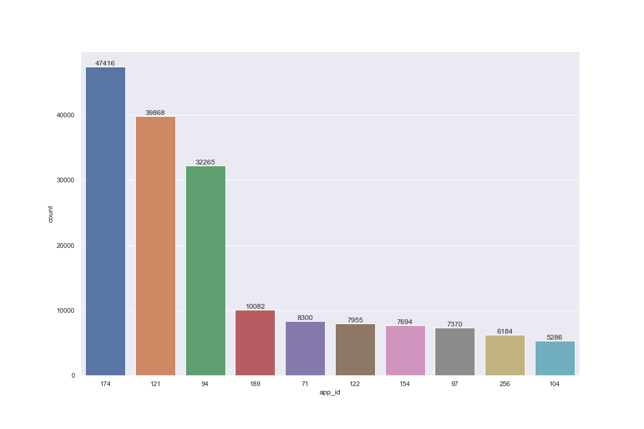
Top ten Number of installs per App Id

Slide 19
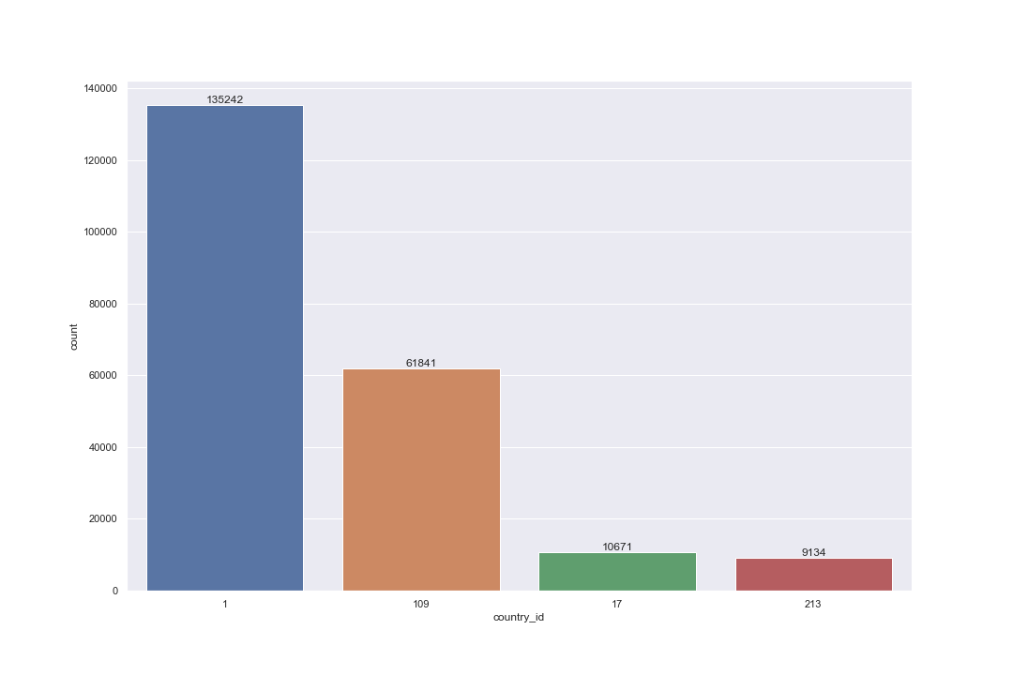
The total number of installs per Country Id

Slide 20
Conclusion
From the data we can draw the following conclusions.
November had the highest amount of revenue at $ 60,209.
November had the highest amount of ad spend at $ 35,577.
April had the lowest ad spend amount at $ 13,239 and also the lowest revenue at $ 21,078.
August had the highest number of installs and also the highest amount of payouts.
Country Id 1 had the highest value in ad spend at $243,186 and the highest number of installs at 135242.
Network id 60 had the highest amount of ad spend at $ 243,186 and also the highest amount of installs at 110463.
The operating system with the highest number of installations was 11 at 79,355 , followed by 12 at 56,679 and 10 at number three with 45,560 installs.
The app Id with the highest number of installs was 174 at 47,416 followed by 121 at 39868 and at number three was 94 with 32,265.

Slide 21
Recommendations
The company should produce more apps or produce more apps in future for the top three operating systems that is 11,12 and 10 because they had the highest number of installations which shows a high preference by the users for the three.
The company should develop more apps in the app id 174,121 and 94 category because they were the top three most preferred apps by users in regards to the number of installations.
The company should focus more on ads because from the data the higher the ad spend the higher the revenue in relation to the November data as well as the country ad spend data.

