Slide 1
Zeus Election Workflow and Cryptography
Georgios D. Tsoukalas
Greek Research and Technology Network (GRNET) S.A
EESTEC Govern the Way of Youth 2013
March 14, 2013

Slide 2
Layout
Introduction
  some engineering philosophy
  cryptography quick overview
  anonymity, verifiability, and challenges
Zeus Elections
Focus on Specific Issues
User Interface and User Experience

Slide 3
Building Secure Cryptographic Applications
Correct Software Function
  fortunately we can (usually) tell when it works or not
Software Security
  we can't tell by the results if it's secure or not
  we have to look at the code to see the “workflow”
Sound Cryptography
  we can't tell by the code if it's secure or not
  you have to look at the math...
If information leaks, you can't get it back.
  wheras if functionality fails, you can just fix it, or you can restore data from backup
Fortunately, others have figured the hard problems out
  they have produced “tools”: programming rules, test methods, cryptosystems, etc.
  we must understand and follow the rules
  you can't do security if you don't understand how information flows (the “workflow” again)

Slide 4
Use of Cryptography in Zeus
ElGamal Cryptosystem
  prime-order quadratic residue subgroup of safe prime
Fortuna Pseudo-Random Generator
SHA-256 for hashing
  Certain SHA-1 parts due to Helios javascript legacy
Schnorr discrete log proof
  prove: knowledge of secret of public key, encryption secret
Chaum-Pedersen discrete log equality proofs
  for DDH tuple proofs: re-encryption, decryption factor
Fiat-Shamir heuristic for non-interactive proofs
Probabilistic Zero-Knowledge proof for the re-encryption mixing

Slide 5
Anonymity and Verifiability
Traditional ballot box elections
handle anonymity better than verifiability
  you have to trust those that oversee the ballot box
Zeus (and Helios) elections
handle verifiabiliy better than anonymity
  must trust no-one for correctness
  must trust one of the trustees for anonymity
  still, better anonymity than traditional, if done right

Slide 6
Layout
Introduction
Zeus Elections
  Software architecture
  Workflow
  Cryptographic Proof Summary
Focus on Specific Issues
User Interface and User Experience

Slide 7
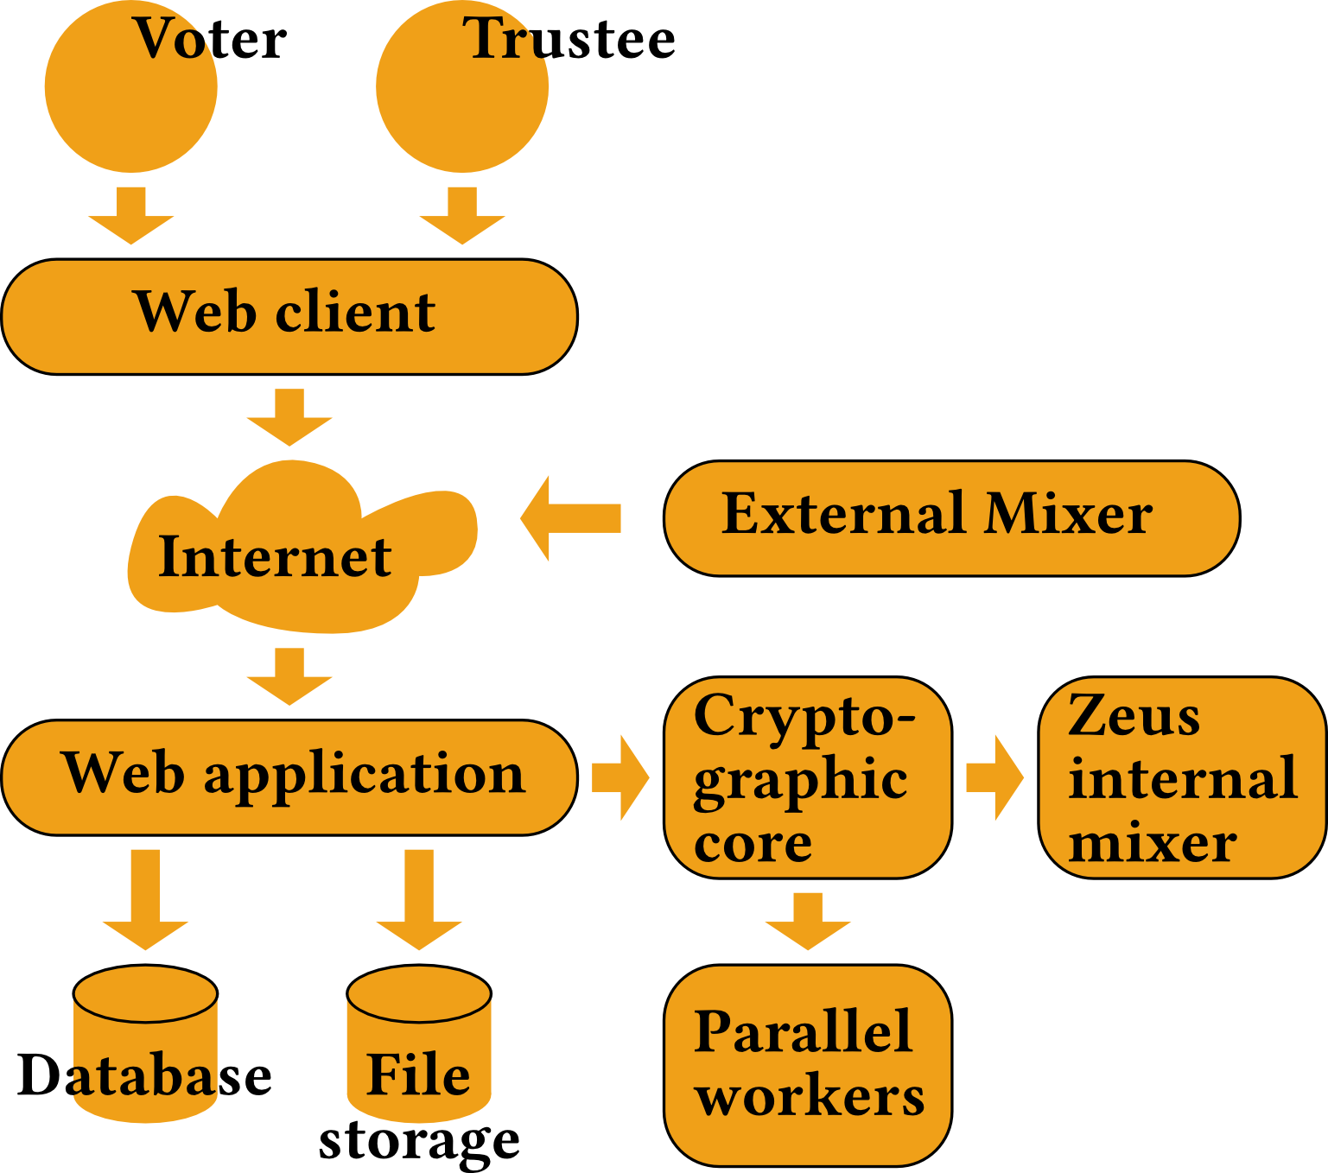
zeus architecture

Slide 8
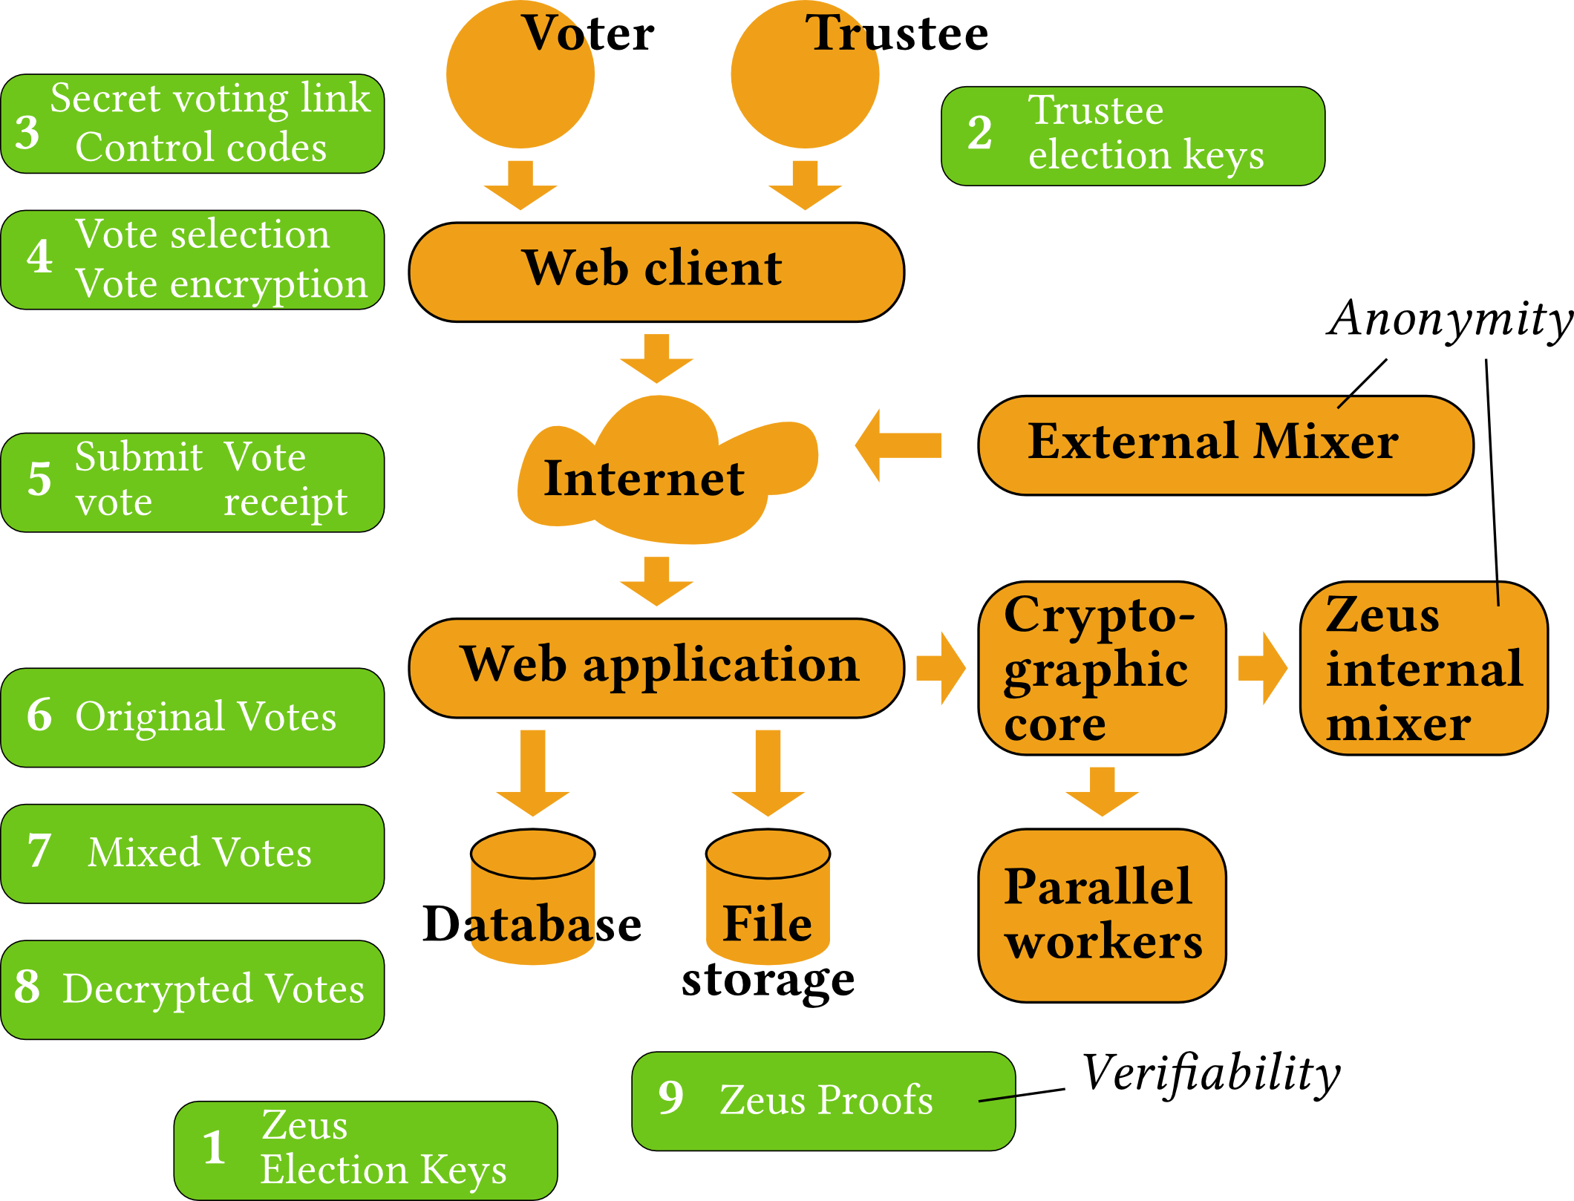
zeus architecture + workflow

Slide 9

zeus architecture + workflow + crypto summary

Slide 10
Zeus Election Workflow
Election Administrator
ZEUS Voting System
Voter Email
- Add Candidates / Voters / Trustees
Election
Public Key
- Private Election URL
- Audit Codes
- Cast Votes / Audit Votes
Trustee Election Keys
Trustee Election Keys
Trustee Election Keys
- Mix Votes
Trustee Election Keys
- Vote Submission Receipt
- Upload Trustee Decryption Factors
Decryption
Factors
- Decrypt Results
Voter Computer
Mix Contributors
Mix Contributors
Mix Contributors
Candidate Selection
Mix Contributors
Vote Encryption

Slide 11
Self-Contained Cryptographic “Core”
Isolate development and testing of core cryptographic functions from the web application
Allows for a simpler and cleaner design
  documents and forces a clear cryptographic workflow
Forces complex, changing, error-prone details out of the cryptography's way
  most of the bugs don't affect cryptography

Slide 12
Add Candidates, Voters, Trustees
Candidates define the ballot options
Voters are notified by e-mail
  e-mail contains a secret personalized URL link that authenticates them without password
Trustees are authorized like voters
  but get extra functions to upload their public key
  may also be given administrator control over election

Slide 13
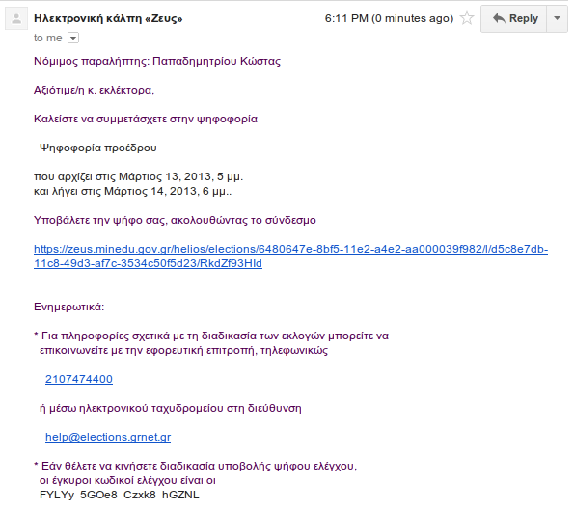
Voter Email Example

Slide 14
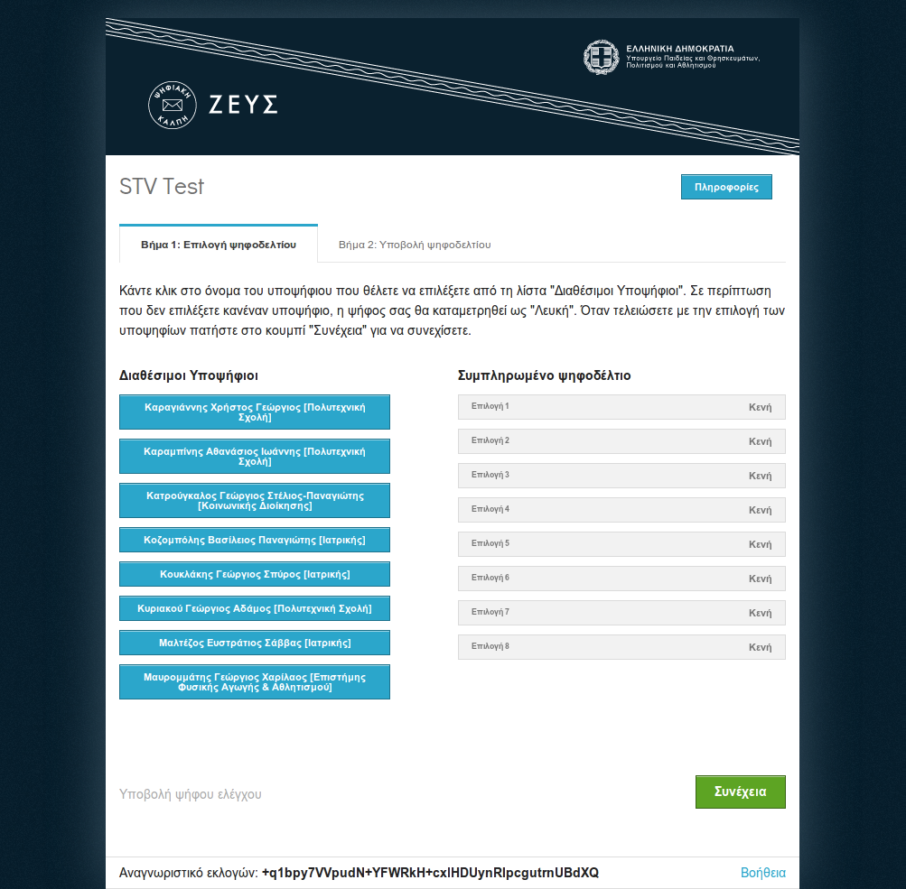
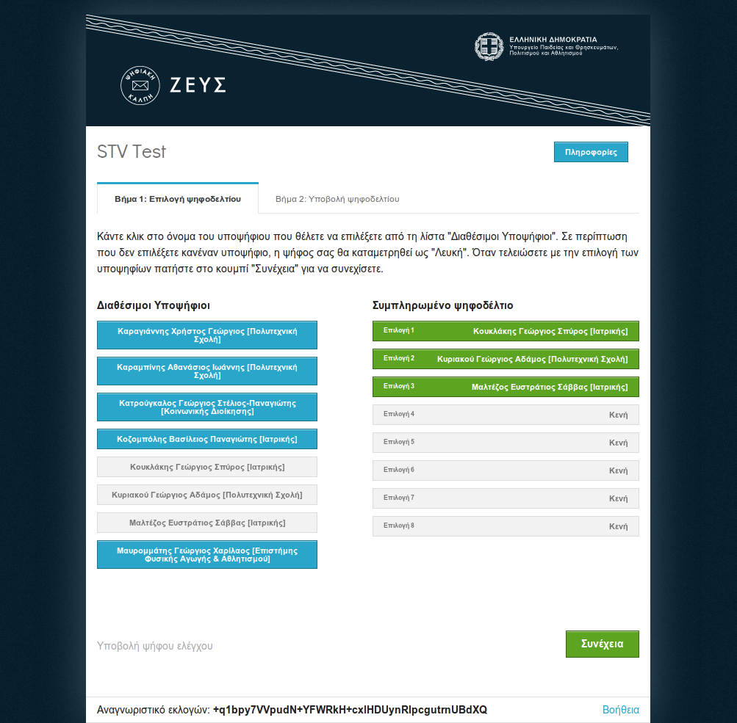
Voting Booth View

Slide 15
Cast Votes
Ballot selection is performed entirely in the voter's computer (i.e. web browser)
Vote is encrypted locally
Vote is submitted to Zeus over the network
  A cryptographically signed receipt is generated
User may vote unlimited times
  each new vote cancels his previous, discuss coercion

Slide 16
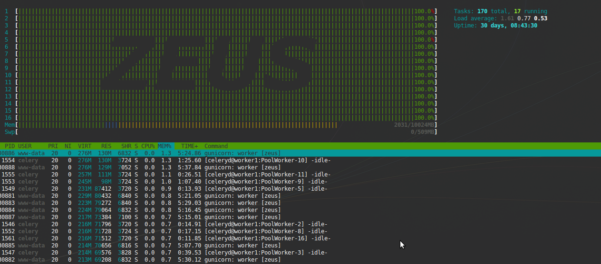
Parallel Mixing in 16 CPU cores

Slide 17
Mix Votes (voter anonymity)
Original votes are archived with voter identity
  publishable data for election verification
Ciphertexts are stripped of all identity
Then are mixed in multiple consecutive passes
  through an ElGamal re-encryption mixnet
  one honest mix suffices for anonymity
  produce a public Zero-Knowledge probabilistic proof for each
  no secrets required, anyone can mix
The resulting ciphertexts are
  decryptable to the same plaintexts
  unrecognizable by their ordering or cipherext appearance

Slide 18
Acquire Decryption Factors
Election public key is a combination of all the public keys of trustees
Each trustee contributes only a factor of decryption
  No decryption possible until all factors acquired
Trustee secret keys are never revealed
Trustee subsets cannot decrypt anything
Zeus can't decrypt anything else with the factors
  (e.g. the eponymous ciphertexts)
Zeus is a trustee for all elections

Slide 19
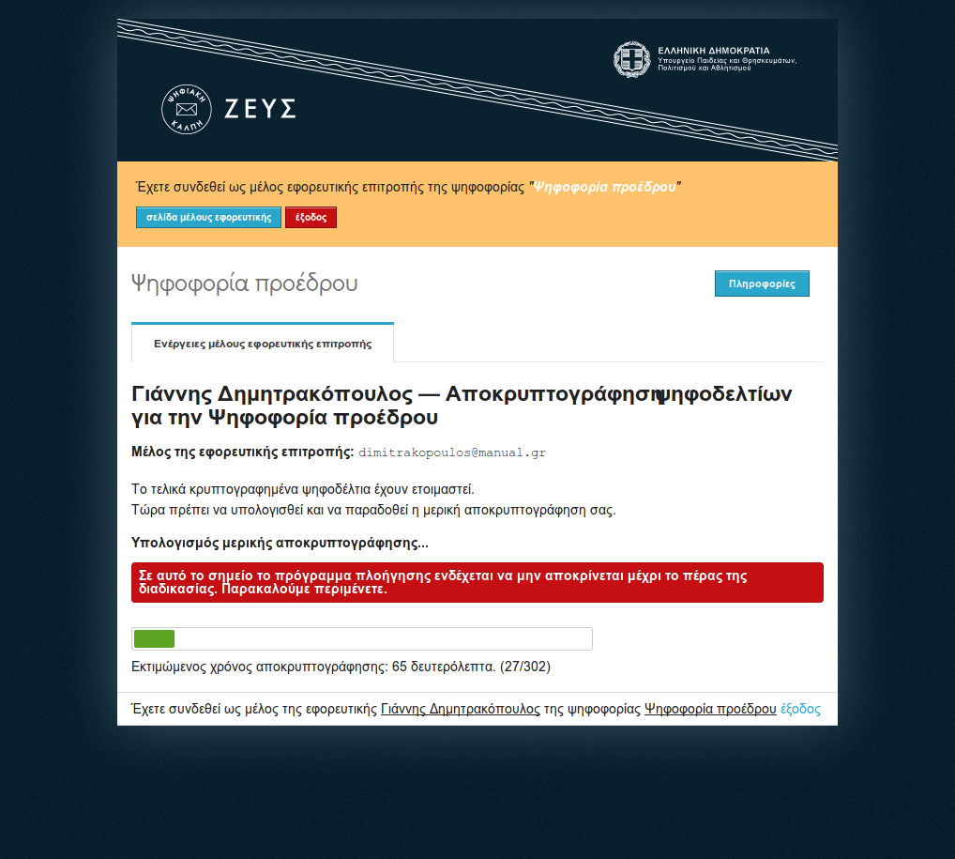
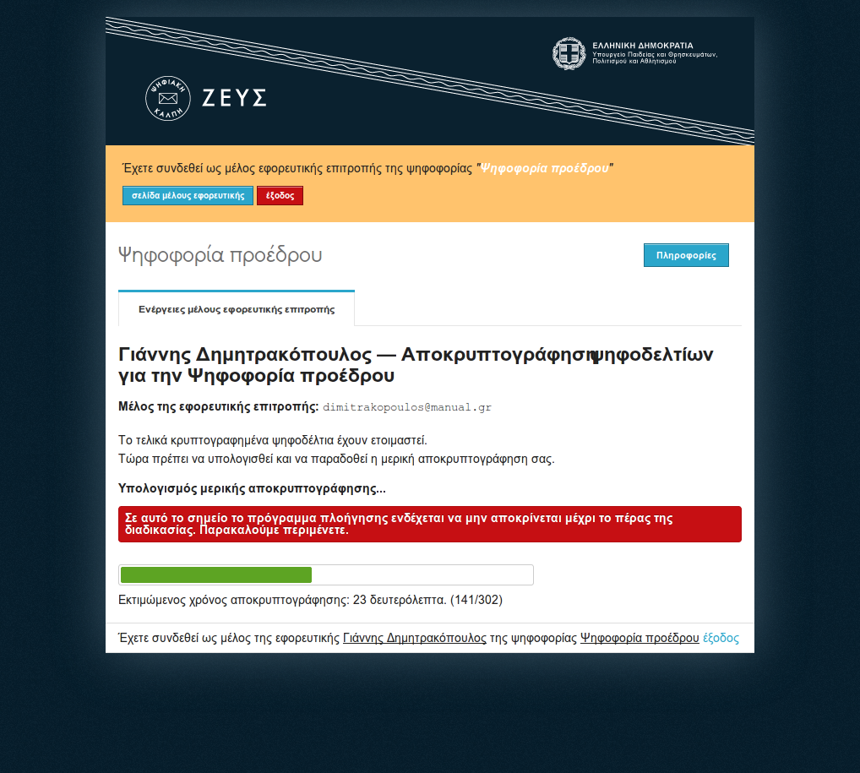
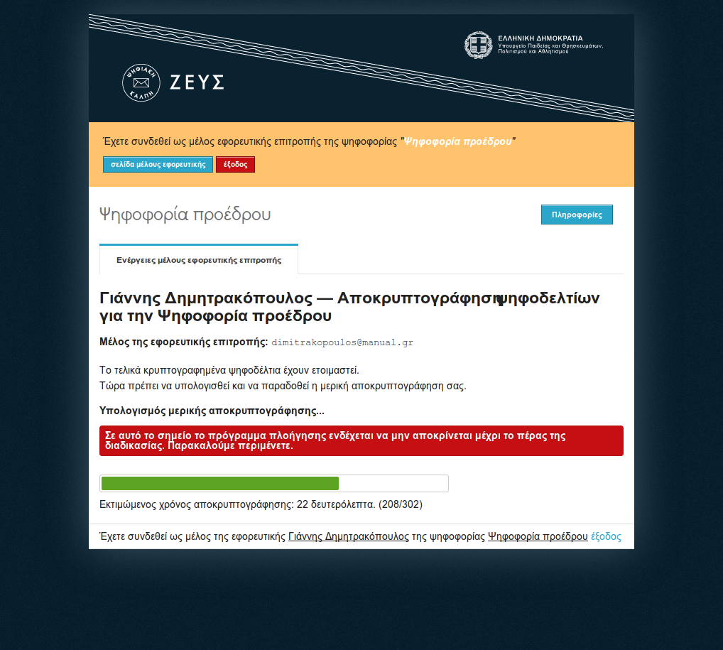
Partial Decryption in Browser

Slide 20
Decrypt Results
Decryption factors are combined
Mixed ciphertexts are decrypted
Individual ballots are published whole
Election data are publishable for verification
Publishing policy at the discretion of authorities

Slide 21
Layout
Introduction
Zeus Elections
Focus on Specific Issues
  Computation costs, parallelization
  Audit votes, proof data, randomness, encoding
  Helios comparison
User Interface and User Experience

Slide 22
zeus architecture + workflow + crypto summary

Slide 23
Zeus Election Workflow
Election Administrator
ZEUS Voting System
Voter Email
- Add Candidates / Voters / Trustees
Election
Public Key
- Private Election URL
- Audit Codes
- Cast Votes / Audit Votes
Trustee Election Keys
Trustee Election Keys
Trustee Election Keys
- Mix Votes
Trustee Election Keys
- Vote Submission Receipt
- Upload Trustee Decryption Factors
Decryption
Factors
- Decrypt Results
Voter Computer
Mix Contributors
Mix Contributors
Mix Contributors
Candidate Selection
Mix Contributors
Vote Encryption

Slide 24
Zeus Cryptography is Costly
Modular exponentiation dominates cost
Mixing in Zeus
  does a lot of modular exponentiation
  produces a lot of proof data
Helios' author considered mixing impractical
Zeus has better hardware, uses faster (7x!) libraries
  libgmp to the rescue, but no luck for browsers
Zeus parallelized mixing

Slide 25
Parallelization of Cryptographic Functions
“Embarassingly parallel”
  ...parallelization is considered a difficult art
  but here it is easy as computations are independent (e.g. each vote decrypts separatey)
  assign those independent loads to worker processes
Mixing and mix verification is parallel
Decryption and decryption verification is parallel

Slide 26
Randomness
A dangerous way to fail at cryptography
No randomness for in-browser key generation
  Helios provides good randomness from the server
Implementations may suffer
Wrong use of good randomness is possible
  e.g. fail to initialize correctly

Slide 27
Audit Votes
Audit votes test the local computer's integrity
  activate with an optional audit code
If the code matches one in the e-mail, it's a normal vote
  otherwise it's an audit vote
Zeus reveals vote type in response
  local can't tell whether to cheat until too late
  (vote already sent)
Audit votes require the publication of their encryption key
  The voter confirms that vote is phony: it will be published
Not everyone can or will do it
  but that a few that will is important

Slide 28
Zeus Proofs
cryptosystem | votes
candidates | cast_votes
trustees | cast_vote_index
zeus_public | excluded_voters
zeus_key_proof | mixes
election_public | trustee_factors
voters | zeus_decryption_factors
voter_audit_codes | results
audit_requests | election_report
audit_publications | election_fingerprint
JSON has no canonical form, had to create our own
This structure is hashed as a whole
Everything it contains is becomes officially verifiable as long as the hash is published
Other information can be included, but it could make the proofs non-publishable

Slide 29
ElGamal Group Element Encoding
Encoding the wrong way can ruin security
Enumerate all possible candidate selections
  give smaller ordinals to ballots with fewer candidates
  this saves plaintext bit-space for very large candidate sets but with few selections possible
0 is blank vote
more than max is a spoilt vote
more election types can be embedded within this encoding
  e.g. multiple party elections

Slide 30
The Helios Voting System
Open audit elections
  means everyone can verify it was done by the rules
Vote encryption in the web-browser
Elections are made of questions with given answers
  voters choose an answer for each question
voting for candidates is technically one yes/no question for each one
  Answer “yes” to those you vote for, “no” to others
  Of course, the user interface hides this technicallity
Software uses homomorphic tallying
  faster (no mixing), but does not support all election types
  had to re-implement significant parts of cryptography

Slide 31
Layout
Introduction
Zeus Elections
Focus on Specific Issues
User Interface and User Experience
  The problem with web browsers
  Remote booth access vs proper authentication, and a solution
  Coercion, trust, proof publishing
  Experiences with user behavior

Slide 32
zeus architecture + workflow + crypto summary

Slide 33
Zeus Election Workflow
Election Administrator
ZEUS Voting System
Voter Email
- Add Candidates / Voters / Trustees
Election
Public Key
- Private Election URL
- Audit Codes
- Cast Votes / Audit Votes
Trustee Election Keys
Trustee Election Keys
Trustee Election Keys
- Mix Votes
Trustee Election Keys
- Vote Submission Receipt
- Upload Trustee Decryption Factors
Decryption
Factors
- Decrypt Results
Voter Computer
Mix Contributors
Mix Contributors
Mix Contributors
Candidate Selection
Mix Contributors
Vote Encryption

Slide 34
The Problem with Web Browsers I
Compatibility headache (fortunately, jQuery)
Limited copy/save as functionality from JavaScript
Banning Internet Explorer
  hard decision, but others have made it too
  too many obsolete versions around
  security issues (phishing, etc.)
  buggier and more unpredictable than the others
  newer versions (9, 10) ok, but slow adoption

Slide 35
The Problem with Web Browsers II
Cryptography
No native cryptographic support in browsers
Addons/extensions not practical
  development and maintainance overhead
  user installation and updates required
There is hope with W3C WebCryptoAPI
  first draft 12 Nov 2012, Zeus already deployed
No other solution than Javascript...
  Cumbersome big-number support from JSBN library
  poor performance (but this improves with newer browsers)
    trustee decryption up to 40 minutes!

Slide 36
Authentication
Voting over the Internet very convenient
  but makes authentication a challenge
E-mail is the most immediately practical
  all the web uses it
Not tied to e-mail, any method for code distribution works
  even showing up in person to receive credentials
Authentication over Mobile SMS is the best solution
  Mobile phones are never anonymous by law
  They are ubiquitous and personal devices
  Already deployed with success (e.g. Google)

Slide 37
User Experiences
Even simple is not simple enough for non-tech savvy users
  many ignore basic computing / internet concepts
  it's ok, a critical mass can propagate understanding
    helpdesk helps too
It takes an expert to understand security
  procedures must be clear and resistant to errors
Trust is very important for elections
  software is not enough
  trustees, representatives, have to be convinced, have control

Slide 38
zeus architecture + workflow + crypto summary

Slide 39
Zeus Election Workflow
Election Administrator
ZEUS Voting System
Voter Email
- Add Candidates / Voters / Trustees
Election
Public Key
- Private Election URL
- Audit Codes
- Cast Votes / Audit Votes
Trustee Election Keys
Trustee Election Keys
Trustee Election Keys
- Mix Votes
Trustee Election Keys
- Vote Submission Receipt
- Upload Trustee Decryption Factors
Decryption
Factors
- Decrypt Results
Voter Computer
Mix Contributors
Mix Contributors
Mix Contributors
Candidate Selection
Mix Contributors
Vote Encryption

Slide 40
THANK YOU

