Slide 1
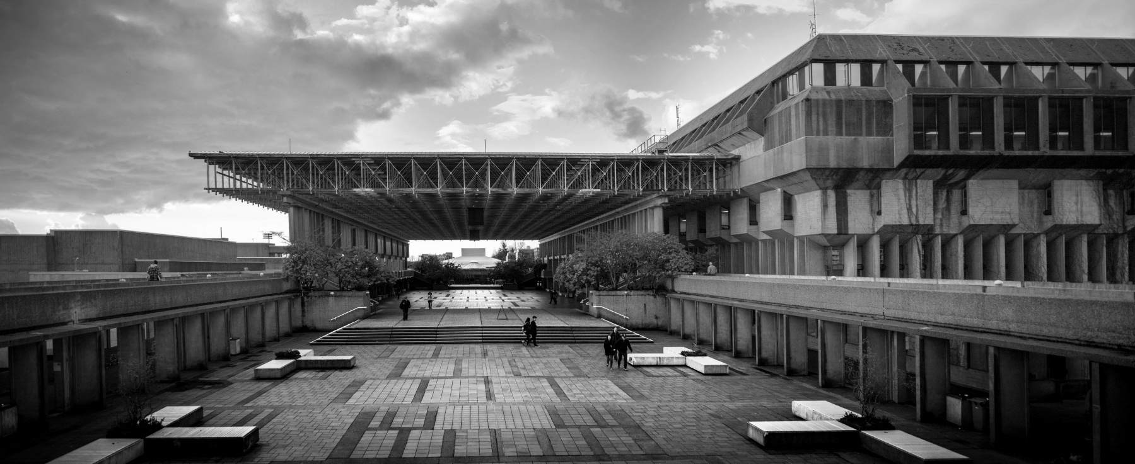

ENSC 450: Lab 1
Group: “What is a CMOS”
Member Names: Ben A, Michael L, Soroush SL

Slide 2
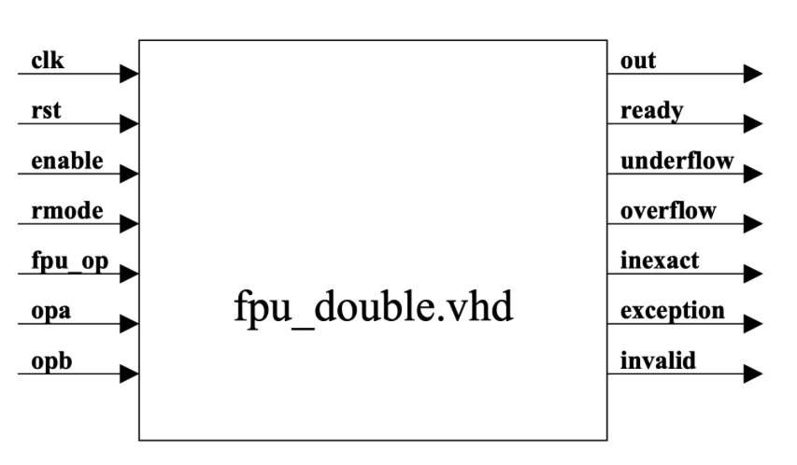
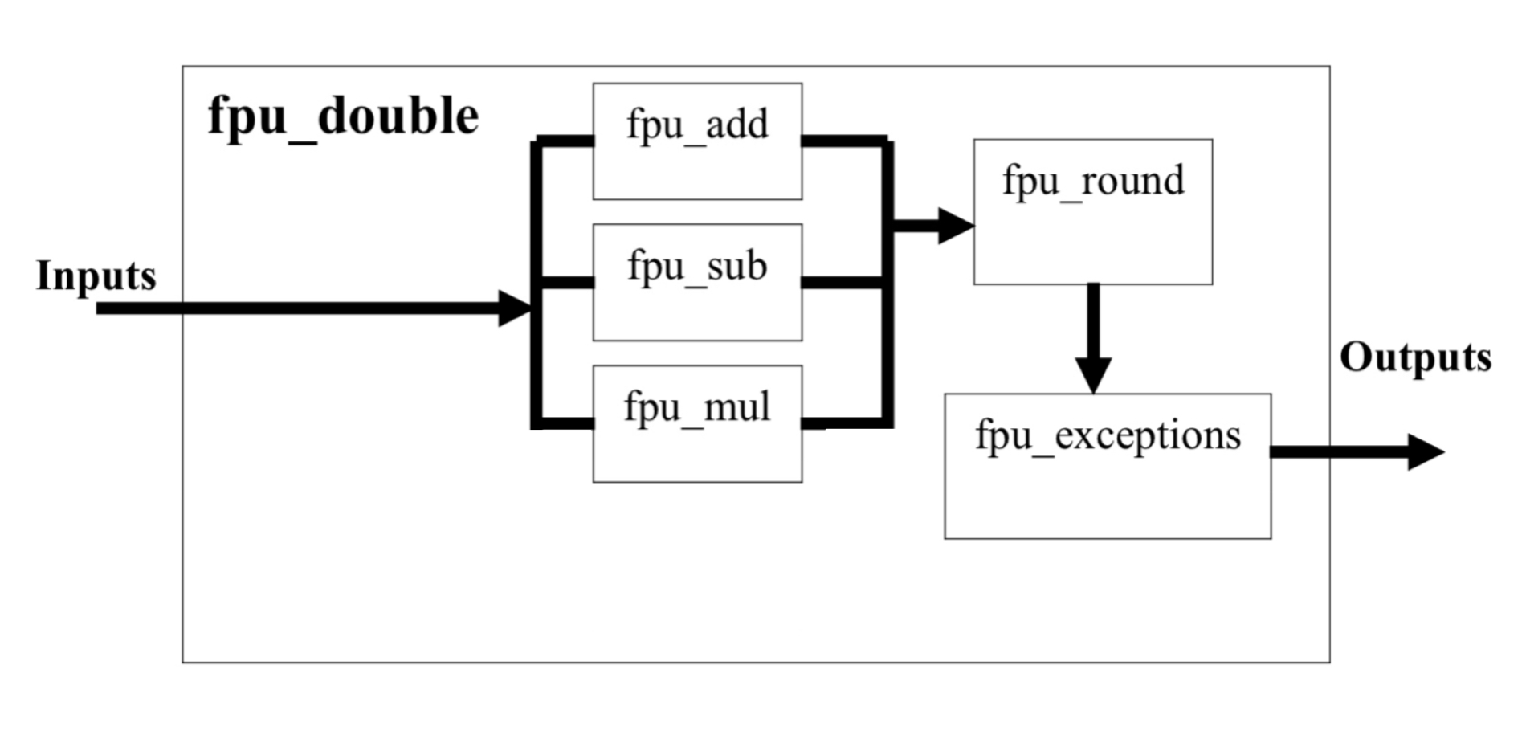
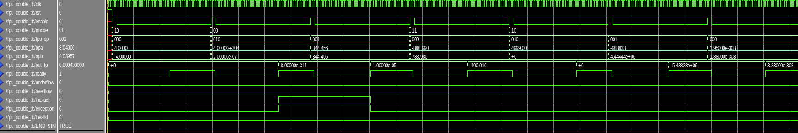
Part 1-2: Core @ 10MHz on CMOS 45nm
Core Description:
7 input Signals, 7 output Signals
float64 arithmetic operations (IEEE 754 Standard)
Add (000), Sub(001), Mul(010)
10 Mhz with 45nm stdcell library:
Area:
48949.053505 um^2
Gate Count: 48949.053505/(1000*0.8) = 61.186 ~ 61 kG
Notes:
Tried Floating Point (32-bit) Adder and Multiplier, FPU - met gate count but designs failed simulations
DSP Core - Hilbert Tranform, Avalon Core, Ultimate CRC all did not have testbenches
Settled on FPU Double (Double Precision) ALU - Adder, Sub, Multiplier Units, removed Division unit
add - 20
sub - 21
mul - 24

Slide 3
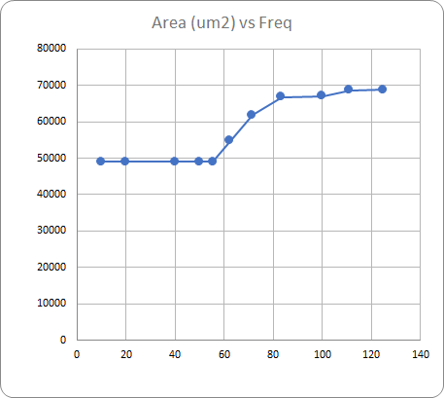
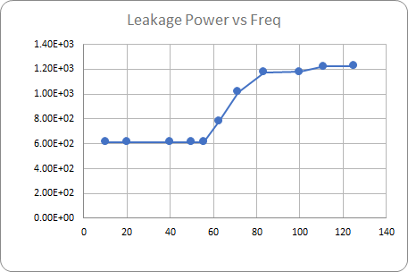
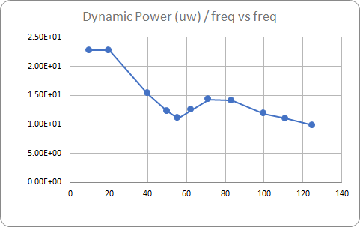
Part 3: Timing, Area, Power Analysis
‘Elbow’ point of plots is ~55MHz
Synthesizer begins to sacrifice area and power to meet timing constraints
Alternate option: Use fastest clock speed (125 MHz)
Metrics vs 55MHz:
performance: 125/55 = 2.27x
area: 1.41x
power: 2.28x
lower dynamic power per freq
Notes:
Choose frequency just before elbow point; past here synthesizer sacrifices area and power to meet timing constraints. As frequency continues to increase, the optimizations taken to meet the timing constraint is likely to result in a design failure when tested on a chip or FPGA

Slide 4
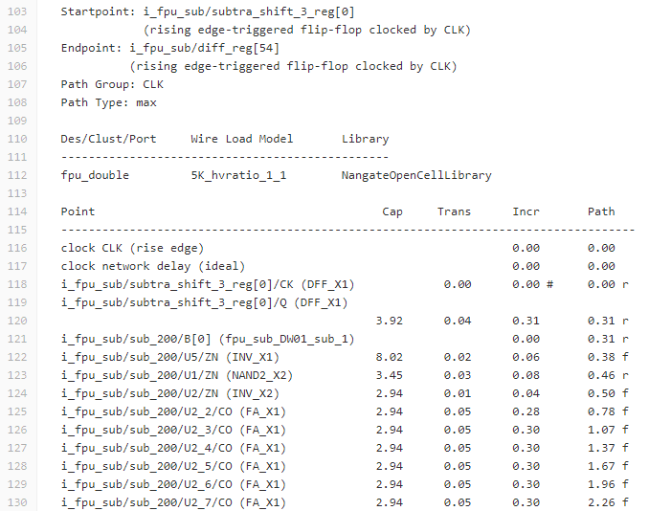
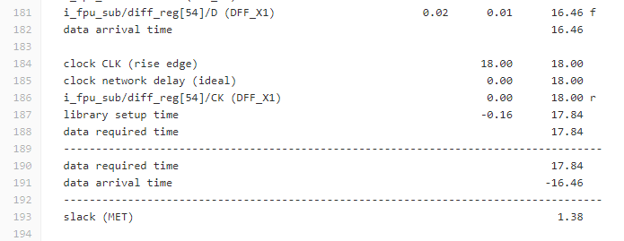
Part 3: Selecting Target Frequency
Target Frequency set at 55MHz
Area occupation: ~= 48949.054 um^2, or 61.186 KGates
Power consumption: Leakage = 613.49 uW, Dynamic = 1265.2 uW
Critical Path Description:
Subtraction Unit; at 55MHz have 1.38ns of slack
Full Adders used in Subtraction Unit contribute to long delay
Notes:
We also attempted synthesis and post-synthesis simulation at 50, 55, and 60 MHz to test how far we can take the design while allowing enough slack to complete calculations on time
55MHz provided a reasonable amount of slack while remaining before the ‘elbow’ point as to not drastically increase area and leakage power

Slide 5
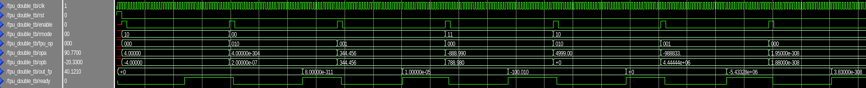
Part 4: Post-synthesis analysis
Synthesized netlist confirmed working after modifications:
Corrected if statements to keep signals if enable is '0'
Fixed enable and ready signal sequencing
Replaced package functions with faster ones for higher max freq.
Post-synthesis power results:
Critical Path: subtraction unit
rpt file lists many FA_X1 (full adder) units in a row in critical path
Likely a ripple adder within subtraction unit
 | fpu_double | top level | fpu_add | fpu_sub | fpu_mul | fpu_round | fpu_exceptions
Total power (uW) | 1,910.00 | 151.27 | 267.82 | 295.202 | 864.106 | 117.632 | 213.969
Total power % | 100.00 | 7.92 | 14.02 | 15.46 | 45.24 | 6.16 | 11.20
Notes:
Talk about how/why these values are different than the synthesis values? Compared to this back-annotation power analysis
We modified the script to print the power consumption of each subunit
VCD back-annotation is a more accurate representation of the power usage because it is based on the testbench results which is a more accurate reflection of real world usage.
Synthesis total power : 1878.69uW
VCD back-annotation : 1910uW

