Slide 1
Hospital Management System

Slide 2
Group Members:
Riad Jubayer Ahmed 14-27309-2
Ahmad Rahar 14-27315-2
Shuvo Md Benajir Ullah 14-27182-2

Slide 3
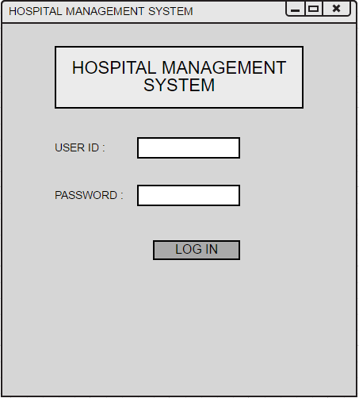

Slide 4
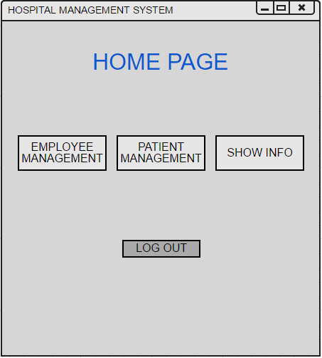

Slide 5
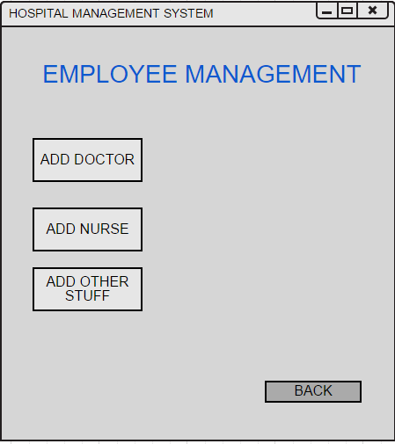

Slide 6
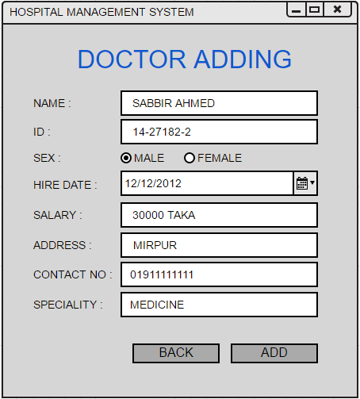

Slide 7
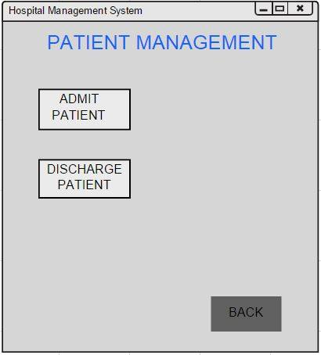

Slide 8
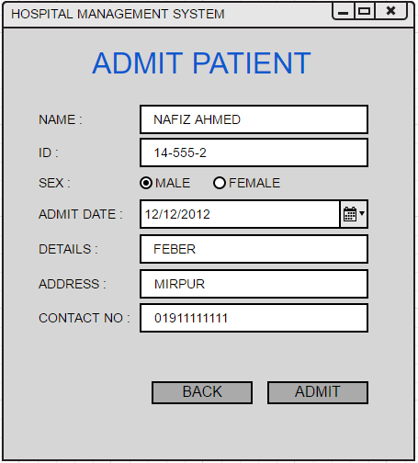

Slide 9
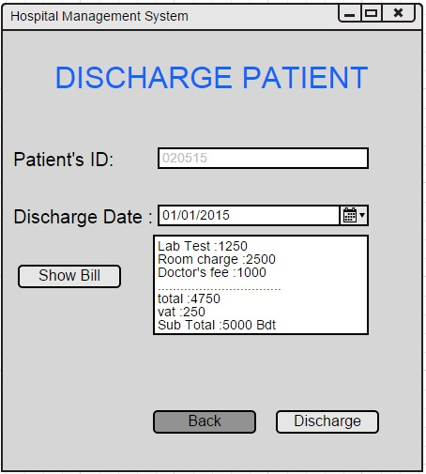

Slide 10
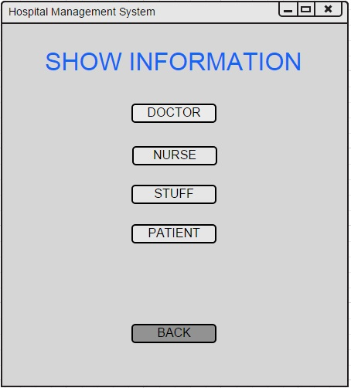

Slide 11
