Slide 1
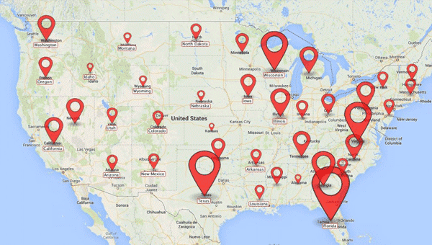
Neighborhood Watch Software

Slide 2
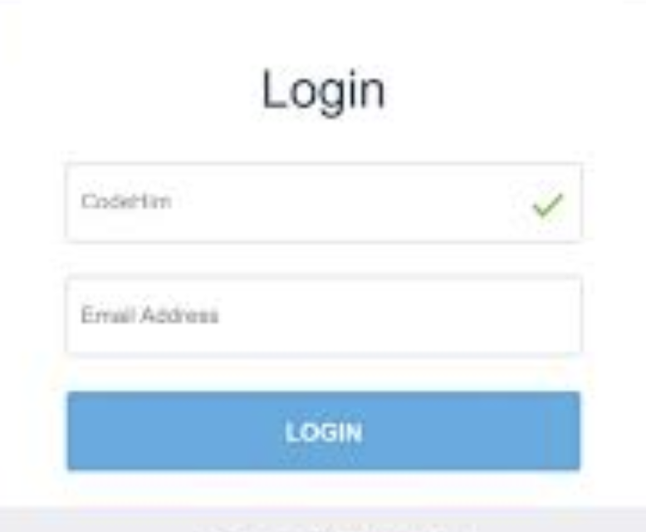

Slide 3
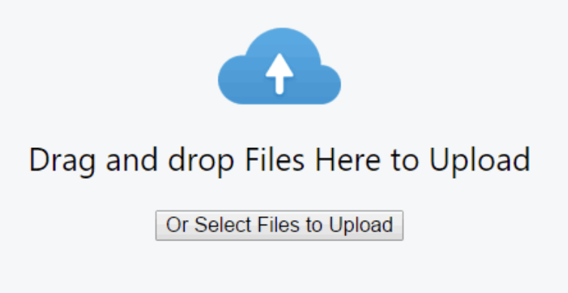
Upload Map Image

Slide 4
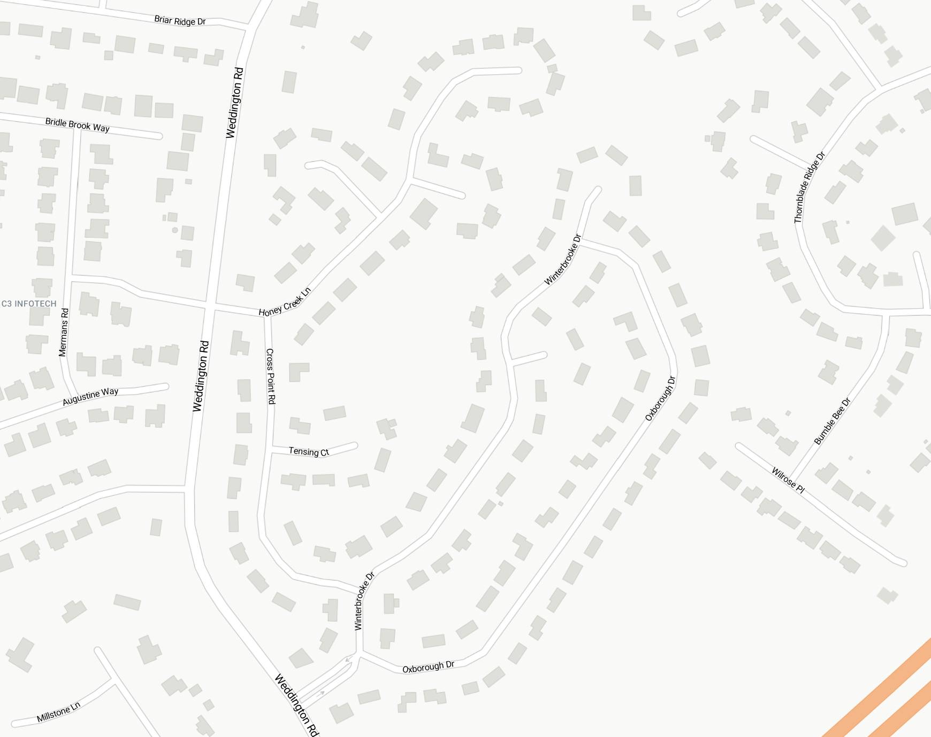
Data
Summary Pins
Hide All Pins
Owners
Renters
Paid
Unpaid
Kids
Garden
Dog
Pool
Xyz
test
Map uploaded and fits into window

Slide 5


Data
Summary Pins
Hide All Pins
First Name
Last Name
Address
Phone
Owners
Renters
Paid
Unpaid
Kids
Garden
Dog
Pool
Xyz
test
Paid
Kids
Pool
Owner
Garden
xyz
Renter
Dog
test
More Data Inputs
Submit
Click place to drop pin and enter data
It is an image… But all that matters is where the pin is dropped in the box as long as the image doesn’t move or change

Slide 6
Data
Summary Pins
Hide All Pins
Owners
Renters
Paid
Unpaid
Kids
Garden
Dog
Pool
Xyz
test
Show all Pin will show all Pins that data is recorded
Hide all Pin will hide all pins

Slide 7
Data
Summary Pins
Hide All Pins
Owners
Renters
Paid
Unpaid
Kids
Garden
Dog
Pool
Xyz
test
Click Hide all Pins

Slide 8

Data
Summary Pins
Hide All Pins
Mark Smith
123 Oak St.
Beth Smith
888-555-1212
marksmith@gmail.com
beth@gmail.com
MORE INFO
Owners
Renters
Paid
Unpaid
Owners
Renters
Paid
Unpaid
Kids
Garden
Dog
Pool
Xyz
test
Click show all Owners
All Pins tagged as owners show up
Click on Pin to see summary data

Slide 9
Data
Summary Pins
Hide All Pins
Mark Smith
123 Oak St.
Beth Smith
888-555-1212
marksmith@gmail.com
beth@gmail.com
MORE INFO
More Info link will open page with all information of person selected
Owners
Renters
Paid
Unpaid
Owners
Renters
Paid
Unpaid
Kids
Garden
Dog
Pool
Xyz
test
Back

Slide 10

Data
Summary Pins
Hide All Pins
Owners
Renters
Paid
Unpaid
Owners
Renters
Paid
Unpaid
Kids
Garden
Dog
Pool
Xyz
test
Show all Unpaid
Then click on Pin to see summary data

