Slide 1
How to avoid Data Disaster
Valeria Bo
Sergio Martinez

Slide 2
Data
Numbers, names, dates, …
Graphs, images, …
Organised in tables, list,
Popular file formats: txt, csv, xls

Slide 3
1st Rule
Always, always RAW data
NOT
processed,
filtered
manipulated
either electronically or manually

Slide 4
1st Rule - Why?
Maintain consistency
Data format
Codes (M/F)
Separator , ; \t
Reduce human errors
Copy / Paste / Cut
Deletion
Addition unwanted characters
Reduce machine errors
Cell formats
Save file with a different extension

Slide 5
2nd Rule
Maintain consistency

Slide 6
Example 1
PatientID | Sex | Date of birth
1 | M | 01-01-2013
2 | f | 04-18-1998
3 | Male | 1st of April 2004
4 | Female | NA
5 | F | 2010/03/12
6 | F
7 | M | 10012012

Slide 7
Example 1
Consistency: F, female, f, fem, 2, …
Single common format for all dates: YYYYMMDD, YYYY-MM-DD
http://www.iso.org/iso/home/standards/iso8601.htm
Consistency about missing values
NA (not available), NULL, , ...

Slide 8
Example 1 corrected
PatientID | Sex | Date of birth
1 | M | 2013-01-01
2 | F | 1998-04-18
3 | M | 2004-04-01
4 | F | NA
5 | F | 2010-03-12
6 | F | NA
7 | M | 2012-01-10

Slide 9
A bit more about consistency
Realistic and easy to understand
Variable names
File names
Unique and consistent variable names
Multiple tables

Slide 10
3rd Rule
Missing values = NA

Slide 11
Blank spaces
Careful!!!
Blank cell ≠ space
“Male” ≠ “ Male “
Last line: “ “
These can be a headache later on!

Slide 12
Example 2
PatientID | Date | Value
1 | 2015-06-14 | 213
2 |  | 76.5
3 | 2016-06-18 | 32
4 |  | 120.3
5 |  | 109
6 | 2015-06-20
7 |  | 143

Slide 13
Example 2
Fill in all cells!
Problems when sorting
Empty cell:
Missing value?
Value meant to be repeated multiple times?
Make sure it’s clear that the data is missing and not unintentionally left blank

Slide 14
Example 2 corrected
PatientID | Date | Value
1 | 2015-06-14 | 213
2 | 2015-06-14 | 76.5
3 | 2016-06-18 | 32
4 | 2016-06-18 | 120.3
5 | 2016-06-18 | 109
6 | 2015-06-20 | NA
7 | 2015-06-20 | 143

Slide 15
4th Rule
Make it RECTANGLE

Slide 16
Example 3
 | A | B | C | D | E | F | G | H | I
1 |  | 1 min |  |  |  | 5 min
2 | strain | normal |  | mutant |  | normal |  | mutant
3 | A | 147 | 139 | 166 | 179 | 334 | 354 | 451 | 474
4 | B | 246 | 240 | 178 | 172 | 514 | 611 | 412 | 447

Slide 17
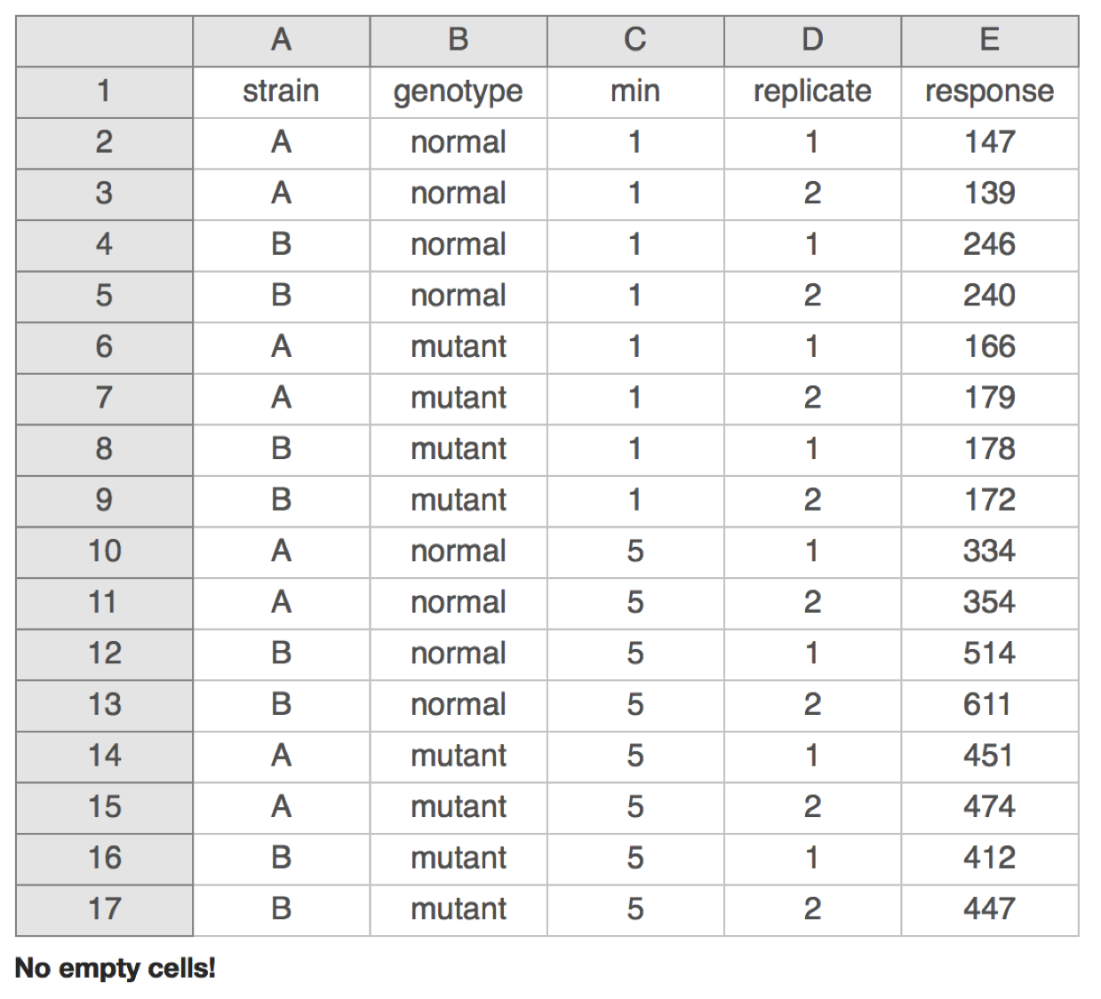
Example 3 corrected

Slide 18
More...
Don’t put too much information in one cell
1 cell = 1 information
Don’t include units such as “30 g” → “g” in the column name
http://unitsofmeasure.org/ucum.html
Write notes in a separate column or data dictionary or metadata
“0 (below threshold)”
Avoid using “,” or “;” or tab
Do not manually modify or copy values

Slide 19
More...
NO calculations
NO font colours
NO highlighting
Computer doesn’t recognize it!

Slide 20
Good vs Bad names
Good name | God alternative | Bad name
MaxTemp | max_temp | Maximum Temperature (C)
Quantity | Quantity_mg | Quamg
Sex |  | M/F
Weight | Weight_kg | w

Slide 21
Write protect
Mac:
Right click on the file in Finder
Select “Get Info”
Sharing and permission
Priviledge
Read only

Slide 22
Write protect
Windows:
Right click on the file in windows explorer
Properties
General tab
Attributes
Select the box for “read only”

Slide 23
Data Validation
Excel data validation feature
Select a column
In the menu bar, choose “Data”
Validation
Integer or decimal number
Range
List of possible values
Limited length text

Slide 24
Be careful!
When identifiers are long integers
1000000 = 1e06
Do not fill blank cells with 0s
0s are data!
*SEPT2 (Septin 2) → ‘2-Sep’
*MARCH1 (Membrane-Associated Ring Finger (C3HC4) 1, E3 Ubiquitin Protein Ligase) → ‘1-Mar’
*Ziemann, Mark, Yotam Eren, and Assam El-Osta. "Gene name errors are widespread in the scientific literature." Genome Biology 17.1 (2016): 177.

Slide 25
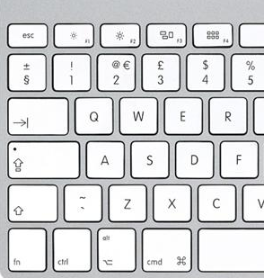
Save
Always keep a copy of your data file in a Plain TEXT Format
Tab delimited
, or ; separated
Such as .csv or .txt

Slide 26
BACKUP
BACKUP
BACKUP
BACKUP
BACKUP
BACKUP!!!!!!!!!!

Slide 27
Practice

