Slide 1

GPU-Accelerated Hybrid Solver for the LABS Problem
We demonstrate that GPU-accelerated Memetic Tabu Search (MTS) with quantum-inspired seeding achieves better time-to-solution than classical baselines for the LABS problem.
MIT iQuHACK 2026 - NVIDIA LABS Challenge
Team: AvoQados
Ben Anstrom - Technical Marketing & GPU Acceleration Lead
Katya Mijatovic - Project Lead & Quality Assurance Lead

Slide 2
The Plan - Seeding algorithms
Random Seeding (Classical Baseline)
Uniformly random ±1 sequences used to establish the classical performance floor and validate MTS behavior.
QAOA-Based Seeding
Canonical quantum baseline using shallow QAOA circuits to generate correlated bitstrings for LABS initialization.
DCQO-Based Seeding (Challenge Template)
Digitized Counterdiabatic Quantum Optimization following Gómez-Cadavid et al., using low-depth counterdiabatic circuits to bias sampling toward low-energy LABS states.
DCQO+ Seeding (Engineering Ablations)
Controlled upgrades to DCQO trotterization (midpoint time discretization, Pauli ordering alternation, k-permutation averaging) that improve sampling quality without increasing circuit depth.
PCE-Based Seeding (Twist Contribution)
Pauli Correlation Encoding (Sciorilli et al. 2025): a qubit-efficient alternative encoding that generates high-quality LABS seeds using a classical optimization loop over a compact quantum ansatz.

Slide 3
The Plan - Research and Trotter+
Research Papers:
Gómez-Cadavid et al. (2025): Quantum-Enhanced Memetic Tabu Search (QE-MTS) for LABS
Challenge-endorsed hybrid template and evaluation metrics
Sciorilli et al. (2025): Pauli Correlation Encoding (PCE)
Qubit-efficient quantum encoding for LABS (alternative seeding strategy)
Farhi et al. (2014): Quantum Approximate Optimization Algorithm (QAOA)
Canonical quantum baseline for combinatorial optimization
Hegade et al. (2022): Digitized Counterdiabatic Quantum Optimization (DCQO)
Low-depth counterdiabatic circuits for improved sampling distributions
Zhang et al. (2025): Massively Parallel Memetic Tabu Search for LABS
GPU-parallelized energy and neighborhood evaluation enabling scalable, high-throughput classical optimization
DCQO+ Trotterization Upgrades:
Midpoint time discretization
Forward/reverse Pauli ordering
K-permutation averaged ordering

Slide 4
DCQO vs DCQO+: Controlled Quantum Ablations
Baseline DCQO (Tutorial / Cadavid):
First-order Lie-Trotter product formula
Right-endpoint time discretization
Fixed Pauli-string ordering
DCQO+ Upgrades (No Extra Quantum Depth):
Midpoint time grid for CD angle evaluation
Forward / reverse Pauli ordering alternation
k-permutation Pauli ordering (randomized product formula lite)
Design Rationale:
Improves discretization & ordering error
Increases sampling diversity
Adds zero additional gates

Slide 5
PCE "Twist" Seeder
Pauli Correlation Encoding (Sciorilli et al., 2025):
Qubit-efficient LABS encoding
n = ceil(log₄(N + 1)) qubits
Implementation Details (True to paper):
Brickwork ansatz
Relaxed LABS cost (Eq. 4)
L-BFGS-B multi-restart classical optimization
Benchmark Result (N = 16):
PCE raw energy min = 24
QAOA / DCQO raw energy = 32-36
Execution:
numpy + scipy simulation
No CUDA-Q dependency

Slide 6
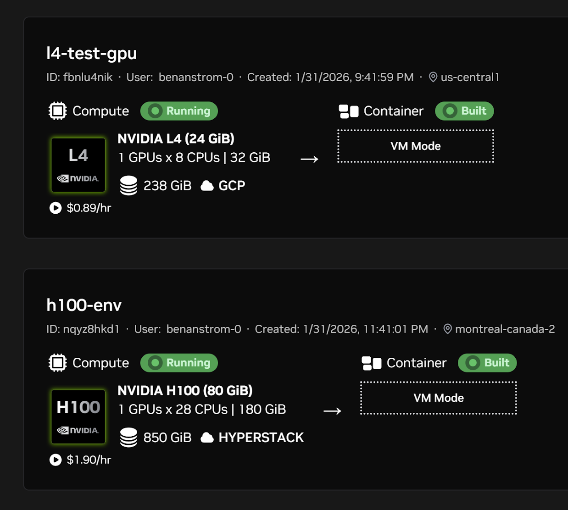
GPU Acceleration Results
Energy Evaluation Kernel:
CuPy RawKernel with shared-memory tree reduction
150-250X speedup
31-40 µs per batch (constant time)
MTS Delta-Energy Kernels:
Three incremental CUDA kernels
13-48X speedup over CPU
Robustness & Scaling:
OOM guard for large-N CUDA-Q seeders
Benchmarks collected on NVIDIA L4 GPU
GPU acceleration reference: Zhang et al., “Massively Parallel Memetic Tabu Search for the Low Autocorrelation Binary Sequences Problem,” 2025.

Slide 7
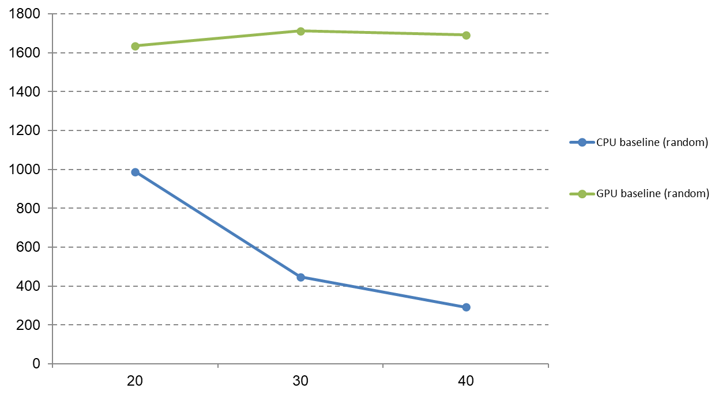
MTS Throughput Scaling with N
* Throughput decays exponentially N for CPU, while GPU remains stable

Slide 8
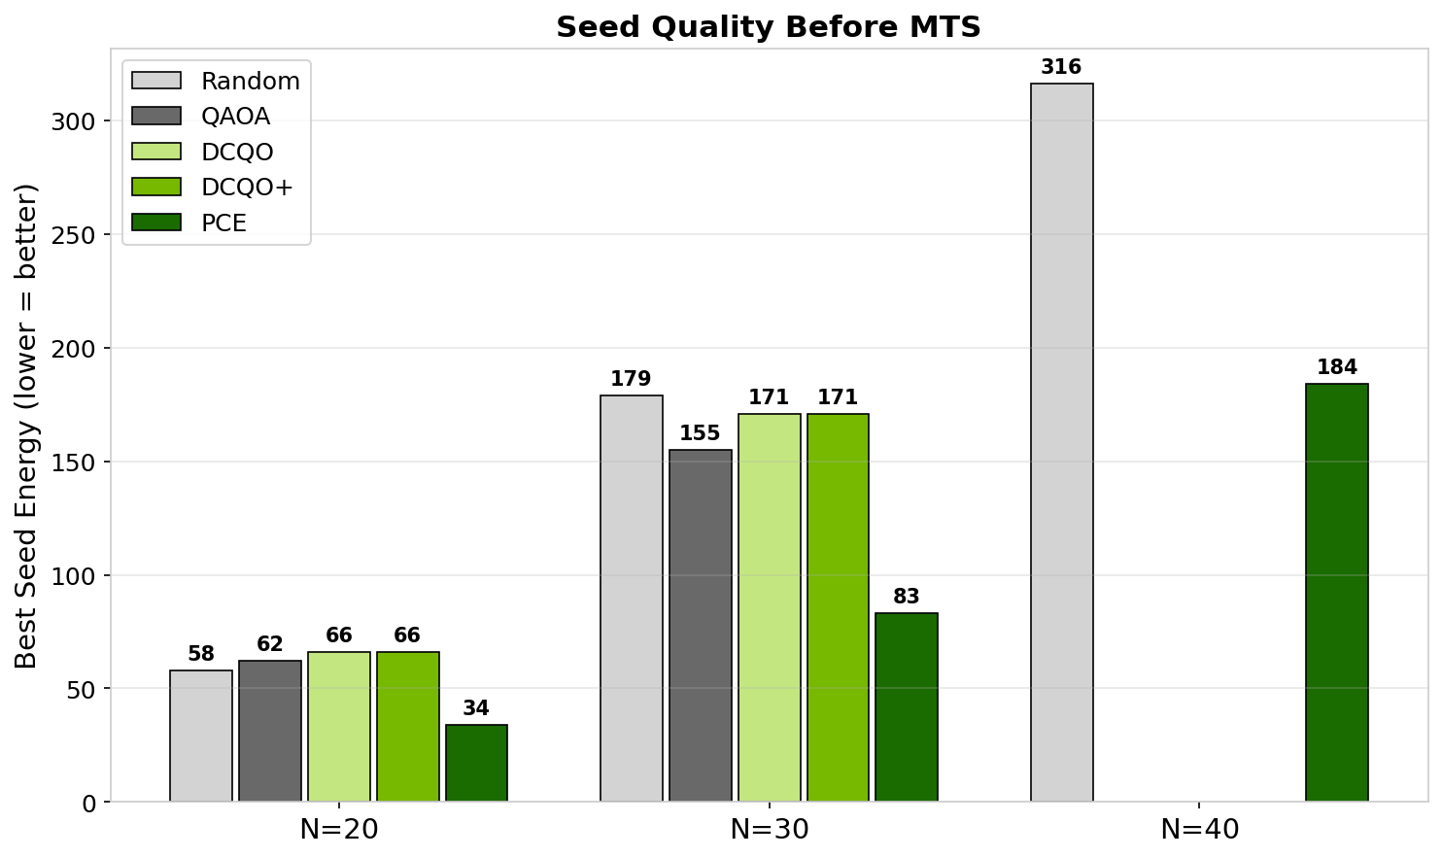
Seed quality
Best raw seed energy before MTS
Takeaway
PCE produces seeds ~2X better than random across all N.

Slide 9
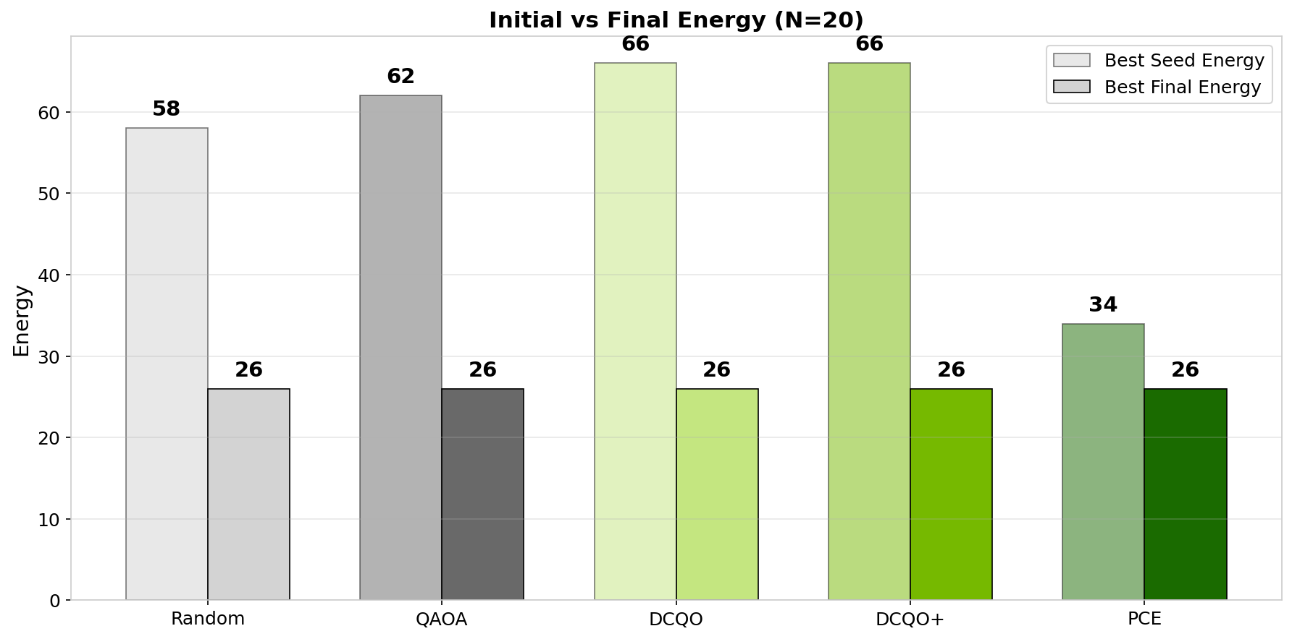
Initial vs Final Energy
Best raw seed energy before MTS vs after
Takeaway
Final seed energy is the same for all seeds (except for PCE for larger N, potential advantage)

Slide 10
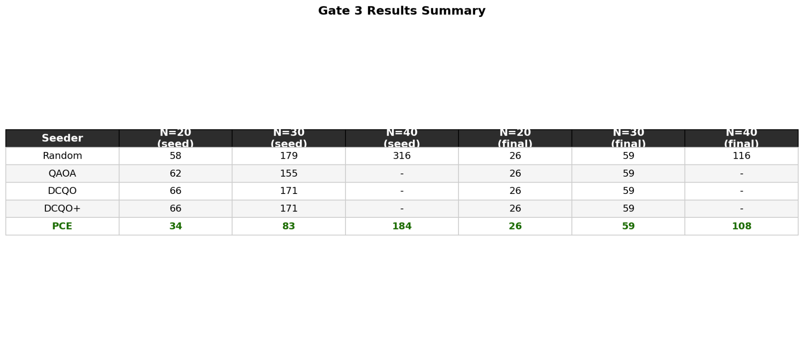
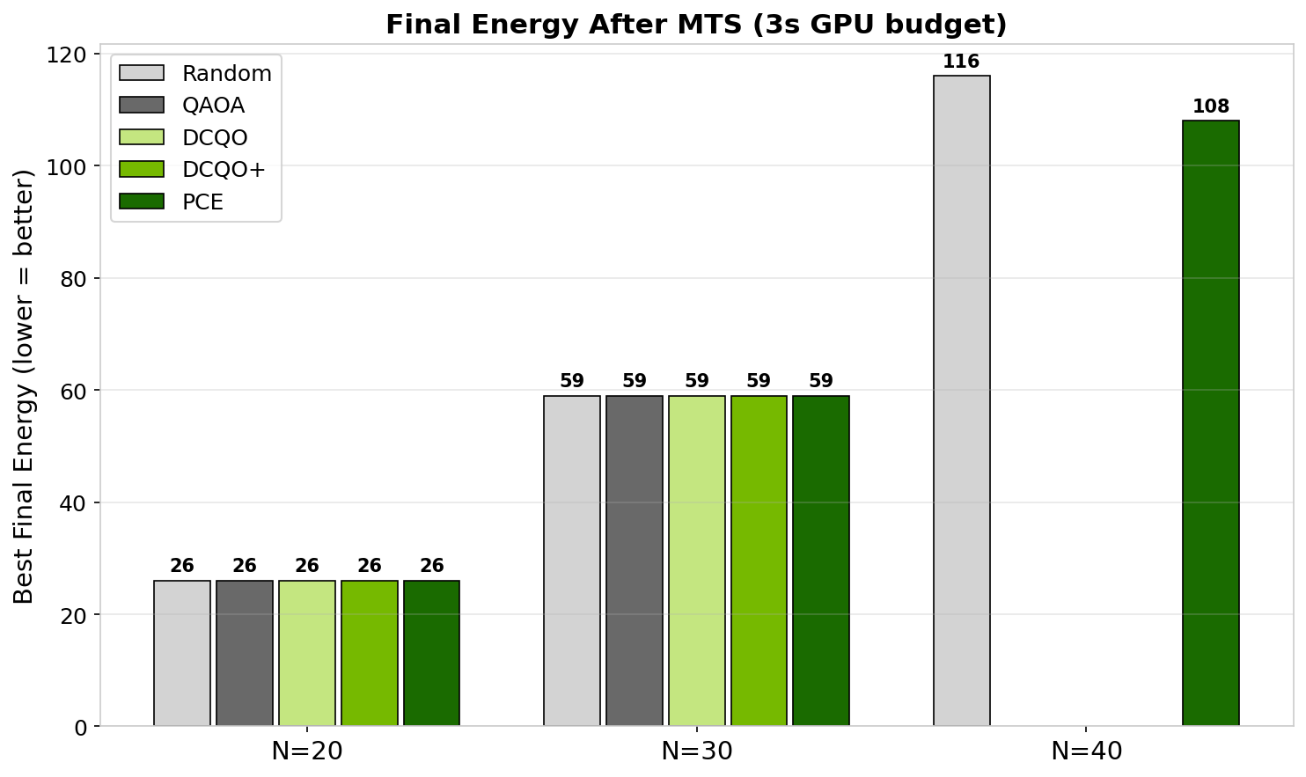
Final energy after MTS
seed quality matters more as N grows
Scaling Note
N = 30 was the largest N for which the statevector could fit on 80 GB of VRAM given a 2.5x safety net. At N = 31, the state vector is 32 GB x 2.5 > 80

Slide 11
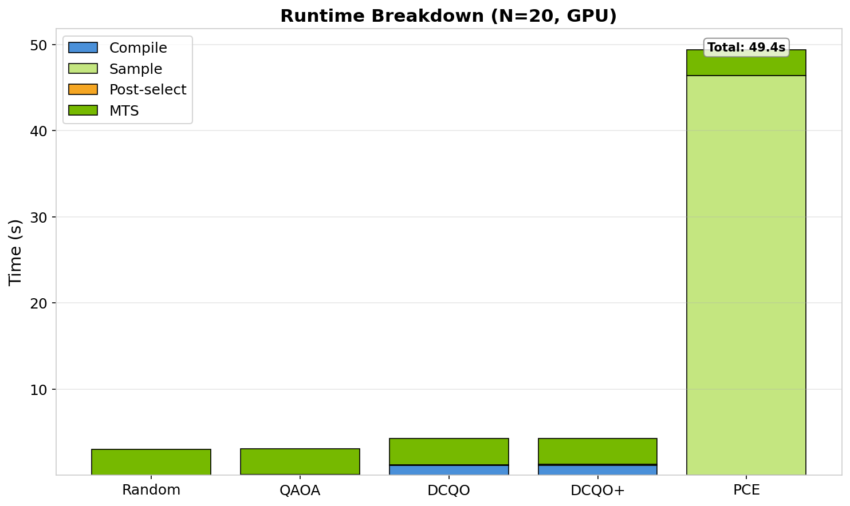
Runtime Breakdown
Time to solution
Takeaway
GPU MTS is fast and stable; some seeders (notably PCE) trade compute time for higher-quality starting points.

Slide 12
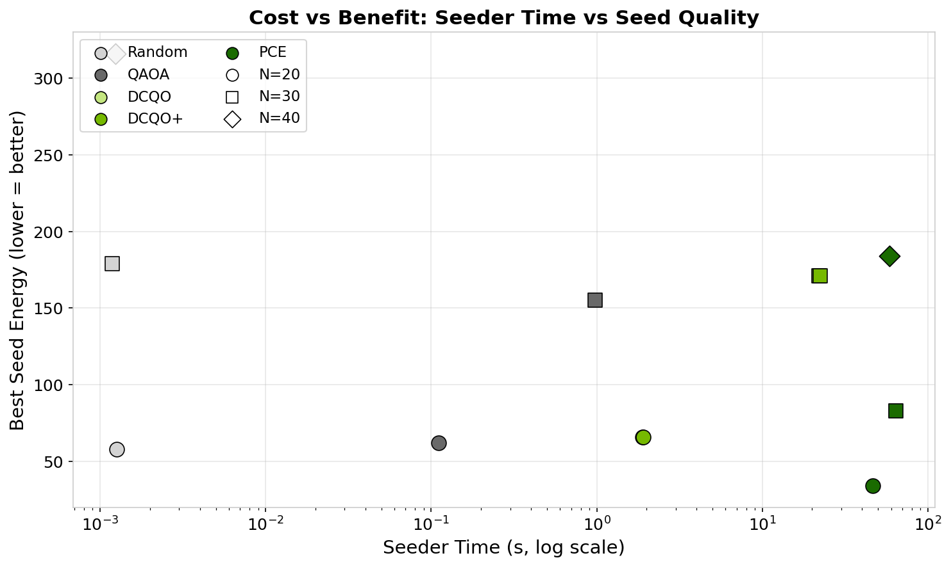
Time vs Seed Quality
Best Seed Energy vs Time to solution
Observation
PCE wins in the seed quality, but requires significant time reduction work

Slide 13
PRD Success Metrics - Checklist (Evidence from Bench Runs)
Metric 1 (GPU speedup ≥5X) - Achieved
Evidence: energy kernel 150-250×; MTS delta-energy 13-48× (L4 benchmarks).
Metric 2 (Scale: N=20-30 end-to-end) - Achieved
Evidence: Gate 3 GPU matrix includes N=20 & N=30 runs + logs/plots.
Metric 3 (Seeder comparison: Random vs DCQO vs DCQO+) - Achieved
Evidence: convergence traces + seed & final-energy plots saved in Gate 3 artifacts.
Metric 4 (Large N: reach N≥40) - Achieved
Evidence: N=40 runs completed for Random & PCE; CUDA-Q seeders skipped via OOM guard.
Metric 5 (PCE seeds implemented) - Achieved
Evidence: PCE seeder integrated.
Metric 6 (Quantum advantage signal at N≥25 vs Random median) - Achieved
Evidence: At N=40 with PCE.
Notes:
Detailed evidence files:
Metric 1 (GPU speedup):
- labs_hybrid_solver/Claude-revisions.md (Sections 1-2) contains benchmark tables:
• Energy kernel RawKernel: 157-252× speedup (31-40 µs per batch)
• Delta-energy MTS kernels: 12.9-47.9× speedup (100 iters)
- labs_hybrid_solver/bench_energy_kernel.py and bench_delta_mts.py reproduce these benchmarks
- labs_hybrid_solver/README.md GPU acceleration bullets
- labs_hybrid_solver/team_submissions/PRESENTATION_OUTLINE.md repeats these numbers
Metric 2 (Scale N=20-30):
- results/run_bench_20260201_052047/gate3_gpu_matrix/metrics.csv (rows for N=20 and N=30)
- results/run_bench_20260201_052047/gate3_gpu_matrix/results_summary.md
Metric 3 (Seeder comparison):
- results/run_bench_20260201_052047/gate3_gpu_matrix/artifacts/plots/
• seed_energy_hist.png
• final_energy_bar.png
• time_to_best.png
• runtime_breakdown.png
- Per-condition traces: *_mts_trace.json and *_seed_energies.npy in Gate 3 artifacts/
Metric 4 (Large N ≥40):
- Gate 3 metrics.csv includes N=40 runs for seeder=random and seeder=pce
- OOM guard implementation: src/labs_hybrid/benchmarks.py (_would_oom)
- OOM guard rationale: Claude-revisions.md (Section 6)
Metric 5 (PCE seeds):
- Paper-accurate PCE implementation: src/labs_hybrid/seeders/pce_seeder.py
- PCE completion details: Claude-revisions.md (Section 3)
- Gate 2 GPU bring-up includes PCE at N=16: results/run_bench_20260201_052047/gate2_gpu_bringup/metrics.csv
- Gate 3 includes PCE at N=20/30/40: results/run_bench_20260201_052047/gate3_gpu_matrix/metrics.csv
Metric 6 (Quantum advantage signal):
- Gate 3 has only one run per seeder per N; no repeated trials to support a median claim.
- At N=30 in Gate 3, best_final_energy is identical across all seeders; median advantage not shown.
- Suggestion: run multiple rng_seed values per seeder at N=30+ and compute median(final_energy) under equal time budgets.

Slide 14
Takeaways
Total time to minimum is best with QAOA and random seeding at N <= 30
PCE is the strongest seeder if time is cheap: ~2X better raw seeds at every N, and the only seeder to beat the baseline on final energy at N=40 (108 vs 116, 7% improvement)
Seed quality matters more as problem size grows - at N=20/30, MTS closes the gap; at N=40 it can't, and this gap should widen further
GPU acceleration (150–250X energy, 13–48X MTS delta) is what makes the 3s budget viable at N=40
DCQO+ zero-depth trotter modifications show no measurable advantage over baseline DCQO - the discretization changes don't shift the seed distribution
30 tests across 8 files, layered from brute-force oracle through full CPU/GPU convergence parity - correctness is not optional

Slide 15
Next Steps
Scale to N=60+ to confirm PCE's advantage widens with problem size
Distributed statevector (multi-GPU / multi-node sharding)
Amortize PCE seeder cost: cache Pauli operator sets, parallelize restarts
Run QAOA/DCQO on real CUDA-Q hardware backends (QPU or tensor-network) to bypass the state-vector memory wall at N>30
Explore PCE layer-depth tradeoffs: current default is 15 layers, paper suggests diminishing returns beyond ~20

Slide 16
Personal Takeaways
Ben
GPU time is expensive, but necessary to reach regimes where scaling behavior is meaningful.
Without removing classical bottlenecks, quantum improvements cannot be measured fairly.
Katya
Structured verification catches real bugs. The gate pipeline meant issues surfaced early.
Living documents work. Claude-revisions.md as a shared checklist kept work focused. Tracking 9 items from identification to completion is a lightweight process that paid off.

