Slide 1
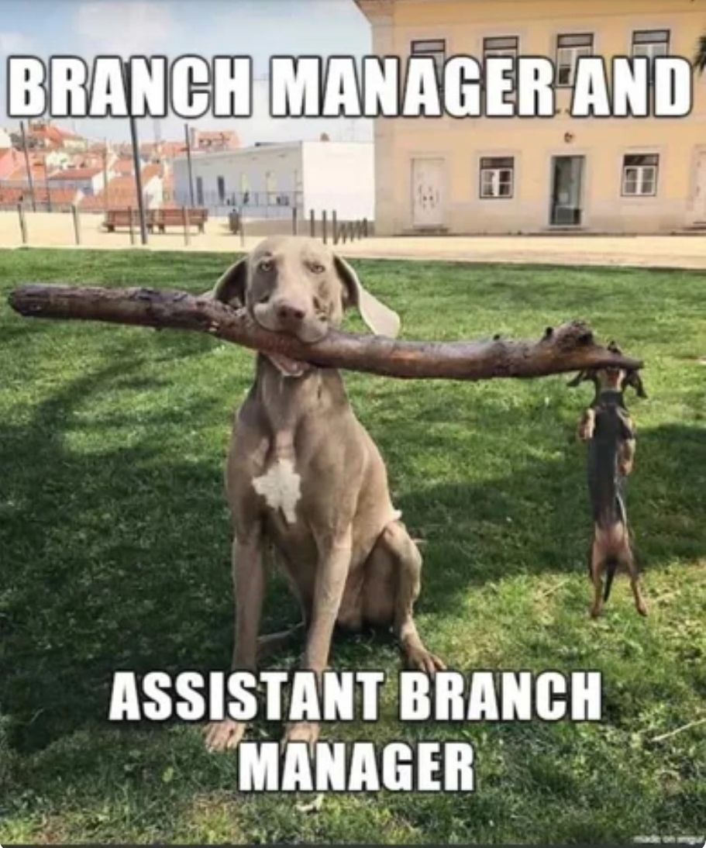
GPU-Accelerated Hybrid Optimization for LABS
Quantum-Inspired Seeding with a GPU-Accelerated Memetic Tabu Search
Ben Anstrom — Technical Marketing & GPU Acceleration Lead
Katya Mijatovic — Project Lead & Quality Assurance Lead
MIT iQuHACK 2026 · NVIDIA LABS Challenge

