Slide 1
Seed quality
Best raw seed energy before MTS
N
Random
QAOA
DCQO
DCQO+
PCE
20
58
62
66
66
34
30
179
155
171
171
83
40
316
—
—
—
184
Note: lower energy is better.
Takeaway
PCE produces seeds ~2× better than random across all N.

Slide 2
Final energy after MTS
3s GPU budget
N
Random
QAOA
DCQO
DCQO+
PCE
20
26
26
26
26
26
30
59
59
59
59
59
40
116
—
—
—
108
Note: lower energy is better.
Observation
With a 3s MTS budget, methods tie at N=20 and N=30; PCE is best at N=40.

Slide 3
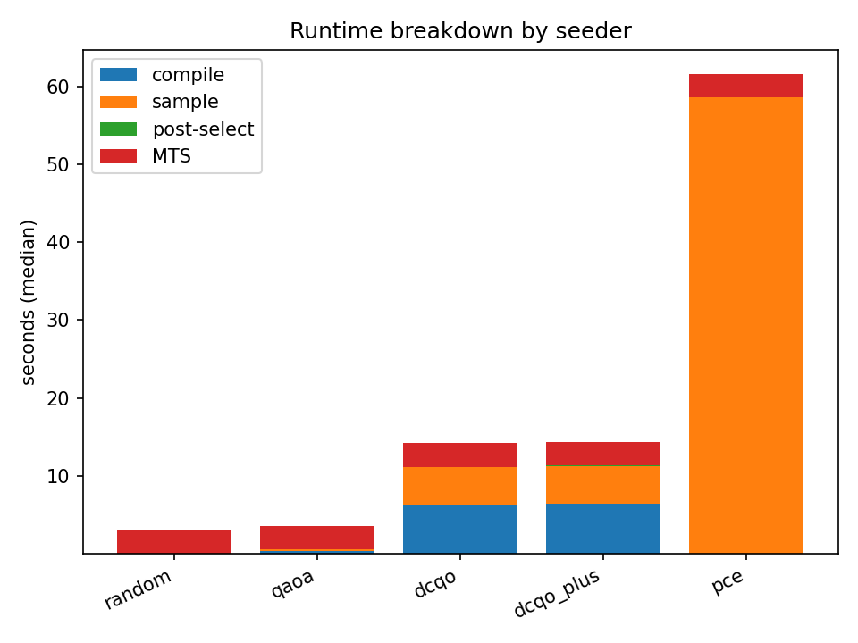
Runtime Breakdown
Time to solution
End-to-end runtime components (seed → postselect → MTS budget)
Takeaway: GPU MTS is fast and stable; some seeders (notably PCE) trade compute time for higher-quality starting points.

