Slide 1

Introduction to the Curriculum
CR 1.1
Private and Confidential

Slide 2

iCare Life – Tata STRIVE Curriculum
This Curriculum is designed for skill development and to up-skill Caregivers to equip them with:
Competency Based Education
Experiential Learning in Workplace
To create:
Skilled Workforce for the healthcare sector
Employability for economically backword section of the society
Professional Caregivers are neither nurses nor are they untrained health workers. They are meticulously trained as per iCare Life Service Standards. They are trained on competency-based learning curriculum to impart knowledge and skills through a blended pedagogy – both classroom-based and by using online course material, and hands-on practical training. They are not registered nurses – they are qualified nursing assistants.
1
Copyright: iCare Life Pte. Ltd., Singapore : This document must not be copied or shared or circulated without the consent of iCare Life and/or its affiliates.

Slide 3




About iCare Life
iCare Life Pte. Ltd., is a Singapore based Company engaged in Training and Certification in South-East Asia. iCare Life’s curriculum is approved by Agency for Integrated Care (AIC), Government of Singapore
iCare Life’s Indian subsidiary, iCare Learning Pvt. Ltd., is a Training Partner of National Skill Development Counsel (NSDC), Government of India and its course curricula are approved under two categories - namely General Duty Assistant (GDA) and Home Healthcare Aide (HHA) by Healthcare Sector Skill Counsel (HSSC), Government of India
2
Copyright: iCare Life Pte. Ltd., Singapore : This document must not be copied or shared or circulated without the consent of iCare Life and/or its affiliates.

Slide 4
About Tata STRIVE
Tata STRIVE, an initiative of Tata Community, and the first Group CSR program to address the pressing need of skill development for India's youth for employment
Tata STRIVE reaches to communities, develops skills of people from financially challenged backgrounds and acclimatizes them with the changing work environment
The core philosophy is to create courses that would help in creating and supplying trained manpower across the spectrum as well as develop entrepreneurial talent
3
Copyright: iCare Life Pte. Ltd., Singapore : This document must not be copied or shared or circulated without the consent of iCare Life and/or its affiliates.

Slide 5
The Course Curriculum
The course covers the following aspects:
Role of a Caregiver
Infection Prevention and Control
Duties and Responsibilities
Respect, Privacy and Dignity
Fluids and Nutrition
Personalized Care and Attention
Self-Development
Mental Health and Wellbeing
Communication
Respecting Equality and Diversity
Maintaining Confidentiality
Technical Knowledge
1
2
3
4
5
6
7
8
9
10
11
12
4
Copyright: iCare Life Pte. Ltd., Singapore : This document must not be copied or shared or circulated without the consent of iCare Life and/or its affiliates.

Slide 6
The Course Architecture
The foundation of the iCare Life Training relies upon the Competency-Based e-Learning (CBE)
Self-paced learning with minimum facilitator intervention
The learners can learn at their pace in the classroom, while the facilitator is always around for any assistance
The participants watch and listen to the animated Information Communication Technology (ICT) content
The learning objectives in the modules are followed up with a summarization in agreement with learning
The voice-over in the videos are multilingual (Hindi and English)
Technical words and standard terminologies are duly explained and handed-out as a Lexicon is provided to the learners
5
Copyright: iCare Life Pte. Ltd., Singapore : This document must not be copied or shared or circulated without the consent of iCare Life and/or its affiliates.

Slide 7
The Course Duration
The Course Duration is for 50-60 Days, as given below:
General Duty Assistant (GDA) Course / Home Healthcare Aide (HHA) Course / Nursing Assistant
Details of Type of Session and Mode | Total Duration Hrs. | Duration (6/7 Hrs. per Day) | Details of Type of Session and Mode | Total Duration Hrs. | Duration (6/7 Hrs. per Day)
Classroom Session (Theory) | 63 | 14 | Classroom Session (Theory) | 63 | 14
Classroom Lab Session (Demo/Practical) | 56 | 14 | Classroom Lab Session (Demo/Practical) | 56 | 14
Laboratory/Clinical Training (Hospital)* | 180 | 22.5 | Laboratory/Clinical Training (Hospital)* | 120 | 15
Self-Learning (Home and Centre Library) | 100 | NA | Self-Learning (Home and Centre Library) | 100 | NA
Assessments (Theory & Demo/Practical) | 4 | 1 | Assessments (Theory & Demo/Practical) | 3 | 1
Tata STRIVE Youth Development Program | 70 | 6 |  | 70 | 6
TOTAL | 473 | 57.5 | TOTAL | 412 | 50
* Hospital Internship is for 8 Hours for any batch duration
6
Copyright: iCare Life Pte. Ltd., Singapore : This document must not be copied or shared or circulated without the consent of iCare Life and/or its affiliates.

Slide 8

iCare Life Service Standard
iCare Life has invested in creating well-researched Service Standards drawing the references from various benchmarks across the globe
The iCare Life Service Standard is divided into six broad heads, as follows:
7
Copyright: iCare Life Pte. Ltd., Singapore : This document must not be copied or shared or circulated without the consent of iCare Life and/or its affiliates.

Slide 9
iCare Life Certification
Assessment of knowledge and understanding include:
Online assessment, workbook, written questions, or voice files
Assessment shall be a continuous process during training
Assessment is mapped to GDA/HHA/Nursing Assistant course
Assessment evidence include:
Multiple choice questions answers – Recoded
Written or oral answers – Recorded Voice Over
Small individual or group project, such as a presentation - Observation rand assessment recorded
Role play or demonstration - Video of simulated activity recorded
Attendance record - attendance on study days and demonstration classes
8
Copyright: iCare Life Pte. Ltd., Singapore : This document must not be copied or shared or circulated without the consent of iCare Life and/or its affiliates.

Slide 10
iCare Life Certification
The essential steps of iCare Life certification process is described below:
Interim assessments during the training program
Regular assessments or practical/demonstration incorporated in the program through the course duration, and
Regular viva test conducted at each term
Summative Assessments:
End of the program assessments comprising of Knowledge assessment – typically written test and viva, and
Skill assessment and report from the hospital and nursing home
To be eligible for certification, the trainees have to qualify in each assessment individually as well as holistically.
9
Copyright: iCare Life Pte. Ltd., Singapore : This document must not be copied or shared or circulated without the consent of iCare Life and/or its affiliates.

Slide 11
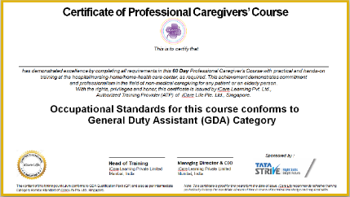
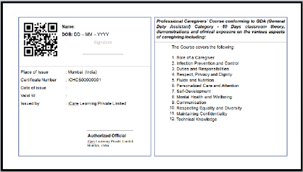
iCare Life Certification
On successful completion of training including Internship and passing the assessment, each candidates will be issues a Certificate by iCare Life, Singapore and Tata STRIVE. Sample Certificate is shown below:
10
Copyright: iCare Life Pte. Ltd., Singapore : This document must not be copied or shared or circulated without the consent of iCare Life and/or its affiliates.

Slide 12
Learning Outcome & Core Value
Care is a core human value that requires doing what one can do with the best interest at heart for the other person to maintain and improve his or her well-being.
The value of a caring society is best described by the 6Cs – Care, Compassion, Competence, Commitment, Courage and Communication.
We advise the Professional Caregivers to follow and maintain the code of conduct for caregiving.
11
Copyright: iCare Life Pte. Ltd., Singapore : This document must not be copied or shared or circulated without the consent of iCare Life and/or its affiliates.

Slide 13
Learning Outcome & Core Value
The Code of Conduct for Professional Caregivers broadly includes the following principles:
To be accountable for their action
To promote and uphold privacy, dignity, rights, health and wellbeing
To work in collaboration with the family, employer, care-recipient and medical staff, etc.
To communicate openly and in an effective way
To respect a right to confidentiality of individuals
To improve the quality of care and support through regular training and skill up-gradation
12
Copyright: iCare Life Pte. Ltd., Singapore : This document must not be copied or shared or circulated without the consent of iCare Life and/or its affiliates.

Slide 14
Why should you learn this Course?
Years ahead of us - 2050
3 out of 10 people will be above the age of 65 by 2025
13
Copyright: iCare Life Pte. Ltd., Singapore : This document must not be copied or shared or circulated without the consent of iCare Life and/or its affiliates.

Slide 15
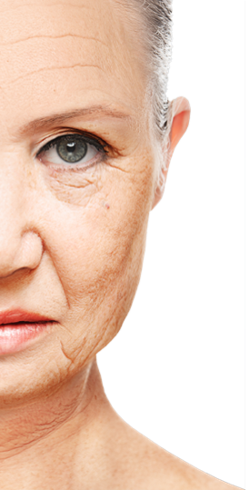



Why should you learn this Course?
Our Aging World
14
Copyright: iCare Life Pte. Ltd., Singapore : This document must not be copied or shared or circulated without the consent of iCare Life and/or its affiliates.
Notes:
We often make a mistake based on the looks of a person as we guess his or her age. Today, thanks to cosmetic surgery technology and various therapies - one’s looks may be quite deceptive. While some may appear younger than they look, others may look older, for whatever reason.

Slide 16
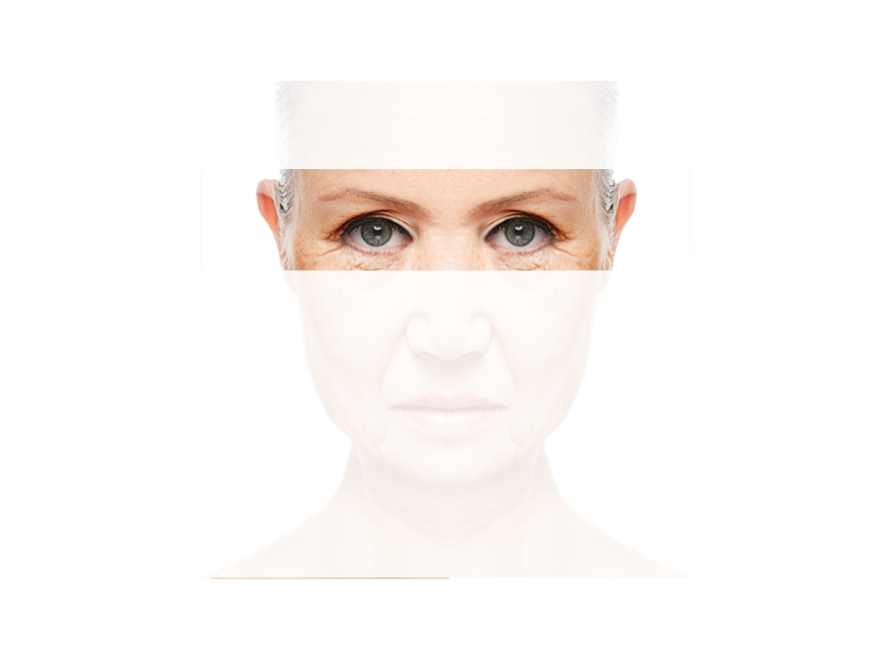
Why should you learn this Course?
We will be older, and there will be more of us…
Our Aging World
15
Copyright: iCare Life Pte. Ltd., Singapore : This document must not be copied or shared or circulated without the consent of iCare Life and/or its affiliates.
Notes:
There will be many more older people in the World. People are now living longer due to advancement in medical science. Every 5 year the life expectancy is going up by 2 years.

Slide 17
Why should you learn this Course?
Affordable Healthcare &
Trained Healthcare Workers
Key Challenges
16
Copyright: iCare Life Pte. Ltd., Singapore : This document must not be copied or shared or circulated without the consent of iCare Life and/or its affiliates.

Slide 18
Why should you learn this Course?
The World Health Organization and the World Bank predicted that to attain universal access to healthcare workers by 2030, there will be need to train and deploy 40-50 million new health and social care workers globally.
The Big Job Opportunity
17
Copyright: iCare Life Pte. Ltd., Singapore : This document must not be copied or shared or circulated without the consent of iCare Life and/or its affiliates.

Slide 19
Why should you learn this Course?
In India Healthcare Sector is growing rapidly:
Poised to grow at a compound rate of 22.9% per year
To meet the growing human resource challenges, National Skill Development Corporation (NSDC), Government of India, has set an ambitious target for skill development
Healthcare Sector Skill Counsel (HSSC) has set up national occupational standards (NOS) to promote vocational education training in the Healthcare Sector
HSSC is working in association with several private institutes to build skill development capacity, assessing competency of trainees and issuing certificates
HSSC aims to facilitate skill development for 4.8 million trainees over the next 10 years in allied health and paramedics space
The Big Job Opportunity
18
Copyright: iCare Life Pte. Ltd., Singapore : This document must not be copied or shared or circulated without the consent of iCare Life and/or its affiliates.

Slide 20
Why should you learn this Course?
The requirement of Caregivers in several developing nation is growing exponentially:
Japan: 5,000,000 Caregivers by 2025
Germany: 2,000,000 Healthcare Employees by 2020
France: More than 1,000,000 health support staff by 2025
Italy: About 3,000,000 Caregivers by 2025
USA: More than 6,000,000 Healthcare Employees by 2020
Singapore: 30,000 incremental Caregivers by 2020
The Big Job Opportunity
19
Copyright: iCare Life Pte. Ltd., Singapore : This document must not be copied or shared or circulated without the consent of iCare Life and/or its affiliates.

Slide 21
Viewing of Modules
CR 1.1
Private and Confidential

Slide 22
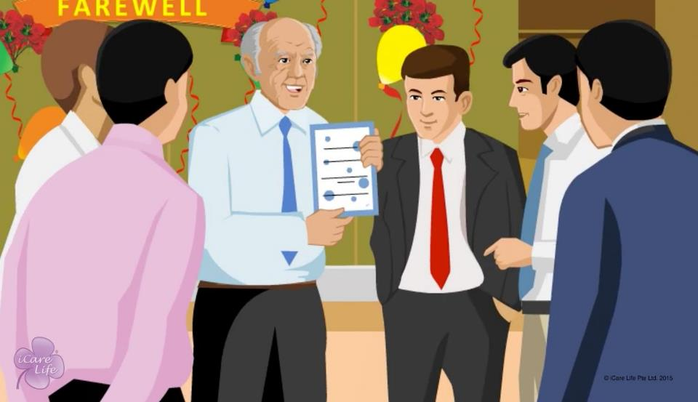
Who is an Elder
1
Copyright: iCare Life Pte. Ltd., Singapore : This document must not be copied or shared or circulated without the consent of iCare Life and/or its affiliates.
Notes:
Who is an elder? Let us understand clearly.

Slide 23

CAREGIVER
A person who assists another person who is dependent for daily activities.
2
Copyright: iCare Life Pte. Ltd., Singapore : This document must not be copied or shared or circulated without the consent of iCare Life and/or its affiliates.
Notes:
Can anyone give an example of a Caregiver? Although there are many different types of Caregivers, but most common are Eldercare and Care for Babies or Children. In this Course we will discuss about Eldercare, emergency care, post operative care, home care, etc. An Elder Caregiver is a person who takes care of a dependent Elderly, who is immobile or bedridden due to age or any other reason. Basically, you will learn to take care of a person who is dependent on you for daily activities of their life.
Do you know who is an Elder and why does an Elder need a Caregiver?
Let’s discuss more…

Slide 24
In this module, you will learn about:
The various categories of elders, according to their age
The role of a person’s perception of their own age
3
Copyright: iCare Life Pte. Ltd., Singapore : This document must not be copied or shared or circulated without the consent of iCare Life and/or its affiliates.

Slide 25
Pre-Module Activity
How old are you?
And how old do you feel?
4
Copyright: iCare Life Pte. Ltd., Singapore : This document must not be copied or shared or circulated without the consent of iCare Life and/or its affiliates.
Notes:
Begin by asking a few participants their chronological age. Ask the same participants how old they feel. Bring their attention to the fact that a person can be taken as old as they feel; and a person’s age depends on a lot of other factors apart from their age.

Slide 26
Pre-Module Activity
What role do the following factors play in determining how old you feel?
Physical exercise
Mental exercise
Diet
Stress
Attitude
Drinking and smoking habits
5
Copyright: iCare Life Pte. Ltd., Singapore : This document must not be copied or shared or circulated without the consent of iCare Life and/or its affiliates.
Notes:
Ask the participants how each of these factors determines how old a person feels.
Conclusion pointers:
If you are physically more active, you look and feel younger
If you engage in mentally stimulating work, you feel younger
If you take diet that includes healthier food (fruits, vegetables, lesser junk and processed food) look and feel younger
While some amount of stress is part of everyone’s life, too much stress over long periods of time should be managed better – it directly impacts how old you feel
Positive attitude in life makes you feel younger
Smoking and excessive drinking makes you age faster

Slide 27

Let’s Watch
Who is an Elder
6
Copyright: iCare Life Pte. Ltd., Singapore : This document must not be copied or shared or circulated without the consent of iCare Life and/or its affiliates.

Slide 28
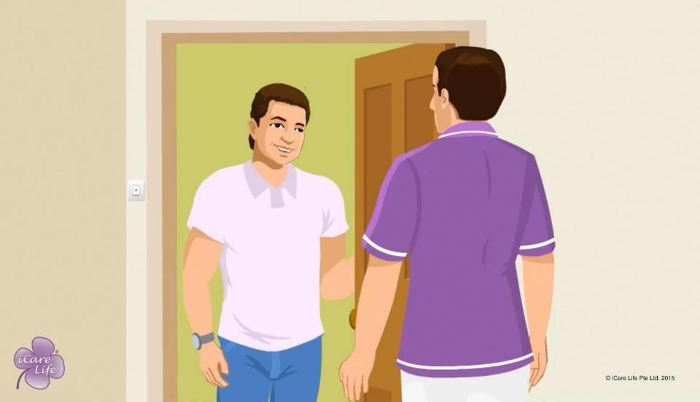
First Day of Duty with the Elder
7
Copyright: iCare Life Pte. Ltd., Singapore : This document must not be copied or shared or circulated without the consent of iCare Life and/or its affiliates.

Slide 29
In this module, you will learn about:
How you can understand the patient and their requirements
What information should you seek from the care receiver and their family
How you can establish and clarify your responsibilities and duties with your employer
8
Copyright: iCare Life Pte. Ltd., Singapore : This document must not be copied or shared or circulated without the consent of iCare Life and/or its affiliates.

Slide 30
Let’s Watch
First Day of Duty with the Elder
9
Copyright: iCare Life Pte. Ltd., Singapore : This document must not be copied or shared or circulated without the consent of iCare Life and/or its affiliates.

Slide 31


