Slide 1

Understanding the Role of a Caregiver
1
Standard
Source: Skills for Health – Website http://www.skillsforhealth.org.uk/
Skills for Care – Website http://www.skillsforcare.org.uk/

Slide 2
Learning outcomes
The Caregivers will:
1. Understand their own role
2. Work in ways that have been agreed with their employer
3. Understand working relationships in health and social care
4. Work in partnership with others in the workplace or family
Source: Skills for Health – Website http://www.skillsforhealth.org.uk/
Skills for Care – Website http://www.skillsforcare.org.uk/
Copyright: iCare Life Pte. Ltd., Singapore
1

Slide 3

Tasks, behaviours and standards of work
The duties and responsibilities that are part of your role will be listed in your job description
Your role is likely to include:
Providing care and support
Working as part of a team whether with the family or workplace
Contributing to activities in your workplace
Respecting confidentiality
Your work must always be carried out in agreed ways and must keep to regulations in mind
Regulations: are rules that come from legislation or laws. The legislation establishes the general ‘laws of the land’. Regulations provide the specific ways in which those laws are interpreted and applied.
Source: Skills for Health – Website http://www.skillsforhealth.org.uk/
Skills for Care – Website http://www.skillsforcare.org.uk/
Copyright: iCare Life Pte. Ltd., Singapore
2
Notes:
Providing care and support, working in a person centred way, communicating well, building relationships and promoting equality and diversity. Equity and diversity means to ensures that care is fair to everyone and individuals are not discriminated against. You will learn more about this later during this course.
Working as part of a team, being a supportive team member and developing your skills to improve your work.
Contributing to activities in a safe way, keeping and filing clear records, keeping to regulations as applicable in your country, and following the agreed way of working.
Respecting confidentiality by not discussing any personal information on individuals or staff with unauthorised people, and storing records securely.

Slide 4
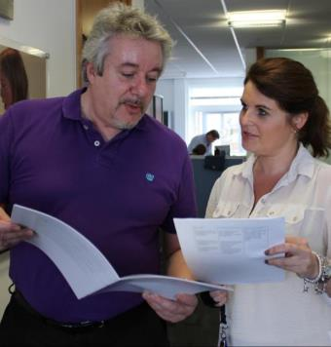

Standards and codes of conduct and practice
To be able to do your job competently you must have skills and knowledge and work in ways that are set out in your country
The iCare Certificate
The iCare Code of Conduct for care support work
^{Competence:} having the ability and expertise to understand an individual’s needs in order to deliver effective care
Source: Skills for Health – Website http://www.skillsforhealth.org.uk/
Skills for Care – Website http://www.skillsforcare.org.uk/
Copyright: iCare Life Pte. Ltd., Singapore
3
Notes:
The iCare Certificate is the shared health and social care training, which must be completed and assessed, before the caregivers can work in any workplace.
The Code of Conduct for Healthcare Support Workers and Adult Social Care Workers has the moral and ethical standards expected of all caregivers or health workers. The Code can be found here:
www.icare.life

Slide 5

Discussion
The ways we need to work to safeguard the people we support
The skills and knowledge we need to be competent in our role
iCare Certificate and iCare Code of Conduct and Standards include…
The moral and ethical standards that we must meet in all aspects of our work
How we should behave when we are at work
Source: Skills for Health – Website http://www.skillsforhealth.org.uk/
Skills for Care – Website http://www.skillsforcare.org.uk/
Copyright: iCare Life Pte. Ltd., Singapore
4
Notes:
QUESTION: What are included in the iCare Certificate and Code of Conduct Standards?

Slide 6
Experiences, attitudes and beliefs
Your experiences, attitudes and beliefs affect how you think and behave and these can:
Lead you to make assumptions
Make judgements
Self-awareness and learning to understand the attitudes and beliefs of others can help you to work in ways that value the individuals that you support
Beliefs: can be described as things in life that you feel strongly about, that guide you in your daily life and are linked very closely to your morals and values
Attitudes: are the approaches, opinions and mind-set that you have developed through your upbringing and life and learning experiences.
Source: Skills for Health – Website http://www.skillsforhealth.org.uk/
Skills for Care – Website http://www.skillsforcare.org.uk/
Copyright: iCare Life Pte. Ltd., Singapore
5
Notes:
QUESTION: What things can influence your experiences, attitudes and beliefs?
Answers could include: Your background, upbringing, relationships, education, the media, attitudes of your friends and family.

Slide 7
Values, aims and objectives
Understanding the values, aims and objectives of your employer will help you to understand your role
Values
Aims
Objectives
Values are the beliefs or ideals that should be evident in all aspects of the service you provide
Aims are the
general goals that one hopes to achieve through their activity, which is the purpose of your job is to achieving these
Objectives are specific things that must be in place in order to achieve the aims
Source: Skills for Health – Website http://www.skillsforhealth.org.uk/
Skills for Care – Website http://www.skillsforcare.org.uk/
Copyright: iCare Life Pte. Ltd., Singapore
6

Slide 8

Rights at work
Legislation gives employees rights and responsibilities at work.
Rights:
To work in a safe environment and be provided with equipment to keep them safe
To have personal and sensitive information treated confidentially
To get paid equitably for your skills
To get fair terms of employment, including pay and working hours
Source: Skills for Health – Website http://www.skillsforhealth.org.uk/
Skills for Care – Website http://www.skillsforcare.org.uk/
Copyright: iCare Life Pte. Ltd., Singapore
7
Notes:
The Act that sets out the rights and responsibilities of the employee in the workplace or at home.
Employees’ have the right to:
Work in an environment that is safe
Be provided, free of charge, with the equipment they need to keep them for work in a safe environment
Employees have the responsibility to work in agreed ways that are safe for them, for others in the workplace and for the people they support.
If you have concerns about safety in your workplace you must talk to your employer or manager.
The Data Protection Act protects people’s rights to confidentiality. It restricts how personal and sensitive information can be used, stored and passed on. It applies to employees information and to how they share the information of others.
The Equality gives all people in most countries including India the right to be treated fairly and afforded equality of opportunity.
Protected: There are many pieces of legislation in any country that set out what are considered to be fair terms of employment including pay and hours of work.

Slide 9
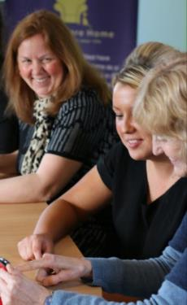
Responsibilities at work
Responsibilities:
To work in agreed ways that are safe for everyone concerned and to discuss safety concerns with their seniors (iCare Life)
To treat other people’s private and sensitive information confidentially
To treat others equally regardless of anything and follow equality
Equality: under legal provision in some country or region identified characteristics or groups are protected under equalities law.
Source: Skills for Health – Website http://www.skillsforhealth.org.uk/
Skills for Care – Website http://www.skillsforcare.org.uk/
8

Slide 10
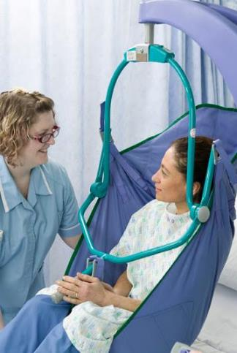
Responsibilities to the individuals you support
You have responsibilities to the people that you provide care and support for including:
Safeguarding their safety and welfare
Involving the individual and their support network in the planning, delivery and review of their care
Ensuring that their dignity is promoted and their rights upheld
Supporting the person to complain or raising concerns if care is inadequate or rights are not upheld
Source: Skills for Health – Website http://www.skillsforhealth.org.uk/
Skills for Care – Website http://www.skillsforcare.org.uk/
Copyright: iCare Life Pte. Ltd., Singapore
9
Notes:
You have responsibilities to the people that you provide care and support for including:
Working for their safety and welfare by ensuring their care plan is followed and that care is provided in agreed, safe ways
Involving the individual and their support network in the planning, delivery and review of their care to ensure that it meets their needs
Ensuring that care is delivered in ways that promote their dignity and upholds their rights
Supporting the person to complain or raising concerns if care is inadequate or rights are not upheld

Slide 11

Agreed ways of working
Agreed ways of working are the ways in which employers expect you to work, which could be:
Part of a policy in a workplace of likes and dislikes in a family environment
Provided by your manager or colleague or family members or engagers
Part of an individual’s care plan about his/her likes and dislikes
Source: Skills for Health – Website http://www.skillsforhealth.org.uk/
Skills for Care – Website http://www.skillsforcare.org.uk/
10

Slide 12

Reporting errors - discussion
Mistakes sometimes happen and it is important to be honest, admit and identify when errors have been made
What action should be taken?
Why is it important to be honest and admit when errors have been made?
What are the potential consequences of not reporting a mistake?
Source: Skills for Health – Website http://www.skillsforhealth.org.uk/
Skills for Care – Website http://www.skillsforcare.org.uk/
Copyright: iCare Life Pte. Ltd., Singapore
11
Notes:
QUESTION : Ask the group to think of a mistake they have made or offer a scenario.
What action should be taken?
Why is it important to be honest and admit when errors have been made?
What are the potential consequences of not reporting a mistake?
Suggested Activity: Ask learners to think of a mistake they have made or give a scenario.
Scenario 1
A meal containing meat is given to a vegetarian. They don’t eat it.
What action should be taken?
The meal should be replaced with something the person can eat – the individual’s welfare is the top priority and they should not be allowed to go hungry.
The mistake should be reported (in line with the agreed ways of working)
Why is it important to be honest and admit when errors have been made?
If a worker does not admit the mistake the individual may miss a meal. This standard of care would not be acceptable.
What are the potential consequences of not reporting a mistake?
In this scenario the individual may be hungry
A complaint could be made
Not eating could affect the effectiveness of medication which has to be taken with or after food
Not reporting may mean that similar incidents happen in the future.
If it happens repeatedly to the same person they could become malnourished
If an unsuitable meal were given to an individual with allergies it could have serious consequences
Scenario 2
An individual tells a worker that they have been experiencing severe headaches everyday an hour after they have taken their medication and the worker forgets to make a note of this in the individual’s care plan
What action should be taken?
The worker must tell their employer, family or supervisor as soon as possible
Why is it important to be honest and admit when errors have been made?
The individual is experiencing pain which may be avoidable if medication is changed
The headaches could be a sign of a more serious problem
What are the potential consequences of not reporting a mistake?
The individual will continue to experience pain- this is not an acceptable level of care if pain could be avoided
The individual may become reluctant to take their medication which could affect other aspects of their health
The individual’s care plan will not be up to date

Slide 13

Whistleblowing
Reporting things that you feel are not right or are illegal is known as whistleblowing
You have a responsibility to report concerns about the safety and welfare of all people around you in the workplace
You must follow the whistleblowing policy for your employer or follow instruction of family
Source: Skills for Health – Website http://www.skillsforhealth.org.uk/
Skills for Care – Website http://www.skillsforcare.org.uk/
12

Slide 14
Whistleblowing - discussion
 | Report?
The health and safety of staff is in danger | YES | NO
Individuals are treated with dignity and respect | YES | NO
The environment is being damaged by work activity | YES | NO
Wrongdoing is being covered up | YES | NO
The individual’s care is inadequate but they cannot or will not complain | YES | NO
Care plans are reassessed and updated regularly | YES | NO
Your manager is involved in the abuse of individuals | YES | NO
Source: Skills for Health – Website http://www.skillsforhealth.org.uk/
Skills for Care – Website http://www.skillsforcare.org.uk/
Copyright: iCare Life Pte. Ltd., Singapore
13
Notes:
QUESTION: Ask group to decide whether each should be reported as a concern – yes/no answers
Alternative suggestion:
This could be printed out as a handout and given to the group to circle their answers

Slide 15
Working in partnership
In your role you will be working with people in a variety of situations, which is known as ‘partnership working’
Working relationships fall into four groups:
Individuals and their friends and family
Your colleagues and managers
People from other workplaces, including advocates
Volunteers and community groups
Advocate: Is a trusted, independent person who can speak and act for the individual. They can advise on matters such as benefits and can ensure that the individual’s voice is heard in care planning meetings, making sure that decisions are made in the interests of the individual. The role of advocates and advocacy services are important in some countries due to regulation of care services by the government.
Source: Skills for Health – Website http://www.skillsforhealth.org.uk/
Skills for Care – Website http://www.skillsforcare.org.uk/
14
Notes:
Question
Think about some of the people who are involved in providing support to an individual.
Suggested answers:
The person
The person’s family and friends
Colleagues doing the same or similar jobs
Managers and supervisors
People who do other jobs such as nurses, GPs, physiotherapists, social workers, dieticians
People who work for charitable organisations
Religious groups
Special interest, recreational and support groups.

Slide 16
Effective partnership working
The effectiveness of partnership working affects the quality of care delivery and the skills and values necessary for it to be effective include:
Communication
Record keeping
Trust
Respect
Conflicts and disagreements can affect the quality of care provided, and seeking advice from seniors and colleagues (iCare Life) who have the experience will help you
Working well in partnership
Failings in partnership working
Good quality care
Meets all the individual’s needs
Poor standard of care
Often identified as a factor when things go wrong
Source: Skills for Health – Website http://www.skillsforhealth.org.uk/
Skills for Care – Website http://www.skillsforcare.org.uk/
Copyright: iCare Life Pte. Ltd., Singapore
15
Notes:
The effectiveness of partnership working affects the quality of care delivery
Skills and values necessary for it to be effective include:
Communication – choosing appropriate ways of communicating, language and avoiding medical terms that the care recipient may not understand
– this may require to use interpreters, communication aids etc. to communicate effectively
Record keeping – information must be understandable, accessible and shared with those who need to know and up to date
Trust – Workers must build working relationships based on trust as this helps to promote openness and honesty and so that everyone is confident that they can rely on the people that they are working with
Respect – Workers must always work in ways that promote respect and, may involved in partnership working play a valuable part in planning and providing care
– Respecting the part that each person has to play helps to promote effective partnership working.

Slide 17







Knowledge check
Which of the following statements about rights and responsibilities is true?
Click to reveal answer
The law states that your employer can choose how they treat you
You have legal rights and responsibilities when you are employed
You can behave however you want in the workplace
The law does not apply to people who work in agreed ways
Source: Skills for Health – Website http://www.skillsforhealth.org.uk/
Skills for Care – Website http://www.skillsforcare.org.uk/
Copyright: iCare Life Pte. Ltd., Singapore
16
Notes:
QUESTION: Ask group question then to answer A,B,C or D
Trainer should ask class why they chose the correct answer

Slide 18


Knowledge check
Which of the following is important for effective partnership working?
Click to reveal answer
Whistleblowing
Keeping relevant information to yourself
Open and honest communication
Making judgements based on your past experiences
Source: Skills for Health – Website http://www.skillsforhealth.org.uk/
Skills for Care – Website http://www.skillsforcare.org.uk/
Copyright: iCare Life Pte. Ltd., Singapore
17
Notes:
QUESTION: Ask group question then to answer A,B,C or D
Trainer should ask class why they chose the correct answer

Slide 19


Knowledge check
What should you do if you are concerned that one of your colleagues is mistreating an individual they are providing care and support for?
Click to reveal answer
I should keep quiet and not complain
I should discuss my concerns with the individuals that I support
I should report concerns to the Care Quality Commission (CQC) immediately
I should report my concerns to my manager
Source: Skills for Health – Website http://www.skillsforhealth.org.uk/
Skills for Care – Website http://www.skillsforcare.org.uk/
Copyright: iCare Life Pte. Ltd., Singapore
18
Notes:
QUESTION: Ask group question then to answer A,B,C or D
Trainer should ask class why they chose the correct answer
Feedback – Answers to Q&A’s
A – Agreeing a PDP is part of an ongoing process of learning and development to improve your skills and knowledge which may be informed by you reflecting on your own practice
B – Feedback from others can be helpful in developing your skills and knowledge but it is not part of reflection on your own work
C – Giving constructive feedback to others can help them to improve the ways in which they work but it is not part of reflecting on your own work
D – Reflection is a form of learning and development in which workers think about what they have done in the past. By thinking about how they could have done things differently to get a different result, they can learn from past experiences and improve the ways in which they work

Slide 20


Slide 21
Viewing of Modules
CR 1.2
Private and Confidential

Slide 22
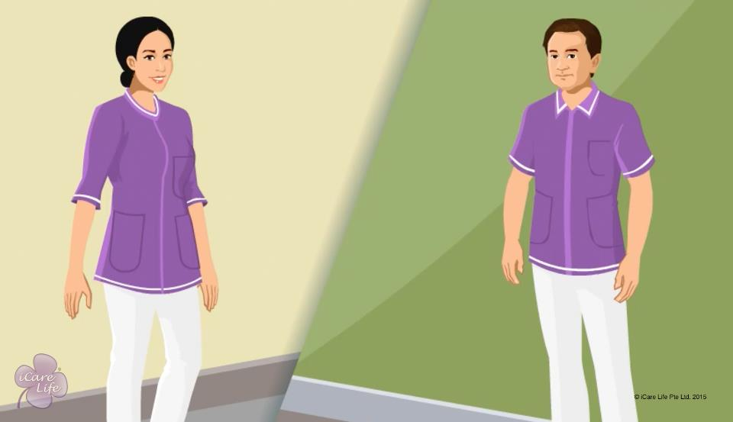
First Impression
1
Copyright: iCare Life Pte. Ltd., Singapore : This document must not be copied or shared or circulated without the consent of iCare Life and/or its affiliates.

Slide 23
In this module, you will learn about:
How to prepare for the first meeting with your employer, care receiver or their family
How to look like a professional for the first meeting
How to conduct yourself and display good etiquette and courtesy
2
Copyright: iCare Life Pte. Ltd., Singapore : This document must not be copied or shared or circulated without the consent of iCare Life and/or its affiliates.

Slide 24


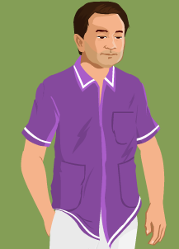
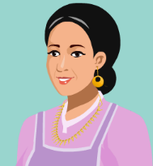

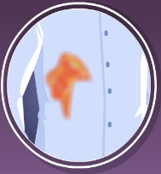
Pre-Module Activity
Good or Bad Impression
3
Copyright: iCare Life Pte. Ltd., Singapore : This document must not be copied or shared or circulated without the consent of iCare Life and/or its affiliates.
Notes:
Ask the class participant as to what do they understand by first impression. A typical answer should be on the lines of “An idea, feeling, or opinion about something or someone, especially one formed without conscious thought or on the basis of little evidence.”
Now show the given pictures one by one and ask the class to identify if they would give a good or a bad first impression.
Answer key:
Hair in a neat bun- good
Trimmed nails- good
Crumpled shirt- bad
Chunky jewelry - bad
Clean shoes- good
Food stains- bad

Slide 25

Let’s Watch
First Impression
4
Copyright: iCare Life Pte. Ltd., Singapore : This document must not be copied or shared or circulated without the consent of iCare Life and/or its affiliates.

Slide 26
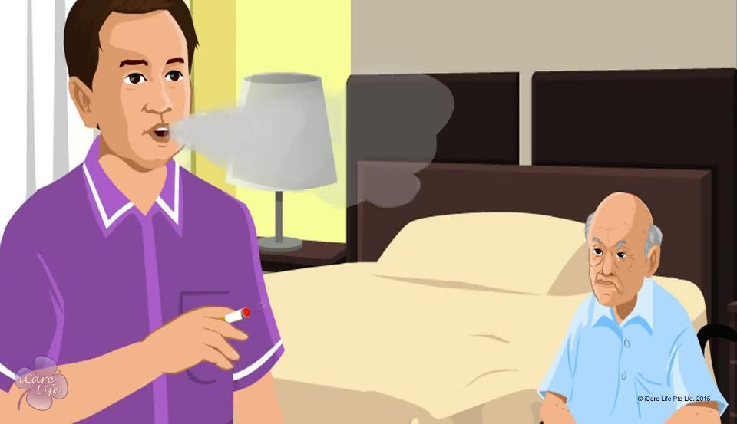
Habits to Kill
5
Copyright: iCare Life Pte. Ltd., Singapore : This document must not be copied or shared or circulated without the consent of iCare Life and/or its affiliates.

Slide 27
In this module, you will learn about:
The habits that you should give up as a professional caregiver
6
Copyright: iCare Life Pte. Ltd., Singapore : This document must not be copied or shared or circulated without the consent of iCare Life and/or its affiliates.

Slide 28


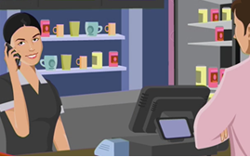

Pre-Module Activity
What is wrong with the behavior of these professionals?
1
2
3
4
7
Copyright: iCare Life Pte. Ltd., Singapore : This document must not be copied or shared or circulated without the consent of iCare Life and/or its affiliates.
Notes:
Notes:
Say that irrespective of the type of work you do, there is certain behavior that is unacceptable in all professions. Show them these images of people in other professions. Ask what is wrong with the behavior of these professionals?
Gossiping
Smoking at work
During work hours, the professional is relaxed, busy on her phone
A sales person on cash counter talking rudely to a customer
Highlight the importance of developing and maintaining good work habits.

Slide 29
Let’s Watch
Habits to Kill
8
Copyright: iCare Life Pte. Ltd., Singapore : This document must not be copied or shared or circulated without the consent of iCare Life and/or its affiliates.

Slide 30
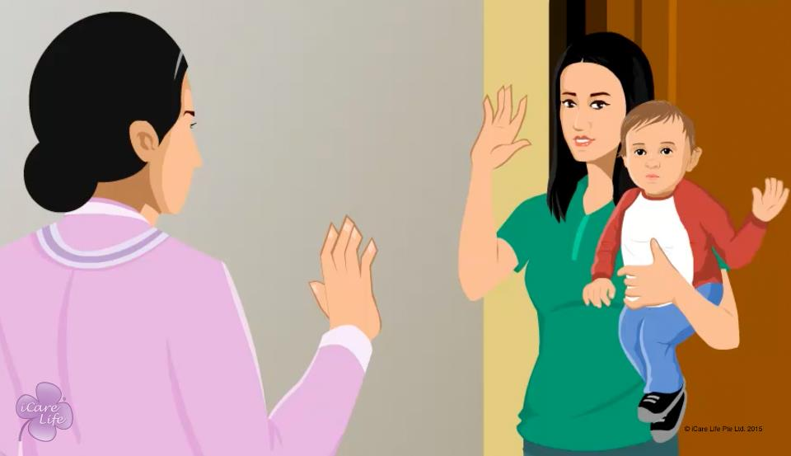
Maintaining Boundaries
9
Copyright: iCare Life Pte. Ltd., Singapore : This document must not be copied or shared or circulated without the consent of iCare Life and/or its affiliates.

Slide 31
In this module, you will learn about:
The importance of maintaining boundaries with the care receiver and their family
How you can maintain these boundaries
10
Copyright: iCare Life Pte. Ltd., Singapore : This document must not be copied or shared or circulated without the consent of iCare Life and/or its affiliates.

Slide 32
Let’s Watch
Maintaining Boundaries
11
Copyright: iCare Life Pte. Ltd., Singapore : This document must not be copied or shared or circulated without the consent of iCare Life and/or its affiliates.

