Slide 1
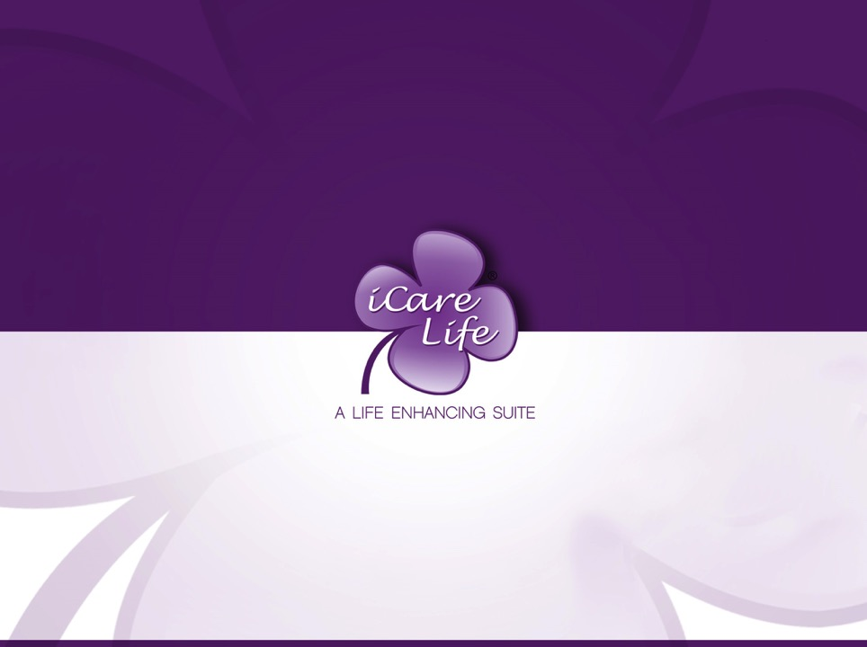
Prevention and Control of Infection
2
CR 1.3
Standard
Private and Confidential

Slide 2
Learning outcomes
1. Learn to prevent event the spread of infection
Source: Skills for Health – Website http://www.skillsforhealth.org.uk/
Skills for Care – Website http://www.skillsforcare.org.uk/
Copyright: iCare Life Pte. Ltd., Singapore
1

Slide 3


Introduction
Infection and infectious diseases in humans are caused when harmful germs, known as pathogens enter the body and multiply
These micro-organisms are so small they can only be seen by using a microscope
Pathogens: A pathogen is something that causes a disease.
Source: Skills for Health – Website http://www.skillsforhealth.org.uk/
Skills for Care – Website http://www.skillsforcare.org.uk/
Copyright: iCare Life Pte. Ltd., Singapore
2

Slide 4
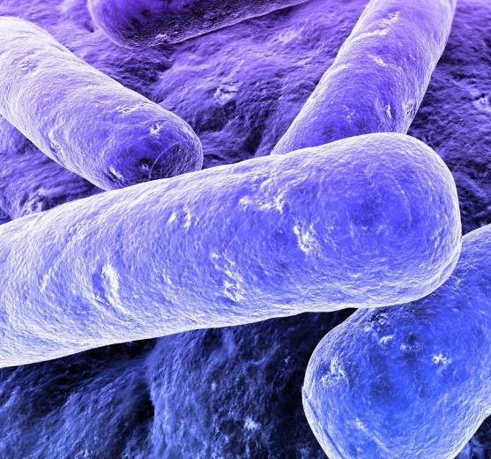
Pathogens
Pathogenic organisms can be:
Bacteria
Viruses
Fungi
Parasites
Protozoa
Source: Skills for Health – Website http://www.skillsforhealth.org.uk/
Skills for Care – Website http://www.skillsforcare.org.uk/
Copyright: iCare Life Pte. Ltd., Singapore
3
Notes:
Additional Information
Bacteria that can multiply quickly at body temperature and reach harmful levels very fast. Examples of harmful bacteria include meticillin-resistant Staphylococcus aureus (commonly known as MRSA) and Clostridium difficile (known as C.Diff or C. Difficile). These two types of bacteria caused, or contributed to, 9000 deaths in hospitals or primary care in 2007.
Viruses that can survive on surfaces and in food but can only multiply in living cells. It takes very few virus organisms to cause illness. They can be spread from person-to-person and from environment-to-food. Examples of viruses include Norovirus (also known as ‘winter vomiting disease’) and Influenza (the flu virus).
Fungi are organisms which live on hosts that can be alive or dead. Examples of fungal infections include; athlete’s foot and ringworm.
Parasites live on or in another plant or animal, known as the host. Scabies is caused by mites that burrow into the skin causing severe itching.
Protozoa are single-celled organisms that live in water and damp conditions. Malaria is an example of a disease caused by protozoa.
Hosts could describe the organism from which the parasite feeds or in which it lives or grows.

Slide 5


Vulnerable people
Some groups of people may be more vulnerable to infection, for example because of age or ill or general health
If these groups become infected the symptoms may be serious and life-threatening
Micro-organisms that are resistant to antibiotics can make it difficult to treat the illness
Source: Skills for Health – Website http://www.skillsforhealth.org.uk/
Skills for Care – Website http://www.skillsforcare.org.uk/
Copyright: iCare Life Pte. Ltd., Singapore
4
Notes:
Activity: Ask the learners for some examples of groups who may be more vulnerable to infection.
Answers could include:
People with weakened immune systems including:
Elderly people
New born babies
People with some long-term health conditions
People who have broken skin (portal of entry) including:
An open wound
A catheter or intravenous drip
Burns or cuts to the skin
Skin conditions such as ulcers
People who have poor nutrition or poor general health

Slide 6
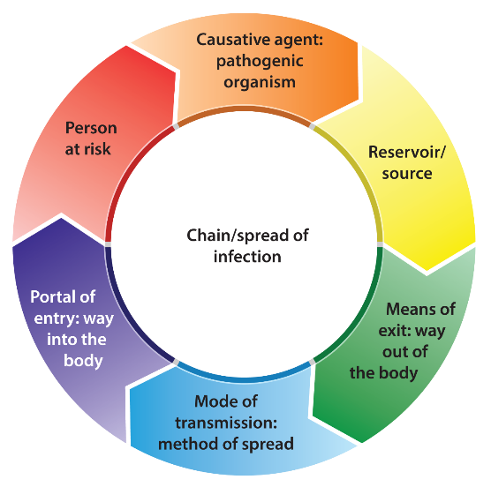
Chain of infection
In order for the spread of infectious diseases to take place, the ‘chain of infection’ must be completed.
Source: Skills for Health – Website http://www.skillsforhealth.org.uk/
Skills for Care – Website http://www.skillsforcare.org.uk/
Copyright: iCare Life Pte. Ltd., Singapore
5
Notes:
Additional Information
Causative agent: This is the harmful germ or pathogen that can cause infection, illness and disease. Examples include bacteria and viruses.
Reservoir or source: This is where pathogens live and multiply.
Remember, that could be in or on a person or animal (host), or in soil or water.
Means of exit: This is how pathogens leave the source. For example, pathogens that live in the respiratory tract (the lungs, throat, etc.) can leave the body through the mouth or nose in saliva or mucus when coughing or sneezing. Other examples of means of exit are broken skin, mucous membranes such as the eyes, via the stomach and via the intestines and anus.
Mode of transmission: It refers to how the pathogen is passed on from one person to another. Contact transmission is the most common route of transmission of pathogens in a health and social care workplace. This can happen by direct (hands) or indirect contact (equipment). Pathogens such as those that cause influenza and chicken pox can stay in the air for a long time and can be breathed in by other people.
Portal of entry: This is the way that the pathogen enters the body of the potential host. Pathogens can enter the body by coming into contact with broken skin, being breathed in or eaten, coming into contact with the eyes, nose and mouth or, for example when needles or catheters are inserted.
Person at risk: A person at risk is the individual the pathogen moves to. The risk of a person becoming infected depends on factors such as their general health and the strength of their immune system (which is the body’s system for fighting germs and micro-organisms).

Slide 7
Breaking the chain
Preventing infection means breaking the links in the chain so that an infection cannot spread
Not everybody who carries harmful micro-organisms will show symptoms
Examples of standard precautions taken in EVERY situation to reduce the risk of infection:
Good hand hygiene
Safe disposal of waste
Safe management of laundry
Correct use of Personal Protective Equipment (PPE).
Source: Skills for Health – Website http://www.skillsforhealth.org.uk/
Skills for Care – Website http://www.skillsforcare.org.uk/
Copyright: iCare Life Pte. Ltd., Singapore
6
Notes:
Activity: Ask workers to identify some examples of ways of working.
Answers should include:
Good hand hygiene
Safe disposal of waste
Safe management of laundry
Correct use of Personal Protective Equipment (PPE).
Additional information
In a workplace it may be necessary to take additional measures when supporting people who are known to be carrying some harmful micro-organisms to protect others from contamination. This can be particularly important if the pathogens travel through air.

Slide 8
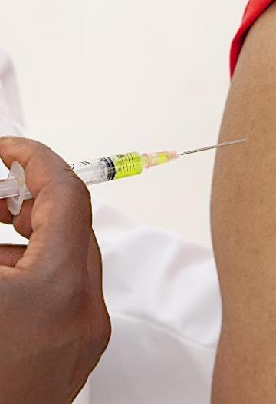
Your health and hygiene
You have an important role to play in preventing the spread of infections
Vaccinations
Illness
Clothing
Personal hygiene
Skin health
Good hand habits
Source: Skills for Health – Website http://www.skillsforhealth.org.uk/
Skills for Care – Website http://www.skillsforcare.org.uk/
Copyright: iCare Life Pte. Ltd., Singapore
7
Notes:
Additional Information
Vaccinations: It is your responsibility to keep up to date with your own vaccinations in line with the vaccination schedule as it is part of your duty to protect the individual.
Illness: If you have cold or flu symptoms, an upset stomach or skin infections, you should speak to your manager before reporting for work.
If you have diarrhoea or vomiting you should not attend work until you have been free from symptoms for 48 hours.
Clothing: Your clothes can become contaminated with harmful micro-organisms. Disposable aprons and over-sleeves should be used when handling anything contaminated with body fluids to protect clothes from contamination. Changing your clothing daily reduces the risk of remaining contaminants being spread to the individuals you provide support for. Uniforms or work clothing should be washed on a hot wash, then tumble-dried or hot ironed, to kill any bacteria present.
Personal hygiene: Personal hygiene is extremely important for people who take care of others. Daily washing, showering or bathing will remove most of the micro-organisms on your skin. Hand hygiene is also extremely important. Fingernails should be kept short. Rings (apart from plain wedding bands), wristwatches or bracelets should not be worn as they can make hand washing less effective.
Skin health: Micro-organisms can live on the skin. The number of pathogens increases when skin is damaged. All cuts should be covered with a waterproof dressing. Using hand cream, good quality paper towels and soaps can help to protect the skin.
Good hand habits: Having good hand habits means not touching areas that can be a source of pathogens more than you need to. These areas include your nose, hair and mouth, and not biting nails. This also applies to work practices such as using foot operated bins rather than lifting bin lids with your hands.

Slide 9

Hand hygiene
Hand hygiene is an important part of preventing infection Hands can be cleaned, or decontaminated by:
Washing with water and soap that removes dirt and germs from the hands but doesn’t kill them
Using alcohol hand rubs and gels which kill most bacteria
Source: Skills for Health – Website http://www.skillsforhealth.org.uk/
Skills for Care – Website http://www.skillsforcare.org.uk/
Copyright: iCare Life Pte. Ltd., Singapore
8
Notes:
Additional information
Alcohol rubs are less effective against Clostridium difficile and some viruses that cause vomiting and diarrhoea if hands are visibly dirty.

Slide 10
5 moments for hand hygiene
The World Health Organisation has identified ‘5 moments’ when health and social care workers should clean their hands. These moments are:
1) Before touching the individual you are supporting
2) Immediately before carrying out a ‘clean’ procedure
3) After exposure to body fluids and after removing gloves
4) After touching the individual you are supporting
5) After touching the area or objects surrounding the individual you are supporting
Source: Skills for Health – Website http://www.skillsforhealth.org.uk/
Skills for Care – Website http://www.skillsforcare.org.uk/
Copyright: iCare Life Pte. Ltd., Singapore
9

Slide 11
Effective hand washing
For hand washing to be effective every part of your hands are carefully washed, rinsed and dried. The steps below show you how to ensure that your hands are washed correctly:
1) Wet hands and wrists thoroughly using warm running water
2) Apply liquid or foam soap
3) Produce a good lather; rub palms together, interlock fingers, rub together again
4) Rub palms ensuring fingertips and fingernails are cleaned
Ensure that the backs of your hands are lathered and cleaned
5) Rub with fingers locked, maintaining a good lather to ensure that wrists are cleaned
6) Rinse hands thoroughly using running water
Source: Skills for Health – Website http://www.skillsforhealth.org.uk/
Skills for Care – Website http://www.skillsforcare.org.uk/
Copyright: iCare Life Pte. Ltd., Singapore
10
Notes:
Additional information
Hands and wrists should be thoroughly dried using paper towels or a hand dryer. Rubbing and lathering your hands should take around 20 seconds.

Slide 12
Personal Protective Equipment (PPE)
Your employer must provide you with the equipment you need to protect you from harm; that includes:
Uniforms
Disposable aprons
Paper towels and soap
Hand cleansing gel or wipes
Gloves
Masks and respiratory masks
Goggles, eye protection and face shields
Source: Skills for Health – Website http://www.skillsforhealth.org.uk/
Skills for Care – Website http://www.skillsforcare.org.uk/
Copyright: iCare Life Pte. Ltd., Singapore
11
Notes:
Additional Information
Ask health learners for some examples of PPE that can be used to protect them from the spread of pathogens.
Answers should include:
Enough uniforms for regular changing and washing
Disposable aprons to protect clothing and uniforms from contamination from blood and body fluids etc.
Skin protecting paper towels and soaps
Hand cleansing gels or wipes
The correct type of gloves to reduce the risk of cross-contamination of you and the individual you are supporting
Masks and respiratory-masks to protect you from breathing in harmful micro-organisms
Goggles, eye protection and face shields – if there is a risk of being splashed with body fluids

Slide 13
Soiled linen
Linen can become contaminated with harmful micro-organisms and body fluids
Precautions for dealing with contaminated linen include:
Wearing PPE
Washing contaminated linen separately
Washing clothing in 40°C-50°C wash followed by tumble-drying or hot ironing
Washing bedding and towels in a hot wash
Sealing laundry in colour coded bags and moving to the washing area
Washing infected linen immediately if you are supporting people in their own home
Source: Skills for Health – Website http://www.skillsforhealth.org.uk/
Skills for Care – Website http://www.skillsforcare.org.uk/
Copyright: iCare Life Pte. Ltd., Singapore
12
Notes:
Additional Information
Linen refers to anything that is made of cloth including bedding, towels and clothing.
Once linen has been decontaminated it must be stored separately from contaminated linen to prevent cross-contamination. You must always follow your agreed ways of working. If you have any questions about these you should speak to your engager, family or manager.

Slide 14







Knowledge check
Which of the following statements relating to hand hygiene is correct?
Click to reveal answer
Hand washing kills all bacteria
Hand drying is an important part of effective hand washing
Wearing gloves avoids the need to practise hand hygiene
Alcohol gel works in the same way as hand washing
Source: Skills for Health – Website http://www.skillsforhealth.org.uk/
Skills for Care – Website http://www.skillsforcare.org.uk/
Copyright: iCare Life Pte. Ltd., Singapore
13
Notes:
Trainer should ask class why they chose the correct answer
Feedback
A – Effective hand washing removes bacteria from the hands but does not kill them
B – For hand washing to be effective every part of your hands are carefully washed, rinsed and dried
C – Hand hygiene must be practiced before putting on gloves and after taking them off (Using gloves does not avoid the need to practise hand hygiene)
D – Alcohol gel kills most bacteria however, they are less effective against Clostridium difficile and some viruses that cause vomiting and diarrhoea if hands are visibly dirty

Slide 15
Knowledge check
Which of the following is the correct sequence for effective hand washing?
Click to reveal answer
Rinse – lather – rub – apply soap – wash – dry
Wet hands – apply soap – lather – rub – rinse – dry
Apply soap – rinse – rub – wash – lather – dry
Dry – lather – rinse – apply soap – wash – rub
Source: Skills for Health – Website http://www.skillsforhealth.org.uk/
Skills for Care – Website http://www.skillsforcare.org.uk/
Copyright: iCare Life Pte. Ltd., Singapore
14
Notes:
Trainer should ask class why they chose the correct answer
Feedback
The correct sequence for effective hand washing is B - Wet hands – apply soap – lather – rub – rinse – dry

Slide 16


Knowledge check
If a caregiver/health worker has cold symptoms, an upset stomach or skin infections what should they do?
Click to reveal answer
Report their illness to the Government Health and Safety Department
Go to the health unit of the nearest hospital
Go to work as normal
Speak to their family or manager before coming into work
Source: Skills for Health – Website http://www.skillsforhealth.org.uk/
Skills for Care – Website http://www.skillsforcare.org.uk/
Copyright: iCare Life Pte. Ltd., Singapore
15
Notes:
Trainer should ask class why they chose the correct answer

Slide 17
Viewing of Modules
Prevention and Control of Infection
CR 1.3
Private and Confidential

Slide 18
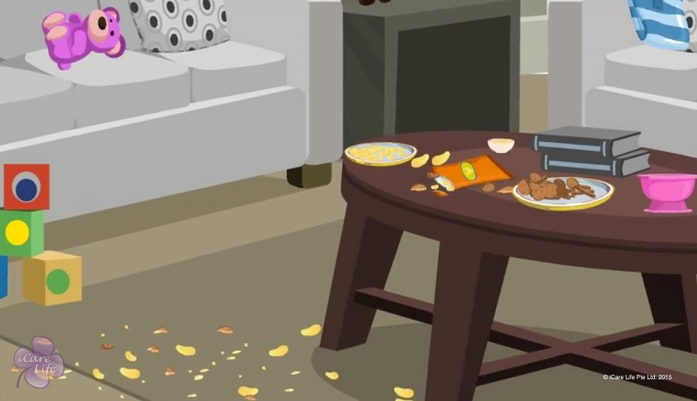
Importance of a Clean Environment
1
Copyright: iCare Life Pte. Ltd., Singapore : This document must not be copied or shared or circulated without the consent of iCare Life and/or its affiliates.

Slide 19
In this module, you will learn about:
Understand why clean environment is important for the health and safety of the person under your care
2
Copyright: iCare Life Pte. Ltd., Singapore : This document must not be copied or shared or circulated without the consent of iCare Life and/or its affiliates.

Slide 20

Let’s Watch
Importance of a Clean Environment for Caregiving
3
Copyright: iCare Life Pte. Ltd., Singapore : This document must not be copied or shared or circulated without the consent of iCare Life and/or its affiliates.

Slide 21
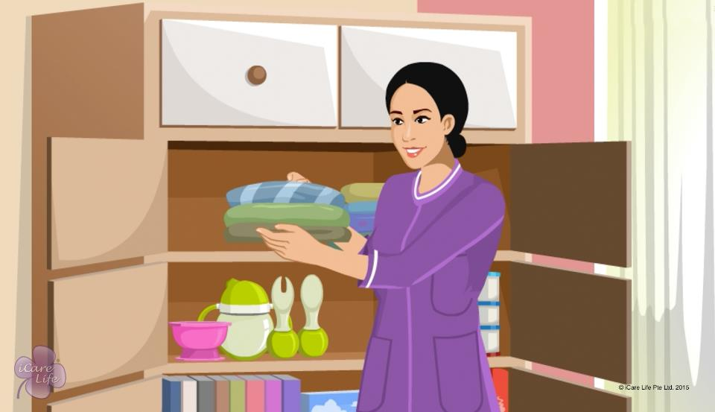
Clean and Hygienic Environment
4
Copyright: iCare Life Pte. Ltd., Singapore : This document must not be copied or shared or circulated without the consent of iCare Life and/or its affiliates.

Slide 22
In this module, you will learn about:
Understand the measures to maintain a clean and hygienic environment
5
Copyright: iCare Life Pte. Ltd., Singapore : This document must not be copied or shared or circulated without the consent of iCare Life and/or its affiliates.

Slide 23
Let’s Watch
Measures to a Maintain Clean and Hygienic Environment
6
Copyright: iCare Life Pte. Ltd., Singapore : This document must not be copied or shared or circulated without the consent of iCare Life and/or its affiliates.

Slide 24
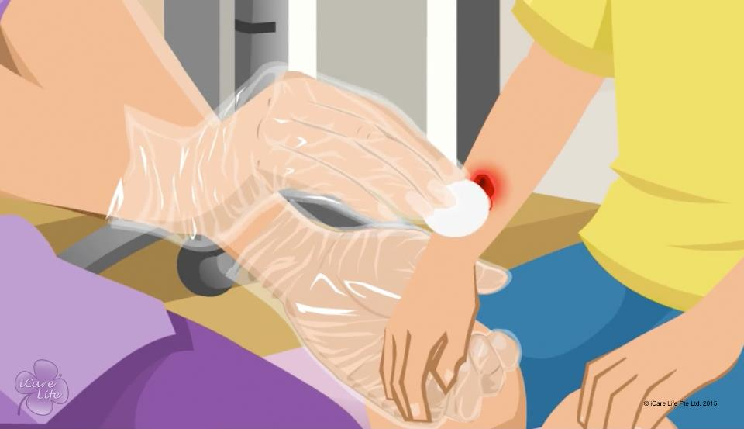
Wearing and Taking Off Gloves
7
Copyright: iCare Life Pte. Ltd., Singapore : This document must not be copied or shared or circulated without the consent of iCare Life and/or its affiliates.

Slide 25
In this module, you will learn about:
When and why should you use disposable gloves
How to wear disposable gloves
How to take off disposable gloves
8
Copyright: iCare Life Pte. Ltd., Singapore : This document must not be copied or shared or circulated without the consent of iCare Life and/or its affiliates.

Slide 26
Let’s Watch
Wearing and Taking Off Gloves
9
Copyright: iCare Life Pte. Ltd., Singapore : This document must not be copied or shared or circulated without the consent of iCare Life and/or its affiliates.

Slide 27
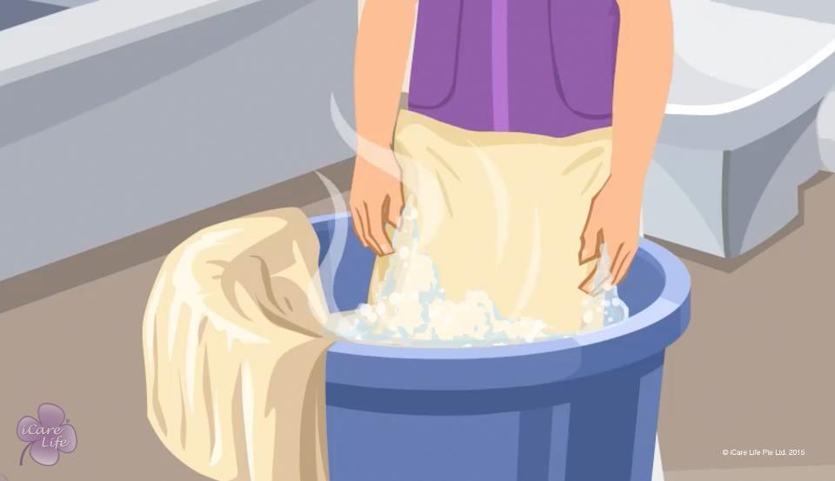
Changing Linen
10
Copyright: iCare Life Pte. Ltd., Singapore : This document must not be copied or shared or circulated without the consent of iCare Life and/or its affiliates.

Slide 28
In this module, you will learn about:
What all is included in linen
When should you change the linen
Why is it important to change linen frequently
11
Copyright: iCare Life Pte. Ltd., Singapore : This document must not be copied or shared or circulated without the consent of iCare Life and/or its affiliates.

Slide 29
Let’s Watch
Changing Linen
12
Copyright: iCare Life Pte. Ltd., Singapore : This document must not be copied or shared or circulated without the consent of iCare Life and/or its affiliates.

Slide 30
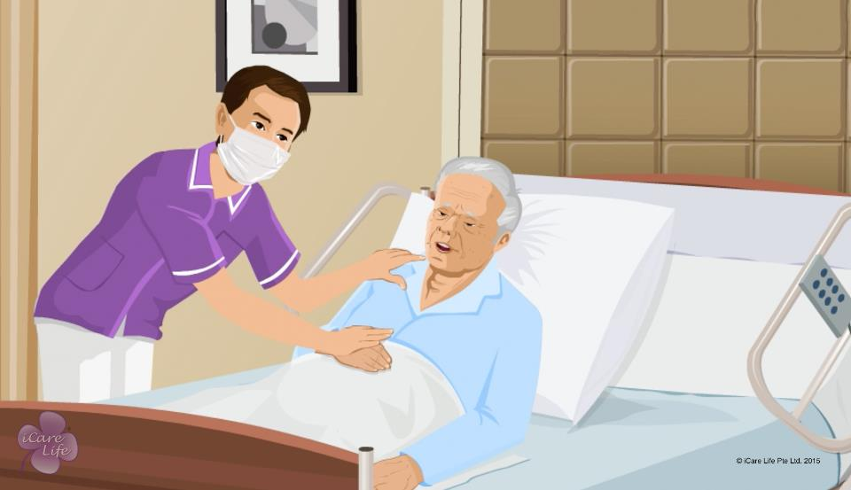
Caregivers’ Safety from Infections
13
Copyright: iCare Life Pte. Ltd., Singapore : This document must not be copied or shared or circulated without the consent of iCare Life and/or its affiliates.

Slide 31
In this module, you will learn about:
How you can ensure your own safety from patient infections
The common articles which can prevent you from catching an infection
14
Copyright: iCare Life Pte. Ltd., Singapore : This document must not be copied or shared or circulated without the consent of iCare Life and/or its affiliates.

Slide 32
Let’s Watch
Ensuring the Caregiver’s Safety from Infections
15
Copyright: iCare Life Pte. Ltd., Singapore : This document must not be copied or shared or circulated without the consent of iCare Life and/or its affiliates.

Slide 33


