Slide 1

Modules Summary Discussion – Q&A
CR 1.4
Private and Confidential

Slide 2

Who is an Elder
1
Copyright: iCare Life Pte. Ltd., Singapore : This document must not be copied or shared or circulated without the consent of iCare Life and/or its affiliates.

Slide 3
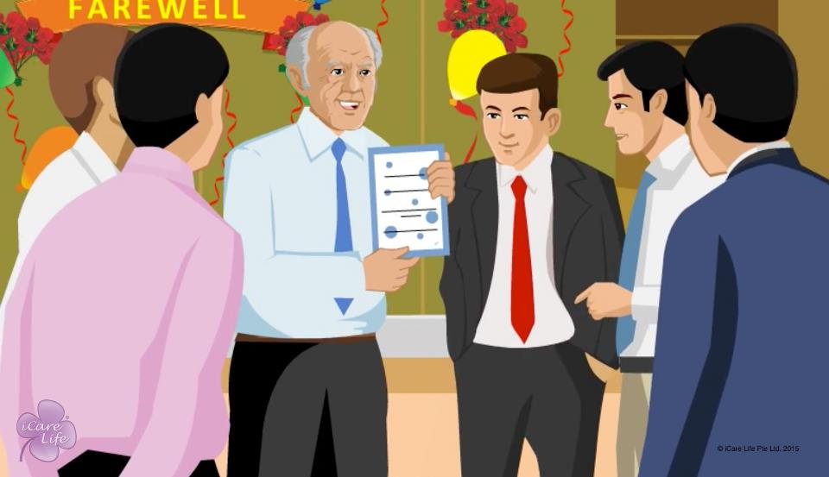
Who is an Elder
2
Copyright: iCare Life Pte. Ltd., Singapore : This document must not be copied or shared or circulated without the consent of iCare Life and/or its affiliates.

Slide 4
Summary
Chronologically, an elder may be:
The Almost Old
The Already Old
The Very Old
The Elite Old
Everyone of a particular age does not have the same physical, mental, or social ability
These days elders are healthier
Being Old - is more a state of mind than a certain age
3
Copyright: iCare Life Pte. Ltd., Singapore : This document must not be copied or shared or circulated without the consent of iCare Life and/or its affiliates.
Notes:
Chronologically, an elder may be:
The Almost Old
The Already Old
The Very Old
The Elite Old
Everyone of a particular age does not have the same physical, mental, or social ability
These days elders are healthier
Being Old - is more a state of mind than a certain age

Slide 5





At what age does
ageing begin?
60 years onwards
When aches and pains begins
70 years onwards
From birth
From birth
4
Copyright: iCare Life Pte. Ltd., Singapore : This document must not be copied or shared or circulated without the consent of iCare Life and/or its affiliates.
Notes:
Let’s see how well have we understood the concept of aging? Could you make a guess?
At which age does aging begin?
Well, as you see aging process starts at birth.

Slide 6
Any Questions?
5
Copyright: iCare Life Pte. Ltd., Singapore : This document must not be copied or shared or circulated without the consent of iCare Life and/or its affiliates.
Notes:
Q.1. What should I do if the elder wants to do activities such as rigorous exercising that I feel they are too old to do?
Ans. See if the elder is comfortable doing the exercise. You may even check with the family and the elder’s doctor. If not, gently explain to the elder that they while it is good to exercise regularly, they should do so within limits prescribed by their doctor.

Slide 7
First Day of Duty with the Elder
6
Copyright: iCare Life Pte. Ltd., Singapore : This document must not be copied or shared or circulated without the consent of iCare Life and/or its affiliates.

Slide 8
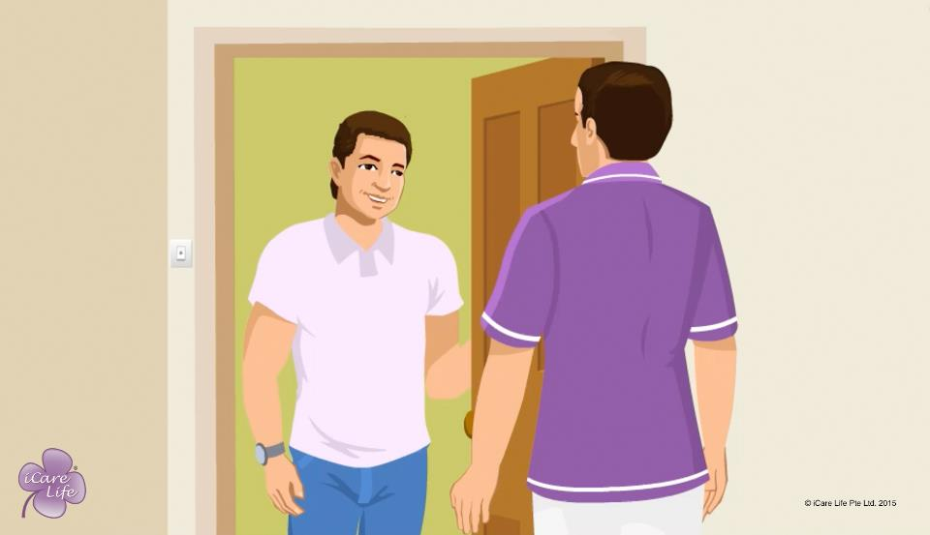
First Day of Duty with the Elder
7
Copyright: iCare Life Pte. Ltd., Singapore : This document must not be copied or shared or circulated without the consent of iCare Life and/or its affiliates.

Slide 9
Summary
Ask your employer about your daily reporting time and the time when you will leave
List down your responsibilities with your employer
Understand the layout of the elder’s home
Ask your employer about the elder’s age, family structure, physical and mental abilities, medical problems, diet, and any specific needs
Ask your employer about the current medications that need to be administered
Check and record vital information of the elder
8
Copyright: iCare Life Pte. Ltd., Singapore : This document must not be copied or shared or circulated without the consent of iCare Life and/or its affiliates.
Notes:
Ask your employer about your daily reporting time and the time when you will leave
List down your responsibilities with your employer
Understand the layout of the elder’s home
Ask your employer about the elder’s age, family structure, physical and mental abilities, medical problems, diet, and any specific needs
Ask your employer about the current medications that need to be administered
Check and record vital information of the elder

Slide 10
Summary
Note down phone numbers of important contacts
Gather and document the elder’s medical problems and records
Observe and understand the elder’s dietary and other habits and routines
Observe and try to fit into the rules and routines
Observe and ask your employer about where various items are kept in the elder’s house
9
Copyright: iCare Life Pte. Ltd., Singapore : This document must not be copied or shared or circulated without the consent of iCare Life and/or its affiliates.
Notes:
Note down phone numbers of important contacts
Gather and document the elder’s medical problems and records
Observe and understand the elder’s dietary and other habits and routines
Observe and try to fit into the rules and routines
Observe and ask your employer about where various items are kept in the elder’s house

Slide 11
What should you not do on the first day?
Do not ask everything on 1st Day
Do not ask everything on 1st Day
Ask about the medications
List down your responsibilities
Check and record vital information
10
Copyright: iCare Life Pte. Ltd., Singapore : This document must not be copied or shared or circulated without the consent of iCare Life and/or its affiliates.
Notes:
Let’s see how well have we understood the first day of duty? Could you make a guess?
Well, you should be very clear about many things on the very first day, but do not ask everything.

Slide 12
Any Questions?
11
Copyright: iCare Life Pte. Ltd., Singapore : This document must not be copied or shared or circulated without the consent of iCare Life and/or its affiliates.
Notes:
Q1. Why should you not try and find out everything that you need to know on the very first day?
Ans. The first day of your work is meant to clarify your responsibilities and start your relationship with the care receiver and their family. If you ask too many questions, it might not only tire out the employer and the care receiver, it might give them a picture of your being too inquisitive which may not be a healthy start. Also, you yourselves may not be in a position to register all the information. It is therefore advised that having found out the basic information to start the work, you should learn more by observing and asking questions as and when required.
Q2. What should you do in case the care receiver had been receiving care from another caregiver previously?
Ans. In such cases, you may:
Find out all necessary information that you may require from the employer and the elderly
Try and check with the elderly as to how did that person work and if they would like any changes to the way they were being cared for earlier
(c) If possible, speak to the previous caregiver and ask them about the routine followed, the response of the elder, and how they handled emergencies, if any
(d) Do not change the routine straight away. If any change is required, do so gradually over a period of time after consulting the elder and the employer or engager.
Q3. Why is the first day of duty important?
Ans. The first impressions last long. The first day sets the tone of relationship that you will have with the care receiver and the family. A good first impression will convey a good feeling about your competence and professional approach to the family and the care receiver. It will be the beginning of the confidence and the trust that is required to exist between the two parties. While you are required to be professional all the time, on the first day of your work, you need to be extra careful.

Slide 13
First Impression
12
Copyright: iCare Life Pte. Ltd., Singapore : This document must not be copied or shared or circulated without the consent of iCare Life and/or its affiliates.

Slide 14
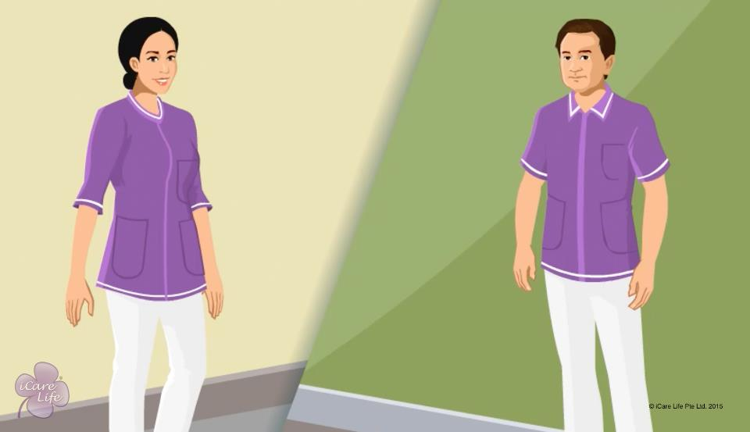
First Impressions
13
Copyright: iCare Life Pte. Ltd., Singapore : This document must not be copied or shared or circulated without the consent of iCare Life and/or its affiliates.

Slide 15
Summary
Prepare a set of questions for your employer
Take care of your personal hygiene and wear clean and ironed clothes
Wear clean, comfortable shoes
Make sure your hair is neat and trimmed
If your hair is long, keep them neatly tied
Do not wear chunky jewelry
Keep your nails clean, short, and trimmed, in case of woman, do not paint your nails
14
Copyright: iCare Life Pte. Ltd., Singapore : This document must not be copied or shared or circulated without the consent of iCare Life and/or its affiliates.
Notes:
Prepare a set of questions for your employer
Take care of your personal hygiene and wear clean and ironed clothes
Wear clean, comfortable shoes
Make sure your hair is neat and trimmed
If your hair is long, keep them neatly tied
Do not wear chunky jewelry
Keep your nails clean, short, and trimmed
If you are a woman, do not paint your nails

Slide 16
Summary
Double-check the time at which you are expected to report
Prepare your clothes a day in advance
If you plan to take public transport, make sure you are aware of the timings
If you plan to travel by your own vehicle, make sure it has enough fuel
Start from home early so that even if you get delayed, you still reach on time
When you meet the care receiver and your employer, greet them
15
Copyright: iCare Life Pte. Ltd., Singapore : This document must not be copied or shared or circulated without the consent of iCare Life and/or its affiliates.
Notes:
Double-check the time at which you are expected to report
Prepare your clothes a day in advance
If you plan to take public transport, make sure you are aware of the timings
If you plan to travel by your own vehicle, make sure it has enough fuel
Start from home early so that even if you get delayed, you still reach on time
When you meet the care receiver and your employer, greet them

Slide 17
Summary
Maintain a degree of formality and mutual respect
Be friendly and pleasant
Be a good listener
When given a chance, ask your questions about the care receiver, their needs, and their lifestyle
Never ask a personal question
16
Copyright: iCare Life Pte. Ltd., Singapore : This document must not be copied or shared or circulated without the consent of iCare Life and/or its affiliates.
Notes:
Maintain a degree of formality and mutual respect
Be friendly and pleasant
Be a good listener
When given a chance, ask your questions about the care receiver, their needs, and their lifestyle
Never ask a personal question

Slide 18
Why is good first impression important?
It will mean you are informal
It will mean you are super smart
It will mean you are well organised
It will mean you are well organised
You will be immediately trusted
17
Copyright: iCare Life Pte. Ltd., Singapore : This document must not be copied or shared or circulated without the consent of iCare Life and/or its affiliates.

Slide 19
Any Questions?
18
Copyright: iCare Life Pte. Ltd., Singapore : This document must not be copied or shared or circulated without the consent of iCare Life and/or its affiliates.
Notes:
Q1. Why is good first impression important?
Ans. A good first impression sets the tone of the confidence the employer will have in the caregiver. Good preparation will tell them about the caregiver being an organized and an efficient person. It will also give them an insight about the professional competence of the care giver. It will give them the confidence in the ability of the caregiver in looking after their loved one.
Q2. Would the principal not have briefed the employer about the caregiver?
Ans. Yes, the principal employer would have briefed the employer in detail about the caregiver. Yet an employer can never be truly satisfied till they have had a personal interaction with the caregiver and formed an opinion about them.
Q3. What should you do in case you get delayed for the first meeting due to unavoidable circumstances?
Ans. You should immediately inform the employer and the principal employer over telephone about your getting late, the circumstances, and expected delay.

Slide 20
Habits to Kill
19
Copyright: iCare Life Pte. Ltd., Singapore : This document must not be copied or shared or circulated without the consent of iCare Life and/or its affiliates.

Slide 21
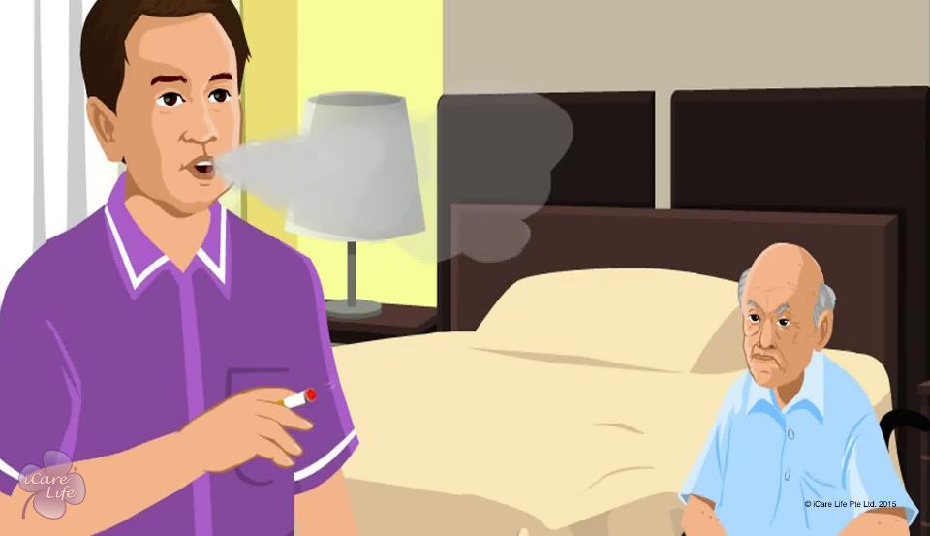
Habits to Kill
20
Copyright: iCare Life Pte. Ltd., Singapore : This document must not be copied or shared or circulated without the consent of iCare Life and/or its affiliates.

Slide 22
Summary
As a caregiver, you should change the following bad habits:
Smoking in the presence of the person under your care, or their family or engager or employer
Drinking alcohol during or before work hours
Watching TV or listening to music during work hours
Taking personal calls during work hours
Inviting friends or family to your employer’s home
Using bad language
Not washing hands when you must
Being careless
Procrastinating, or postponing work for a later time
21
Copyright: iCare Life Pte. Ltd., Singapore : This document must not be copied or shared or circulated without the consent of iCare Life and/or its affiliates.
Notes:
As a caregiver, you should change the following bad habits:
Smoking in the presence of the person under your care, or their family or engager or employer
Drinking alcohol during or before work hours
Watching TV or listening to music during work hours
Taking personal calls during work hours
Inviting friends or family to your employer’s home
Using bad language
Not washing hands when you must
Being careless
Procrastinating, or postponing work for a later time

Slide 23
How does a bad habit affect you in your job?
You may be scolded or punished
You may be influencing others
You may do harm to others
The other person may dislike you
The other person may dislike you
22
Copyright: iCare Life Pte. Ltd., Singapore : This document must not be copied or shared or circulated without the consent of iCare Life and/or its affiliates.

Slide 24
Any Questions?
23
Copyright: iCare Life Pte. Ltd., Singapore : This document must not be copied or shared or circulated without the consent of iCare Life and/or its affiliates.
Notes:
Q.1. What should I do if a family member asks me if I would like to smoke with them?
Ans. Refuse the invitation politely.

Slide 25
Maintaining Boundaries
24
Copyright: iCare Life Pte. Ltd., Singapore : This document must not be copied or shared or circulated without the consent of iCare Life and/or its affiliates.

Slide 26
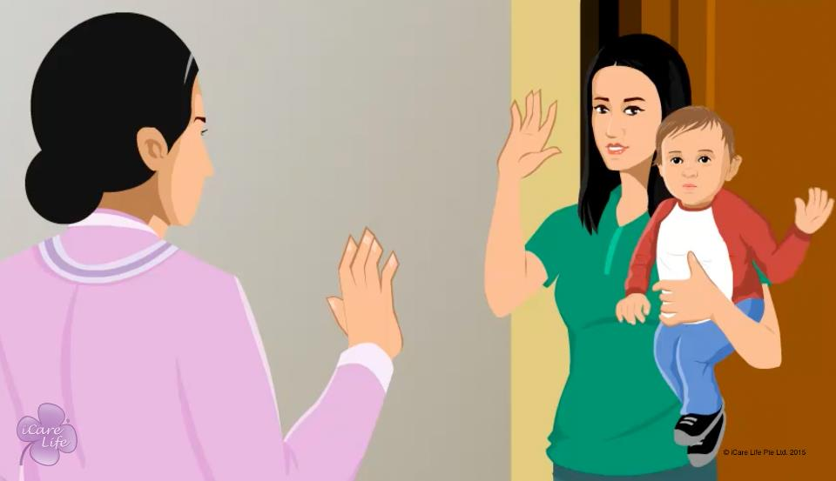
Maintaining Boundaries
25
Copyright: iCare Life Pte. Ltd., Singapore : This document must not be copied or shared or circulated without the consent of iCare Life and/or its affiliates.

Slide 27
Summary
Disconnect from your role as a caregiver when your work hours are over
Every day, connect back to your own life
Respect the family’s beliefs but feel free to follow your own
Do not feel obliged to conform to the family’s political views
You may occasionally perform a task that is not a part of your job duties, but if it is critical at that point of time
Do not routinely perform tasks that are not a part of your duties, or your primary duties may suffer
Do not try to influence children with your beliefs or opinions about people or family members
26
Copyright: iCare Life Pte. Ltd., Singapore : This document must not be copied or shared or circulated without the consent of iCare Life and/or its affiliates.
Notes:
Disconnect from your role as a caregiver when your work hours are over
Every day, connect back to your own life
Respect the family’s beliefs but feel free to follow your own
Do not feel obliged to conform to the family’s political views
You may occasionally perform a task that is not a part of your job duties, but if it is critical at that point of time
Do not routinely perform tasks that are not a part of your duties, or your primary duties may suffer
Do not try to influence children with your beliefs or opinions about people or family members

Slide 28
Summary
Do not listen to and become a part of the family conversations
Do not give your opinion, unless asked
27
Copyright: iCare Life Pte. Ltd., Singapore : This document must not be copied or shared or circulated without the consent of iCare Life and/or its affiliates.
Notes:
Do not listen to and become a part of the family conversations
Do not give your opinion, unless asked

Slide 29
Why is it important to define boundaries?
To avoid conflict or argument
To avoid conflict or argument
To prove that you are smart
To be show you are professional
To be extra friendly
28
Copyright: iCare Life Pte. Ltd., Singapore : This document must not be copied or shared or circulated without the consent of iCare Life and/or its affiliates.

Slide 30
Any Questions?
29
Copyright: iCare Life Pte. Ltd., Singapore : This document must not be copied or shared or circulated without the consent of iCare Life and/or its affiliates.
Notes:
Q1. Why is it important to define boundaries between the caregiver and the employer or the care receiver?
Ans. It is important so as to avoid any kind of confrontation, misunderstanding, or misgivings which may arise in case the boundaries are not defined. An omission on this account may also lead to improper care of the care receiver. In the long run, both parties learn to respect each other’s boundaries and avoid unpleasant situations.
Q2. Can a caregiver start to tell on the very first day as to what should be expected of him and what he would not be doing or what he may consider as impinging on his privacy etc?
Ans. That kind of a conversation may not be a good start for the relationship which may continue for years. The caregiver should when the need arises, politely tell the employer as to what may not be appropriate to be asked of them. Slowly but steadily depending upon a situation both parties may make themselves clear on aspects which they may set as their boundaries.

Slide 31
Importance of a Clean Environment for Caregiving
30
Copyright: iCare Life Pte. Ltd., Singapore : This document must not be copied or shared or circulated without the consent of iCare Life and/or its affiliates.

Slide 32
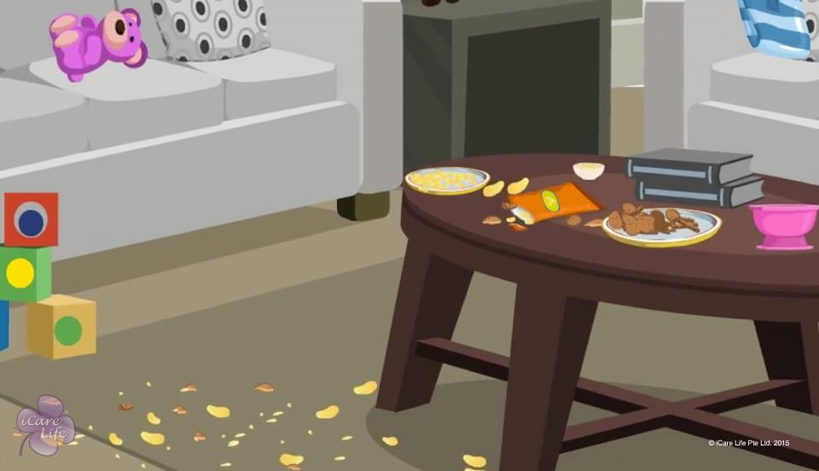
Importance of a Clean Environment
31
Copyright: iCare Life Pte. Ltd., Singapore : This document must not be copied or shared or circulated without the consent of iCare Life and/or its affiliates.

Slide 33
Post-Module Activity
Test Your Skills!
32
Copyright: iCare Life Pte. Ltd., Singapore : This document must not be copied or shared or circulated without the consent of iCare Life and/or its affiliates.
Notes:
The participants are divided into groups of two. One participant is blindfolded while the other has to direct the other through an obstacle path. Place chairs, desks, and other obstacles.
After the participant completes the obstacle path, ask the following:
1. How did you feel when you were walking blindfolded?
2. Now imagine the elder walking in a cluttered, poorly lit room. What do you think will happen then?
The facilitator must draw out the importance of a clutter-free and well lit environment for the elder.

Slide 34
Summary
Dust and dust mites cause allergies, sinus infections, respiratory problems, and asthma
A dirty kitchen attracts pests, which are carriers of several diseases
Bacteria in bathrooms can also cause health issues
A person, especially an elder or a baby, can get a urinary tract infection from using dirty toilets and showers
Wet bathrooms can cause a dangerous fall
A cluttered bathroom or loose bathroom fittings can cause injuries
Molds, caused due to high moisture content, can trigger asthma and other respiratory diseases
33
Copyright: iCare Life Pte. Ltd., Singapore : This document must not be copied or shared or circulated without the consent of iCare Life and/or its affiliates.
Notes:
Dust and dust mites cause allergies, sinus infections, respiratory problems, and asthma
A dirty kitchen attracts pests, which are carriers of several diseases
Bacteria in bathrooms can also cause health issues
A person, especially an elder or a baby, can get a urinary tract infection from using dirty toilets and showers
Wet bathrooms can cause a dangerous fall
A cluttered bathroom or loose bathroom fittings can cause injuries
Molds, caused due to high moisture content, can trigger asthma and other respiratory diseases

Slide 35
Summary
Clutter attracts pests and dust; can also result in falls and injuries
Poor ventilation increases the risk of respiratory irritation, cold, or flu
Odors and smoke can cause respiratory diseases and allergies
34
Copyright: iCare Life Pte. Ltd., Singapore : This document must not be copied or shared or circulated without the consent of iCare Life and/or its affiliates.
Notes:
Clutter attracts pests and dust; can also result in falls and injuries
Poor ventilation increases the risk of respiratory irritation, cold, or flu
Odors and smoke can cause respiratory diseases and allergies

Slide 36
Why is clean environment important in caregiving?
It looks neat and clean
It saves time and effort
It makes everyone happy
It prevents and controls infection
It prevents and controls infection
35
Copyright: iCare Life Pte. Ltd., Singapore : This document must not be copied or shared or circulated without the consent of iCare Life and/or its affiliates.

Slide 37
Any Questions?
36
Copyright: iCare Life Pte. Ltd., Singapore : This document must not be copied or shared or circulated without the consent of iCare Life and/or its affiliates.
Notes:
Q1. What do I do if there is a problem of pests in the care receiver’s home?
Inform the family members so that action can be taken immediately.
Q2. How can I ensure that the room of the person is clutter free?
Encourage the elder or the baby’s mother to organize the things better. You can also take their permission and help organize the room better.
Q3. How do I get rid of dust mites?
Soak bedspreads in hot water before washing.
Q4. How do I ensure that the kitchen does not attract pests?
Never leave food in an open container. Also, if you spill food, wipe it immediately.
Q5. Is it enough if I wipe the bathroom with a wiper?
A. It is better to mop the bathroom after use as wiping might leave the bathroom a little damp.

Slide 38
Measures to a Maintain Clean and Hygienic Environment
37
Copyright: iCare Life Pte. Ltd., Singapore : This document must not be copied or shared or circulated without the consent of iCare Life and/or its affiliates.

Slide 39
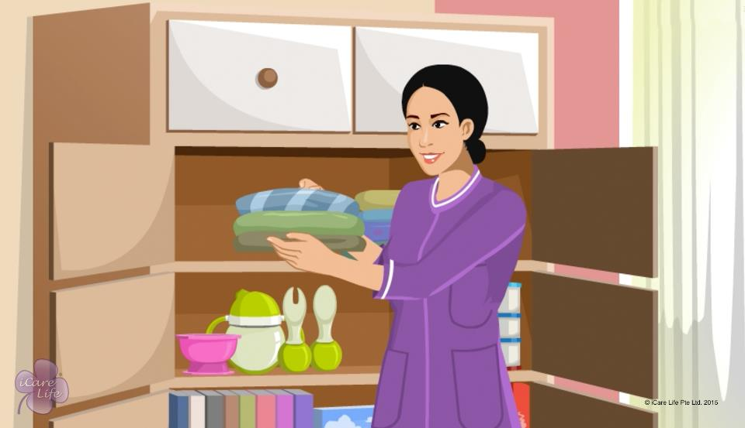
Clean and Hygienic Environment
38
Copyright: iCare Life Pte. Ltd., Singapore : This document must not be copied or shared or circulated without the consent of iCare Life and/or its affiliates.

Slide 40
Post-Module Activity
Test Your Skills!
39
Copyright: iCare Life Pte. Ltd., Singapore : This document must not be copied or shared or circulated without the consent of iCare Life and/or its affiliates.
Notes:
The participants are divided into small batches. Fix an appointment in an old people’ home or nursing home and inform the participants of the location and timings for the demonstration. The participants can go and see how space is utilized to allow free access for elders. Ask them to note their observations. Also ask the participants for suggestions on how space can be utilized better/kept more clean.
Ask the participants to spot any health hazards or good practices.

Slide 41
Summary
Dust every day or on alternate days
Clean the ceiling, mats, window frames, fans, and air conditioners once a month
Once in a month, clean the shelves and cabinets and dry clean curtains and rugs
Use the vacuum cleaner at least once a week to clean rugs, upholstery, windowsills, and carpets
To avoid dust bunnies, dust corners and under furniture and objects
To reduce clutter, keep things back in their place
Change linen regularly; soak linen in hot water before washing
40
Copyright: iCare Life Pte. Ltd., Singapore : This document must not be copied or shared or circulated without the consent of iCare Life and/or its affiliates.
Notes:
Dust every day or on alternate days
Clean the ceiling, mats, window frames, fans, and air conditioners once a month
Once in a month, clean the shelves and cabinets and dry clean curtains and rugs
Use the vacuum cleaner at least once a week to clean rugs, upholstery, windowsills, and carpets
To avoid dust bunnies, dust corners and under furniture and objectsTo reduce clutter, keep things back in their place
Change linen regularly; soak linen in hot water before washing

Slide 42
Summary
Store food in closed containers
Ensure that things that you do not need regularly need in the kitchen are easily accessible; store rarely used items on higher shelves
Clean wall titles, bathroom fittings, and ceiling of the bathroom once a week
Clean bathroom floor, sink and commode every day
41
Copyright: iCare Life Pte. Ltd., Singapore : This document must not be copied or shared or circulated without the consent of iCare Life and/or its affiliates.
Notes:
Store food in closed containers
Ensure that things that you do not need regularly need in the kitchen are easily accessible; store rarely used items on higher shelves
Clean wall titles, bathroom fittings, and ceiling of the bathroom once a week
Clean bathroom floor, sink and commode every day

Slide 43
Summary
To improve ventilation:
Open windows
Clean filters of air conditioners and heaters
Avoid smoking
Avoid aerosol sprays
Use natural air fresheners
To avoid pest problems:
Do not leave open food
Seal all cracks
Ensure windows have screens
Avoid the use of pesticides
42
Copyright: iCare Life Pte. Ltd., Singapore : This document must not be copied or shared or circulated without the consent of iCare Life and/or its affiliates.
Notes:
To improve ventilation:
Open windows
Clean filters of air conditioners and heaters
Avoid smoking
Avoid aerosol sprays
Use natural air fresheners
To avoid pest problems:
Do not leave open food
Seal all cracks
Ensure windows have screens
Avoid the use of pesticides

Slide 44
To maintain hygiene why should you clean regularly?
It is easy to clean regularly
It prevents breeding of germs
It prevents breeding of germs
It consumes less time
Your employer will be happy
43
Copyright: iCare Life Pte. Ltd., Singapore : This document must not be copied or shared or circulated without the consent of iCare Life and/or its affiliates.

Slide 45
Any Questions?
44
Copyright: iCare Life Pte. Ltd., Singapore : This document must not be copied or shared or circulated without the consent of iCare Life and/or its affiliates.
Notes:
Q1. What do I do if there are a lot of unwanted things lying around?
Explain the hazard of having clutter around to a family member.
Q2. How often should I have to clear the garbage?
Clear the garbage on a daily basis. This will help keep the environment odour and pest free.
Q3. How do I ensure good hygiene if the family has a pet?
It would be hygienic to keep the pet away from beds and mattresses. The pet should also be maintained well to avoid respiratory problems. If the pet is a dog or cat, this may include regular wash and brushing of fur.
Q4. If not pesticides, what can be used to catch rodents?
A. You can use sticky glue and mouse traps to catch rodents. If there are many pests, call a professional.

Slide 46
Wearing and Taking Off Gloves
45
Copyright: iCare Life Pte. Ltd., Singapore : This document must not be copied or shared or circulated without the consent of iCare Life and/or its affiliates.

Slide 47
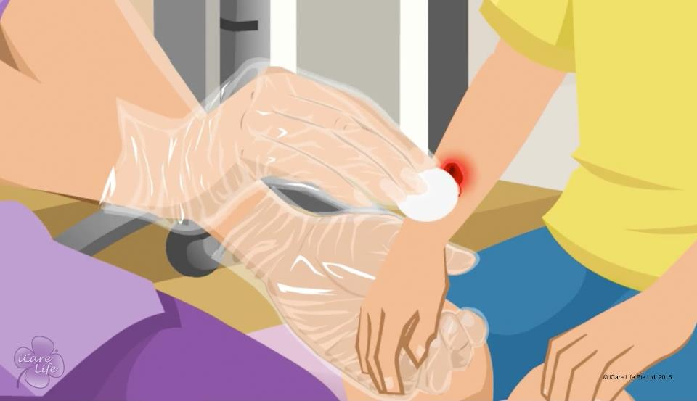
Wearing and Taking Off Gloves
46
Copyright: iCare Life Pte. Ltd., Singapore : This document must not be copied or shared or circulated without the consent of iCare Life and/or its affiliates.

Slide 48

Post-Module Activity
Wearing and taking off gloves
47
Copyright: iCare Life Pte. Ltd., Singapore : This document must not be copied or shared or circulated without the consent of iCare Life and/or its affiliates.
Notes:
Arrange for:
A pair of surgical/disposable gloves for each participant in the class
One for yourself for demonstration
Alcohol-based hand-rub
Demonstrate the wearing of gloves using the following steps:
Rub your hands with an alcohol-based hand-rub and dry them
Take out the pair of gloves from the packet and spread one of them
Identify whether it will fit in your left or right hand, when you face your palm upwards
Slide the correct hand inside to wear it
Pull the glove at the wrist to ensure it fits properly
Follow this for the other hand as well
Demonstrate the taking off of gloves using the following steps:
The first step is to pinch the first glove at the wrist
Fold it over and peel it back, turning it inside out as it goes. Once the glove is off, hold it with your gloved hand
To remove the other glove, place your bare fingers inside the cuff without touching the glove exterior. Peel the glove off from the inside, turning it inside out as it goes. Use it to envelope the other glove.
Now handover one pair of gloves to each student in the class and ask them to follow the instructions and practice.

Slide 49
Summary
Wear disposable gloves for activities that involve contact with body fluids, mucous membranes, non-intact skin, or other potentially infectious material
Always use disposable gloves and do not reuse them
When wearing and taking off gloves:
Ensure proper hand hygiene
Ensure your hands are completely dry
Take care not to touch the outer part of the glove
Dispose of the gloves properly
48
Copyright: iCare Life Pte. Ltd., Singapore : This document must not be copied or shared or circulated without the consent of iCare Life and/or its affiliates.
Notes:
Wear disposable gloves for activities that involve contact with body fluids, mucous membranes, non-intact skin, or other potentially infectious material
Always use disposable gloves and do not reuse them
When wearing and taking off gloves:
Ensure proper hand hygiene
Ensure your hands are completely dry
Take care not to touch the outer part of the glove
Dispose of the gloves properly

Slide 50
Why disposable gloves should be used?
It can be thrown away after use
It is fashionable
It protects your hand
It prevents spread of infection
It prevents spread of infection
49
Copyright: iCare Life Pte. Ltd., Singapore : This document must not be copied or shared or circulated without the consent of iCare Life and/or its affiliates.

Slide 51
Any Questions?
50
Copyright: iCare Life Pte. Ltd., Singapore : This document must not be copied or shared or circulated without the consent of iCare Life and/or its affiliates.
Notes:
Q1. Can you use the gloves again if you feel that the gloves could not have got infected?
Ans. One can never be sure if the gloves have got infected or not whatever precautions you might have taken. It is not advisable to reuse the gloves.
Q2. Why is it important to dispose of the gloves properly?
Ans. Any spread of infection may aggravate the condition of the care receiver and may make the care giver sick. Gloves or any other infected material like the dressing, cotton etc must be put in a sealable plastic bag and then put in the bin for municipal authorities to take away.
Q3. What does one do with the rings etc worn on hand while wearing gloves?
Ans. Wearing of rings unless the ring is like a flat band is prohibited; otherwise it may puncture the glove and the whole purpose of wearing of gloves is defeated.

Slide 52
Changing Linen
51
Copyright: iCare Life Pte. Ltd., Singapore : This document must not be copied or shared or circulated without the consent of iCare Life and/or its affiliates.

Slide 53
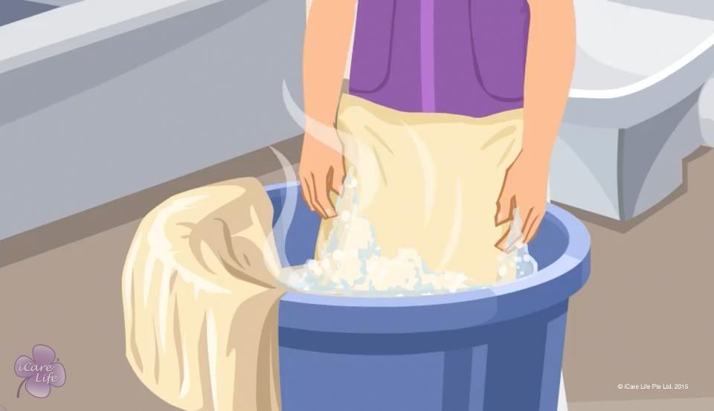
Changing Linen
52
Copyright: iCare Life Pte. Ltd., Singapore : This document must not be copied or shared or circulated without the consent of iCare Life and/or its affiliates.

Slide 54


Post-Module Activity
Changing bed linen
53
Copyright: iCare Life Pte. Ltd., Singapore : This document must not be copied or shared or circulated without the consent of iCare Life and/or its affiliates.
Notes:
In this demonstration activity, the class participants will learn how to make a bed neatly. This will include:
changing a bed sheet
changing pillow covers
and folding top sheets/duvets
You will require:
A bed with a mattress with a relatively dirty and crumpled bed sheet
Pillow covers
A top sheet/ duvet
A clean and ironed bed sheet
A laundry basket
Divide the class into batches of 3-4 students each. Each student of a batch will perform one of the following tasks:
Remove the dirty bed sheet and pillow cover and put them in the laundry basket
Put a clean bed sheet on the mattress and tuck it in well
Put a clean pillow cover on the pillow
Fold the top sheet/ duvet and lay it neatly at the base of the mattress

Slide 55
Summary
Change bed linen weekly, or earlier, if it gets dirty
For a person who spends most of their time in bed or a person who frequently eats in bed, you may need to change bed linen multiple times in a week
If the person soils the bed, change bed linen immediately
Put bath, hand and face towels for drying as soon as they become damp
Replace towels once in four days, or earlier, if they get dirty
If hand and face towels are used to wipe off food or dirt, change them immediately
54
Copyright: iCare Life Pte. Ltd., Singapore : This document must not be copied or shared or circulated without the consent of iCare Life and/or its affiliates.
Notes:
Change bed linen weekly, or earlier, if it gets dirty
For a person who spends most of their time in bed or a person who frequently eats in bed, you may need to change bed linen multiple times in a week
If the person soils the bed, change bed linen immediately
Put bath, hand and face towels for drying as soon as they become damp
Replace towels once in four days, or earlier, if they get dirty
If hand and face towels are used to wipe off food or dirt, change them immediately

Slide 56
Summary
Observe how often a bathroom rug gets wet or dirty and change it accordingly
To get rid of germs, dust mites, and bed bugs, soak and wash linen in hot water
Ensure that before you use it, linen has been dried and ironed properly
55
Copyright: iCare Life Pte. Ltd., Singapore : This document must not be copied or shared or circulated without the consent of iCare Life and/or its affiliates.
Notes:
Observe how often a bathroom rug gets wet or dirty and change it accordingly
To get rid of germs, dust mites, and bed bugs, soak and wash linen in hot water
Ensure that before you use it, linen has been dried and ironed properly

Slide 57
To maintain hygiene why hot water is used for washing?
It removes stains in clothes
It kills common harmful bacteria
It kills common harmful bacteria
It consumes less soap
It kills all germs of all kinds
56
Copyright: iCare Life Pte. Ltd., Singapore : This document must not be copied or shared or circulated without the consent of iCare Life and/or its affiliates.

Slide 58
Any Questions?
57
Copyright: iCare Life Pte. Ltd., Singapore : This document must not be copied or shared or circulated without the consent of iCare Life and/or its affiliates.
Notes:
Q1. Why is it important to change linen regularly?
Ans. Dirty linen can be a source of new diseases and rashes. It is also uncomfortable for the person to use dirty linen.
Q2. Should you make use of disinfectants while washing the linen?
Ans. It would be a good idea linen to use disinfectant which would improve hygiene and cleanliness of the linen.
Q3. What is the best way to clean dirty linen belonging to a person with an infection?
Ans. Washing them by soaking them in hot water and drying them in the sun can help kill all germs. One may ask the dry cleaners to dry clean the woollen blankets etc separately so that the infection may not spread.

Slide 59
Ensuring the Caregivers’ Safety from Infections
58
Copyright: iCare Life Pte. Ltd., Singapore : This document must not be copied or shared or circulated without the consent of iCare Life and/or its affiliates.

Slide 60
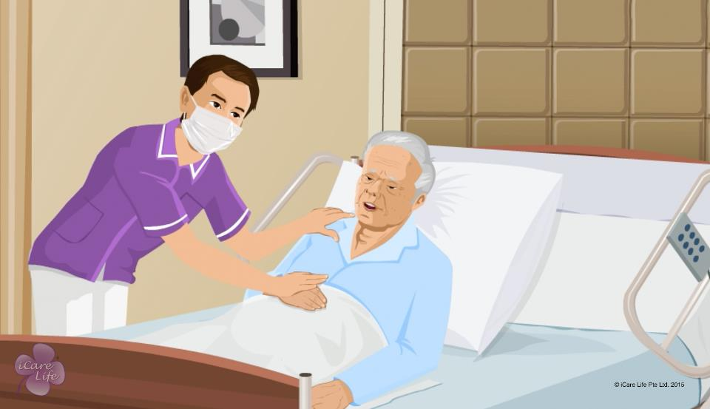
Caregivers’ Safety from Infections
59
Copyright: iCare Life Pte. Ltd., Singapore : This document must not be copied or shared or circulated without the consent of iCare Life and/or its affiliates.

Slide 61

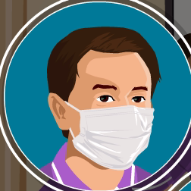
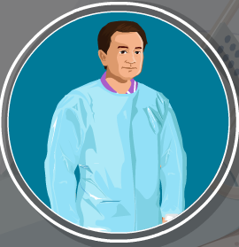
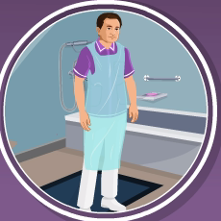
Post-Module Activity
Demonstration
60
Copyright: iCare Life Pte. Ltd., Singapore : This document must not be copied or shared or circulated without the consent of iCare Life and/or its affiliates.
Notes:
Arrange for the following things for the demonstration:
A pair of surgical/disposable gloves for each student in the class
A barrier mask for each student in the class
At least 3-4 gowns
At least 3-4 aprons
The aim of this activity is to make the students aware about these articles and how to wear them. You will have to demonstrate the wearing of each article and then the students can be invited to try the same
Tying a mask and apron and wearing a gown are simple activities
For gloves, use the following steps:
First wear the gloves
The first step is to take hold of the first glove at the wrist
Fold it over and peel it back, turning it inside out as it goes. Once the glove is off, hold it with your gloved hand
To remove the other glove, place your bare fingers inside the cuff without touching the glove exterior. Peel the glove off from the inside, turning it inside out as it goes. Use it to envelope the other glove.
You can also arrange to show an online video on the same.
Give one pair of gloves and a mask to each student. The aprons and gowns may be shared.

Slide 62
Summary
Use gloves and aprons when there is a possibility of exposure to blood and other body fluids
Wear an apron or gown when you are caring for a wound or near equipment with a suction pipe
Wear gloves when handling items that are soiled with blood or other body fluids
Discard disposable gloves after each use
Wear gloves if you have a skin disease, cuts, or cracks on your hands
Wear a barrier mask if the person under your care is coughing
Avoid breath to breath contact with the person you are caring for
61
Copyright: iCare Life Pte. Ltd., Singapore : This document must not be copied or shared or circulated without the consent of iCare Life and/or its affiliates.
Notes:
Use gloves and aprons when there is a possibility of exposure to blood and other body fluids
Wear an apron or gown when you are caring for a wound or near equipment with a suction pipe
Wear gloves when handling items that are soiled with blood or other body fluids
Discard disposable gloves after each use
Wear gloves if you have a skin disease, cuts, or cracks on your hands
Wear a barrier mask if the person under your care is coughing
Avoid breath to breath contact with the person you are caring for

Slide 63
Summary
Wear a barrier mask if the patient under your care is known to have a communicable disease
Wash your hands before and after care of the person
Wash all contaminated skin surfaces immediately after contact with blood or bodily fluids
Wash hands after removing gloves
Change from your work clothes into clean set of clothes when you return home after work
Wash your work clothes every day
Bathe twice a day
62
Copyright: iCare Life Pte. Ltd., Singapore : This document must not be copied or shared or circulated without the consent of iCare Life and/or its affiliates.
Notes:
Wear a barrier mask if the patient under your care is known to have a communicable disease
Wash your hands before and after care of the person
Wash all contaminated skin surfaces immediately after contact with blood or bodily fluids
Wash hands after removing gloves
Change from your work clothes into clean set of clothes when you return home after work
Wash your work clothes every day
Bathe twice a day

Slide 64
Why should you keep yourself safe from infection?
You don’t want to fall sick
It is a good practice
It prevents spread of infection
It prevents spread of infection
You will be rewarded
63
Copyright: iCare Life Pte. Ltd., Singapore : This document must not be copied or shared or circulated without the consent of iCare Life and/or its affiliates.

Slide 65
Any Questions?
64
Copyright: iCare Life Pte. Ltd., Singapore : This document must not be copied or shared or circulated without the consent of iCare Life and/or its affiliates.
Notes:
Q1. What should you do with infected equipment that is taken away from care receiver after use?
Ans. It has to be disposed of in the same manner as is done in the hospitals. If such facilities cannot be provided at the place of the care receiver, you can contact a hospital or a clinic where the material can be disposed off.
Q2. What should a caregiver do in case they themselves have some kind of infection and may infect an otherwise healthy care receiver?
Ans. The caregiver should take no chances and start with appropriate medication till they are cured of the infection. The caregiver should not try to hide the same. They should keep the employer and principal employer duly informed and persuade them to make alternate arrangement till the caregiver is fully cured.

Slide 66


