Slide 1

Modules Summary Discussion – Q&A
CR 10.1
Private and Confidential

Slide 2

Age Related Changes in the Elder
1
Copyright: iCare Life Pte. Ltd., Singapore : This document must not be copied or shared or circulated without the consent of iCare Life and/or its affiliates.

Slide 3
Class Discussion
Pre Module Activity
2
Copyright: iCare Life Pte. Ltd., Singapore : This document must not be copied or shared or circulated without the consent of iCare Life and/or its affiliates.
Notes:
You will need a white board and a marker for noting important points discussed in the class.
Discuss the following questions in the class. Do not encourage the participants to bring up personal family examples.
Who is an elder?
Generally which people are part of the elder category in a family?
What changes occur in physical conditions as an elder ages?
What changes occur in mental and emotional conditions as an elder ages?
Model answers:
Most countries define an elder with a chronological age of 60 years and above.
Grand parents and great grandparents
Elders become physically weak. They become tired very quickly and are prone to diseases as their immune system weakens. Their skin is wrinkled and they may have trouble seeing clearly and hearing properly. They cannot walk briskly or run as their joints may also become weak. They may develop chronic pains in some parts of the body. Fractures and dislocations may also become common.
Elders become a little aloof. They start feeling lonely and left out as their families become involved further in life. They may or may not be a part of important decisions. They start spending more time praying and going out for walks. They may like to join clubs and join charity programs. They try and look forward to spending more time with family.

Slide 4
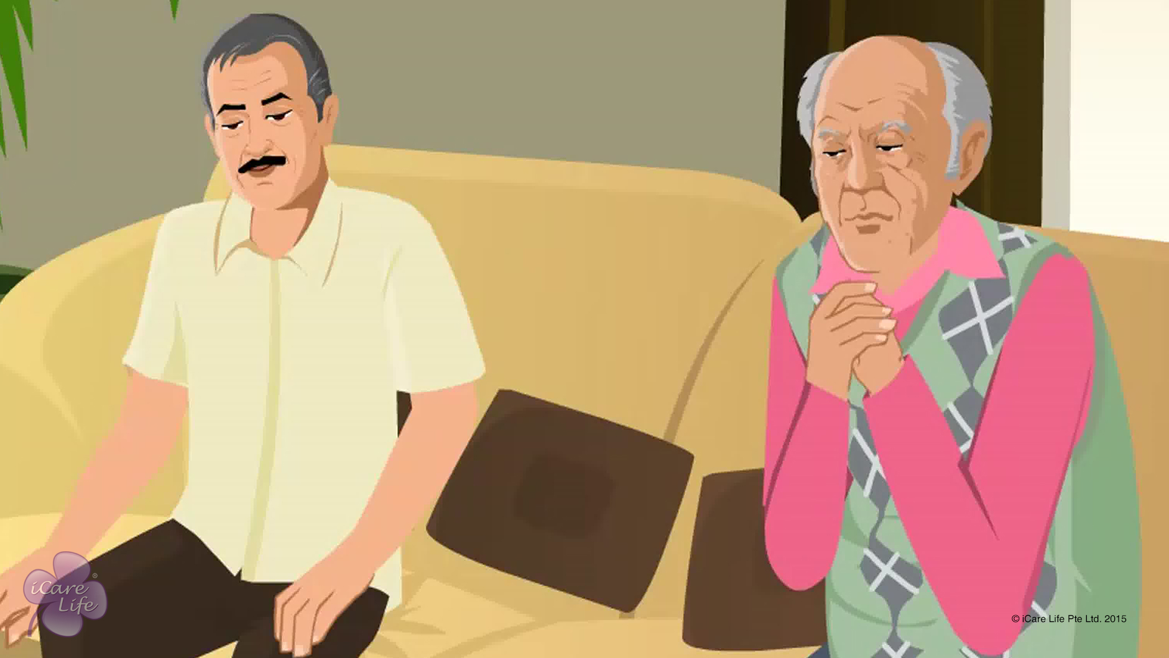
Age Related Changes in the Elder
3
Copyright: iCare Life Pte. Ltd., Singapore : This document must not be copied or shared or circulated without the consent of iCare Life and/or its affiliates.

Slide 5
Summary
With age:
The skin becomes dry, wrinkled, and may develop pigment spots
Wounds take more time to heal
Hair becomes sparse and gray
Nails grow slower
The eyes sink into their sockets
The pupil becomes much smaller
The lenses become yellow and cloudy, leading to reduced clarity of vision
The hearing abilities reduce gradually
The sense of smell declines
The person may increasingly breathe from the mouth while sleeping
The efficiency in ventilation and gas exchange reduces
The person may lose teeth and their sense of taste may decline, in turn causing loss of appetite and nutrition
The person may lose teeth and their sense of taste may decline, in turn causing loss of appetite and nutrition
The person may become more susceptible to gastric irritation and intolerance to fatty foods
4
Copyright: iCare Life Pte. Ltd., Singapore : This document must not be copied or shared or circulated without the consent of iCare Life and/or its affiliates.
Notes:
With age:
The skin becomes dry, wrinkled, and may develop pigment spots
Wounds take more time to heal
Hair becomes sparse and gray
Nails grow slower
The eyes sink into their sockets
The pupil becomes much smaller
The lenses become yellow and cloudy, leading to reduced clarity of vision
The hearing abilities reduce gradually
The sense of smell declines
The person may increasingly breathe from the mouth while sleeping
The efficiency in ventilation and gas exchange reduces
The person may lose teeth and their sense of taste may decline, in turn causing loss of appetite and nutrition
The person may lose teeth and their sense of taste may decline, in turn causing loss of appetite and nutrition
The person may become more susceptible to gastric irritation and intolerance to fatty foods

Slide 6
Summary
With age:
The bladder cannot stretch as much as before and can hold lesser amount of urine
Calcium is reduced from the bones and vertebral disks become thin
The person may lose height and assume a stooped, forward-bent posture
In the heart, the left ventricle wall and valves thicken and the left atrium increases
The heart contracts more slowly and the blood provided by the artery blood flow to the circulatory system decreases
The nerve cells gradually deteriorate and die
The person may take longer to perform various tasks and become forgetful
The sense to orient one’s body deteriorates
The sense of touch decreases
The person may become less responsive to pain
5
Copyright: iCare Life Pte. Ltd., Singapore : This document must not be copied or shared or circulated without the consent of iCare Life and/or its affiliates.
Notes:
With age:
The bladder cannot stretch as much as before and can hold lesser amount of urine
Calcium is reduced from the bones and vertebral disks become thin
The person may lose height and assume a stooped, forward-bent posture
In the heart, the left ventricle wall and valves thicken and the left atrium increases
The heart contracts more slowly and the blood provided by the artery blood flow to the circulatory system decreases
The nerve cells gradually deteriorate and die
The person may take longer to perform various tasks and become forgetful
The sense to orient one’s body deteriorates
The sense of touch decreases
The person may become less responsive to pain

Slide 7
Any Questions?
6
Copyright: iCare Life Pte. Ltd., Singapore : This document must not be copied or shared or circulated without the consent of iCare Life and/or its affiliates.
Notes:
Q1. Why do some elders experience changes in their bodies earlier than others?
Ans. Changes in one’s body are dependent upon a lot of factors which differ from person to person. Some of them can be:
Heredity factors
Any body ailments or accidents
Mental factors like depression
Lifestyle discipline
Everyday nutrition
Work-life balance
Q2. Can an elder donate organs if they wish to?
Ans. Yes. The decision to donate organs is not dependent on age but only on medical fitness of the organs. Also, there is no cut-off age for organ donation. The doctors can decide whether the elder’s organs are healthy enough to be donated.

Slide 8
Changing Roles of the Elder
7
Copyright: iCare Life Pte. Ltd., Singapore : This document must not be copied or shared or circulated without the consent of iCare Life and/or its affiliates.

Slide 9
Class Discussion
Pre Module Activity
8
Copyright: iCare Life Pte. Ltd., Singapore : This document must not be copied or shared or circulated without the consent of iCare Life and/or its affiliates.
Notes:
Discuss the following with the class participants.
What are the social changes a person goes through as they change from:
A child to a teenager
A teenager to an adult
An adult to an elder
The participants can share personal examples in this activity. They can share how their roles changes in their families as they grew up.
Model answers:
When a child becomes a teenager, the family starts depending upon them. They become more responsible and start understanding the family conditions better. They become more careful with the finances and so the family may give them small responsibilities around the house. They are even trusted to take care of the younger siblings and elders in the parents’ absence.
When teenagers become adults, they start earning. They are given more decision power in the house. They are given more independence. As they start their own families, they become decision makers in their families as well. They are trusted with family situations and finances.
When adults become elders, then they might have to become the background operators in the family. They might still hold some decision making power with them, but most of the decisions are then taken by their younger generation. They might be retired and therefore might not have hold on the household financial issues. They may take care of the grandchildren in case of parents’ absence. They might sort to simpler jobs around the house like buying groceries for the house or tending to the garden.

Slide 10
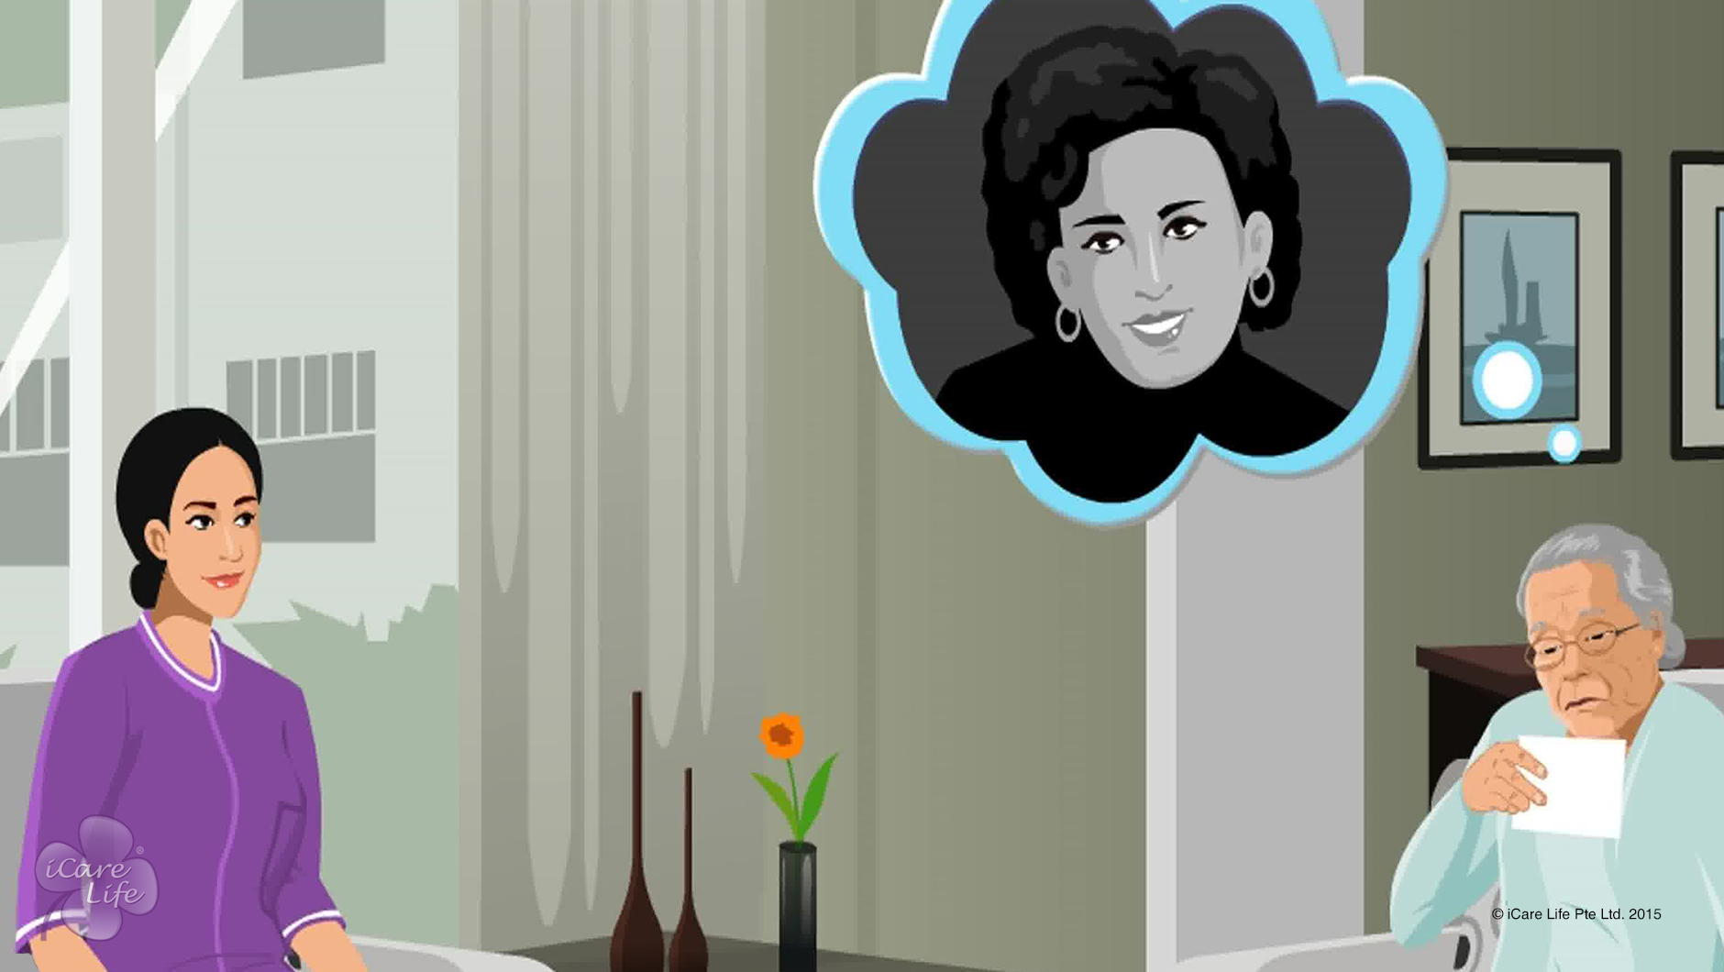
Changing Roles of the Elder
9
Copyright: iCare Life Pte. Ltd., Singapore : This document must not be copied or shared or circulated without the consent of iCare Life and/or its affiliates.

Slide 11
Summary
Elders are no longer as strong and energetic as they used to be
Their face and body ages
Their health begins to deteriorate
Another major change in role is retirement from an active work life
Their children begin to take responsibility for decisions
Elders may need to relocate due to reasons of health and safety
Their role as a neighbor or a person of influence in their locality may change
The loss of a spouse or friend through death impacts their role as a companion
10
Copyright: iCare Life Pte. Ltd., Singapore : This document must not be copied or shared or circulated without the consent of iCare Life and/or its affiliates.
Notes:
Elders are no longer as strong and energetic as they used to be
Their face and body ages
Their health begins to deteriorate
Another major change in role is retirement from an active work life
Their children begin to take responsibility for decisions
Elders may need to relocate due to reasons of health and safety
Their role as a neighbor or a person of influence in their locality may change
The loss of a spouse or friend through death impacts their role as a companion

Slide 12
Any Questions?
11
Copyright: iCare Life Pte. Ltd., Singapore : This document must not be copied or shared or circulated without the consent of iCare Life and/or its affiliates.
Notes:
Q.1. When everyone goes through the same stages in life, why do elders get depressed as their roles change with age?
Ans. While everyone goes through similar stages in life, one understands them as they experience each stage themselves. Moreover everyone goes through unique situations and reacts differently to them.

Slide 13
Helping Elder Cope with Changing Roles
12
Copyright: iCare Life Pte. Ltd., Singapore : This document must not be copied or shared or circulated without the consent of iCare Life and/or its affiliates.

Slide 14
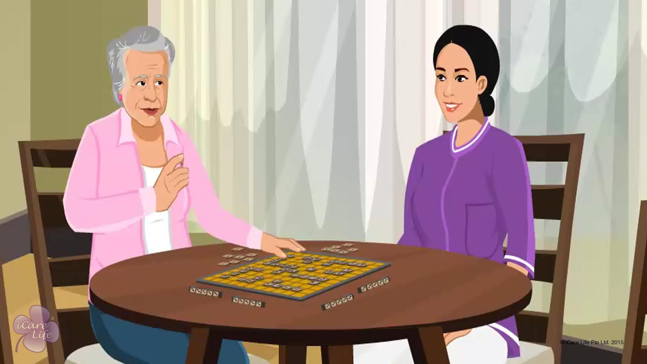
Helping Elder Cope with Changing Roles
13
Copyright: iCare Life Pte. Ltd., Singapore : This document must not be copied or shared or circulated without the consent of iCare Life and/or its affiliates.

Slide 15
Spending a Day @ Old Age Home
Post Module Activity
14
Copyright: iCare Life Pte. Ltd., Singapore : This document must not be copied or shared or circulated without the consent of iCare Life and/or its affiliates.
Notes:
Set up an appointment with a nursing home or an old age home where the class participants can go and spend a day with the elders.
Ask the class participants to interact with the elders by playing games with them. They should help the elders with tasks like taking medicines, take a walk, eat, read etc. They should talk to the elders about their families and their lives.
This activity will give the participants an idea about how to keep an elder engaged and what helps in keeping them happy.

Slide 16
Summary
Allow the elder to be as independent as possible
Involve the elder in brain-based activities and physical exercise
Build the elder’s schedule such that it keeps them busy throughout the day
Involve the elder in hobbies
Value what they think and say
Make them feel that they still have the opportunity to make choices about their own life
Organize family get-togethers, outings, and picnics
Help the elder explore their new neighborhood
Encourage them to volunteer their time in a local charity
Ask them to join a hobby group
Encourage them to make new friends
15
Copyright: iCare Life Pte. Ltd., Singapore : This document must not be copied or shared or circulated without the consent of iCare Life and/or its affiliates.
Notes:
Allow the elder to be as independent as possible
Involve the elder in brain-based activities and physical exercise
Build the elder’s schedule such that it keeps them busy throughout the day
Involve the elder in hobbies
Value what they think and say
Make them feel that they still have the opportunity to make choices about their own life
Organize family get-togethers, outings, and picnics
Help the elder explore their new neighborhood
Encourage them to volunteer their time in a local charity
Ask them to join a hobby group
Encourage them to make new friends

Slide 17
Any Questions?
16
Copyright: iCare Life Pte. Ltd., Singapore : This document must not be copied or shared or circulated without the consent of iCare Life and/or its affiliates.
Notes:
Q1. What do I do if the elder does not wish to spend time in hobbies or making friends?
Ans. In such a case, look for other interests which the elder may have like praying or meditating or reading. These will allow the elders their privacy and they would be happy as well. If the elder does not speak to anybody, then you might have to talk to the family about this. Leaving the elder in such a condition might make the elder depressed. Spending more time with the family might help the elder to become more open in their demeanor.

Slide 18
Positive Caregiving for Elders
17
Copyright: iCare Life Pte. Ltd., Singapore : This document must not be copied or shared or circulated without the consent of iCare Life and/or its affiliates.

Slide 19
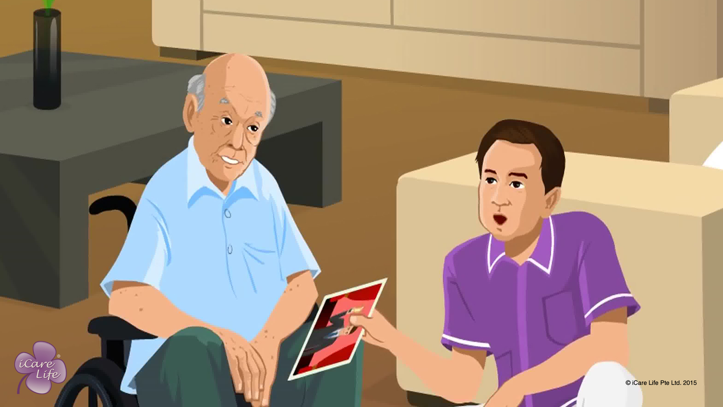
Positive Caregiving for Elders
18
Copyright: iCare Life Pte. Ltd., Singapore : This document must not be copied or shared or circulated without the consent of iCare Life and/or its affiliates.

Slide 20
Visit
Post Module Activity
19
Copyright: iCare Life Pte. Ltd., Singapore : This document must not be copied or shared or circulated without the consent of iCare Life and/or its affiliates.
Notes:
Arrange a visit to an old age home or a nursing home. Fix a prior appointment for the activity and inform the participants of the location and timings for the demonstration.
During the visit, divide the class into two batches and ask one batch to shadow caregivers and assist them. The participants should speak to the elder they are responsible for on the lines of the module and should make a general note of the conversations.
The second batch should observe the surroundings or the house and look for any places which could be dangerous for an elder. They should also look for :
If the house/nursing home is clutter-free
If it is properly lit
Are there any inlets for fresh air and sunlight
Do the elders have enough space to walk around
Are there any means of entertainment provided for like a TV, magazines, books, garden space for gardening, etc.
This activity could be carried on for half a day and responsibilities of the two batches can be interchanged for the next half.
When they come back to class, ask each group to present their observations.

Slide 21
Summary
Greet the elder in the morning and try to make them look forward to the rest of the day
Speak softly around the elder
Encourage the elder to be as independent as possible
Never make fun of them, shout at them, or shame them
Never make them feel that it takes much of your effort and time
Always respect their dignity
Give the person the right to choose and make decisions about their lives
Encourage the elder to pursue their passions
Plan and engage the elder in various social activities
Keep the elder in good cheer and engage them in meaningful conversations
20
Copyright: iCare Life Pte. Ltd., Singapore : This document must not be copied or shared or circulated without the consent of iCare Life and/or its affiliates.
Notes:
Greet the elder in the morning and try to make them look forward to the rest of the day
Speak softly around the elder
Encourage the elder to be as independent as possible
Never make fun of them, shout at them, or shame them
Never make them feel that it takes much of your effort and time
Always respect their dignity
Give the person the right to choose and make decisions about their lives
Encourage the elder to pursue their passions
Plan and engage the elder in various social activities
Keep the elder in good cheer and engage them in meaningful conversations

Slide 22
Summary
Ensure that the elder’s living space is clean, hygienic, and clutter free
Ensure that the living space gets adequate sunshine and is well-lit
Keep the rooms smelling fresh
Use flowers and indoor plants
Play soft music at a low volume
Encourage the elder to watch entertaining or knowledge-based programs on television
21
Copyright: iCare Life Pte. Ltd., Singapore : This document must not be copied or shared or circulated without the consent of iCare Life and/or its affiliates.
Notes:
Ensure that the elder’s living space is clean, hygienic, and clutter free
Ensure that the living space gets adequate sunshine and is well-lit
Keep the rooms smelling fresh
Use flowers and indoor plants
Play soft music at a low volume
Encourage the elder to watch entertaining or knowledge-based programs on television

Slide 23
Any Questions?
22
Copyright: iCare Life Pte. Ltd., Singapore : This document must not be copied or shared or circulated without the consent of iCare Life and/or its affiliates.
Notes:
Q1. What is positive caregiving?
Ans. Positive care giving means letting the elder in your care feel that they are in charge of their life and that are not dependent on you. This one can do by encouraging the elder to undertake as many tasks for their own care as is possible, but if required you would be around. You must understand that it is psychologically difficult for an elder to accept their reduced physical and mental capabilities.

Slide 24
Emotional Wellbeing of the Elder
23
Copyright: iCare Life Pte. Ltd., Singapore : This document must not be copied or shared or circulated without the consent of iCare Life and/or its affiliates.

Slide 25
Discussion about Emotions
Pre Module Activity
24
Copyright: iCare Life Pte. Ltd., Singapore : This document must not be copied or shared or circulated without the consent of iCare Life and/or its affiliates.
Notes:
You will require a white board and a marker for this discussion. Discuss the following topics/ questions with the class and note down their responses:
What are emotions?
What is emotional wellbeing?
What are the different emotions exhibited by a human?
If you see an elder usually angry/ anxious, what could be the possible reasons?
If you see an elder usually happy, what could be the possible reasons?
If you see an elder usually sad, what could be the possible reasons?
Model answers:
It is a strong feeling deriving from one's circumstances, mood, or relationships with others. It can be an instinctive or intuitive feeling as distinguished from reasoning or knowledge.
A positive sense of wellbeing which enables an individual to be able to function in society and meet the demands of everyday life; people in good mental health have the ability to recover effectively from an illness, change, or misfortune.
Happiness, sadness, anger, rage, shyness, guilt, anxiety, fear, etc.
Elder wants something which is being denied; could be hiding a backdraw; is not in agreement with the situation/ instructions; is dealing with a great loss; is lonely; the elder is dealing with an illness and is not able to accept the same; change in routine activity
Is healthy; is at peace with their life and surroundings; is engaged well in activities and conversations; has good company
Is lonely; has lost a loved one; is suffering from health issues; is fearful of something; is not engaged well in activities that they like

Slide 26
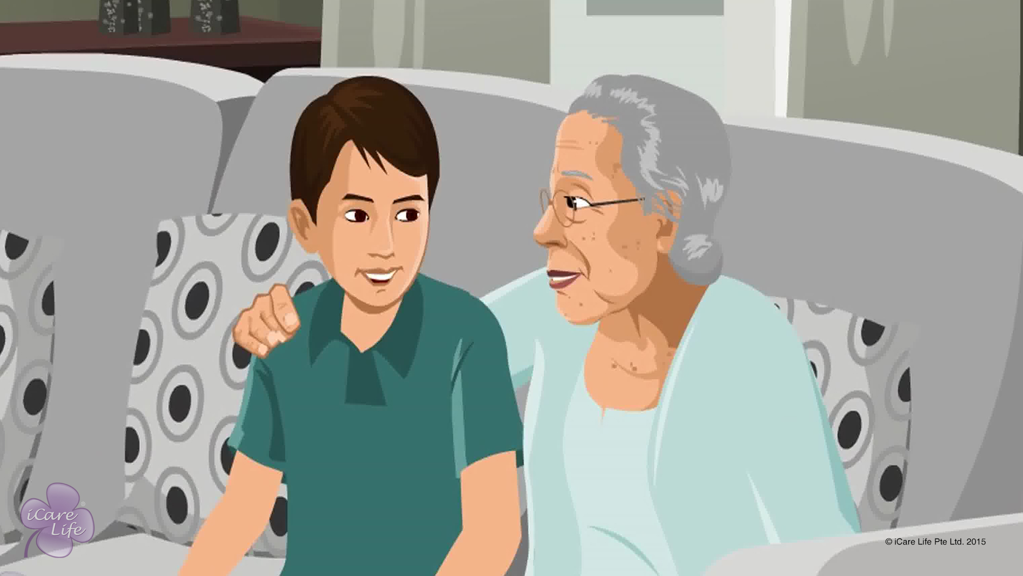
Emotional Wellbeing of the Elder
25
Copyright: iCare Life Pte. Ltd., Singapore : This document must not be copied or shared or circulated without the consent of iCare Life and/or its affiliates.

Slide 27
Role Play
Pre Module Activity
26
Copyright: iCare Life Pte. Ltd., Singapore : This document must not be copied or shared or circulated without the consent of iCare Life and/or its affiliates.
Notes:
Ask two volunteers from the class to play the elder and the caregiver.
The situation is that the elder is being difficult to the caregiver. The elder is refusing to eat their meal and wants to go out to have an ice-cream. The elder is even angry because the caregiver is not giving into their demands.
The caregiver has to manage elder’s anger by being assertive. They should be polite and in no circumstance should the caregiver become angry himself. They should reason with the elder and not fight.

Slide 28
Summary
Observe the elder for the presence of negative emotions
Talk to the elder to identify the negative emotions and their causes
Through suggestions, empathy and your own experiences, try to replace them with positive emotions of hope, faith, love, contentment, and forgiveness
27
Copyright: iCare Life Pte. Ltd., Singapore : This document must not be copied or shared or circulated without the consent of iCare Life and/or its affiliates.
Notes:
Q1. How do negative feelings affect a person’s physical health?
Ans. Negative feelings affect the whole system of a person:
(a) Vagus nerve which serves the brain may slow the heart in case of hostile persons
(b) Anxiety and hostility may lead to heart attacks
(c) Anxiety may also cause depression
(d) Medicines may have a lesser healing impact
It is therefore important to understand the psychology of the elder and help them get over such feelings by helping them replace negative thoughts with positive ones. You should also try to keep the atmosphere light and involve the elder in praying and meditation.

Slide 29
Any Questions?
28
Copyright: iCare Life Pte. Ltd., Singapore : This document must not be copied or shared or circulated without the consent of iCare Life and/or its affiliates.
Notes:
Q1. Is the statement, “Sorry, but I cannot let you do this” polite and firm?
Ans. Yes
Q2. Is it ok to bargain with the elder to allow them something in limited quantities to make them do something like taking medicine?
Ans. Yes, bargaining is one of the ways to deal with the elders but it cannot be made a routine.
Q3. What happens in case you lose your temper while dealing with the elders?
Ans. Well, after sometime you should apologize to them and try and explain that you wanted only the best for the elder and that you were trying to follow the instructions of the doctor and the family.
Q4. What can you do to prevent the elderly from talking to strangers which you feel may compromise their safety or security?
Ans. You may like to initially explain to them, not let them be alone with the person whom you may feel as a threat and if nothing works you may like to inform the family about it.

Slide 30
Indicators of Wellness in the Elder
29
Copyright: iCare Life Pte. Ltd., Singapore : This document must not be copied or shared or circulated without the consent of iCare Life and/or its affiliates.

Slide 31
Class Discussion
Pre Module Activity
30
Copyright: iCare Life Pte. Ltd., Singapore : This document must not be copied or shared or circulated without the consent of iCare Life and/or its affiliates.
Notes:
Arrange for a white board and a marker. Keep noting all the points given by class participants on it.
Discuss the following in the class:
How do you determine if a person is well, just by looking at them?
How do you determine if a person is not well, just be looking at them?
Model answers:
a)
They should look happy
Their skin and eyes should look healthy
Should look active and full of energy
Lips should not be dry
Nails should be smooth and not yellow
b)
Eyes can be puffy and red
Blemishes on skin
Person looks dull and lethargic
Dry lips
Nails may be yellow in color and broken in places

Slide 32
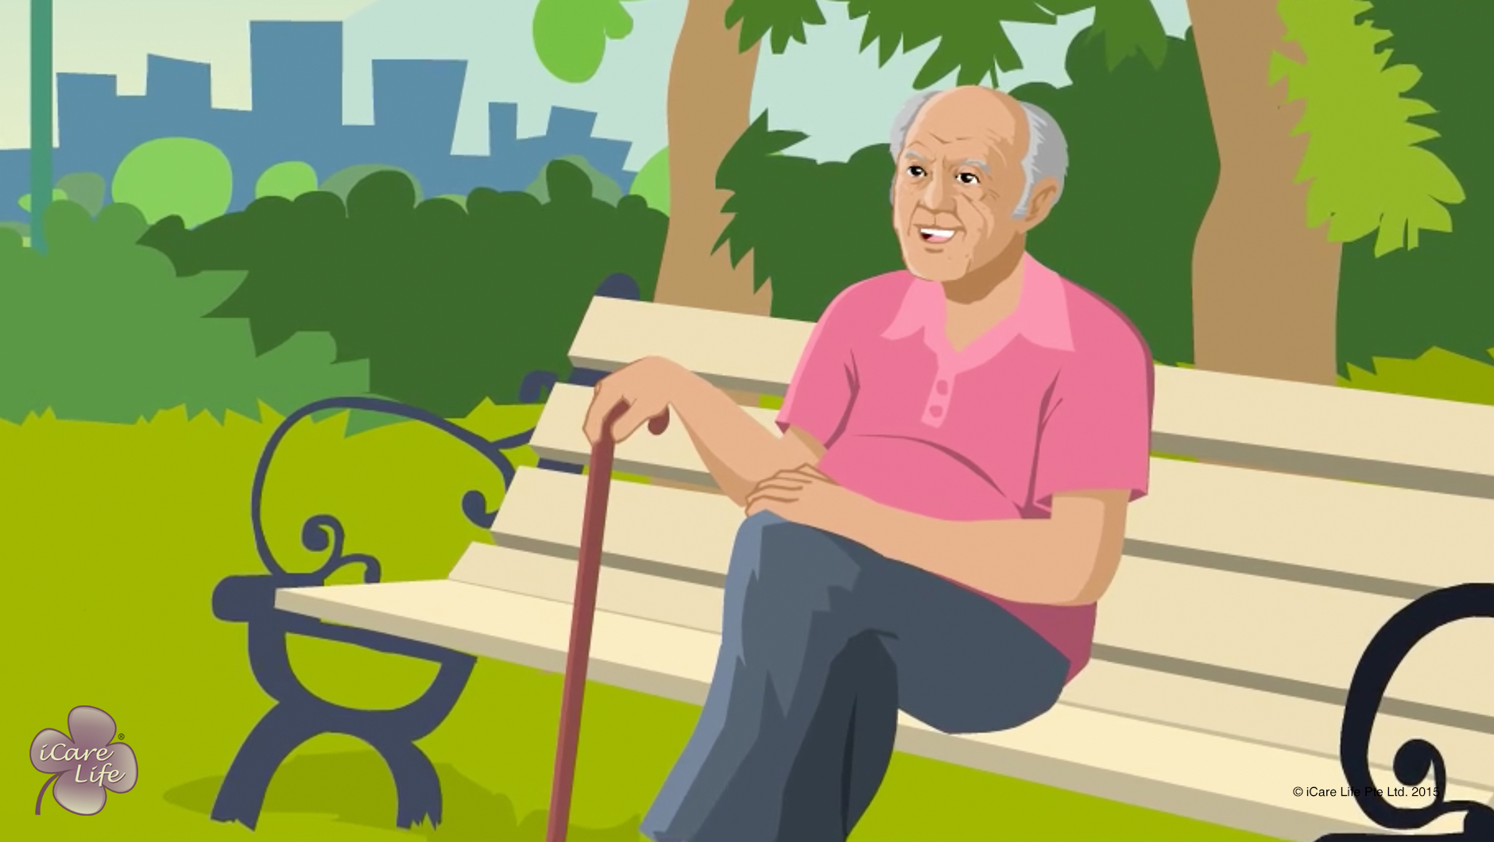
Indicators of Wellbeing in the Elder
31
Copyright: iCare Life Pte. Ltd., Singapore : This document must not be copied or shared or circulated without the consent of iCare Life and/or its affiliates.

Slide 33
Summary
To know that the elder under you care is mentally well:
See that the elder smiles and laughs frequently
Note that the elder takes an interest in their day to day activities
See if the elder has hobbies and interests
Check if the elder enjoys the company of others
To know that the elder under you care is physically well,
See that the elder has a good appetite and is sleeping well
Check that the elder’s vitals are within normal limit
Note that the elder is relatively pain free
See that the elder does not have constipation
Check if the elder’s skin looks healthy
Examine that the results of the elder’s lab tests as indicators of physical wellness
Arrange for a check up of the elder with the doctor
32
Copyright: iCare Life Pte. Ltd., Singapore : This document must not be copied or shared or circulated without the consent of iCare Life and/or its affiliates.
Notes:
To know that the elder under you care is mentally well:
See that the elder smiles and laughs frequently
Note that the elder takes an interest in their day to day activities
See if the elder has hobbies and interests
Check if the elder enjoys the company of others
To know that the elder under you care is physically well,
See that the elder has a good appetite and is sleeping well
Check that the elder’s vitals are within normal limit
Note that the elder is relatively pain free
See that the elder does not have constipation
Check if the elder’s skin looks healthy
Examine that the results of the elder’s lab tests as indicators of physical wellness
Arrange for a check up of the elder with the doctor

Slide 34
Any Questions?
33
Copyright: iCare Life Pte. Ltd., Singapore : This document must not be copied or shared or circulated without the consent of iCare Life and/or its affiliates.
Notes:
Q1. Why is it important to look for the vital signs in an elderly?
Ans. All the vital signs are indicators of the well being or otherwise of the body. Any change in these vital signs may indicate an illness developing in the body. Maintaining the readings of these vital signs in the chart that the caregiver prepares is of utmost importance. A simple study of these readings may indicate to the doctor of what may be going inside the body and what treatment should be administered to the elder.
Q2. How can you motivate an elderly person to remain healthy?
Ans. Some of the spheres in which you may like to motivate an elderly person are: -
(a) Be active physically- One has to think of physical activity as an opportunity and not an inconvenience.
(b) Enjoy healthy eating- Keep high carbohydrate diet, reduce intake of salt and sugar. Avoid processed food and drink at least eight glasses of water a day.
(c) Relationships- Maintain good relationships with the family, your friends, and neighbours. Joining a club which gives social and personal satisfaction is good for a peaceful mind. Spending time with children and grand children helps restoring emotional well being.
(d) Further Education- Learning is enriching, rewarding and a challenging experience- an integral part of life itself-with the emphasis on ‘growing’ rather than on the ‘old’ in growing old. Today Internet provides a great platform for learning.

Slide 35
Promotion of Wellness in the Elder
34
Copyright: iCare Life Pte. Ltd., Singapore : This document must not be copied or shared or circulated without the consent of iCare Life and/or its affiliates.

Slide 36
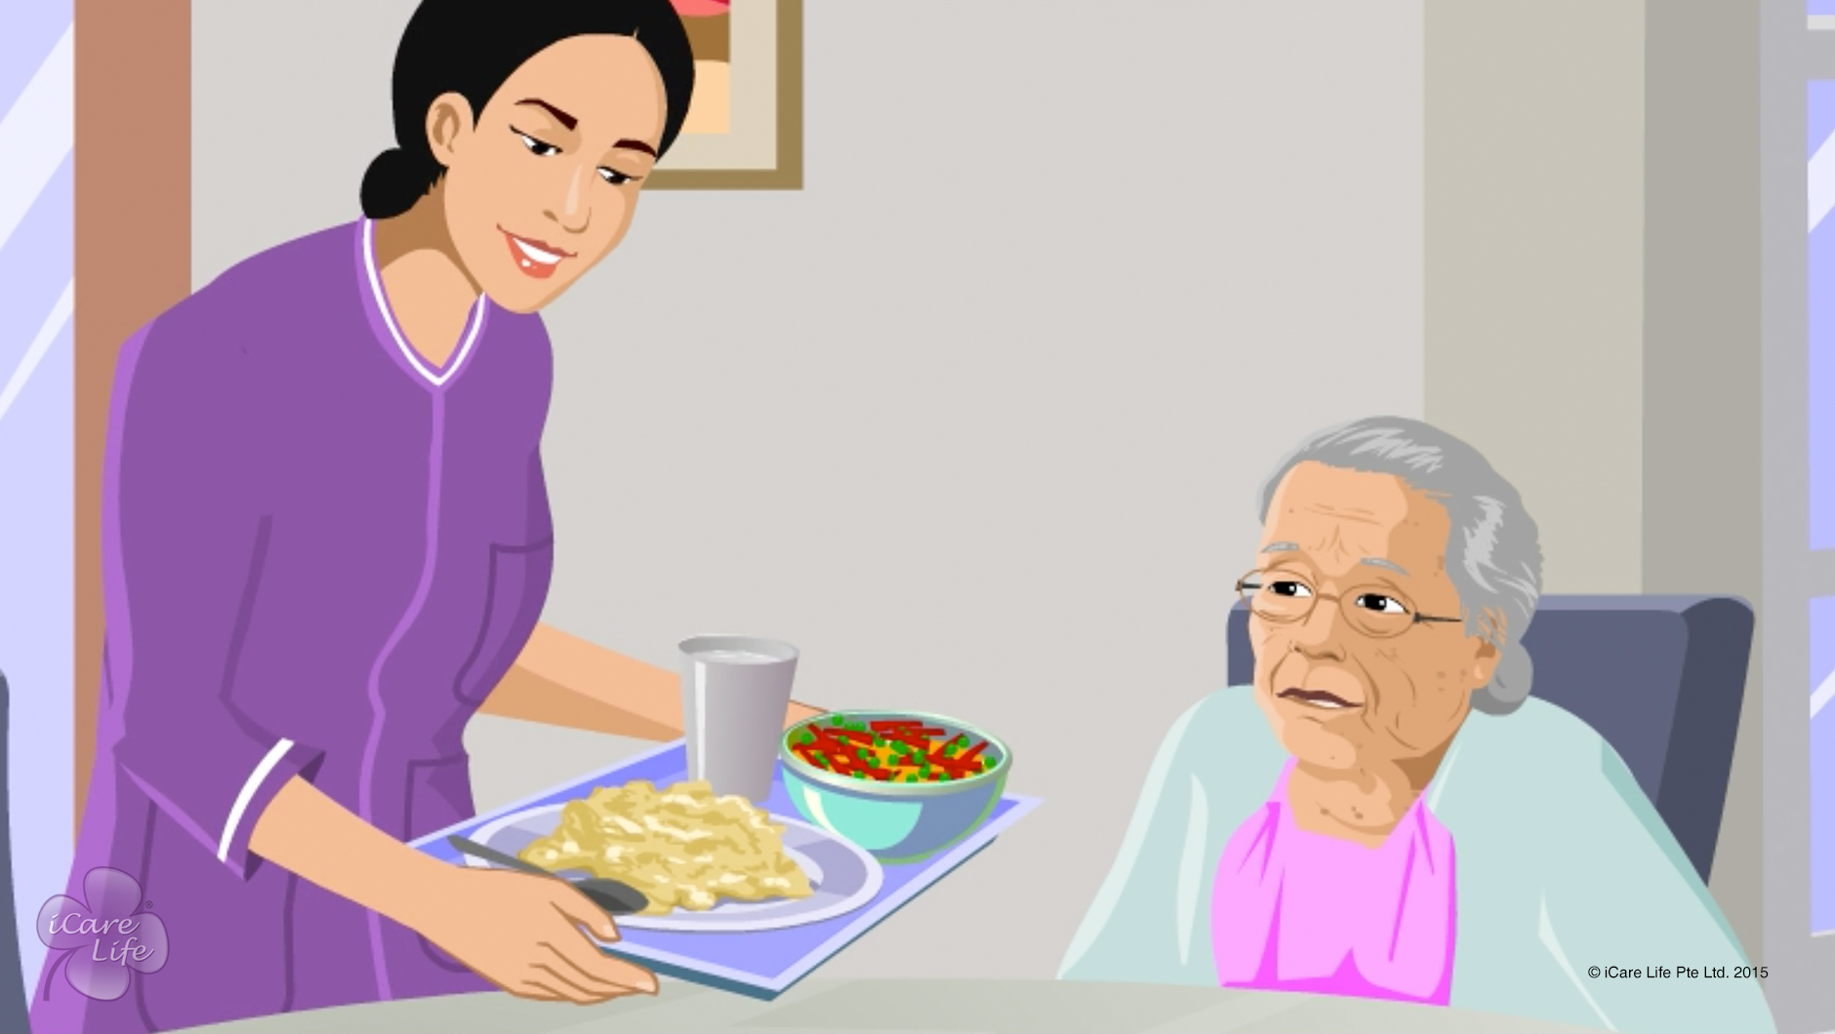
Promotion of Wellness in the Elder
35
Copyright: iCare Life Pte. Ltd., Singapore : This document must not be copied or shared or circulated without the consent of iCare Life and/or its affiliates.

Slide 37
Activities to Promote Wellness
Post Module Activity
36
Copyright: iCare Life Pte. Ltd., Singapore : This document must not be copied or shared or circulated without the consent of iCare Life and/or its affiliates.
Notes:
Arrange for a white board and a marker.
Divide the class into 3 groups. Give one topic to each group to make a list of activities for improving:
Elder’s mental health
Elder’s emotional happiness
Elder’s physical health
Give 10 minutes to each group to compile their lists. Invite one participant from each group to share their list with the rest of the class by writing on the white board. Invite inputs from the class as to what more can be added.
Model answers:
Elder’s mental health- playing games like Sudoku, chess, reading books, watching news, hobby classes, knitting, painting, gardening, writing poetry
Elder’s emotional happiness- spending tie with family, spending time with friends, volunteer in a school or a society office or animal shelter, gardening, writing poetry, pursuing an activity they are passionate about
Elder’s physical health- meditation, praying, walking, yoga, breathing exercises, sleeping well

Slide 38
Summary
Ensure that the elder eats well and healthy
Make sure the elder gets enough sleep at night
Ensure that the elder exercises regularly
Keep the elder in good cheer
Occupy the elder throughout the day with an easy routine
Encourage the elder to take up a hobby
Make sure that the elder socializes with friends and family
37
Copyright: iCare Life Pte. Ltd., Singapore : This document must not be copied or shared or circulated without the consent of iCare Life and/or its affiliates.
Notes:
Ensure that the elder eats well and healthy
Make sure the elder gets enough sleep at night
Ensure that the elder exercises regularly
Keep the elder in good cheer
Occupy the elder throughout the day with an easy routine
Encourage the elder to take up a hobby
Make sure that the elder socializes with friends and family

Slide 39
Any Questions?
38
Copyright: iCare Life Pte. Ltd., Singapore : This document must not be copied or shared or circulated without the consent of iCare Life and/or its affiliates.
Notes:
Q1. What is more important, physical wellbeing or emotional wellbeing?
Ans. Both types of wellbeing are interdependent, each complementing the other. Unless the physical wellbeing is ensured, it is difficult to ensure emotional wellbeing. Similarly, it is difficult to maintain physical wellbeing when a person is emotionally disturbed. Therefore it is the task of the caregiver to employ all means available to him to keep the care receiver physically and mentally healthy.
Q2. What possible activities can you plan to keep the elderly persons engaged mentally?
Ans. Often, older people can become happier, more productive individuals when they are encouraged to perform fun, brain-stimulating activities. The following activities are especially good for homebound elderly:
sew or knit,
be a pen pal,
be a reader to children at an elementary school,
save stamps for collectors,
write favourite recipes on cards and share them with others,
read books, magazines, newspapers,
do puzzles (jigsaw, crossword),
try artwork (calligraphy, painting, drawing),
write or record memoirs, poetry, thoughts,
keep a joke book,
care for pets or plants,
listen to soothing music,
take correspondence courses,
play musical instruments,
start or re-arrange a family photo album,
volunteer at libraries, hospitals, museums, schools,
bake for self and others,
plan a potluck or brown-bag lunch at home,
tutor for children and youth,
type for self and others,
learn to use a computer
In addition, older people who are physically active should be encouraged to participate in swimming, bowling, gardening, dancing, miniature golf, nature walks, mall-walking, jogging, shuffleboard and other activities outside the home.
Drawing, writing, reading, crafts, taking classes, and other hobbies encourage creativity. Indoor games including chess, checkers, monopoly, cards, and billiards provide interesting relief from boredom as well.

Slide 40


