Slide 1

Viewing of Modules
Administering Medication
CR 10.2
Private and Confidential

Slide 2
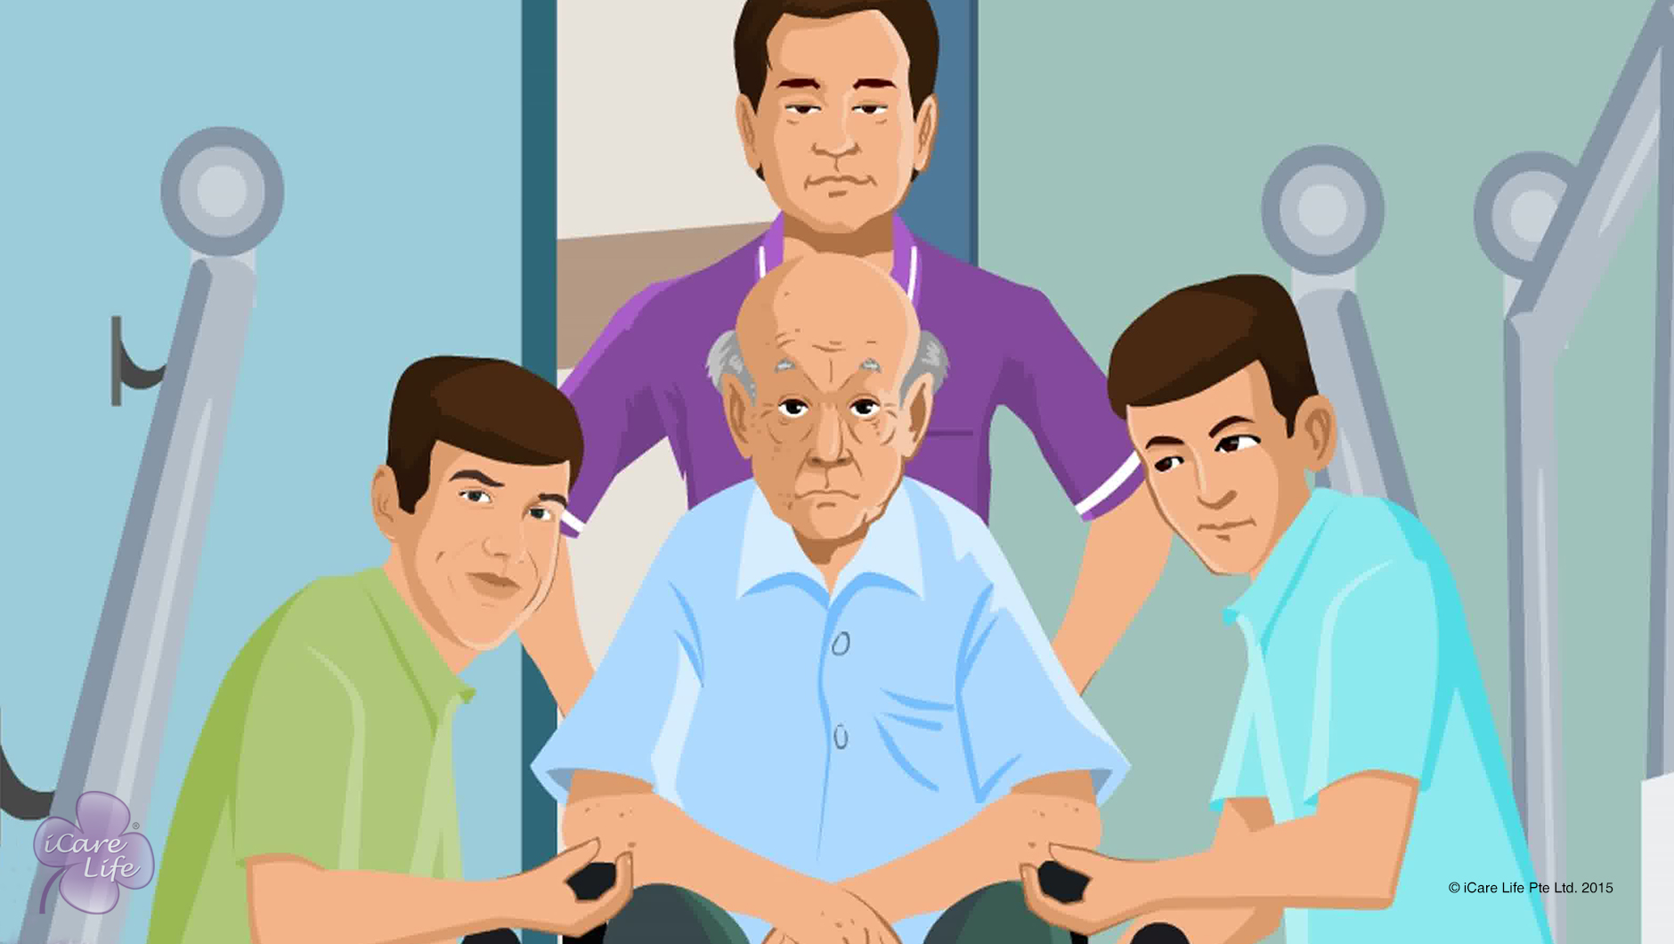
Handling Emergency Situations
1
Copyright: iCare Life Pte. Ltd., Singapore : This document must not be copied or shared or circulated without the consent of iCare Life and/or its affiliates.

Slide 3
In this module, you will learn about:
Some emergency situations that you can face when caring for an elder
How to handle emergency situations for an elder
2
Copyright: iCare Life Pte. Ltd., Singapore : This document must not be copied or shared or circulated without the consent of iCare Life and/or its affiliates.

Slide 4

Let’s Watch
Handling Emergency Situations
3
Copyright: iCare Life Pte. Ltd., Singapore : This document must not be copied or shared or circulated without the consent of iCare Life and/or its affiliates.

Slide 5
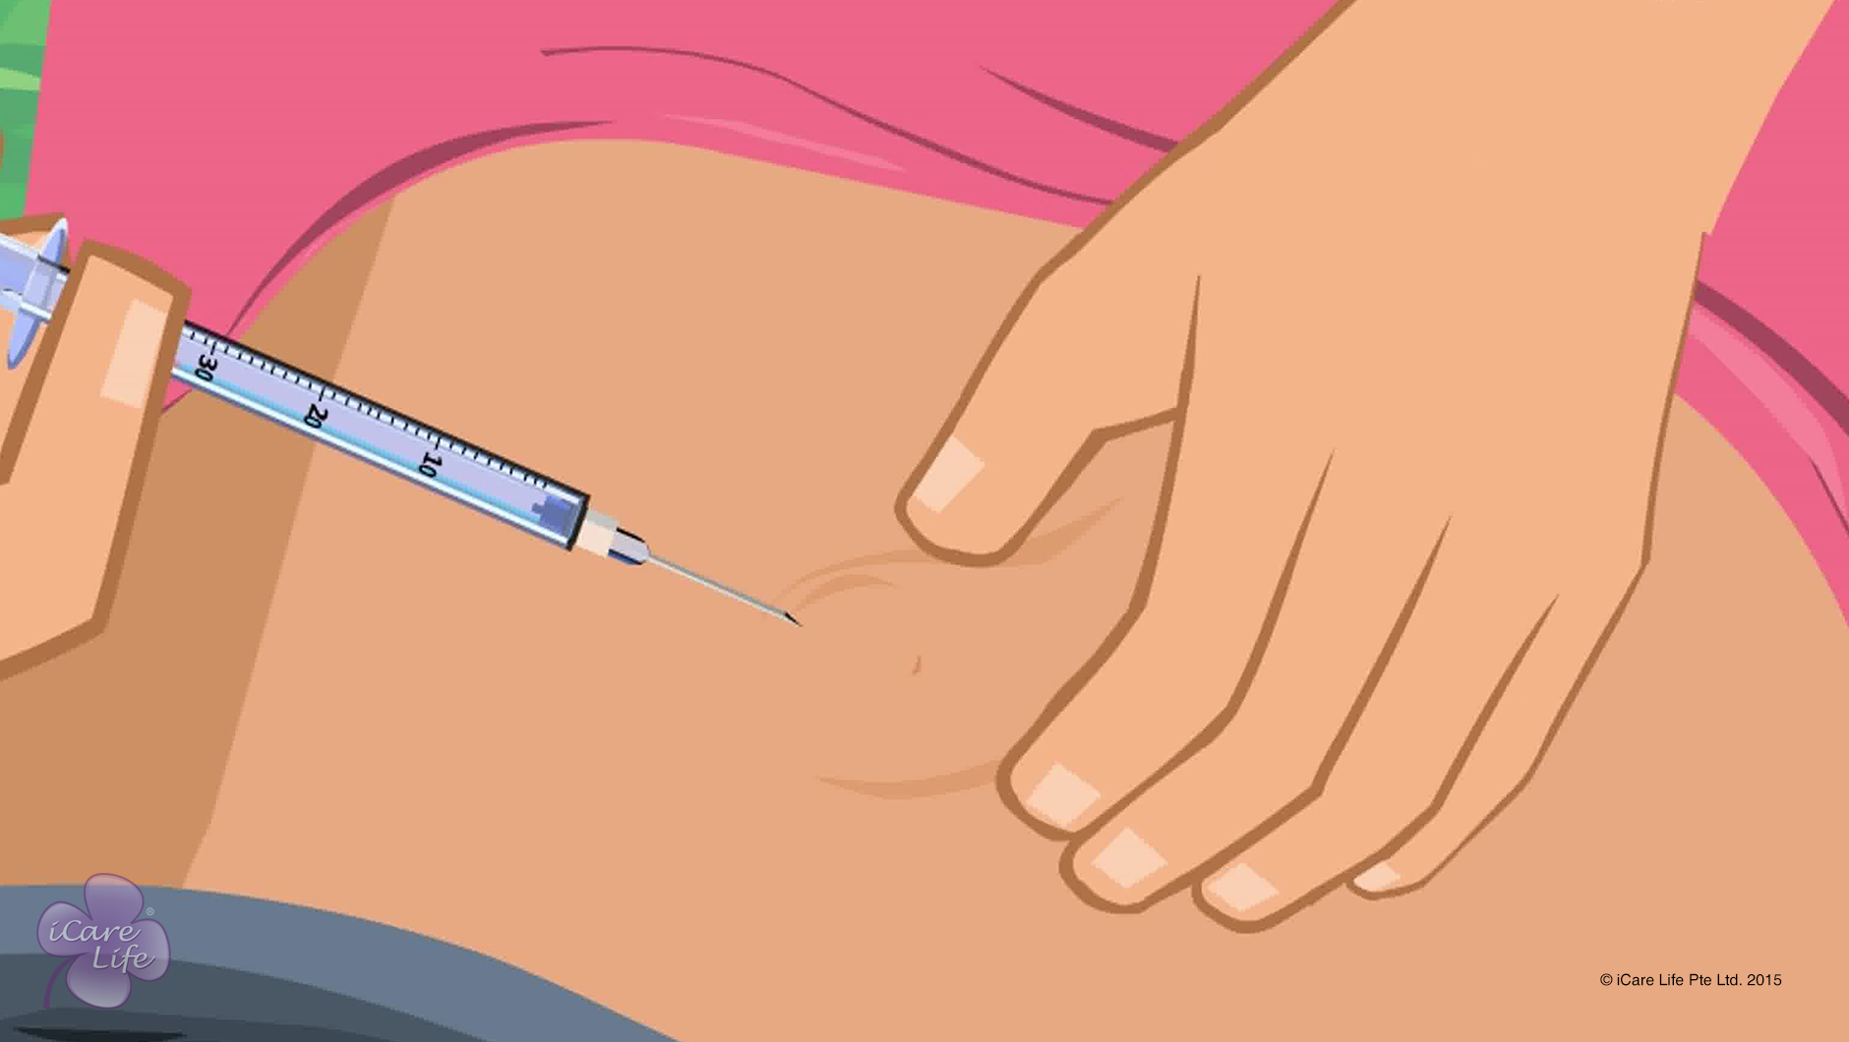
Giving Insulin Shots
4
Copyright: iCare Life Pte. Ltd., Singapore : This document must not be copied or shared or circulated without the consent of iCare Life and/or its affiliates.

Slide 6
In this module, you will learn about:
What are the methods of giving insulin
How to use a syringe to give insulin
How to use an insulin pen
5
Copyright: iCare Life Pte. Ltd., Singapore : This document must not be copied or shared or circulated without the consent of iCare Life and/or its affiliates.

Slide 7
Let’s Watch
Giving Insulin Shots
6
Copyright: iCare Life Pte. Ltd., Singapore : This document must not be copied or shared or circulated without the consent of iCare Life and/or its affiliates.

Slide 8
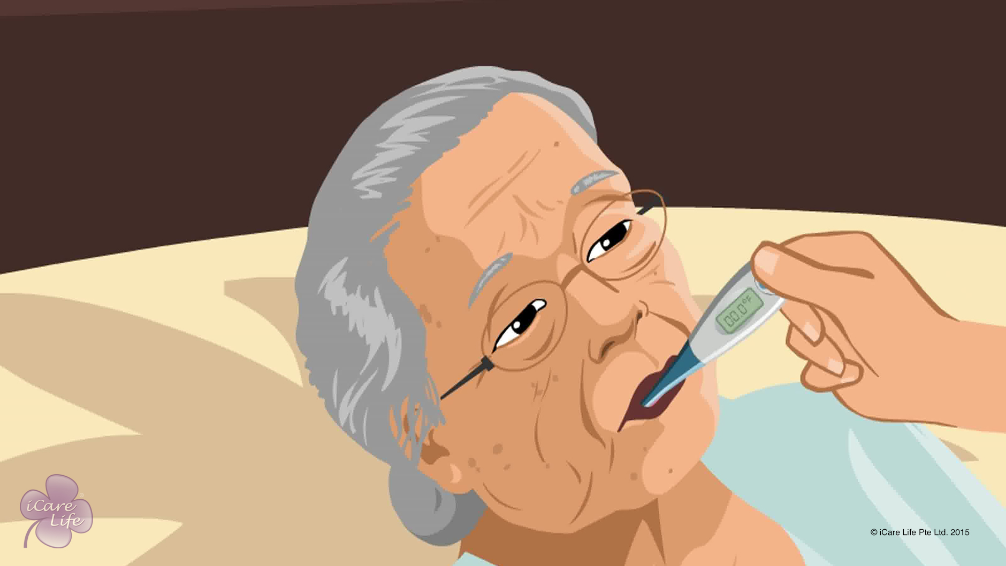
Common Home Tests for the Elder
7
Copyright: iCare Life Pte. Ltd., Singapore : This document must not be copied or shared or circulated without the consent of iCare Life and/or its affiliates.

Slide 9
In this module, you will learn about:
The common home tests for an elder
The devices that are required for common home tests
How to use various devices to perform common home tests
8
Copyright: iCare Life Pte. Ltd., Singapore : This document must not be copied or shared or circulated without the consent of iCare Life and/or its affiliates.

Slide 10
Let’s Watch
Common Home Tests for the Elder
9
Copyright: iCare Life Pte. Ltd., Singapore : This document must not be copied or shared or circulated without the consent of iCare Life and/or its affiliates.

Slide 11


