Slide 1

Viewing of Modules
Common Vitals & Handling Emergencies
CR 10.3
Private and Confidential

Slide 2
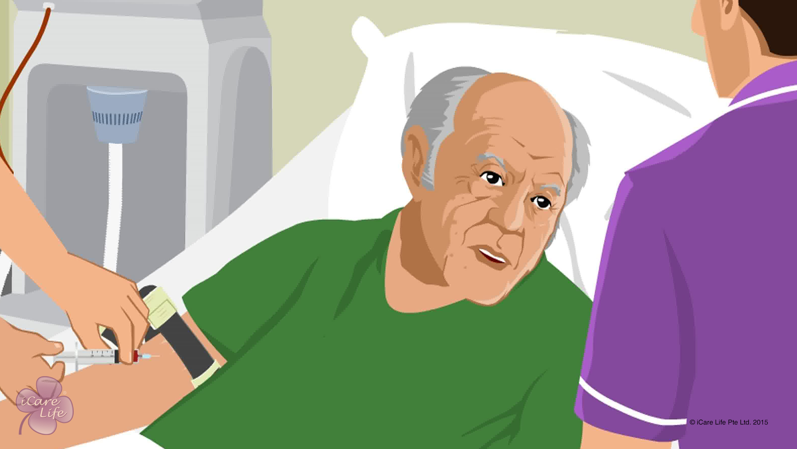
Common Blood & Urine Tests
1
Copyright: iCare Life Pte. Ltd., Singapore : This document must not be copied or shared or circulated without the consent of iCare Life and/or its affiliates.

Slide 3
In this module, you will learn about:
The common blood and urine tests
The equipment used during blood and urine tests
How to assist the elder before and during the tests
2

Slide 4

Let’s Watch
Common Blood & Urine Tests of the Elder
3
Copyright: iCare Life Pte. Ltd., Singapore : This document must not be copied or shared or circulated without the consent of iCare Life and/or its affiliates.

Slide 5
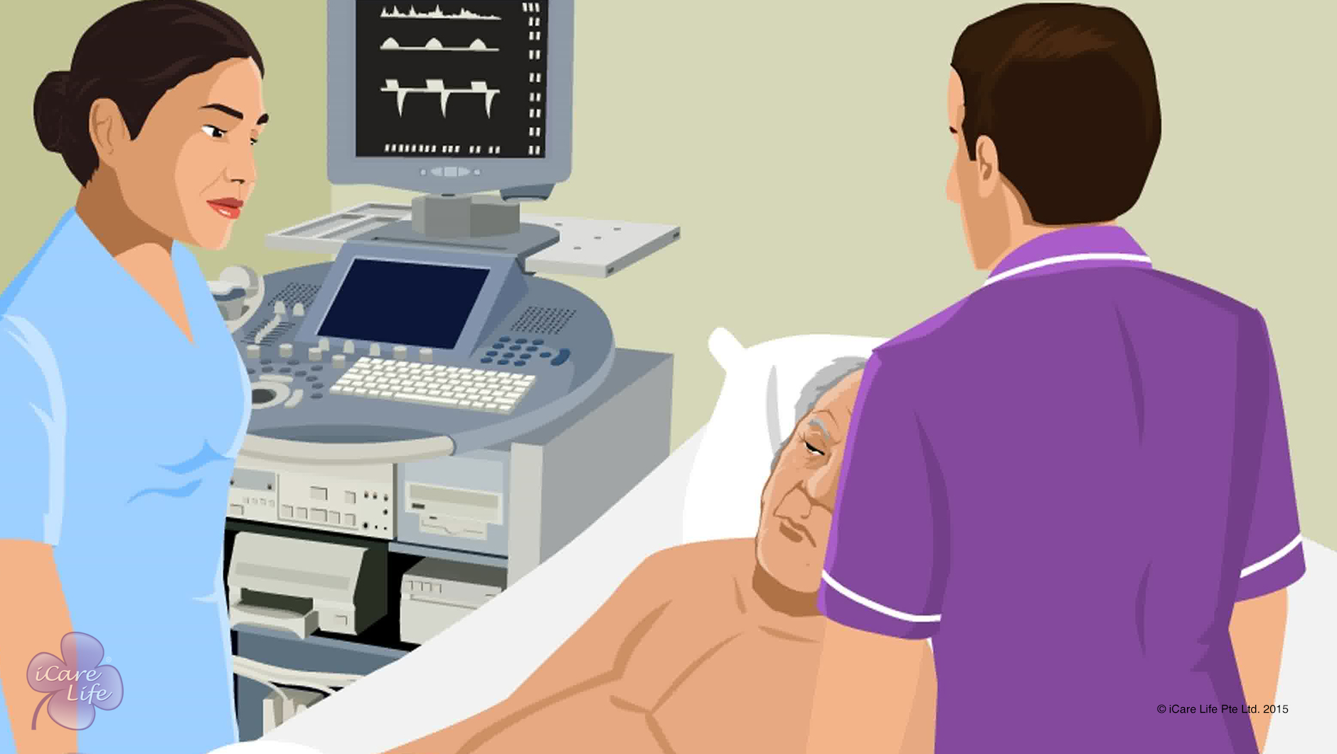
Common Medical Scans of the Elder
4
Copyright: iCare Life Pte. Ltd., Singapore : This document must not be copied or shared or circulated without the consent of iCare Life and/or its affiliates.

Slide 6
In this module, you will learn about:
The common medical scans
The equipment used during medical scans
How to assist the elder before and during the various scans
5
Copyright: iCare Life Pte. Ltd., Singapore : This document must not be copied or shared or circulated without the consent of iCare Life and/or its affiliates.

Slide 7
Let’s Watch
Common Medical Scans of the Elder
6
Copyright: iCare Life Pte. Ltd., Singapore : This document must not be copied or shared or circulated without the consent of iCare Life and/or its affiliates.

Slide 8
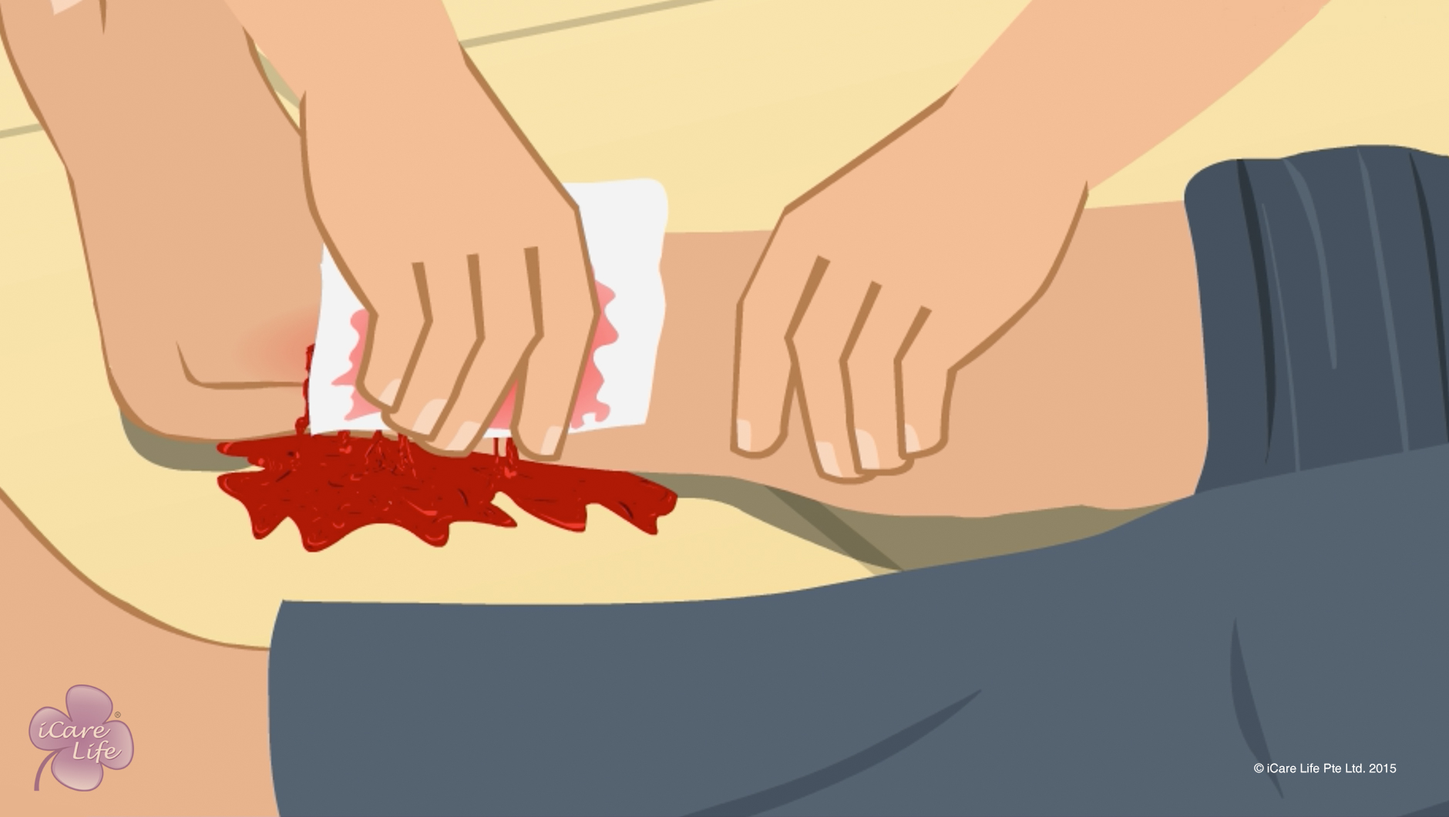
Handling Health Emergencies
7
Copyright: iCare Life Pte. Ltd., Singapore : This document must not be copied or shared or circulated without the consent of iCare Life and/or its affiliates.

Slide 9
In this module, you will learn about:
What should be done in case of health emergencies such as severe bleeding, severe burns, poisoning, electric shock, choking, or drowning
8
Copyright: iCare Life Pte. Ltd., Singapore : This document must not be copied or shared or circulated without the consent of iCare Life and/or its affiliates.

Slide 10
Let’s Watch
Handling Health Emergencies
9
Copyright: iCare Life Pte. Ltd., Singapore : This document must not be copied or shared or circulated without the consent of iCare Life and/or its affiliates.

Slide 11


