Slide 1

Modules Summary Discussion – Q&A
CR 10.4
Private and Confidential

Slide 2

Handling Emergency Situations
1
Copyright: iCare Life Pte. Ltd., Singapore : This document must not be copied or shared or circulated without the consent of iCare Life and/or its affiliates.

Slide 3
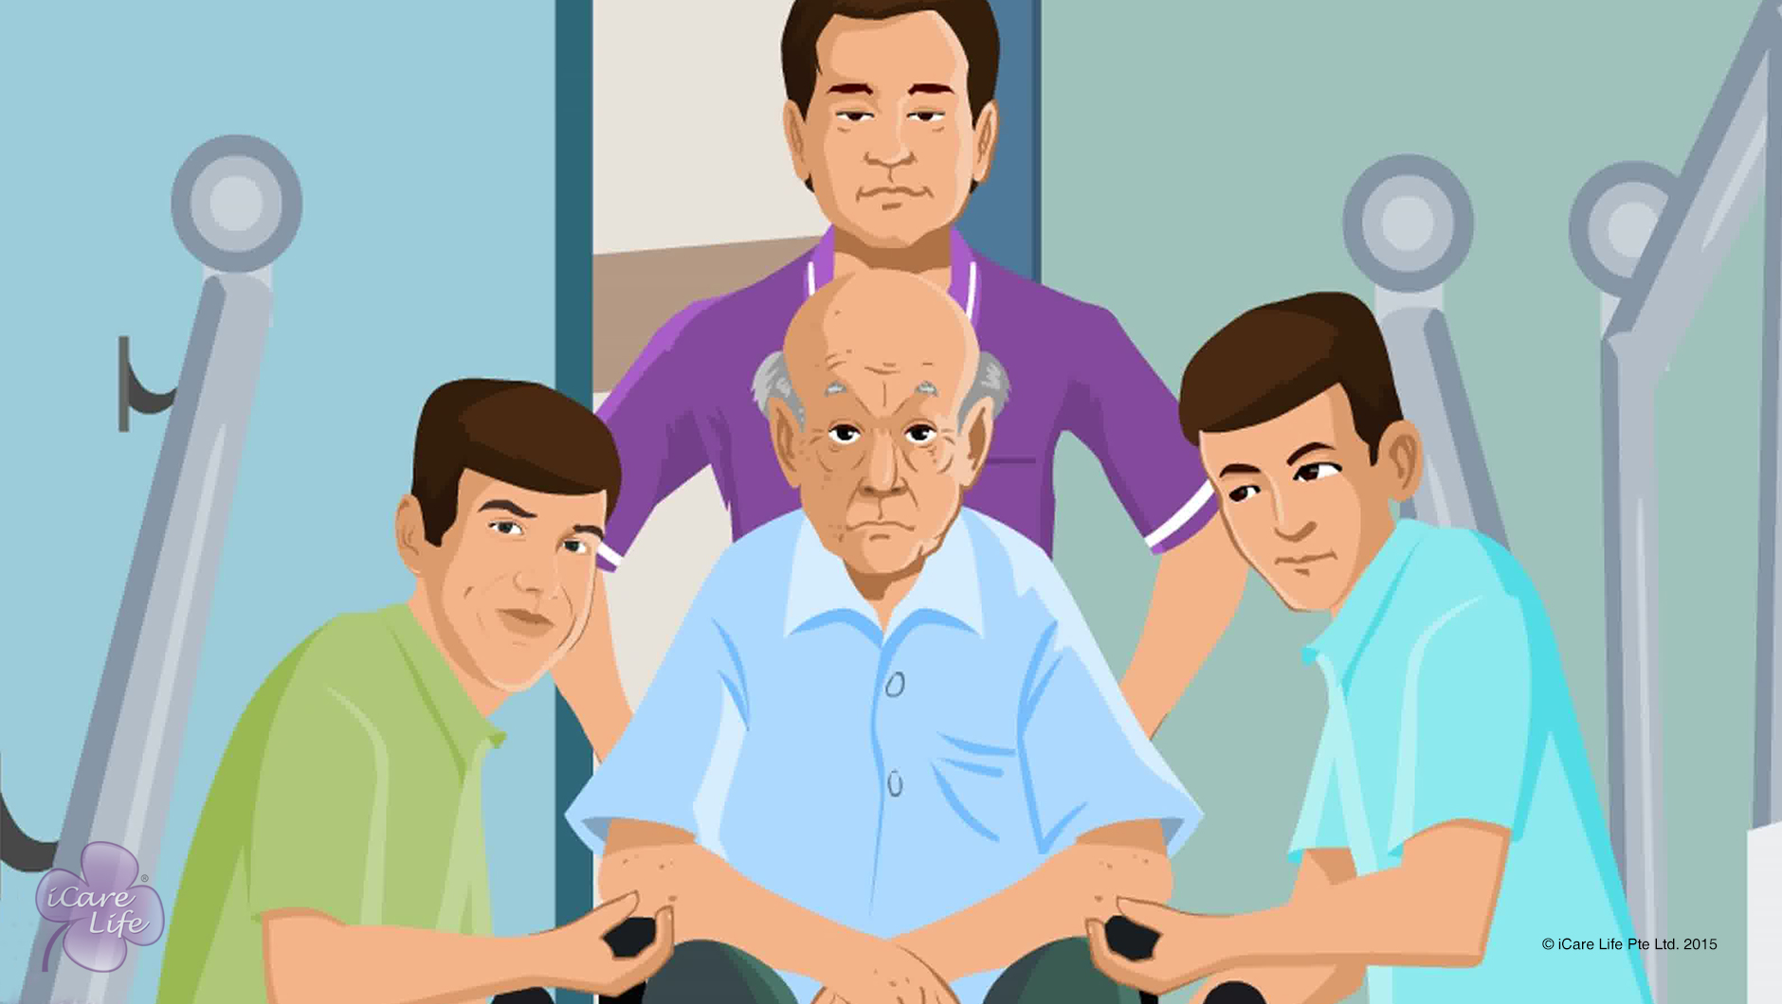
Handling Emergency Situations
2
Copyright: iCare Life Pte. Ltd., Singapore : This document must not be copied or shared or circulated without the consent of iCare Life and/or its affiliates.

Slide 4
Post-Module Activity
Guess the Problem!
3
Copyright: iCare Life Pte. Ltd., Singapore : This document must not be copied or shared or circulated without the consent of iCare Life and/or its affiliates.
Notes:
Objective: Role play activity to help the participants identify symptoms and related them with ailments such as heart attack, paralysis, and appendicitis/gall bladder issues
Ask three participants to volunteer to act. Give the following instructions to each volunteer:
Act that you have chest pain, sweating, breathlessness
Act that one of your limb is not moving
Act that you have a severe abdominal pain (no other symptoms)
As each participant acts, you can ask the class what they think may be happening to the person
Correct answers:
Heart attack
Paralysis
Appendicitis/gall bladder issues

Slide 5
Summary
Call a family member and if required a doctor, if the elder:
Complains of chest pain, sweating or breathlessness – it may be a heart attack
Displays decreased movement of one or more limbs, sudden weakness of a part of the body, or facial distortion – it may be paralysis
Has fever with no other symptoms
Complains of headache for more than 24 hours
Complains of unexplained abdominal pain – it may indicate appendicitis or gall bladder issues or uterus issues in women
If the elder suffers a serious fall when you are alone in the house with the elder, call the doctor
In case of a theft, secure the elder and call the police
In case of a fire or earthquake, call for help and move the elder to a safe location
4
Notes:
Call a family member and if required a doctor, if the elder:
Complains of chest pain, sweating or breathlessness – it may be a heart attack
Displays decreased movement of one or more limbs, sudden weakness of a part of the body, or facial distortion – it may be paralysis
Has fever with no other symptoms
Complains of headache for more than 24 hours
Complains of unexplained abdominal pain – it may indicate appendicitis or gall bladder issues or uterus issues in women
If the elder suffers a serious fall when you are alone in the house with the elder, call the doctor
In case of a theft, secure the elder and call the police
In case of a fire or earthquake, call for help and move the elder to a safe location

Slide 6
Any Questions?
5
Notes:
Q.1. What should I do if I am not sure of the sudden problem that the elder may be suffering from?
Ans. In such a case, you should call for medical help and inform a family member immediately.

Slide 7
Giving Insulin Shots
6
Copyright: iCare Life Pte. Ltd., Singapore : This document must not be copied or shared or circulated without the consent of iCare Life and/or its affiliates.

Slide 8
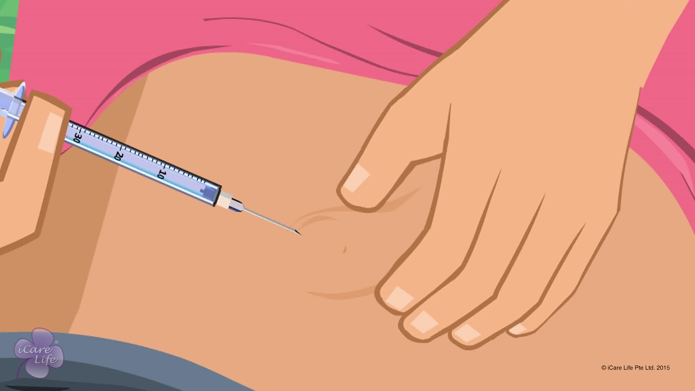
Giving Insulin Shots
7
Copyright: iCare Life Pte. Ltd., Singapore : This document must not be copied or shared or circulated without the consent of iCare Life and/or its affiliates.

Slide 9
Post-Module Activity
Practice & Learn
8
Notes:
You will need to set up an appointment with medical professional who knows how to use syringes and insulin pens very well.
You will have to arrange for:
A syringe
Bottle of insulin (glass bottle with rubber top)
An insulin pen
A sponge or dummy on which the class participants can learn injecting insulin
Ask the medical professional to show:
The various parts do syringes and insulin pens have
The correct administration of insulin – how to check if it is the correct insulin, correct syringe, etc.
How is the insulin bottle opened for using
How is a syringe used (pinching the skin, how deep should the syringe be inserted, how much pressure to use, etc.)
How is an insulin pen used
What parts of the body can the injection be given in
Now divide the class into two parts. Give one group a syringe and the insulin bottle and the give the insulin pen to the other. Once the groups have practiced, they can interchange the instruments and practice again. Ask the medical professional to observe and give the participants appropriate feedback.
You and the medical professional have to be vigilant and careful as there are syringes involved in the learning. Make sure that students practice only on sponges or dummies provided.

Slide 10
Summary
Syringe and insulin pen are the two main methods of giving an insulin shot to an elder
Before deciding on the method, check with the elder’s family and doctor
Before giving the shot, make sure you have the correct insulin and that it has not expired
Also match the last marking on the syringe and the number written on the insulin bottle
When reusing, do not let the needle touch any unrequired surfaces
Keep the needle capped when you are not using it
Reuse a needle only on the same person
If the needle seems dull or bent, change it immediately
You can store an insulin pen in the refrigerator until its expiration date
If the elder under your care is taking insulin, always watch out for signs like restlessness, sweating, or tiredness; these signs may indicate low blood sugar
9
Notes:
Syringe and insulin pen are the two main methods of giving an insulin shot to an elder
Before deciding on the method, check with the elder’s family and doctor
Before giving the shot, make sure you have the correct insulin and that it has not expired
Also match the last marking on the syringe and the number written on the insulin bottle
When reusing, do not let the needle touch any unrequired surfaces
Keep the needle capped when you are not using it
Reuse a needle only on the same person
If the needle seems dull or bent, change it immediately
You can store an insulin pen in the refrigerator until its expiration date
If the elder under your care is taking insulin, always watch out for signs like restlessness, sweating, or tiredness; these signs may indicate low blood sugar

Slide 11
Any Questions?
10
Notes:
Q1. How often should you get their blood sugar level tested?
Ans. If you do not have diabetes, but your immediate family members do, then for precautionary measures you should get your blood sugar tested once a year. Diabetes can be a hereditary condition.
If you do have diabetes, then you should get tested at least once in six months, or according to the doctor’s prescription.
Q2. Is there any other option apart from injections to take insulin?
Ans. Yes. There are tablets available which help you similarly, but these have to be taken on doctor’s advice only. You can speak to the doctor about this option, but if the doctor feels that injections are necessary, then taking tablets is not advised.

Slide 12
Common Home Tests for the Elder
11
Copyright: iCare Life Pte. Ltd., Singapore : This document must not be copied or shared or circulated without the consent of iCare Life and/or its affiliates.

Slide 13
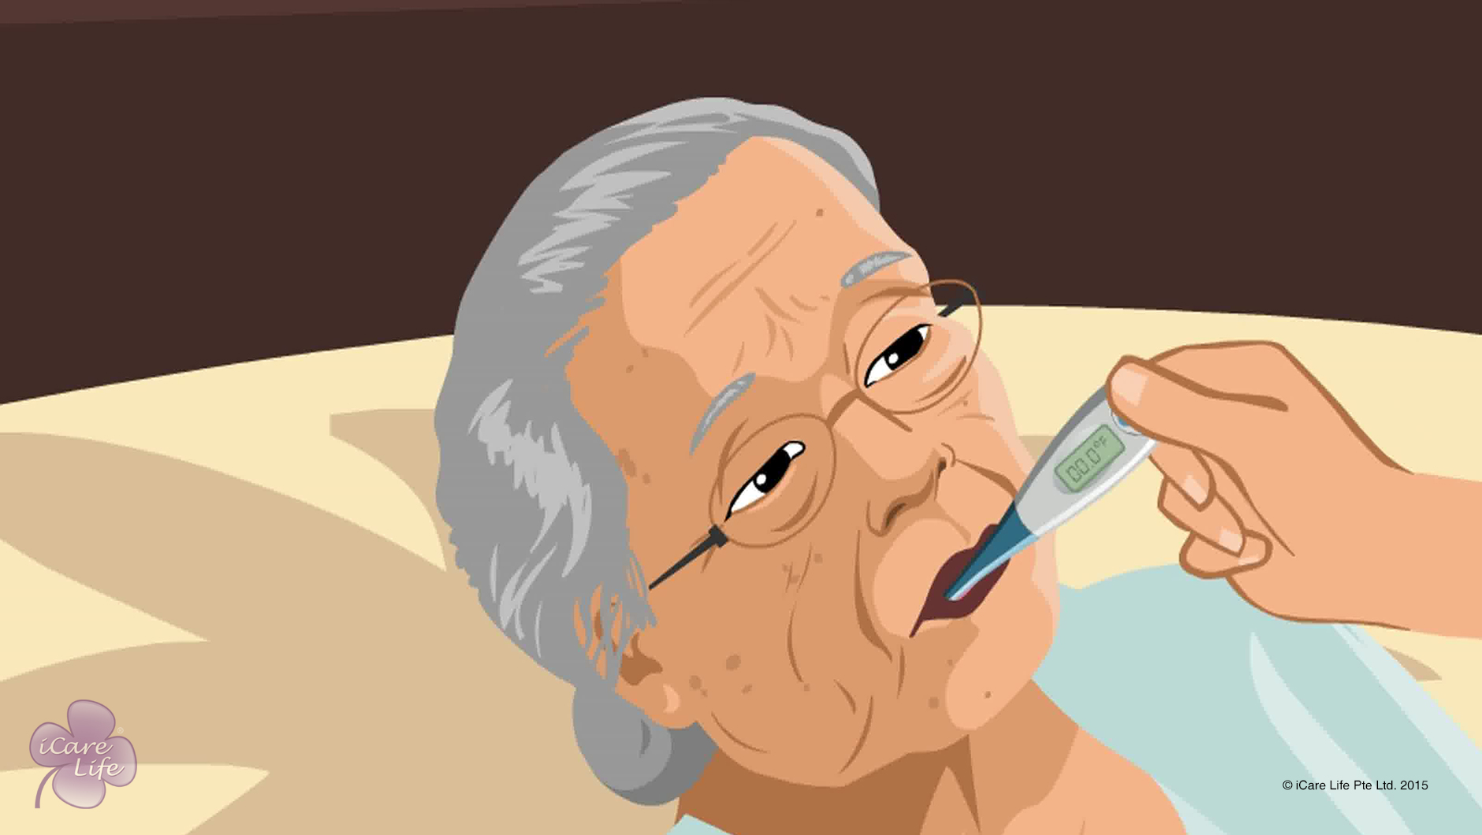
Common Home Tests for the Elder
12
Copyright: iCare Life Pte. Ltd., Singapore : This document must not be copied or shared or circulated without the consent of iCare Life and/or its affiliates.

Slide 14
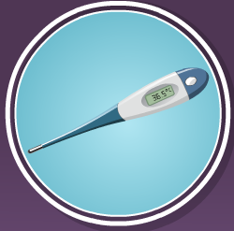
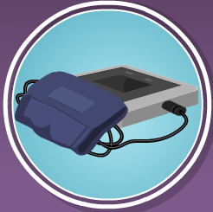
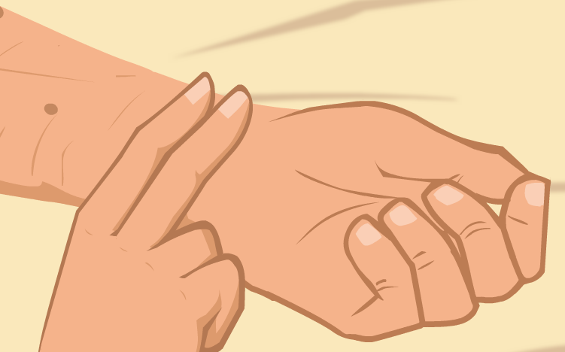
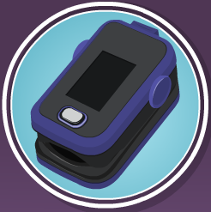
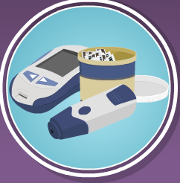
Post-Module Activity
Demonstration & Practice
Notes:
Divide the class into pairs. Set up an appointment with a medical expert who will be able to teach the class participants how to:
Check temperature using a digital thermometer
Check blood pressure using a digital sphygmomanometer
Check pulse
Check oxygen saturation using an oximeter
Check blood sugar level using a digital glucose meter
Check with the expert and arrange for all equipment (all digital equipment) for every pair in the class.
Ask the medical expert to demonstrate each test and encourage the pairs to practice the same amongst themselves. Make sure that the medical expert is available for supervision and providing feedback to the participants.
Ask the class participants to keep taking notes wherever they feel necessary.

Slide 15
Summary
To check temperature using a digital thermometer:
Switch on and place in the mouth or under the arm
Wait till it beeps
Read temperature
Use alcohol rub to sanitize the thermometer
To check pulse:
Place the first and second fingertips firmly at the wrist
Start counting the pulse when the seconds hand of the clock is at 12
Count pulse for 60 seconds and note the number
To check the oxygen saturation using a pulse oximeter:
Switch on the device
Put the probe onto the finger
Record the readings
14
Copyright: iCare Life Pte. Ltd., Singapore : This document must not be copied or shared or circulated without the consent of iCare Life and/or its affiliates.
Notes:
To check temperature using a digital thermometer:
Switch on and place in the mouth or under the arm
Wait till it beeps
Read temperature
Use alcohol rub to sanitize the thermometer
To check pulse:
Place the first and second fingertips firmly at the wrist
Start counting the pulse when the seconds hand of the clock is at 12
Count pulse for 60 seconds and note the number
To check the oxygen saturation using a pulse oximeter:
Switch on the device
Put the probe onto the finger
Record the readings

Slide 16
Summary
To check blood pressure using a digital sphygmomanometer:
Ask the elder to sit still and place their arm at heart level
Wrap the cuff around the upper arm
Start the machine
Note the readings
To check the elder’s blood sugar using a glucose meter:
Ask the elder to wash their hands with soap and dry them
Remove a test strip from the container
Insert the test strip into the meter
Prick the elder’s finger with the needle or lancet
Squeeze the finger until a drop of blood forms
Touch the test strip to the blood
Note the blood sugar reading
15
Copyright: iCare Life Pte. Ltd., Singapore : This document must not be copied or shared or circulated without the consent of iCare Life and/or its affiliates.
Notes:
To check blood pressure using a digital sphygmomanometer:
Ask the elder to sit still and place their arm at heart level
Wrap the cuff around the upper arm
Start the machine
Note the readings
To check the elder’s blood sugar using a glucose meter:
Ask the elder to wash their hands with soap and dry them
Remove a test strip from the container
Insert the test strip into the meter
Prick the elder’s finger with the needle or lancet
Squeeze the finger until a drop of blood forms
Touch the test strip to the blood
Note the blood sugar reading

Slide 17
Any Questions?
16
Notes:
Q1. Why are digital thermometers, digital sphygmomanometers, and digital glucose meters preferred to manual ones?
Ans. These are preferred as they are:
More accurate
Faster in giving results
Require lesser apparatus than regular tests
Easier to use
Q2. How often should these tests be conducted?
Ans. These tests should be conducted as per doctor’s guidelines. Always note down the date, time and the reading of the test so that it is easier for the doctor to track changes in the pattern of these test readings.

Slide 18
Common Blood & Urine Tests of the Elder
17
Copyright: iCare Life Pte. Ltd., Singapore : This document must not be copied or shared or circulated without the consent of iCare Life and/or its affiliates.

Slide 19
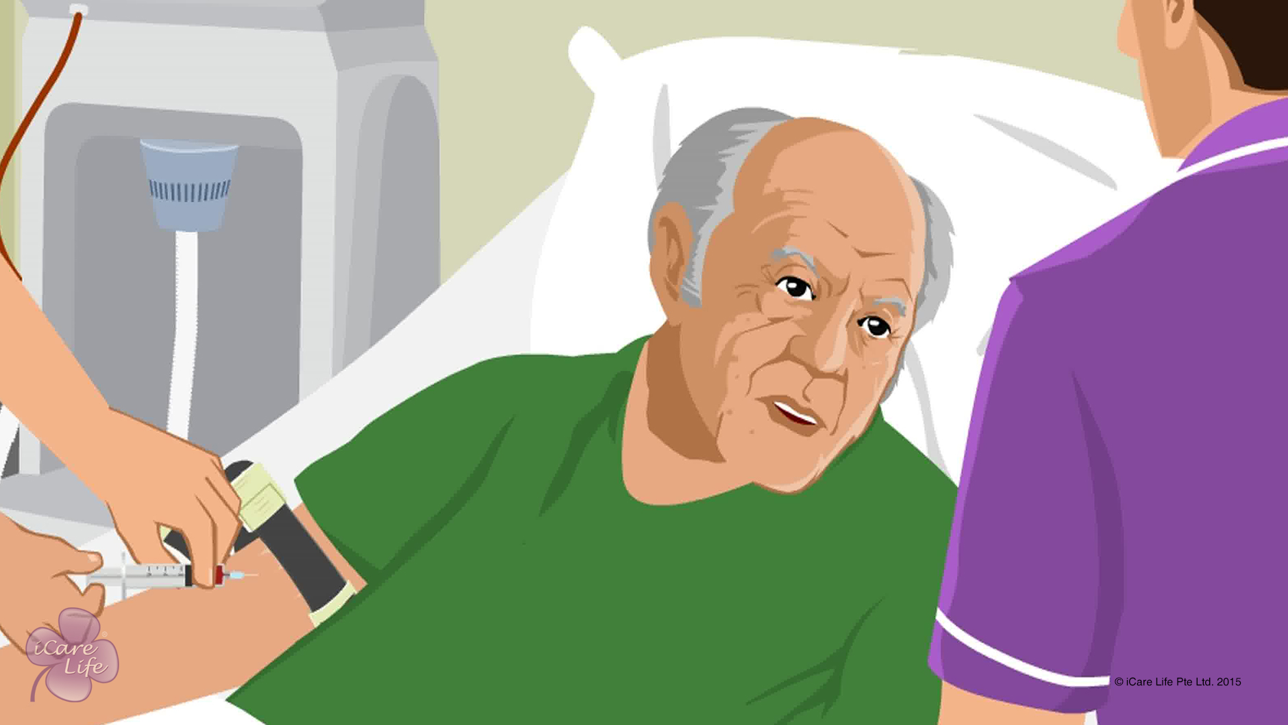
Common Blood & Urine Tests
18
Copyright: iCare Life Pte. Ltd., Singapore : This document must not be copied or shared or circulated without the consent of iCare Life and/or its affiliates.

Slide 20
Post-Module Activity
Let’s Practice
Notes:
Take prior appointment and the participants to a test laboratory and let them view the different tests – blood, urine, ultrasound, CT scan, MRI scan- being carried out. Also arrange for a laboratory technician to describe the various tests and the necessary precautions to be taken before, during, and after the tests.

Slide 21
Summary
For a diabetes test:
The elder should fast for at least eight hours before the test and can drink only water
The elder must not smoke, chew gum, or exercise before the test
You should take the elder for the test early in the morning
For blood lipid tests, the elder must not eat for 12 hours
For iron tests, the elder should not take iron tablets 12 hours before the test
For any blood test:
Inform the nurse if the elder is prone to feeling sick after the test
To calm down the elder, ask them to breathe deeply
Ask the elder to look away when blood is being drawn
Tell them to relax when the needle is being inserted
Try to talk to the elder through the test
After a blood test, ensure that the elder holds the cotton wool in place for some time
For urine tests:
Give clear step-by-step instructions to the elder
Give them privacy, while ensuring their safety
20
Copyright: iCare Life Pte. Ltd., Singapore : This document must not be copied or shared or circulated without the consent of iCare Life and/or its affiliates.
Notes:
For a diabetes test:
The elder should fast for at least eight hours before the test and can drink only water
The elder must not smoke, chew gum, or exercise before the test
You should take the elder for the test early in the morning
For blood lipid tests, the elder must not eat for 12 hours
For iron tests, the elder should not take iron tablets 12 hours before the test
For any blood test:
Inform the nurse if the elder is prone to feeling sick after the test
To calm down the elder, ask them to breathe deeply
Ask the elder to look away when blood is being drawn
Tell them to relax when the needle is being inserted
Try to talk to the elder through the test
After a blood test, ensure that the elder holds the cotton wool in place for some time
For urine tests:
Give clear step-by-step instructions to the elder
Give them privacy, while ensuring their safety

Slide 22
Any Questions?
21
Notes:
FAQs
Q1. Before the blood sugar test, can the elder have coffee?
No, the elder can only have water before the test.
Q2. Can the elder have medications before urine tests?
A. Some medications change the color of the urine. Check with the doctor.

Slide 23
Common Medical Scans of the Elder
22
Copyright: iCare Life Pte. Ltd., Singapore : This document must not be copied or shared or circulated without the consent of iCare Life and/or its affiliates.

Slide 24
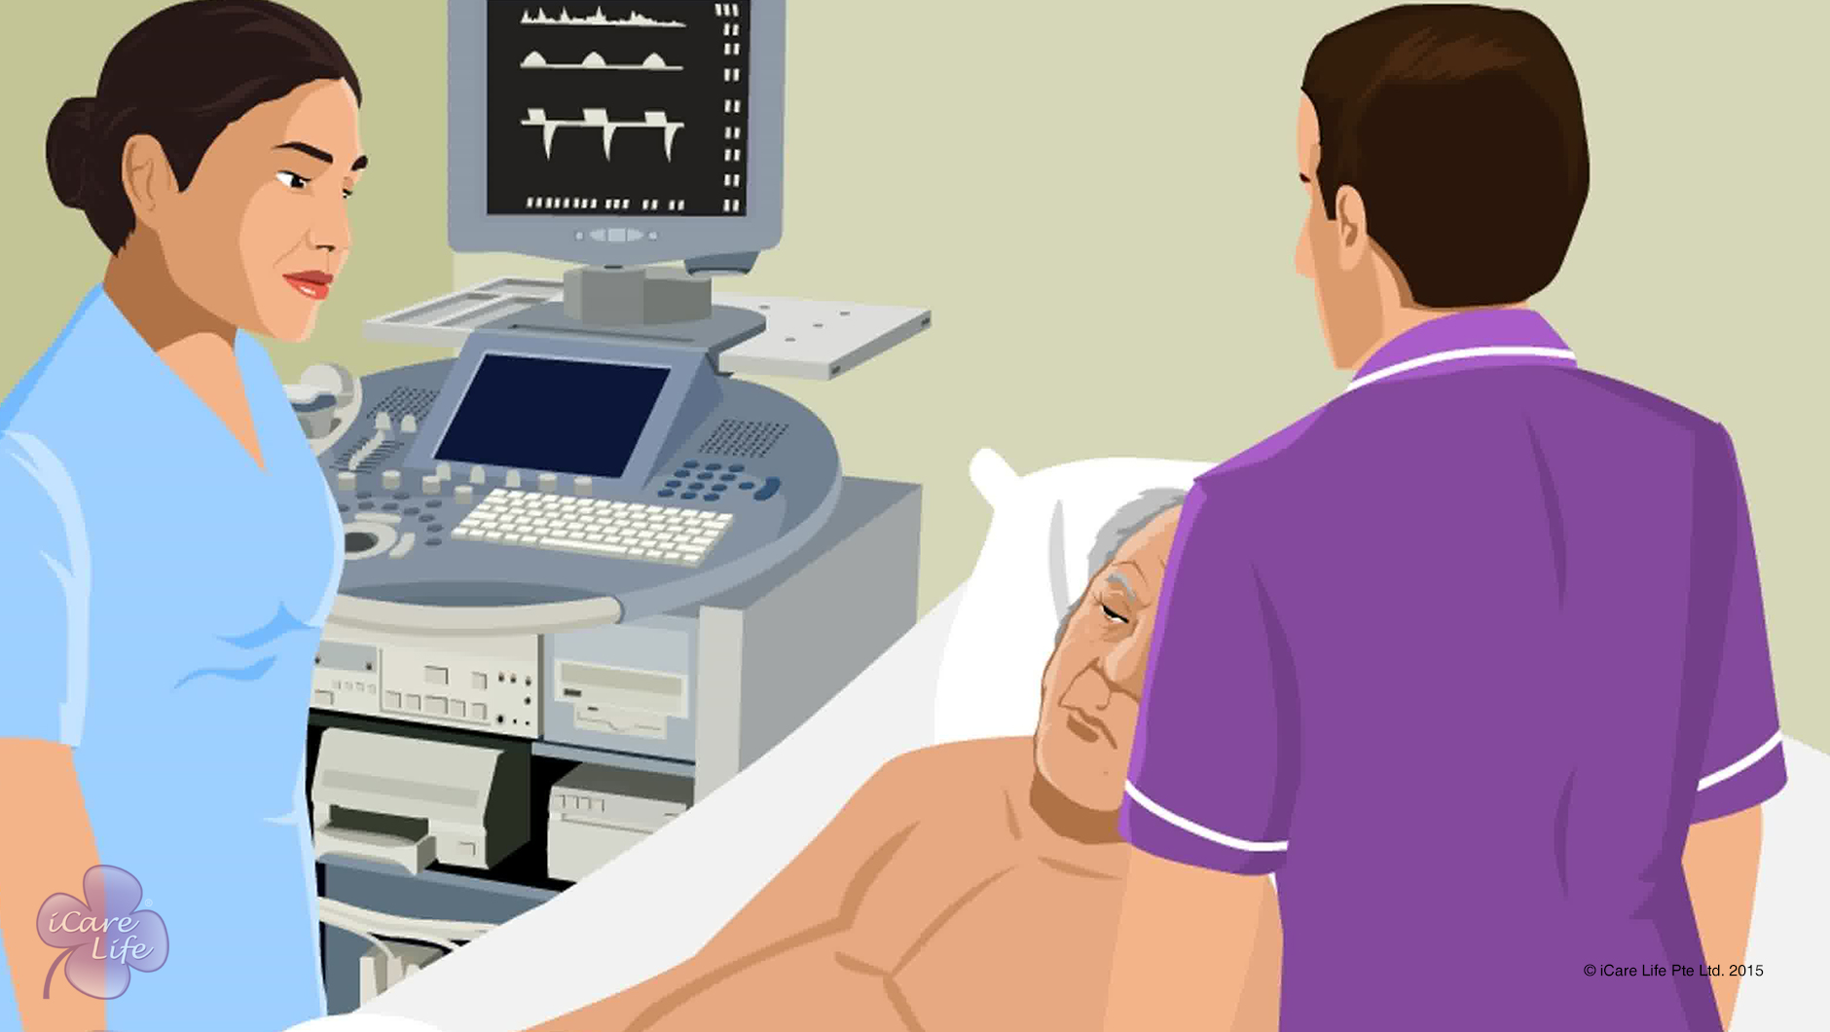
Common Medical Scans fo the Elder
23
Copyright: iCare Life Pte. Ltd., Singapore : This document must not be copied or shared or circulated without the consent of iCare Life and/or its affiliates.

Slide 25
Post-Module Activity
Visit
24
Copyright: iCare Life Pte. Ltd., Singapore : This document must not be copied or shared or circulated without the consent of iCare Life and/or its affiliates.
Notes:
Take prior appointment and take the participants to a scan center and let them view the different scans being carried out. Also arrange for a technician to describe the various scans and the necessary precautions to be taken before, during, and after the scans.

Slide 26
Summary
Before an X-ray:
Remind the elder that they will need to change into a robe
Ask the elder to avoid wearing jewellery
The elder may have to remove eyeglasses
Remind the elder to hold their breath when the X-ray picture is being taken
For the gall bladder ultrasound, the elder must fast for at least six hours prior to the examination
For the pelvic ultrasound test, the bladder must be full
25
Notes:
Before an X-ray:
Remind the elder that they will need to change into a robe
Ask the elder to avoid wearing jewellery
The elder may have to remove eyeglasses
Remind the elder to hold their breath when the X-ray picture is being taken
For the gall bladder ultrasound, the elder must fast for at least six hours prior to the examination
For the pelvic ultrasound test, the bladder must be full

Slide 27
Summary
For the CT scan:
Remind the elder that they will need to change into a robe
Ask the elder to avoid wearing jewellery
If advised by the doctor, the elder must fast for the required duration
If the elder is claustrophobic, the doctor may give medication to calm them down
If the elder is allergic to any substance, inform the doctor
Ask the elder to lie still inside the machine
Explain that you will need to wait outside
For the MRI scan:
Remind the elder that they will need to change into a robe
Ask the elder to avoid wearing jewellery
The elder cannot take the scan if they have pacemaker or metal implants
If elder is claustrophobic, , the doctor may give medication to calm them down
26
Notes:
For the CT scan:
Remind the elder that they will need to change into a robe
Ask the elder to avoid wearing jewellery
If advised by the doctor, the elder must fast for the required duration
If the elder is claustrophobic, the doctor may give medication to calm them down
If the elder is allergic to any substance, inform the doctor
Ask the elder to lie still inside the machine
Explain that you will need to wait outside
For the MRI scan:
Remind the elder that they will need to change into a robe
Ask the elder to avoid wearing jewellery
The elder cannot take the scan if they have pacemaker or metal implants
If elder is claustrophobic, , the doctor may give medication to calm them down

Slide 28
Any Questions?
27
Notes:
FAQs
Q1. Why should the elder take off jewelry before an MRI scan?
Ans. An MRI is a magnetic device. The jewelry metal can interfere with the equipment itself will or may not take the proper pictures that are needed or could throw the machinery off course as it is metal sensitive.

Slide 29
Handling Health Emergencies
28
Copyright: iCare Life Pte. Ltd., Singapore : This document must not be copied or shared or circulated without the consent of iCare Life and/or its affiliates.

Slide 30
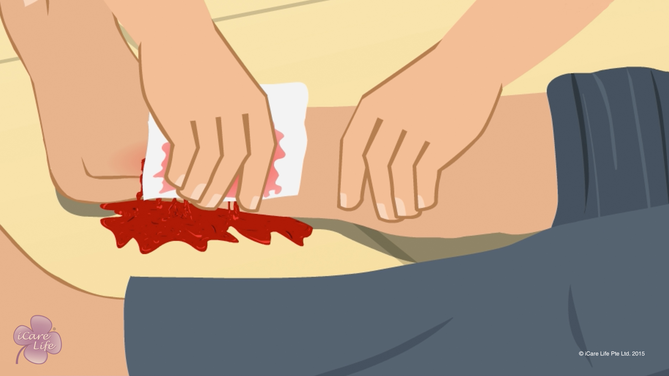
Handling Health Emergencies
29
Copyright: iCare Life Pte. Ltd., Singapore : This document must not be copied or shared or circulated without the consent of iCare Life and/or its affiliates.

Slide 31
Post-Module Activity
Demonstration
30
Copyright: iCare Life Pte. Ltd., Singapore : This document must not be copied or shared or circulated without the consent of iCare Life and/or its affiliates.
Notes:
You will have to make an appointment with a care home or a hospital to send one of their first aid experts for a demonstration.
Also arrange for dummies for students to practice on and materials like bandages, gauze, sling, sheets, etc., as advised by the first aid expert
Request the expert to demonstrate:
What to do in case of severe bleeding
How do you lay a person down when they have hit their head on a hard surface and is unconscious
What to do if a person is choking
How to give artificial respiration
Once the demonstration is over, you and the demonstrator can help the students practice on life-size dummies

Slide 32
Summary
If the person is bleeding severely, call for medical help. Till then, try to control the bleeding
In case of internal bleeding, call the doctor and do not give the person anything to eat or drink
If the person suffers from severe burns, wrap the person in clean sheets and take them to a hospital
If you suspect the person has consumed poison, rush the person to a hospital
In case of exposure, get the person dry and warm as soon as possible
If the person hits their head to a hard surface while falling, a concussion or an injury may occur; call the doctor
In case of an electric shock, switch off the electricity and move the person away from the source
To remove the object that is choking the person, give them a firm thump between the shoulder blades
In any situation, if the person is not breathing, give them artificial respiration
f the person is breathing, but is unconscious, lay them on their stomach and turn their head to one side; draw up the arm and leg of that side
31
Notes:
If the person is bleeding severely, call for medical help. Till then, try to control the bleeding
In case of internal bleeding, call the doctor and do not give the person anything to eat or drink
If the person suffers from severe burns, wrap the person in clean sheets and take them to a hospital
If you suspect the person has consumed poison, rush the person to a hospital
In case of exposure, get the person dry and warm as soon as possible
If the person hits their head to a hard surface while falling, a concussion or an injury may occur; call the doctor
In case of an electric shock, switch off the electricity and move the person away from the source
To remove the object that is choking the person, give them a firm thump between the shoulder blades
In any situation, if the person is not breathing, give them artificial respiration
f the person is breathing, but is unconscious, lay them on their stomach and turn their head to one side; draw up the arm and leg of that side

Slide 33
Any Questions?
32
Notes:
Q1 What happens to the body when an electric shock takes place?
Ans. The current may, if high enough, cause tissue damage or fibrillation which leads to cardiac arrest.
Q2. What can cause choking?
Ans. Choking can be caused by –
(a) Physical obstruction of the airway by a foreign body
(b) Respiratory diseases that involve obstruction of the airway
(c) Compression of the laryngopharynx, larynx, or vertebrate trachea in strangulation
(d) Laryngospasm, a temporary closing of the vocal chords which simulates the feeling of choking
The caregiver, therefore should know that the only reason for choking is not obstruction of the airway due to some foreign body and therefore should look for other possibilities also.

Slide 34


