Slide 1

Modules Summary Discussion – Q&A
CR 11.1
Private and Confidential

Slide 2

Reducing Stress of the Elder
1
Copyright: iCare Life Pte. Ltd., Singapore : This document must not be copied or shared or circulated without the consent of iCare Life and/or its affiliates.

Slide 3
Situation: Mr. Grey is a widower, who stays alone. He has no major ailment, but has issues with high blood pressure and diabetes. He spends most of the time at home and does not have much to do. He often complains of feeling lonely. Mr. Grey has a son, who stays with his wife and son in the same city. Mr. Grey’s younger sister also stays in the same city.
Pre Module Activity
2
Copyright: iCare Life Pte. Ltd., Singapore : This document must not be copied or shared or circulated without the consent of iCare Life and/or its affiliates.
Notes:
Notes to conduct the activity:
Characters for role-play:
Participant 1: Elderly man, Mr. Grey
Participant 2: Caregiver, Jim
Participant 3: Son, George
Participant 4: Ms. Katy, younger sister of Mr. Grey
Total time for the activity: 15 minutes
Activity:
Assign the roles to four volunteers
Ask them to discuss amongst each other and create an act (give them 10 minutes)
Ask the four participants to enact the play
Time for role play: 5 minutes
Ask the other learner’s if Participant 2 responded appropriately and if they would do anything differently in this situation
Tell the learners that they will learn more about how to deal with similar situations

Slide 4
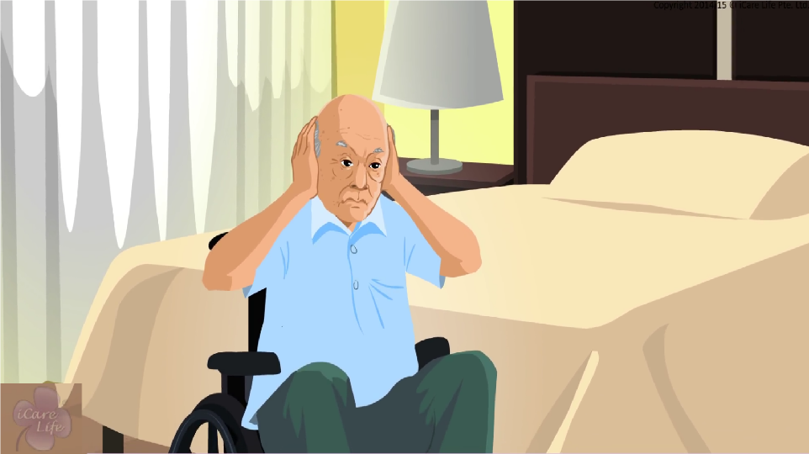
Reducing Stress of an Elder
3
Copyright: iCare Life Pte. Ltd., Singapore : This document must not be copied or shared or circulated without the consent of iCare Life and/or its affiliates.

Slide 5
Summary
An elder may be stressed due to:
Changes in lifestyle and status
Death or illness of a loved one
Loneliness
Illness or deteriorating capabilities
Dislike for specific things or activities
To reduce stress of an elderly person:
Ask them to share their problems and feelings
Ask family and friends to spend time with them
Motivate them to do things they like
Share jokes and stories
Try alternative therapies
Support religious and spiritual activities
4
Copyright: iCare Life Pte. Ltd., Singapore : This document must not be copied or shared or circulated without the consent of iCare Life and/or its affiliates.
Notes:
An elder may be stressed due to:
Changes in lifestyle and status
Death or illness of a loved one
Loneliness
Illness or deteriorating capabilities
Dislike for specific things or activities
To reduce stress of an elderly person:
Ask them to share their problems and feelings
Ask family and friends to spend time with them
Motivate them to do things they like
Share jokes and stories
Try alternative therapies
Support religious and spiritual activities

Slide 6
Any Questions?
5
Copyright: iCare Life Pte. Ltd., Singapore : This document must not be copied or shared or circulated without the consent of iCare Life and/or its affiliates.
Notes:
FAQs:
Question 1: What if we are not able to figure out if the symptoms are of stress or a serious illness?
Answer 1: First try to talk to the elderly person if they have any problems. If you are still not able to understand, inform a family member or contact the doctor who attends to the elderly person.
Question 2: What if the elderly person has no family to talk to or spend time with?
Answer 2: Try finding out about the elderly person’s friend or neighbors who would like to spend some time with the elder.
Question 3: What if the elderly person does not like my jokes and gets offended?
Answer 3: Do not take it personally. Apologize to the elderly person and start talking about a different topic.
Question 3: What if the elderly person follows a different religion than mine and my religious sentiments don’t let me to encourage religious or spiritual practices of other religions?
Answer 3: Find out if a family member, a friend or a social group can support the elderly person with the religious and spiritual activities.

Slide 7

Sleep and Rest for the Elder
6
Copyright: iCare Life Pte. Ltd., Singapore : This document must not be copied or shared or circulated without the consent of iCare Life and/or its affiliates.

Slide 8
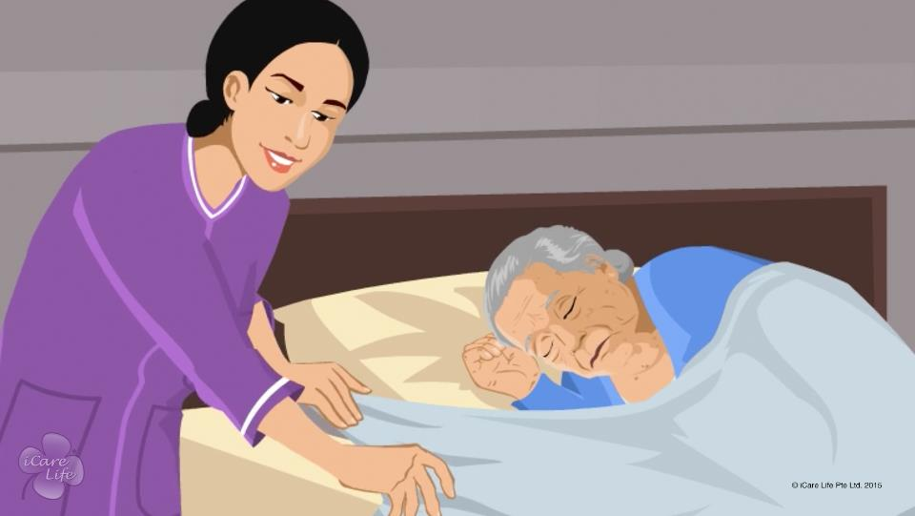
Sleep and Rest for the Elder
7
Copyright: iCare Life Pte. Ltd., Singapore : This document must not be copied or shared or circulated without the consent of iCare Life and/or its affiliates.

Slide 9
Identify the Elder’s Sleep & Rest Pattern
Post Module Activity
Day | Time When Elder Rested | Activity Done Before Rest
1 | 9:00 AM – 9:30 AM 1:30 PM – 2:30 PM 7:00 PM – 7:15 PM | Bath Lunch Reading
2 | 9:15 AM – 9:35 AM 2:00 PM – 2:45 PM 5:00 PM – 5:25 PM | Breakfast Lunch Walk
3 | 9:00 AM – 9:20 AM 1:45 PM – 2:30 PM 5:30 PM – 5:55 PM | Bath Lunch Walk
4 | 8:50 AM – 9:25 AM 1:30 PM – 2:15 PM 5:15 PM – 5:35 PM | Bath Lunch walk
8
Copyright: iCare Life Pte. Ltd., Singapore : This document must not be copied or shared or circulated without the consent of iCare Life and/or its affiliates.
Notes:
Materials required: Writing sheets and pens for all participants.
Draw the participants’ attention to the table shown on the screen. Explain that the table shows the observations recorded for four days by a caregiver about the times when an elder rested and the activities the elder performed before taking rest during the day.
Distribute the writing material and say aloud the instruction on the screen – Identify the elder’s sleep and rest pattern using the above observations.
Allow the participants a fixed duration of time, say 15-20 minutes, to observe the table and create a sleep and rest pattern for the elder. If required, tell the participants that they have to identify the activities after which rest is required and approximate duration of rest required after such an activity.
Invite participants to share their results. Finally move to the next slide.

Slide 10
Post Module Activity
Day | Time When Elder Rested | Activity Done Before Rest
1 | 9:00 AM – 9:30 AM 1:30 PM – 2:30 PM 7:00 PM – 7:15 PM | Bath Lunch Reading
2 | 9:15 AM – 9:35 AM 2:00 PM – 2:50 PM 5:00 PM – 5:25 PM | Breakfast Lunch Walk
3 | 9:00 AM – 9:20 AM 1:45 PM – 2:30 PM 5:30 PM – 5:55 PM | Bath Lunch Walk
4 | 8:50 AM – 9:25 AM 1:30 PM – 2:15 PM 5:15 PM – 5:35 PM | Bath Lunch walk
Sleep and Rest Pattern
Activity After Which Rest is Required | Duration of Rest Required
Bath | Around 30 minutes
Lunch | Around 1 hour
Walk | Around 30 minutes
9
Copyright: iCare Life Pte. Ltd., Singapore : This document must not be copied or shared or circulated without the consent of iCare Life and/or its affiliates.
Notes:
Ask the participants to compare their results with the sleep and rest pattern of the elder shown above.

Slide 11
Summary
To identify sleep and rest pattern:
Record times of the day when the elder feels tired or wants to sleep
Record the activity performed by the elder before feeling tired and sleepy
Record your observations for several days
Analyze your observations and look for similarities
Identify the pattern from specific times and activities after which the elder feels tired and sleepy
The activities for the day should not interfere with the elder's sleep and rest pattern
If the elder has a problem of sleeplessness, inform a family member or the elder’s doctor
10
Copyright: iCare Life Pte. Ltd., Singapore : This document must not be copied or shared or circulated without the consent of iCare Life and/or its affiliates.
Notes:
To identify sleep and rest pattern of an elder:
Record times of the day when the elder feels tired or wants to sleep
Record activity performed by the elder before feeling tired and sleepy
Record your observations for several days
Analyze your observations and look for similarities – Similarities can be that the elder feels tired and sleepy at the same time of the day or after the same activity everyday
Identify the pattern from specific times and activities after which the elder feels tired and sleepy
The activities for the day should not interfere with the elder's sleep and rest pattern – Design the daily routine of the elder so that no activity is scheduled for the times when the elder feels tired or sleepy
If the elder has problem of sleeplessness, inform a family member of the elder’s doctor – The problem of sleeplessness is often called insomnia

Slide 12
Any Questions?
11
Copyright: iCare Life Pte. Ltd., Singapore : This document must not be copied or shared or circulated without the consent of iCare Life and/or its affiliates.
Notes:
Q.1. What should I do if the elder wants to rest at a different time and after a different activity from what is planned in their routine?
Ans. Allow the elder to rest when they want. If the elder wants to rest in a similar manner for some days, consider modifying the elder’s routine accordingly.

Slide 13

Handling Loneliness in the Elder
12
Copyright: iCare Life Pte. Ltd., Singapore : This document must not be copied or shared or circulated without the consent of iCare Life and/or its affiliates.

Slide 14
Class Discussion
Pre Module Activity
13
Copyright: iCare Life Pte. Ltd., Singapore : This document must not be copied or shared or circulated without the consent of iCare Life and/or its affiliates.
Notes:
You will require a white board and a marker for noting important points of the discussion.
Discuss with the class participants as to what they do when they feel lonely and the activities which help them to overcome loneliness.
Keep noting down those activities which exhibit positive behavior which in turn helps combat loneliness. E.g. read a book, listen to music, dance, speak to a friend, engage in a hobby, volunteer at an animal rescue home or an old age home or sleep.
Ask the class participants to keep connecting their thoughts with the upcoming module video.

Slide 15
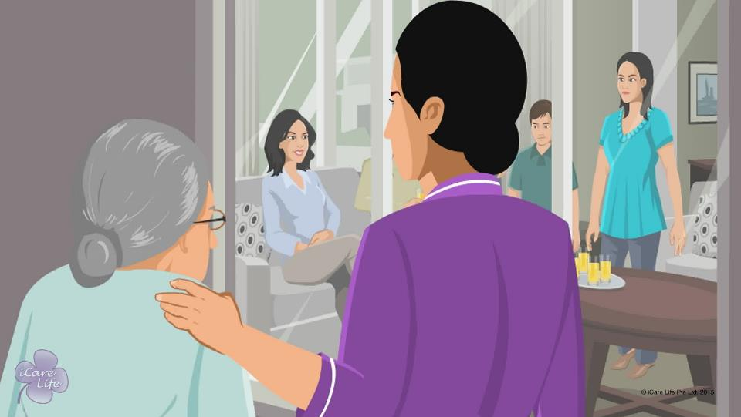
Handling Loneliness in the Elder
14
Copyright: iCare Life Pte. Ltd., Singapore : This document must not be copied or shared or circulated without the consent of iCare Life and/or its affiliates.

Slide 16
Summary
If the elder under your care feels lonely:
Listen to them and find out about their passions
Read up on their areas of interests and try to engage them in good conversations
Plan social interactions around their areas of interests
Try to bridge the gap with younger generations through activities they can do together
Encourage family members and friends to stay connected with the elder
Encourage elders to meet new people and make new friends
15
Copyright: iCare Life Pte. Ltd., Singapore : This document must not be copied or shared or circulated without the consent of iCare Life and/or its affiliates.
Notes:
If the elder under your care feels lonely:
Listen to them and find out about their passions
Read up on their areas of interests and try to engage them in good conversations
Plan social interactions around their areas of interests
Try to bridge the gap with younger generations through activities they can do together
Encourage family members and friends to stay connected with the elder
Encourage elders to meet new people and make new friends

Slide 17
Any Questions?
16
Copyright: iCare Life Pte. Ltd., Singapore : This document must not be copied or shared or circulated without the consent of iCare Life and/or its affiliates.
Notes:
Q1. What adverse effects can loneliness have on a person?
Ans. Loneliness can be very deteriorating for a person’s spirit. It can make a person go through many negative emotions. Many a times, people take adverse steps to combat loneliness. They may:
Lose their self-confidence
Start eating/sleeping/spending money excessively
Become socially awkward
Find very hard to make any new friends
Hurt themselves
Develop depression
Have a risk of heart strokes and other diseases
Have increased stress levels
Get into alcoholism or drug abuse

Slide 18
Helping the Elders with Depression
17
Copyright: iCare Life Pte. Ltd., Singapore : This document must not be copied or shared or circulated without the consent of iCare Life and/or its affiliates.

Slide 19
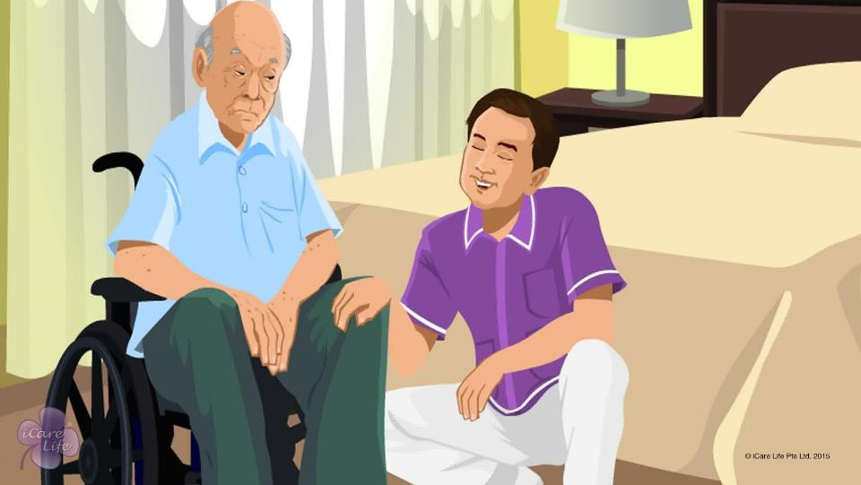
Helping the Elders with Depression
18
Copyright: iCare Life Pte. Ltd., Singapore : This document must not be copied or shared or circulated without the consent of iCare Life and/or its affiliates.

Slide 20
List of Hobbies
Post Module Activity
19
Copyright: iCare Life Pte. Ltd., Singapore : This document must not be copied or shared or circulated without the consent of iCare Life and/or its affiliates.
Notes:
Ask the class participants to make a list of 10 recreational activities or hobbies which an elder can be introduced to. Make sure that:
The hobby/ activity is not very strenuous for the elder
The elder should be able to spend substantial amount of time in it, like an hour every day or on alternate days
If possible, some hobbies/activities should make it possible for the elder to make new friends and meet people
Allow 5 minutes for making the list. Now invite one participant to read-out their list to the rest of the class. The class participants should strike-off the common activities that they have in their lists. Any uncommon ones should be read out later by the other participants.

Slide 21
Summary
If you notice the elder under your care is depressed, identify the reason for depression
For external reasons, try to get the elder to see the positive side of life
If there are no external reasons, report the depression to their family
Provide better nutrition to the elder
Incorporate outdoor activities in the elder’s daily or weekly routine
Ensure that the elder gets enough sunshine
Encourage the elder to interact with others and build a social circle
Encourage the elders to pursue their hobbies
20
Copyright: iCare Life Pte. Ltd., Singapore : This document must not be copied or shared or circulated without the consent of iCare Life and/or its affiliates.
Notes:
If you notice the elder under your care is depressed, identify the reason for depression
For external reasons, try to get the elder to see the positive side of life
If there are no external reasons, report the depression to their family
Provide better nutrition to the elder
Incorporate outdoor activities in the elder’s daily or weekly routine
Ensure that the elder gets enough sunshine
Encourage the elder to interact with others and build a social circle
Encourage the elders to pursue their hobbies

Slide 22
Any Questions?
21
Copyright: iCare Life Pte. Ltd., Singapore : This document must not be copied or shared or circulated without the consent of iCare Life and/or its affiliates.
Notes:
Q1. Should you take notes on the activities and mood changes of the elderly on an everyday basis?
Ans. Yes. It will help the doctor understand the patient much better and ensure that you do not miss out anything when you brief the doctor on the prognosis of the elderly.
Q2. What else can be done to help getting the elderly out of depression?
Ans. Humor is a very good tool. Be pleasant and humorous. Tell the elderly some jokes, collect and show some comedy movies to them and keep them away from sad and depressing news on TV etc.
Q3. Is letting the elderly play with children a good way of helping the elderly get out of depression?
Ans. Yes, children have a way of making the environment light and interesting. Most elderly love children and vice versa. One could in fact encourage the family to call the children whenever possible to spend time with the elderly.

Slide 23
Dealing with Death of a Loved One
22
Copyright: iCare Life Pte. Ltd., Singapore : This document must not be copied or shared or circulated without the consent of iCare Life and/or its affiliates.

Slide 24
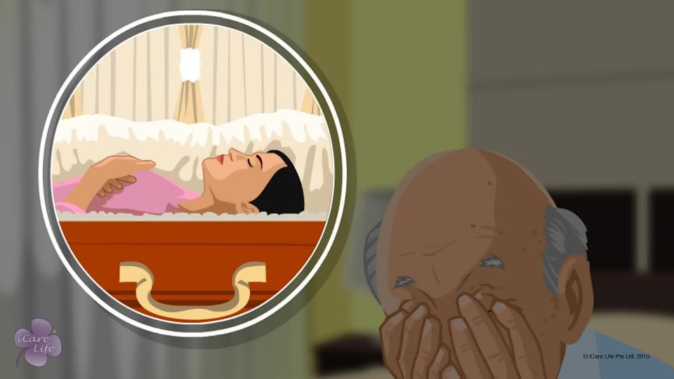
Dealing with Death of a Loved One
23
Copyright: iCare Life Pte. Ltd., Singapore : This document must not be copied or shared or circulated without the consent of iCare Life and/or its affiliates.

Slide 25
Group Activity
Post Module Activity
Elder’s Remark | Stage | Caregiver’s Reply
 | Denial
 | Anger
 | Bargaining
 | Guilt
 | Depression
 | Acceptance
24
Copyright: iCare Life Pte. Ltd., Singapore : This document must not be copied or shared or circulated without the consent of iCare Life and/or its affiliates.
Notes:
Recap the 6 stages with the class:
Denial or disbelief
Anger
Bargaining
Guilt
Depression
Acceptance
Divide the class into two groups and give them a few sheets of paper and pens
Each group has to pick up one issue and work on the elder’s and caregiver’s dialogs (that may indicate the stage they are in) – through all the six stages.
The group should imagine an elder going through the relevant stage. Make 2-3 dialogs/sentences the elder can say and caregiver’s respective answer, for each stage. Fill it up in the table given above.
Once both the groups have finished, a representative can come ahead and discuss their work with the class. They can either present the table or showcase through small role-plays.

Slide 26
Summary
Help the elder reach acceptance by supporting them through each stage of grief
Watch out for signs like refusal to eat , palpitations, sleeplessness, and wanting to be alone all the time
Help arrange for a doctor’s visit if necessary
Help the elder cope with a positive outlook
Wish them cheerfully every day
Keep them in good humor with positive anecdotes and jokes
Encourage them to go outdoors or spend time with their family and friends
25
Copyright: iCare Life Pte. Ltd., Singapore : This document must not be copied or shared or circulated without the consent of iCare Life and/or its affiliates.
Notes:
Help the elder reach acceptance by supporting them through each stage of grief
Watch out for signs like refusal to eat , palpitations, sleeplessness, and wanting to be alone all the time
Help arrange for a doctor’s visit if necessary
Help the elder cope with a positive outlook
Wish them cheerfully every day
Keep them in good humor with positive anecdotes and jokes
Encourage them to go outdoors or spend time with their family and friends

Slide 27
Any Questions?
26
Copyright: iCare Life Pte. Ltd., Singapore : This document must not be copied or shared or circulated without the consent of iCare Life and/or its affiliates.
Notes:
Q1. Can some people try and take the extreme step in state of guilt or depression?
Ans. Nothing can be ruled out. It may quite be possible that though the elderly trusts you, they may still not give out their innermost feelings.
Q2. How can the caregiver prevent such an occurrence?
Ans. The caregiver has to keep a keen eye on the elderly. They need to take special care during the guilt and depression stages. They also need to keep encouraging the elderly and keep their faith up in the God. They should try and not let the elderly be alone.
Q3. What kind of outdoor activities can grief-stricken elderly people may indulge in?
Ans. These would actually depend on the physical and mental condition of the elderly person. Activities as simple as a walk to market, some shopping, gardening, doing charity work, watching a movie, meditating/praying or a small family picnic, meeting family friends may help the elderly overcome his grief.

Slide 28
Handling End of Life Issues
27
Copyright: iCare Life Pte. Ltd., Singapore : This document must not be copied or shared or circulated without the consent of iCare Life and/or its affiliates.

Slide 29
Class Discussion
Pre Module Activity
28
Copyright: iCare Life Pte. Ltd., Singapore : This document must not be copied or shared or circulated without the consent of iCare Life and/or its affiliates.
Notes:
Discuss with the class what kind of help do elders typically require when they are nearing end of life.
Model Answer:
Help with daily routines like walking, bathing, eating, etc.
Wanting to talk to someone as they might feel lonely/anxious about death
Help with taking regular medication
Might want to settle their finances so will need family’s or a lawyer’s help
If in a healthy state then they might want to travel and visit new places

Slide 30
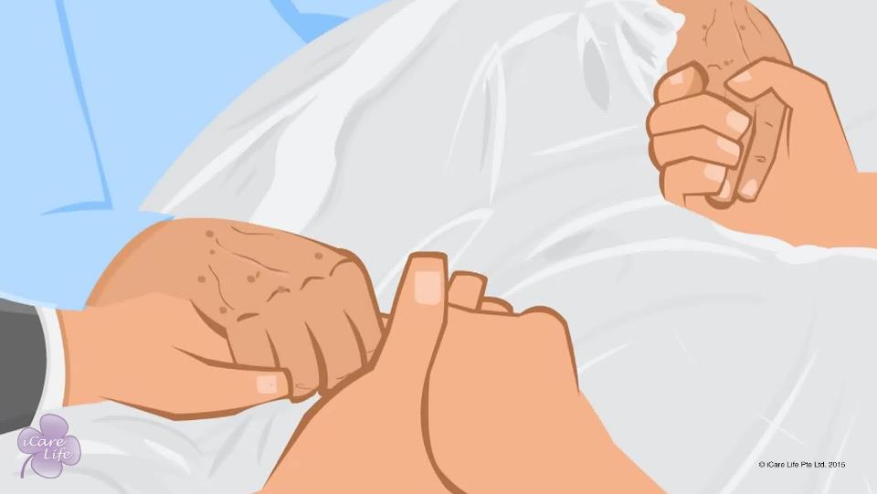
Handling End of Life Issues
29
Copyright: iCare Life Pte. Ltd., Singapore : This document must not be copied or shared or circulated without the consent of iCare Life and/or its affiliates.

Slide 31
Summary
You should not get involved in discussions around end of life issues
Never bring up these topics when you are with the elder
Encourage the elder to discuss these matters with their family
Never influence the elder to will you any part of their wealth
Do not take their promises seriously
Never give your opinion regarding the elder’s medical treatment
Share facts about the elder’s condition with the family
Never give your opinion on the place the elder should spend their last days
Do not participate in discussions around the elder’s funeral
30
Copyright: iCare Life Pte. Ltd., Singapore : This document must not be copied or shared or circulated without the consent of iCare Life and/or its affiliates.
Notes:
You should not get involved in discussions around end of life issues
Never bring up these topics when you are with the elder
Encourage the elder to discuss these matters with their family
Never influence the elder to will you any part of their wealth
Do not take their promises seriously
Never give your opinion regarding the elder’s medical treatment
Share facts about the elder’s condition with the family
Never give your opinion on the place the elder should spend their last days
Do not participate in discussions around the elder’s funeral

Slide 32
Any Questions?
31
Copyright: iCare Life Pte. Ltd., Singapore : This document must not be copied or shared or circulated without the consent of iCare Life and/or its affiliates.
Notes:
Q1. What is hospice care?
Ans. Hospice care is end-of-life care. A team of health care professionals and volunteers provides such care. They give medical, psychological, and spiritual support. The goal of hospice care is to help people who are dying have peace, comfort, and dignity.
Q2. What is palliative care?
Ans. Palliative care generally aims at improving the quality of life of people with advanced life threatening or debilitating illness. If cure is possible, support is given by treating symptoms like pain and attempting to minimize suffering. It involves physical and psychosocial support to the patient and the affected family to cope with the illness and even bereavement.
Q3. What is the difference between the two?
Ans. All hospice care (care at the end of life) is palliative care, but not all palliative care (care to make the patient comfortable), is hospice. Both focus on patient-centered care that relieve suffering, enhance quality of life and is unique to each person’s culture, values, and beliefs. Palliative Care is most often provided in hospitals and is offered regardless of stage of disease or need for other therapies. Hospice is generally for people who have advanced illness whose curative-oriented treatment is causing more burden than benefit. Patients usually enroll when their physicians determine that they may have a life expectancy of less than six months if their disease runs its normal course.

Slide 33


