Slide 1

Administering Medication
CR 11.2

Slide 2
Introduction
Learning outcomes
The Caregivers will learn:
1.1 What is administration of medicines
1.2 Different routes of administration of medicine
1.3 Post administration activities
1
Copyright: iCare Life Pte. Ltd., Singapore : This document must not be copied or shared or circulated without the consent of iCare Life and/or its affiliates.

Slide 3
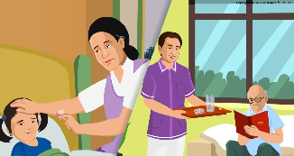
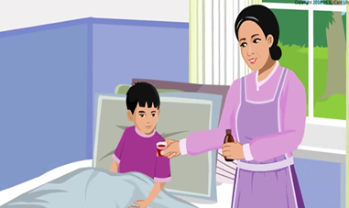
Right Way of Administering Medication
What is Administration of Medicine:
Administration of Medicine refers to dispensing of medicine or drug to a patient for remedial and/or diagnostic purposes
Medicine Administration must be:
Right Patient
Right Drug/Medicine
Right Dose/Quantity
Right Time (as per the time chart)
Right Route
Right Method
Note: Do not forget to check expiry date of medicine before use.
2

Slide 4
Routes of Administering Medication (1/5)
There are various routes of administration of medicines:
Oral – is the most common, convenient, less expensive and safe for most of the patients
Sublingual – where a drug is placed under the tongue for faster absorption
Buccal- – where a drug is placed between the gum and teeth for slow absorption
3

Slide 5
Cont;
4. Rectal - administered rectally
5. Vaginal –administered vaginally for woman
6.Topical – like, inhalation and nebulisation to carry the drug into lungs by breath, use of eye drop, steroids in the management of dermatitis are given by this method to have local or systemic effect
7. Parenteral – where it is giving of therapeutic agent outside the alimentary tracks; like intravenous, intramuscular, subcutaneous, etc.

Slide 6
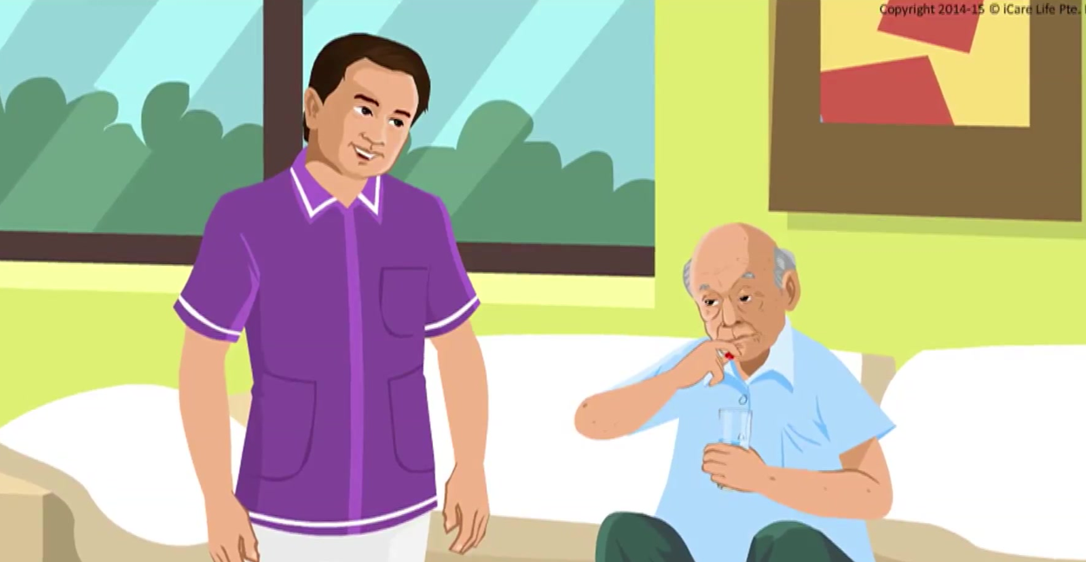
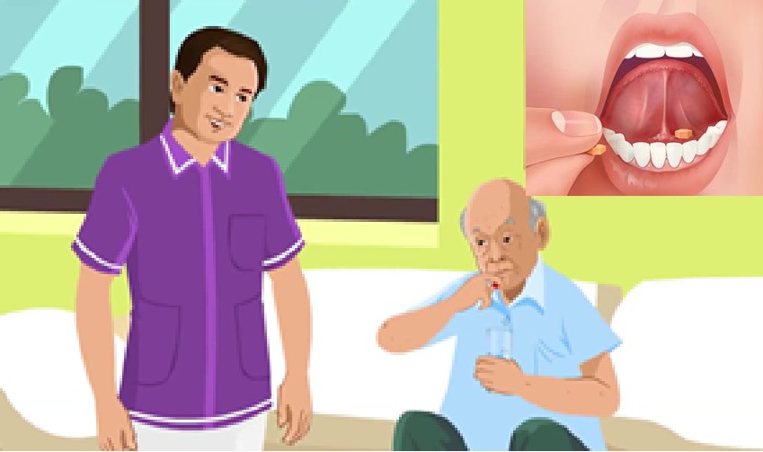
Oral –Administration
Right Way of Administering Medication
Routes of Administering Medication (2/5)
Administration of medicine through mouth for prophylactic and therapeutic effects; Purpose:
Promote health
Prevent illness
Help in diagnosis
Alleviate illness or symptomatic pain
Sublingual or Buccal
A few drugs are placed under the tongue (taken sublingually) or between the gums and teeth (buccal); Purpose:
Dissolve directly in the blood vessels
Rapid absorption and dugs immediately enters the blood stream
4

Slide 7
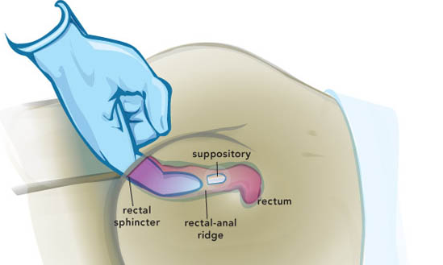
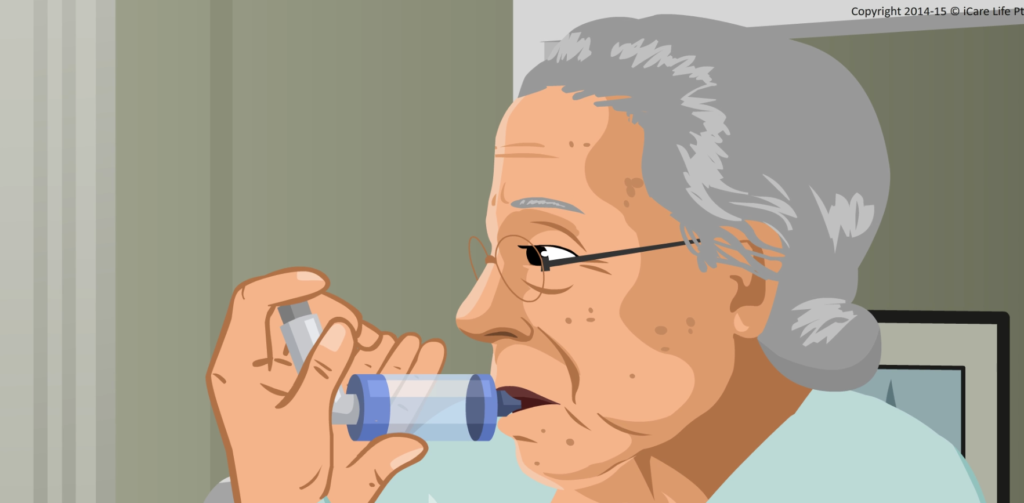
Rectal and Vaginal
Right Way of Administering Medication
Routes of Administering Medication (3/5)
Administered rectally as a suppository or as a solution, tablet, cream, gel, suppository, or ring through vagina; Purpose:
Drug is readily absorbed
Help people who cannot take drug orally
Require after many surgical operation
Topical
Like inhalation and nebulisation to carry the drug into lungs by breath, use of eye drop, steroids in the management of dermatitis, etc.; Purpose:
Smaller droplets go deeper
Increases the amount of drug absorbed
5

Slide 8
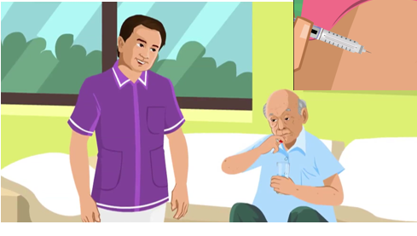
Parenteral
Right Way of Administering Medication
Routes of Administering Medication (4/5)
Means any non-oral means of administration, but is generally interpreted as relating to injecting directly into the body; Purpose:
Drug do not enter the gastrointestinal system
Faster absorption
Drugs go the bloodstream through intramuscular (IM), subcutaneous (SC) and intravenous (IV)
6

Slide 9
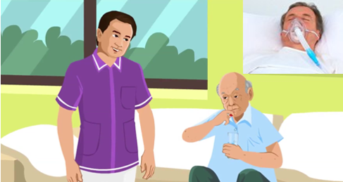
Caution
Right Way of Administering Medication
Routes of Administering Medication (5/5)
Do not administer oral medicine:
For unconscious patient
For uncooperative patient
After oral and gastric surgeries
Oral cancers
Before diagnostic tests and operation
7

Slide 10
Instructions for Medicine Administration
General Instructions: Before Medication
Identify the patient by checking the medication card
Check the physician’s prescription
Check the label of the containers thrice
Before the medication container is taken from the shelf
Before pouring the drug
Before replacing the container in shelf
Check the expiry date of the drug
Shake the liquid medicine before pouring it into ounce glass, pour it away from the label
Wipe the mouth of the bottle, close it tightly and replace it at the proper place
Aa
8

Slide 11
Instructions for Medicine Administration
General Instructions: Before Medication
Hold the ounce glass at eye level & place the thumb on the neck of the ounce glass to which medicine is to be poured
When taking tablets or capsules do not touch them with hands, drop them from the container to its lid and then to the medicine cup
Do not put back the medicine once it is taken out of the container
Do not use the medicine if there is a change in colour, odour or consistency
Prepare the drugs just before the time of administration and do not leave the drug in the medicine tray without proper identification
9

Slide 12


Instructions for Medicine Administration
General Instructions: After Medication
Record only the medicine, which you have administered only
Record the date, time, name and dose of the drug administered
Never record a medicine before it is given
Record the effect observed after medication, if any
10

Slide 13
Viewing of Modules
Administering Medication
CR 11.2
Private and Confidential

Slide 14
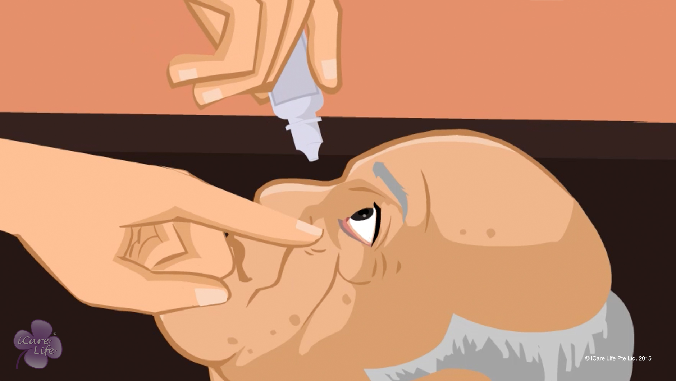
Administering Medicines
1
Copyright: iCare Life Pte. Ltd., Singapore : This document must not be copied or shared or circulated without the consent of iCare Life and/or its affiliates.

Slide 15
In this module, you will learn about:
Considerations while administering medicines to a person under your care
The methods to administer various types of medicines
2

Slide 16

Let’s Watch
Administering Medicines
3
Copyright: iCare Life Pte. Ltd., Singapore : This document must not be copied or shared or circulated without the consent of iCare Life and/or its affiliates.

Slide 17
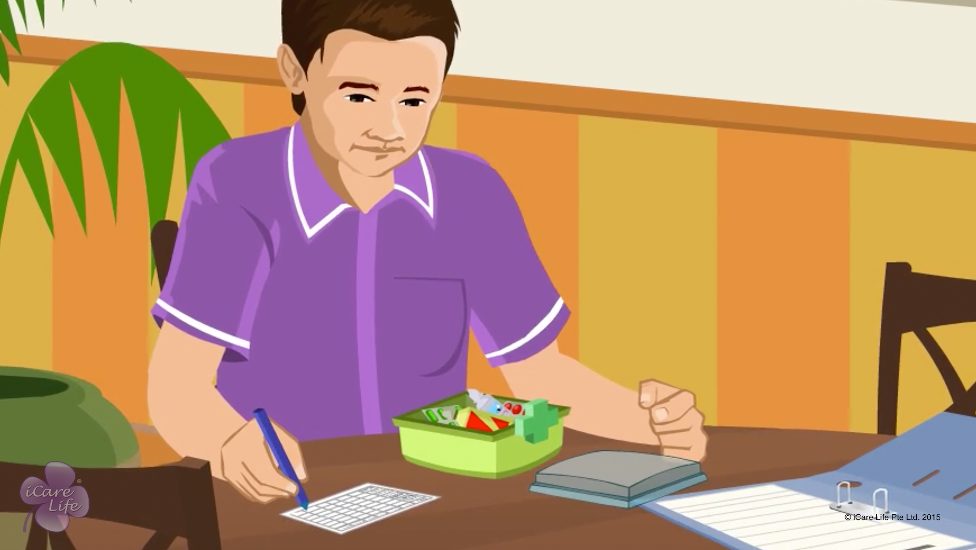
Managing Medications
4
Copyright: iCare Life Pte. Ltd., Singapore : This document must not be copied or shared or circulated without the consent of iCare Life and/or its affiliates.

Slide 18
In this module, you will learn about:
How to manage an elder’s medications correctly
What precautions should you take when managing the medicines
5
Copyright: iCare Life Pte. Ltd., Singapore : This document must not be copied or shared or circulated without the consent of iCare Life and/or its affiliates.

Slide 19
Let’s Watch
Managing Medications
6
Copyright: iCare Life Pte. Ltd., Singapore : This document must not be copied or shared or circulated without the consent of iCare Life and/or its affiliates.

Slide 20


